Slide 1
Concepts of Biology:
The Immune System

Slide 2
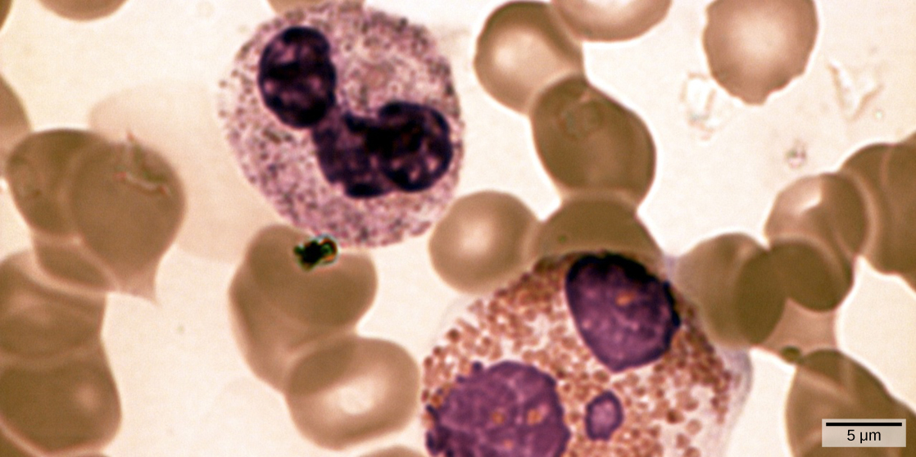
In this compound light micrograph purple-stained neutrophil (upper left) and eosinophil (lower right) are white blood cells that float among red blood cells in this blood smear. Neutrophils provide an early, rapid, and nonspecific defense against invading pathogens. Eosinophils play a variety of roles in the immune response. Red blood cells are about 7–8 μm in diameter, and a neutrophil is about 10–12μm. (Credit: modification of work by Dr. David Csaba)

Slide 3
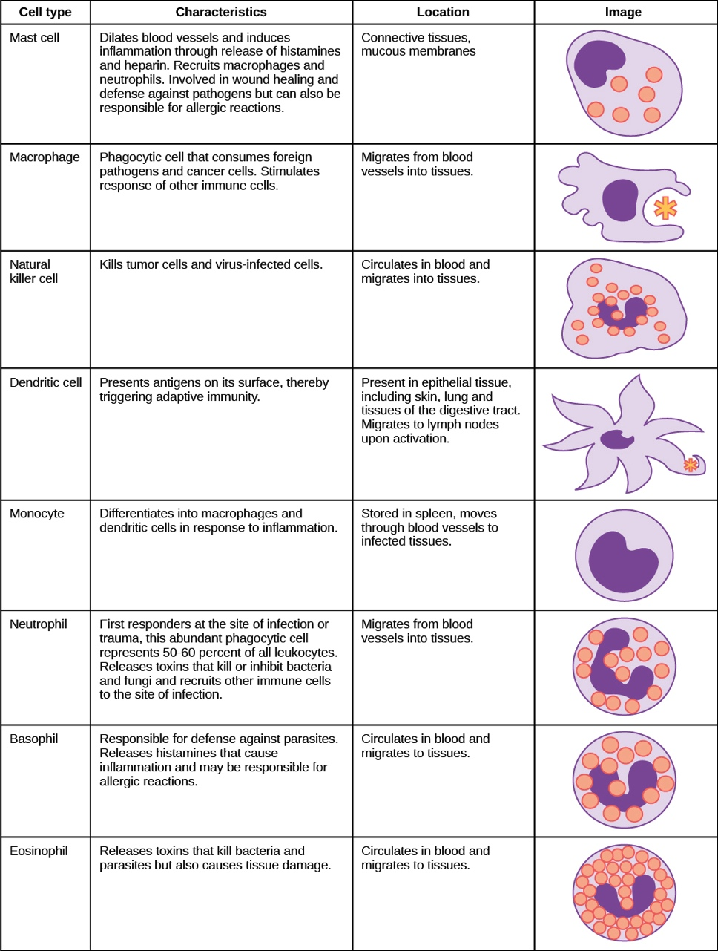
Notes:
The characteristics and location of cells involved in the innate immune system are described. (Credit: modification of work by NIH)

Slide 4
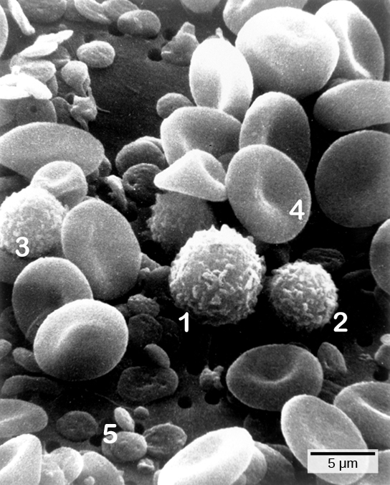
Cells of the blood include (1) monocytes, (2) lymphocytes, (3) neutrophils, (4) red blood cells, and (5) platelets. Note the very similar morphologies of the leukocytes (1, 2, 3). (Credit: modification of work by Bruce Wetzel, Harry Schaefer, NCI; scale-bar data from Matt Russell)

Slide 5
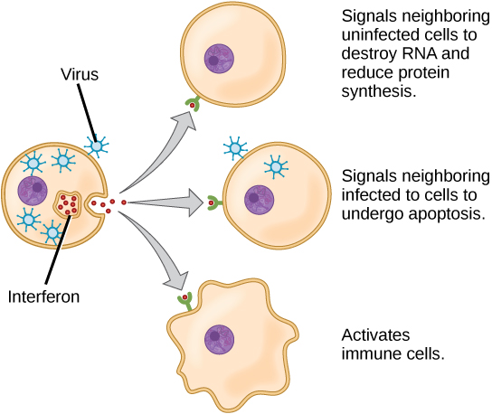
Interferons are cytokines that are released by a cell infected with a virus. Response of neighboring cells to interferon helps stem the infection.

Slide 6
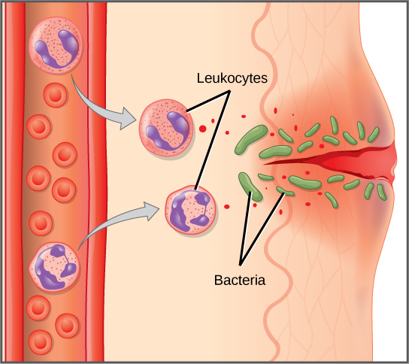
In response to a cut, mast cells secrete histamines that cause nearby capillaries to dilate. Neutrophils and monocytes leave the capillaries. Monocytes mature into macrophages. Neutrophils, dendritic cells and macrophages release chemicals to stimulate the inflammatory response. Neutrophils and macrophages also consume invading bacteria by phagocytosis.

Slide 7
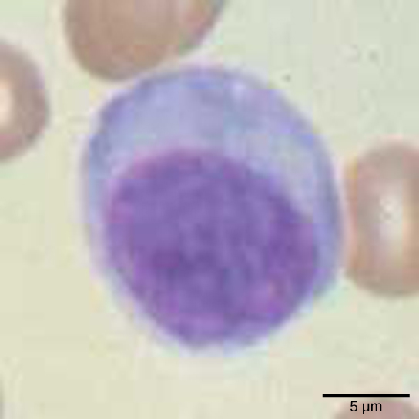
Lymphocytes, such as NK cells, are characterized by their large nuclei that actively absorb Wright stain and therefore appear dark colored under a microscope.

Slide 8
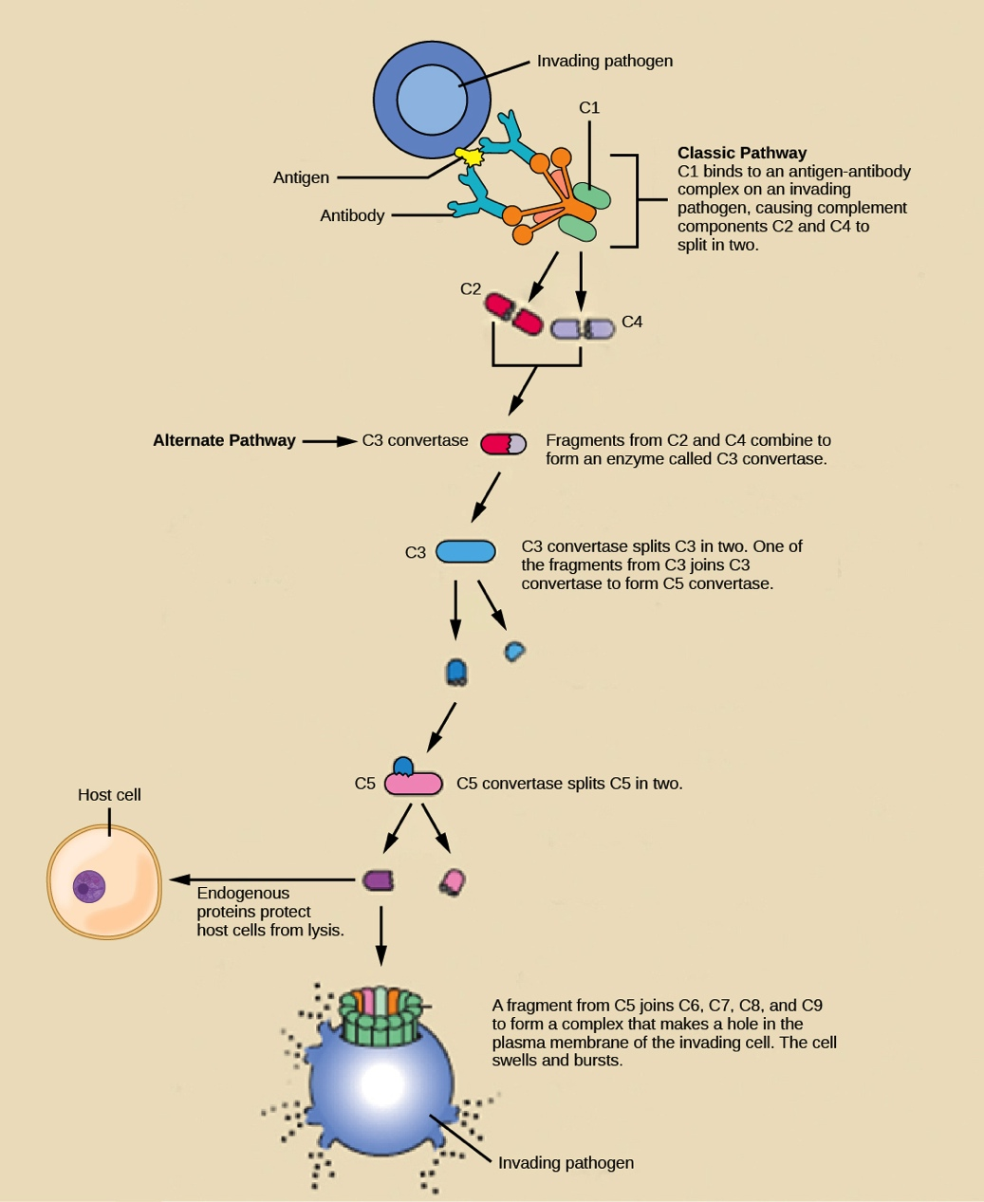
The classic pathway for the complement cascade involves the attachment of several initial complement proteins to an antibody-bound pathogen followed by rapid activation and binding of many more complement proteins and the creation of destructive pores in the microbial cell envelope and cell wall. The alternate pathway does not involve antibody activation. Rather, C3 convertase spontaneously breaks down C3. Endogenous regulatory proteins prevent the complement complex from binding to host cells. Pathogens lacking these regulatory proteins are lysed. (Credit: modification of work by NIH)

Slide 9
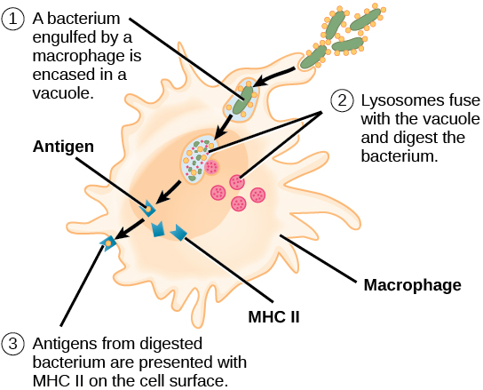
An APC, such as a macrophage, engulfs and digests a foreign bacterium. An antigen from the bacterium is presented on the cell surface in conjunction with an MHC II molecule Lymphocytes of the adaptive immune response interact with antigen-embedded MHC II molecules to mature into functional immune cells.

Slide 10
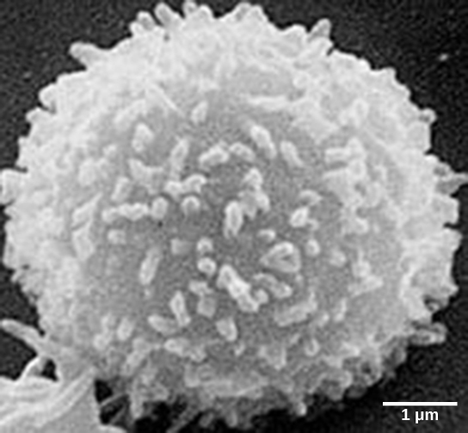
This scanning electron micrograph shows a T lymphocyte, which is responsible for the cell-mediated immune response. T cells are able to recognize antigens. (Credit: modification of work by NCI; scale-bar data from Matt Russell)

Slide 11
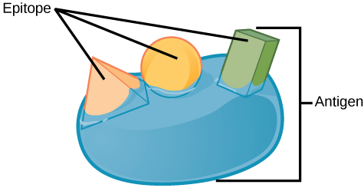
An antigen is a macromolecule that reacts with components of the immune system. A given antigen may contain several motifs that are recognized by immune cells. Each motif is an epitope. In this figure, the entire structure is an antigen, and the orange, salmon and green components projecting from it represent potential epitopes.

Slide 12
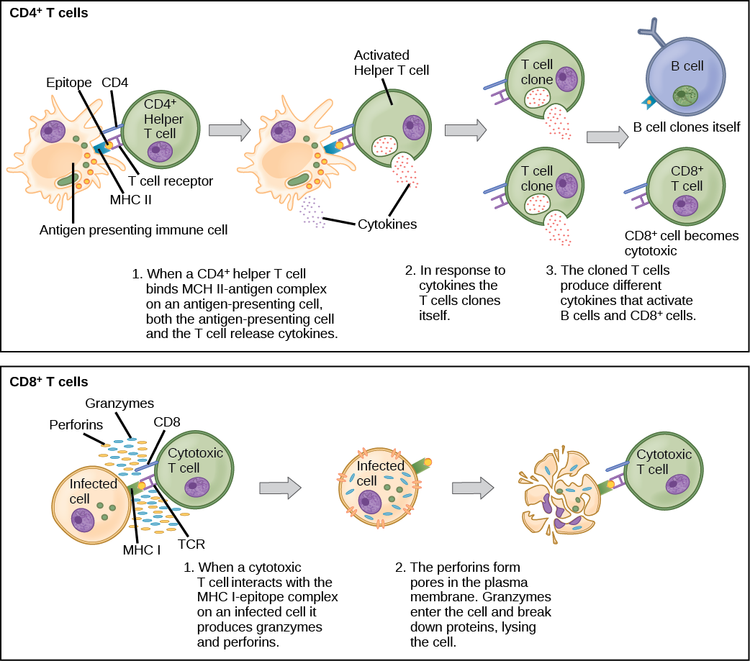
Naïve CD4⁺ T cells engage MHC II molecules on antigen-presenting cells (APCs) and become activated. Clones of the activated helper T cell, in turn, activate B cells and CD8⁺ T cells, which become cytotoxic T cells. Cytotoxic T cells kill infected cells.

Slide 13
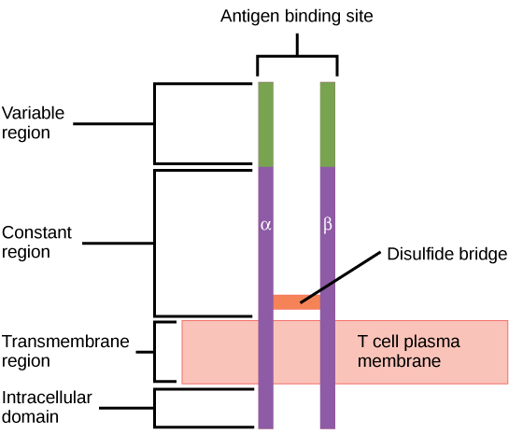
A T cell receptor spans the membrane and projects variable binding regions into the extracellular space to bind processed antigens via MHC molecules on APCs.

Slide 14
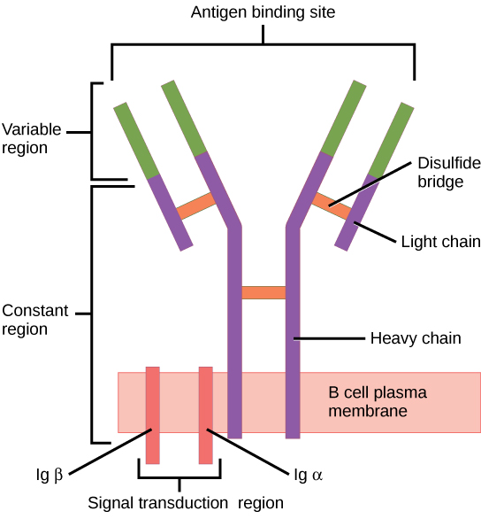
B cell receptors are embedded in the membranes of B cells and bind a variety of antigens through their variable regions. The signal transduction region transfers the signal into the cell.

Slide 15
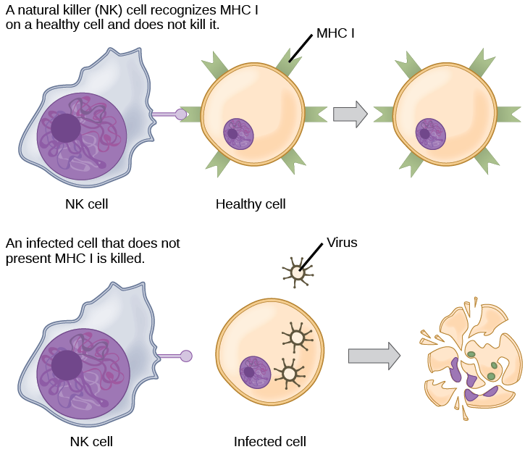
Natural killer (NK) cells recognize the MHC I receptor on healthy cells. If MHC I is absent, the cell is lysed.

Slide 16
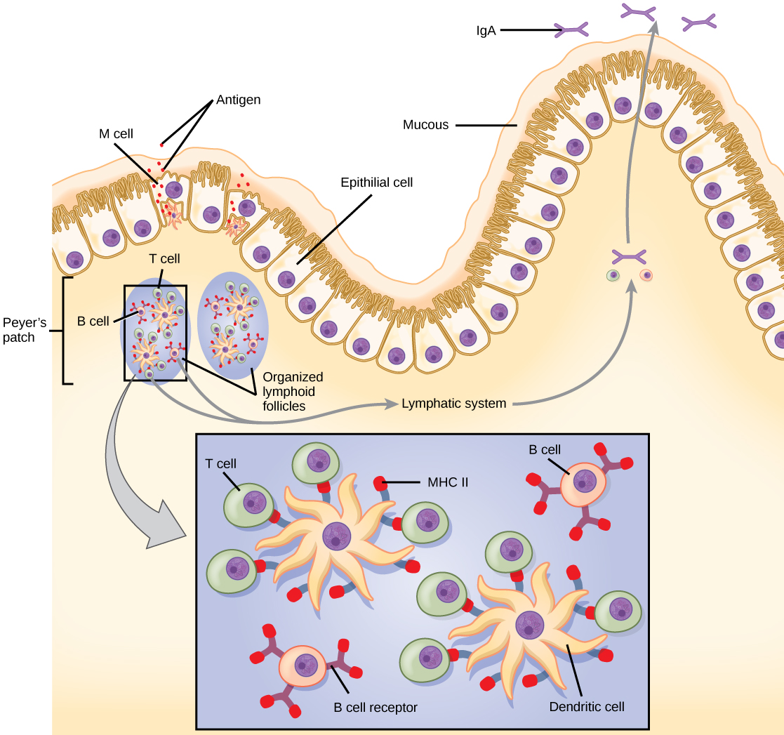
Notes:
The topology and function of intestinal MALT is shown. Pathogens are taken up by M cells in the intestinal epithelium and excreted into a pocket formed by the inner surface of the cell. The pocket contains antigen-presenting cells such as dendritic cells, which engulf the antigens, then present them with MHC II molecules on the cell surface. The dendritic cells migrate to an underlying tissue called a Peyer’s patch. Antigen-presenting cells, T cells, and B cells aggregate within the Peyer’s patch, forming organized lymphoid follicles. There, some T cells and B cells are activated. Other antigen-loaded dendritic cells migrate through the lymphatic system where they activate B cells, T cells, and plasma cells in the lymph nodes. The activated cells then return to MALT tissue effector sites. IgA and other antibodies are secreted into the intestinal lumen.

Slide 17
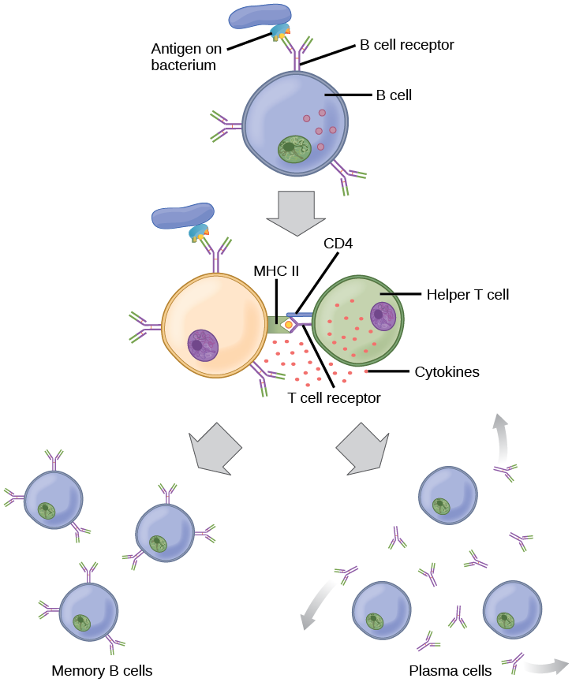
After initially binding an antigen to the B cell receptor (BCR), a B cell internalizes the antigen and presents it on MHC II. A helper T cell recognizes the MHC II–antigen complex and activates the B cell. As a result, memory B cells and plasma cells are made.

Slide 18
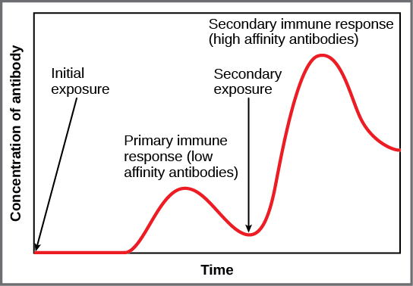
In the primary response to infection, antibodies are secreted first from plasma cells. Upon re-exposure to the same pathogen, memory cells differentiate into antibody-secreting plasma cells that output a greater amount of antibody for a longer period of time.

Slide 19
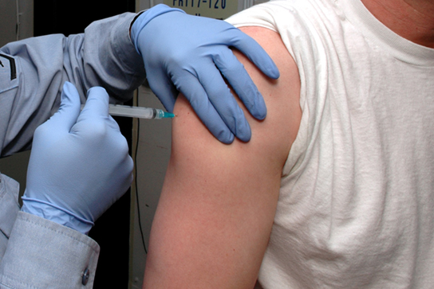
Vaccines are often delivered by injection into the arm. (Credit: U.S. Navy Photographer's Mate Airman Apprentice Christopher D. Blachly)

Slide 20
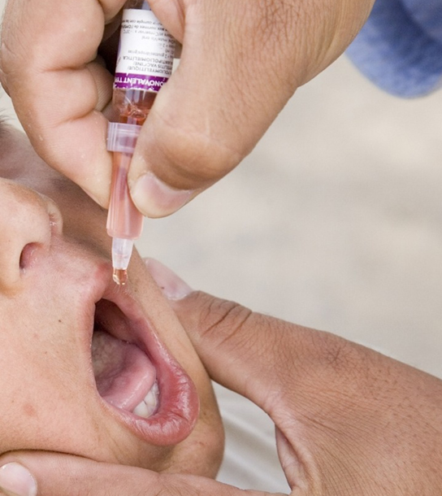
The polio vaccine can be administered orally. (Credit: modification of work by UNICEF Sverige)

Slide 21
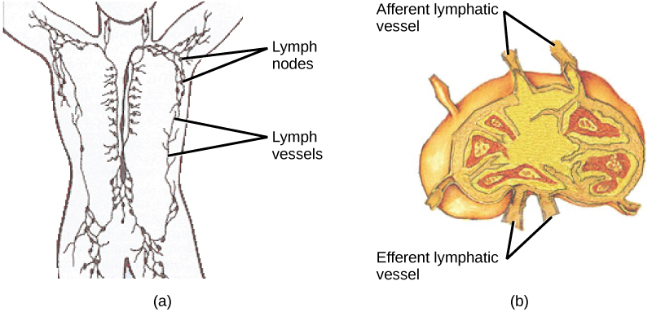
(a) Lymphatic vessels carry a clear fluid called lymph throughout the body. The liquid enters (b) lymph nodes through afferent vessels. Lymph nodes are filled with lymphocytes that purge infecting cells. The lymph then exits through efferent vessels. (Credit: modification of work by NIH, NCI)

Slide 22
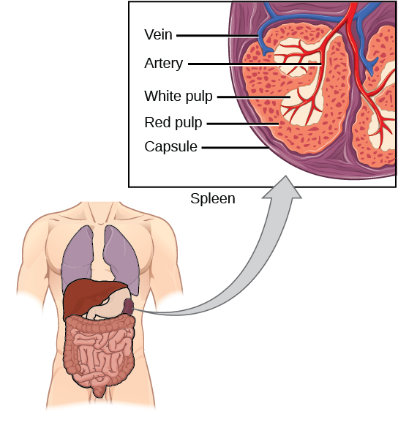
The spleen is similar to a lymph node but is much larger and filters blood instead of lymph. Blood enters the spleen through arteries and exits through veins. The spleen contains two types of tissue: red pulp and white pulp. Red pulp consists of cavities that store blood. Within the red pulp, damaged red blood cells are removed and replaced by new ones. White pulp is rich in lymphocytes that remove antigen-coated bacteria from the blood. (Credit: modification of work by NCI)

Slide 23
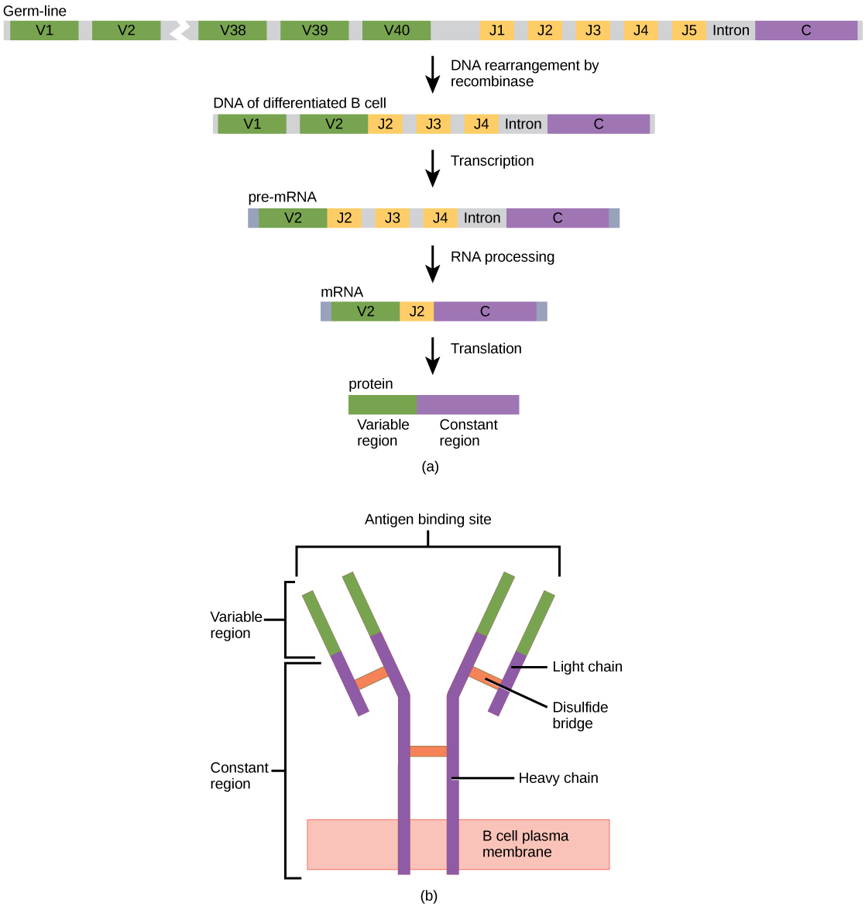
(a) As a germ-line B cell matures, an enzyme called DNA recombinase randomly excises V and J segments from the light chain gene. Splicing at the mRNA level results in further gene rearrangement. As a result, (b) each antibody has a unique variable region capable of binding a different antigen.

Slide 24
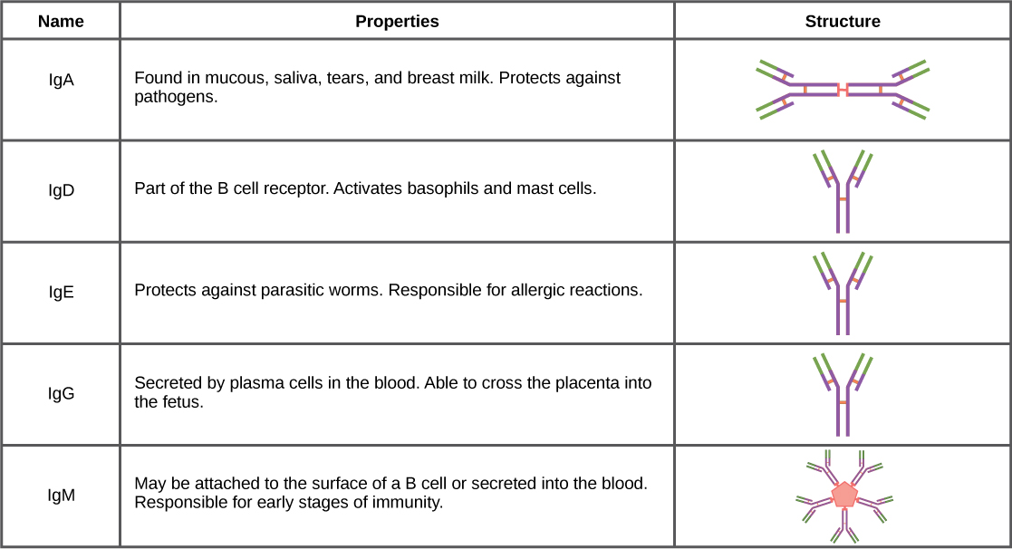
Immunoglobulins have different functions, but all are composed of light and heavy chains that form a Y-shaped structure.

Slide 25
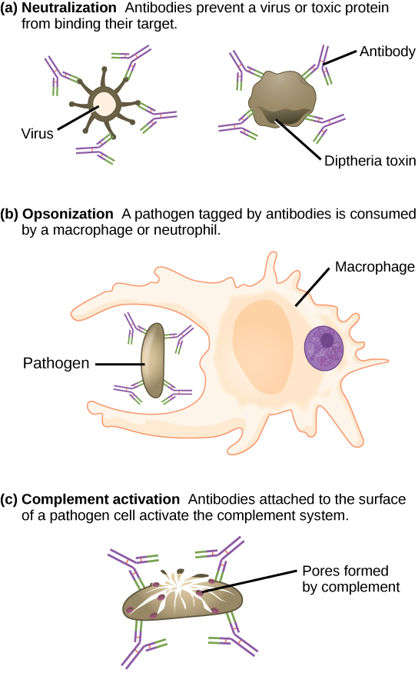
Antibodies may inhibit infection by (a) preventing the antigen from binding its target, (b) tagging a pathogen for destruction by macrophages or neutrophils, or (c) activating the complement cascade.

Slide 26
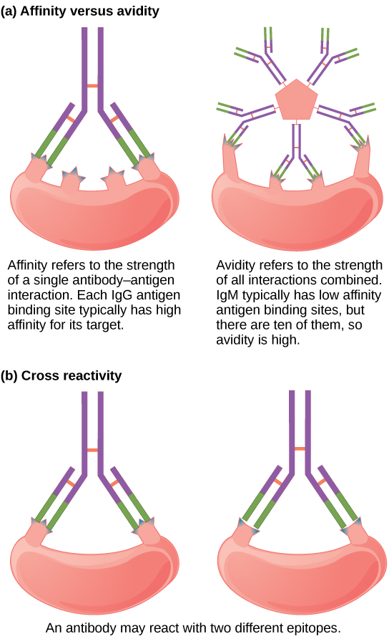
Affinity refers to the strength of single interaction between antigen and antibody, while avidity refers to the strength of all interactions combined.
An antibody may cross react with different epitopes.

Slide 27
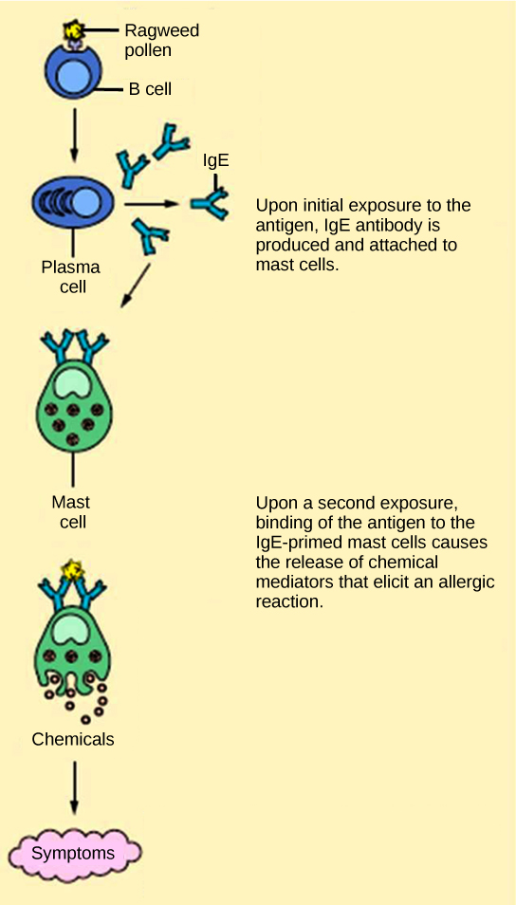
On first exposure to an allergen, an IgE antibody is synthesized by plasma cells in response to a harmless antigen. The IgE molecules bind to mast cells, and on secondary exposure, the mast cells release histamines and other modulators that affect the symptoms of allergy. (Credit: modification of work by NIH)

Slide 28
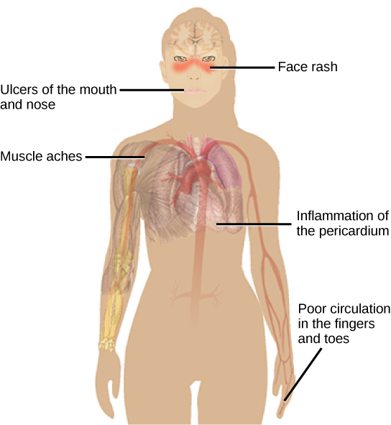
Systemic lupus erythematosus is characterized by autoimmunity to the individual’s own DNA and/or proteins, which leads to varied dysfunction of the organs. (Credit: modification of work by Mikael Häggström)

