Slide 1
Concepts of Biology:
Animal Reproduction and Development

Slide 2
Female seahorses produce eggs that are then fertilized by the male. Unlike with almost all other animals, the young then develop in a pouch of the male seahorse until birth. (Credit: “cliff1066”/Flickr)

Slide 3
The Anthopleura artemisia sea anemone can reproduce through fission.

Slide 4
Hydra reproduce asexually through budding: a bud forms on the tubular body of an adult hydra, develops a mouth and tentacles, and then detaches from its parent. The new hydra is fully developed and will find its own location for attachment.
Some coral, such as the Lophelia pertusa shown here, can reproduce through budding. (Credit b: modification of work by Ed Bowlby, NOAA/Olympic Coast NMS; NOAA/OAR/Office of Ocean Exploration)

Slide 5
CONCEPT IN ACTION
View this video to see a hydra budding.
https://www.youtube.com/watch?v=wfbhwq95Duc&feature=youtube

Slide 6
(a) Linckia multifora is a species of sea star that can reproduce asexually via fragmentation. In this process, (b) an arm that has been shed grows into a new sea star. (Credit a: modifiction of work by Dwayne Meadows, NOAA/NMFS/OPR)

Slide 7
Many (a) snails are hermaphrodites. When two individuals (b) mate, they can produce up to 100 eggs each. (Credit a: modification of work by Assaf Shtilman; credit b: modification of work by “Schristia”/Flickr)

Slide 8
During sexual reproduction in toads, the male grasps the female from behind and externally fertilizes the eggs as they are deposited. (Credit: Bernie Kohl)

Slide 9
In (a) oviparity, young develop in eggs outside the female body, as with these Harmonia axydridis beetles hatching. Some aquatic animals, like this (b) pregnant Xiphophorus maculatus are ovoviparous, with the egg developing inside the female and nutrition supplied primarily from the yolk. In mammals, nutrition is supported by the placenta, as was the case with this (c) newborn squirrel. (Credit b: modification of work by Gourami Watcher; credit c: modification of work by “audreyjm529”/Flickr)

Slide 10
Fertilization is the process in which sperm and egg fuse to form a zygote. (Credit: scalebar data from Matt Russell)

Slide 11
During cleavage, the zygote rapidly divides into multiple cells.
The cells rearrange themselves to form a hollow ball called the blastula. (Credit a: modification of work by Gray’s Anatomy; credit b: modification of work by Pearson Scott Foresman; donated to the Wikimedia Foundation)

Slide 12
CONCEPT IN ACTION
Visit the Virtual Human Embryo project at the Endowment for Human Development site to click through an interactive video of the stages of embryo development, including micrographs and rotating 3-D images.
http://www.ehd.org/virtual-human-embryo/

Slide 13
Gastrulation is the process wherein the cells in the blastula rearrange themselves to form the germ layers. (Credit: modification of work by Abigail Pyne)

Slide 14
As seen in this scanning electron micrograph, human sperm has a flagellum, neck, and head. (Credit: scale-bar data from Matt Russell)

Slide 15
The reproductive structures of the human male

Slide 16
The reproductive structures of the human female (Credit a: modification of work by Gray’s Anatomy; credit b: modification of work by CDC)

Slide 17
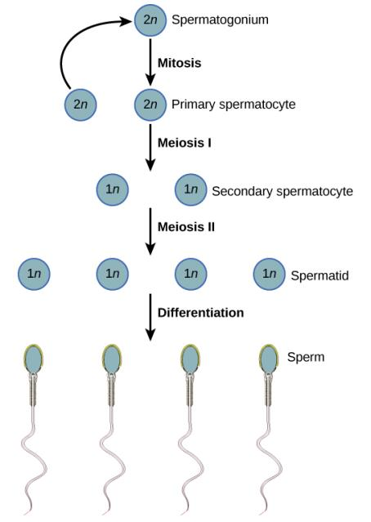
During spermatogenesis, four sperm result from each primary spermatocyte. The process also maps onto the physical structure of the wall of the seminiferous tubule, with the spermatogonia on the outer side of the tubule, and the sperm with their developing tails extended into the lumen of the tubule.

Slide 18
CONCEPT IN ACTION
Visit this site to see the process of spermatogenesis.
http://www.dnatube.com/video/2086/Animation-on-Spermatogenesis-by-NurseReview

Slide 19
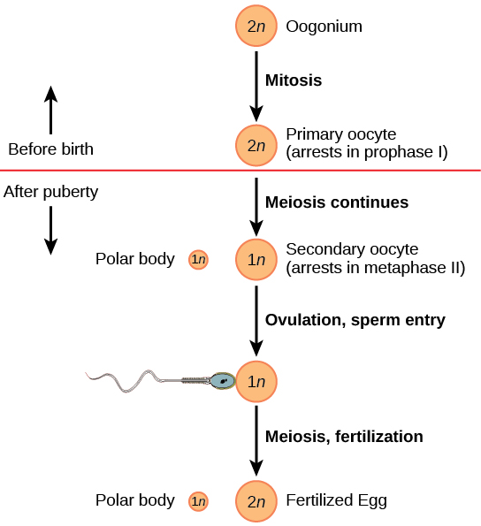
The process of oogenesis occurs in the ovary’s outermost layer.

Slide 20
Hormones control sperm production in a negative feedback system.

Slide 21
The ovarian and menstrual cycles of female reproduction are regulated by hormones produced by the hypothalamus, pituitary, and ovaries.

Slide 22
Fetal development is shown at nine weeks gestation.
This fetus is just entering the second trimester, when the placenta takes over more of the functions performed as the baby develops.
There is rapid fetal growth during the third trimester. (Credit a: modification of work by Ed Uthman; credit b: modification of work by National Museum of Health and Medicine; credit c: modification of work by Gray’s Anatomy)

Slide 23
CONCEPT IN ACTION
Visit this website to see the stages of human fetal development.
http://www.pennmedicine.org/encyclopedia/em_DisplayAnimation.aspx?gcid=000056&ptid=17

Slide 24
LTS Activity
http://outreach.letstalkscience.ca/component/zoo/item/diy-activities-3.html

