Slide 1
Concepts of Biology:
Sensory Systems

Slide 2
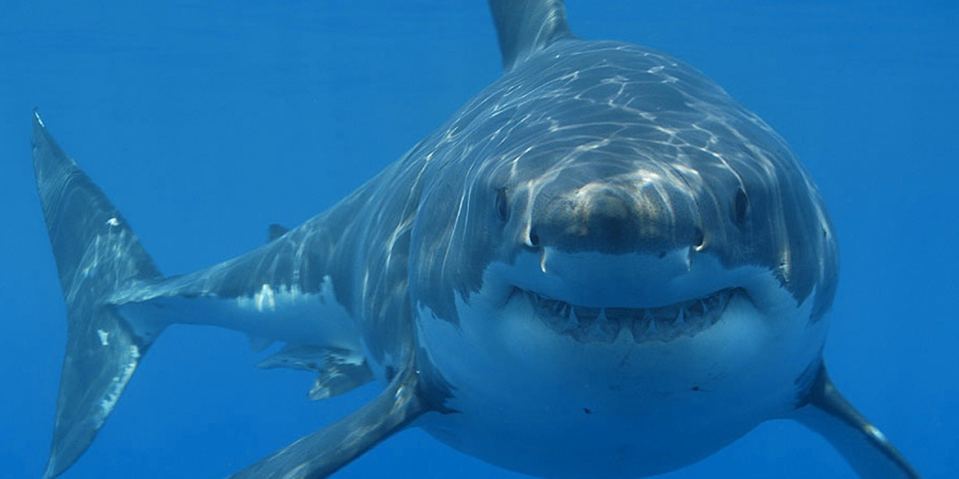
This shark uses its senses of sight, vibration (lateral-line system), and smell to hunt, but it also relies on its ability to sense the electric fields of prey, a sense not present in most land animals. (credit: modification of work by Hermanus Backpackers Hostel, South Africa)

Slide 3
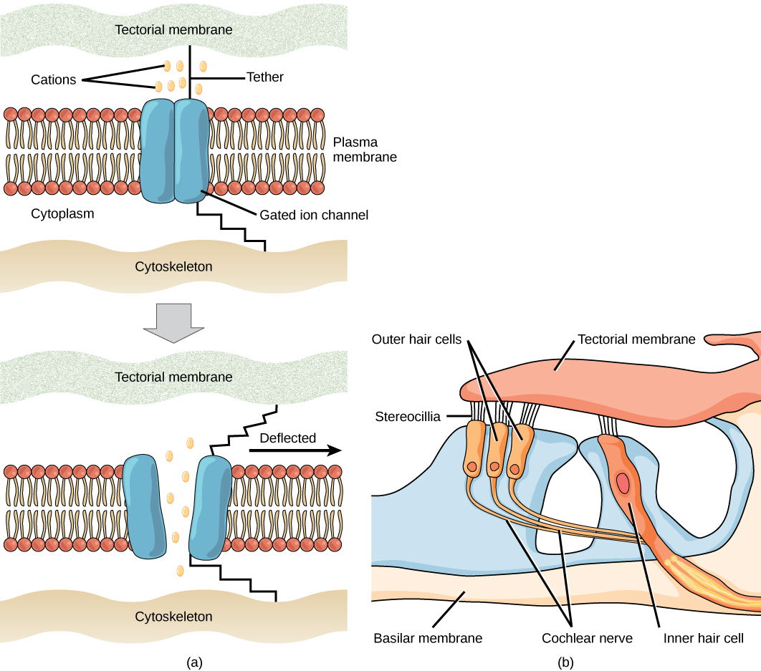
Notes:
Mechanosensitive ion channels are gated ion channels that respond to mechanical deformation of the plasma membrane. A mechanosensitive channel is connected to the plasma membrane and the cytoskeleton by hair-like tethers. When pressure causes the extracellular matrix to move, the channel opens, allowing ions to enter or exit the cell.
Stereocilia in the human ear are connected to mechanosensitive ion channels. When a sound causes the stereocilia to move, mechanosensitive ion channels transduce the signal to the cochlear nerve.

Slide 4
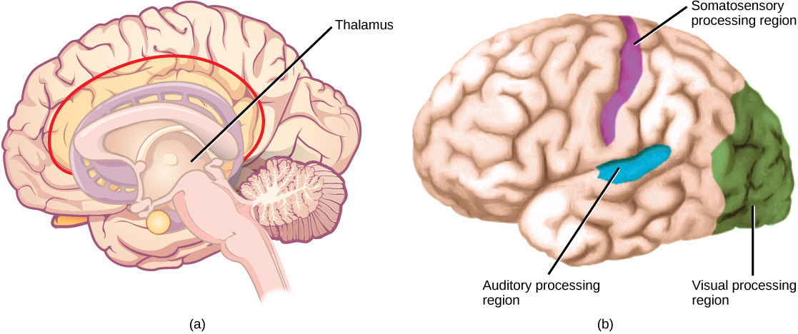
In humans, with the exception of olfaction, all sensory signals are routed from the (a) thalamus to (b) final processing regions in the cortex of the brain. (credit b: modification of work by Polina Tishina)

Slide 5
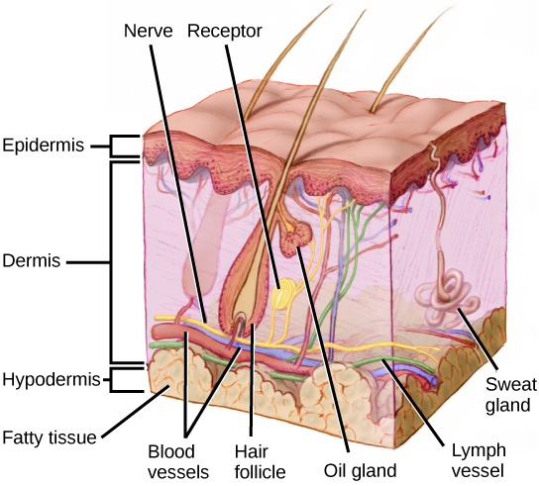
Mammalian skin has three layers: an epidermis, a dermis, and a hypodermis. (credit: modification of work by Don Bliss, National Cancer Institute)

Slide 6
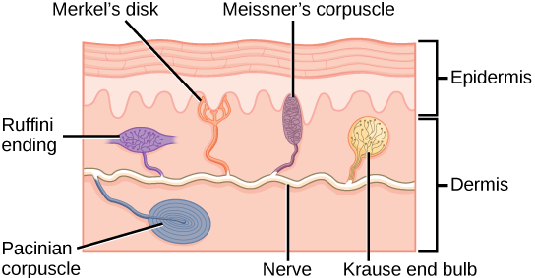
Four of the primary mechanoreceptors in human skin are shown. Merkel’s disks, which are unencapsulated, respond to light touch. Meissner’s corpuscles, Ruffini endings, Pacinian corpuscles, and Krause end bulbs are all encapsulated. Meissner’s corpuscles respond to touch and low-frequency vibration. Ruffini endings detect stretch, deformation within joints, and warmth. Pacinian corpuscles detect transient pressure and high-frequency vibration. Krause end bulbs detect cold.

Slide 7
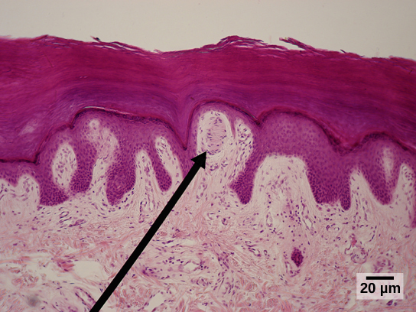
Meissner corpuscles in the fingertips, such as the one viewed here using bright field light microscopy, allow for touch discrimination of fine detail. (credit: modification of work by “Wbensmith”/Wikimedia Commons; scale-bar data from Matt Russell)

Slide 8
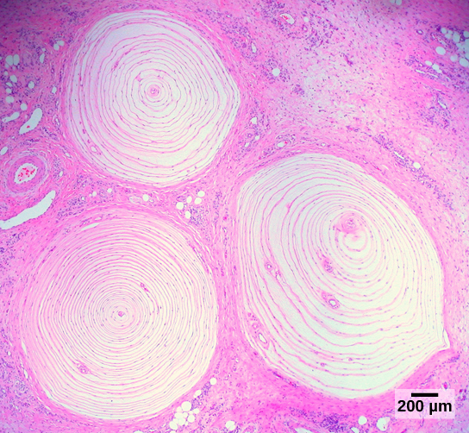
Pacinian corpuscles, such as these visualized using bright field light microscopy, detect pressure (touch) and high-frequency vibration. (credit: modification of work by Ed Uthman; scale-bar data from Matt Russell)

Slide 9
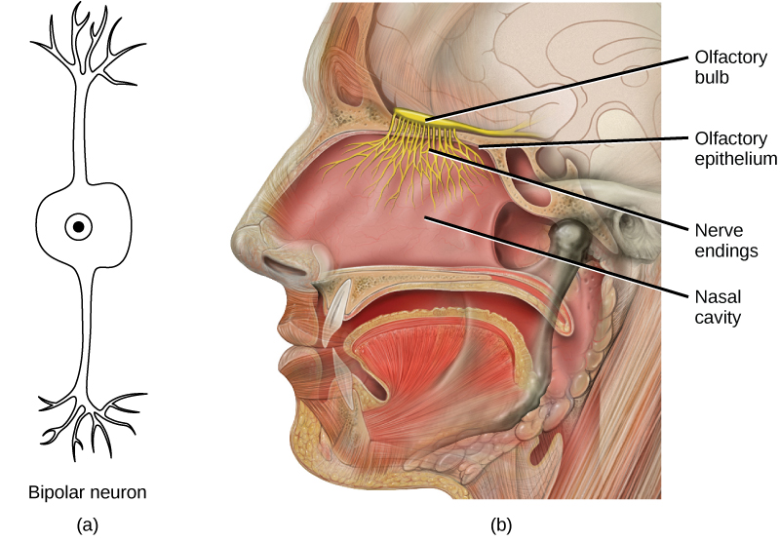
In the human olfactory system, (a) bipolar olfactory neurons extend from (b) the olfactory epithelium, where olfactory receptors are located, to the olfactory bulb. (credit: modification of work by Patrick J. Lynch, medical illustrator; C. Carl Jaffe, MD, cardiologist)

Slide 10

The flehmen response in this tiger results in the curling of the upper lip and helps airborne pheromone molecules enter the vomeronasal organ. (credit: modification of work by “chadh”/Flickr)

Slide 11
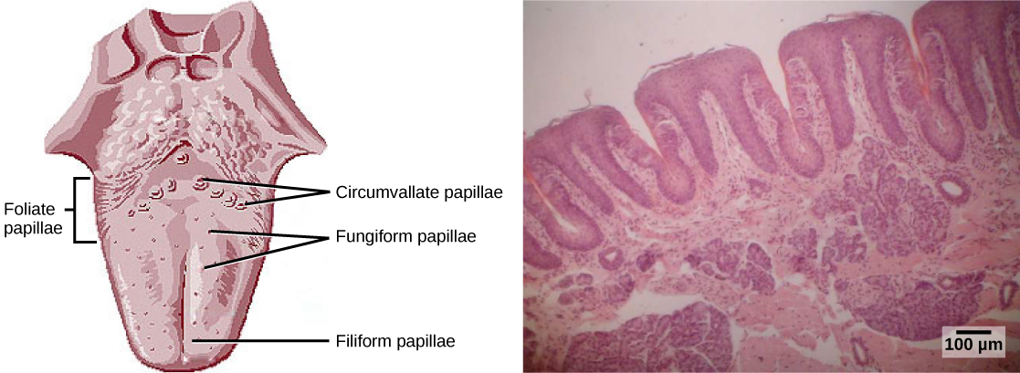
Foliate, circumvallate, and fungiform papillae are located on different regions of the tongue.
Foliate papillae are prominent protrusions on this light micrograph. (credit a: modification of work by NCI; scale-bar data from Matt Russell)

Slide 12
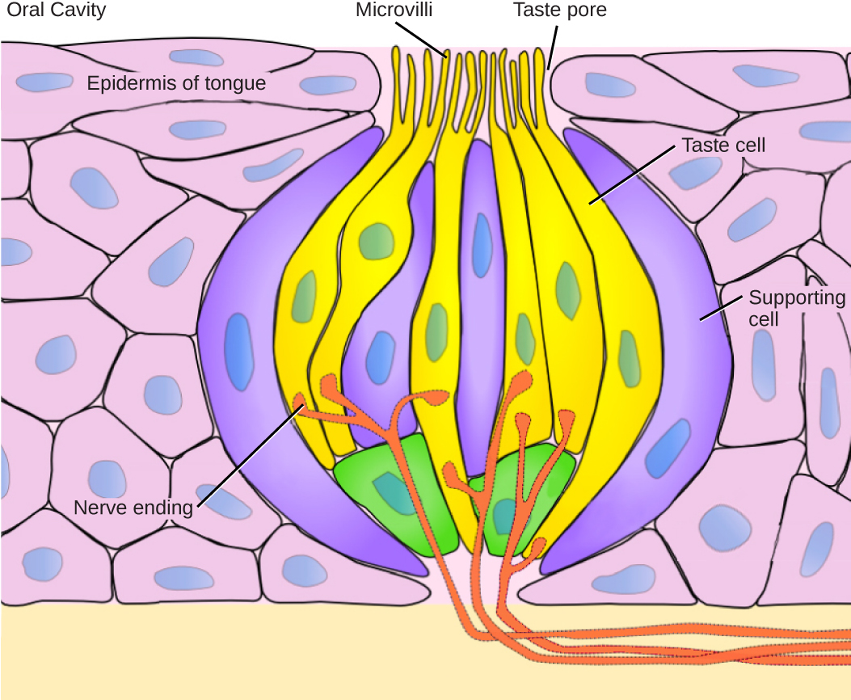
Pores in the tongue allow tastants to enter taste pores in the tongue. (credit: modification of work by Vincenzo Rizzo)

Slide 13
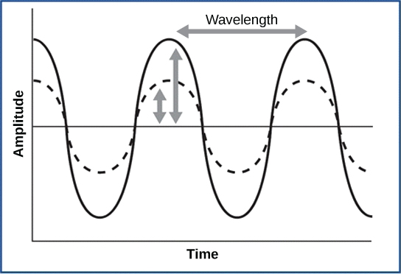
For sound waves, wavelength corresponds to pitch. Amplitude of the wave corresponds to volume. The sound wave shown with a dashed line is softer in volume than the sound wave shown with a solid line. (credit: NIH)

Slide 14
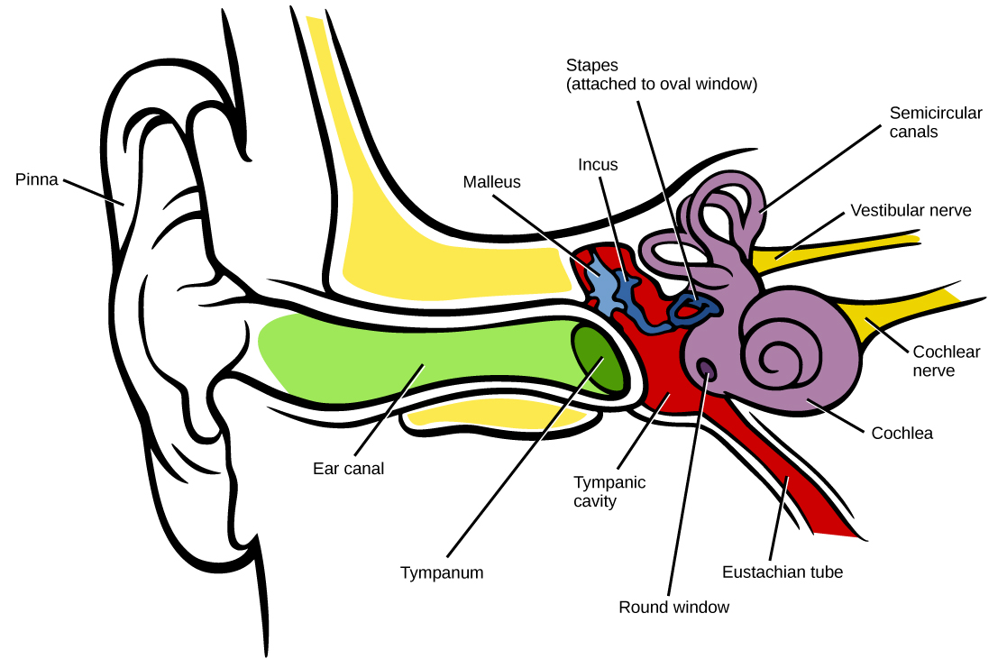
Sound travels through the outer ear to the middle ear, which is bounded on its exterior by the tympanic membrane. The middle ear contains three bones called ossicles that transfer the sound wave to the oval window, the exterior boundary of the inner ear. The organ of Corti, which is the organ of sound transduction, lies inside the cochlea. (credit: modification of work by Lars Chittka, Axel Brockmann)

Slide 15
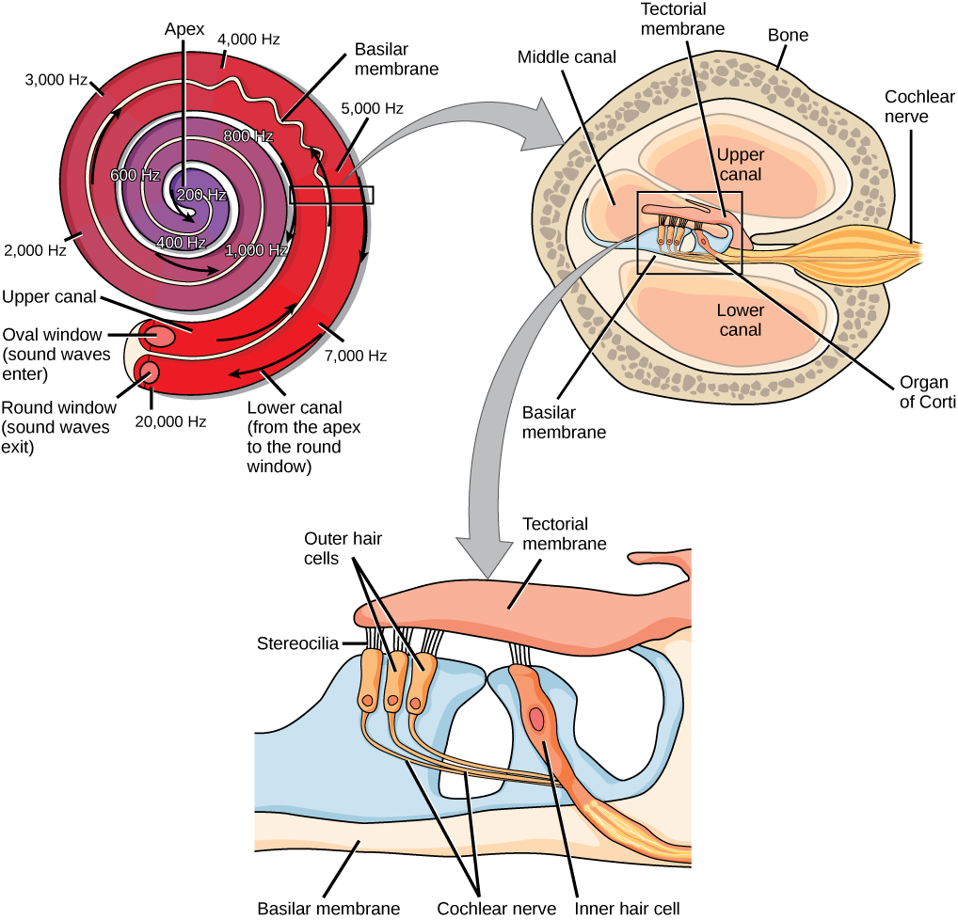
In the human ear, sound waves cause the stapes to press against the oval window. Vibrations travel up the fluid-filled interior of the cochlea. The basilar membrane that lines the cochlea gets continuously thinner toward the apex of the cochlea. Different thicknesses of membrane vibrate in response to different frequencies of sound. Sound waves then exit through the round window. In the cross section of the cochlea (top right figure), note that in addition to the upper canal and lower canal, the cochlea also has a middle canal. The organ of Corti (bottom image) is the site of sound transduction. Movement of stereocilia on hair cells results in an action potential that travels along the auditory nerve.

Slide 16
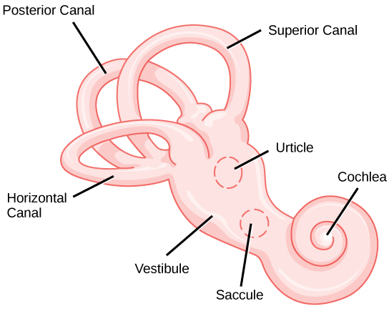
The structure of the vestibular labyrinth is shown. (credit: modification of work by NIH)

Slide 17
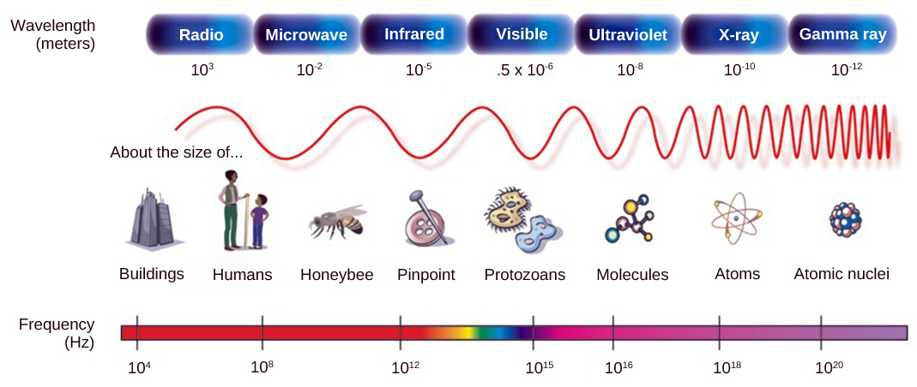
In the electromagnetic spectrum, visible light lies between 380 nm and 740 nm. (credit: modification of work by NASA)

Slide 18
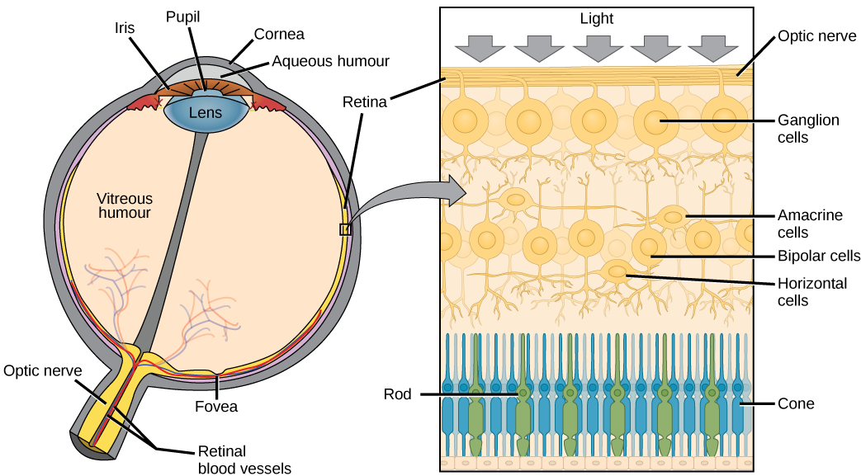
The human eye is shown in cross section.
A blowup shows the layers of the retina.

Slide 19
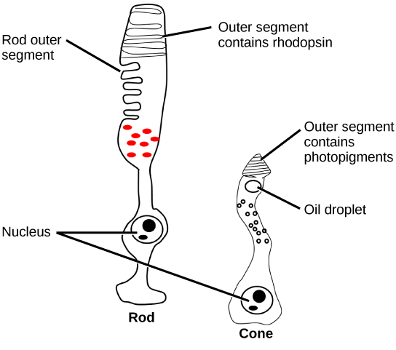
Rods and cones are photoreceptors in the retina. Rods respond in low light and can detect only shades of gray. Cones respond in intense light and are responsible for color vision. (credit: modification of work by Piotr Sliwa)

Slide 20
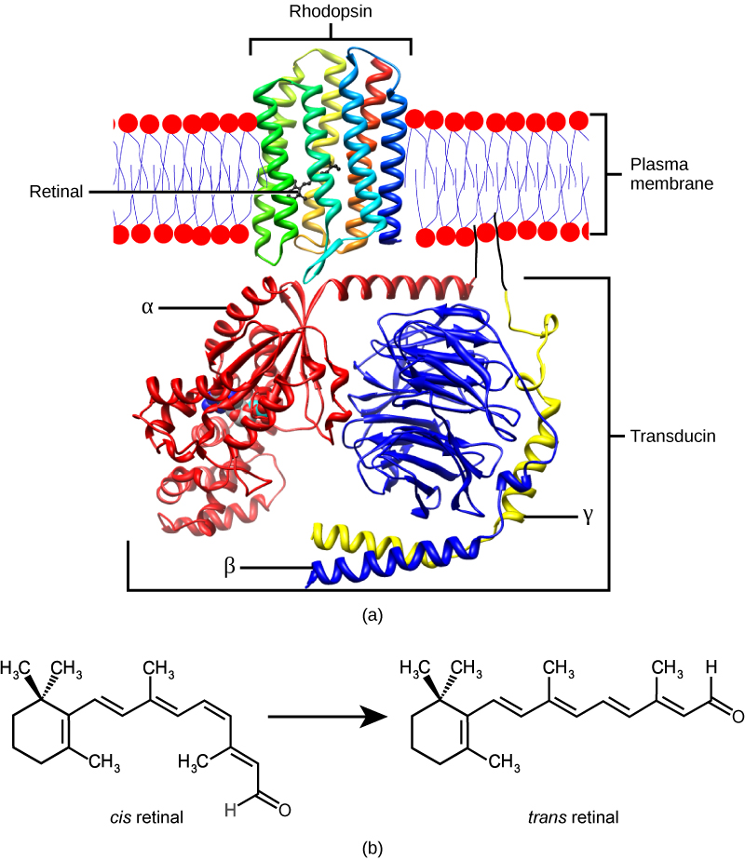
(a) Rhodopsin, the photoreceptor in vertebrates, has two parts: the trans-membrane protein opsin, and retinal. When light strikes retinal, it changes shape from (b) a cis to a trans form. The signal is passed to a G-protein called transducin, triggering a series of downstream events.

Slide 21
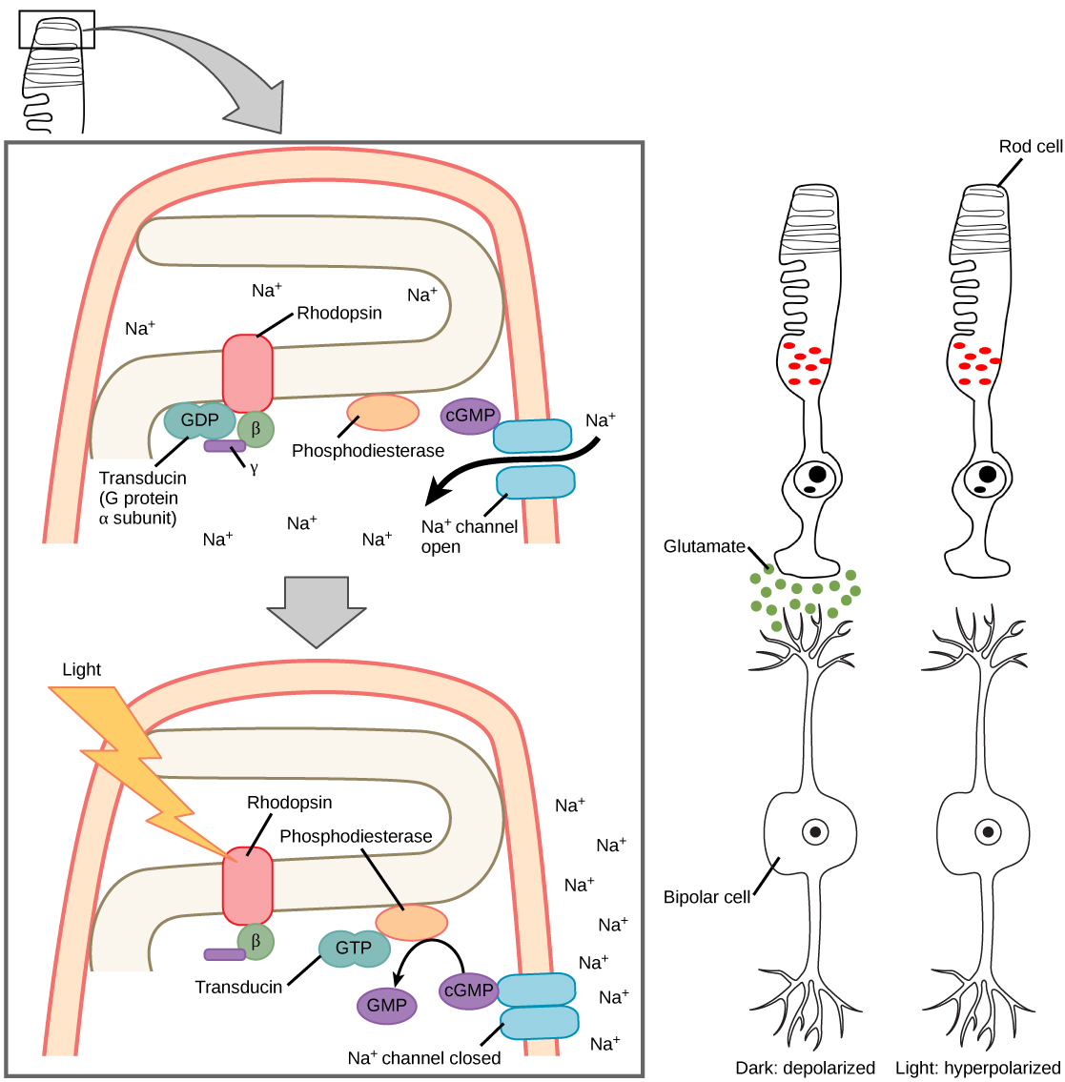
When light strikes rhodopsin, the G-protein transducin is activated, which in turn activates phosphodiesterase. Phosphodiesterase converts cGMP to GMP, thereby closing sodium channels. As a result, the membrane becomes hyperpolarized. The hyperpolarized membrane does not release glutamate to the bipolar cell.

Slide 22
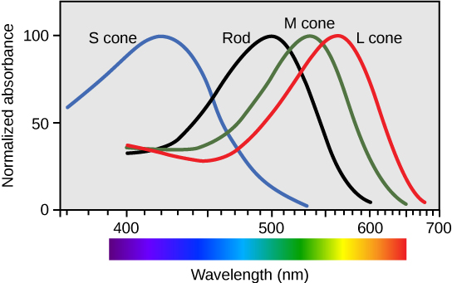
Human rod cells and the different types of cone cells each have an optimal wavelength. However, there is considerable overlap in the wavelengths of light detected.

Slide 23

View this flag to understand how retinal processing works. Stare at the center of the flag (indicated by the white dot) for 45 seconds, and then quickly look at a white background, noticing how colors appear.

