Slide 1
Concepts of Biology:
The Endocrine System

Slide 2
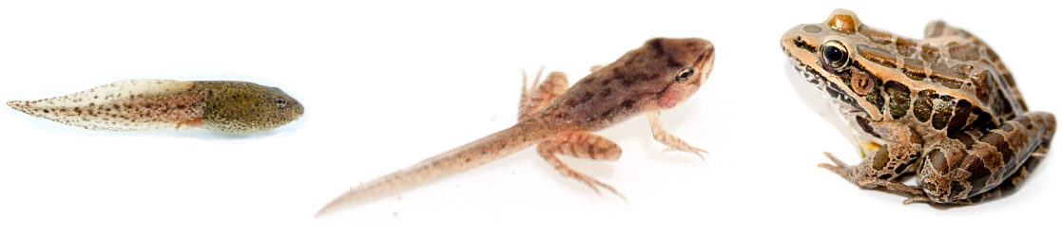
The process of amphibian metamorphosis, as seen in the tadpole-to-frog stages shown here, is driven by hormones. (credit “tadpole”: modification of work by Brian Gratwicke)

Slide 3
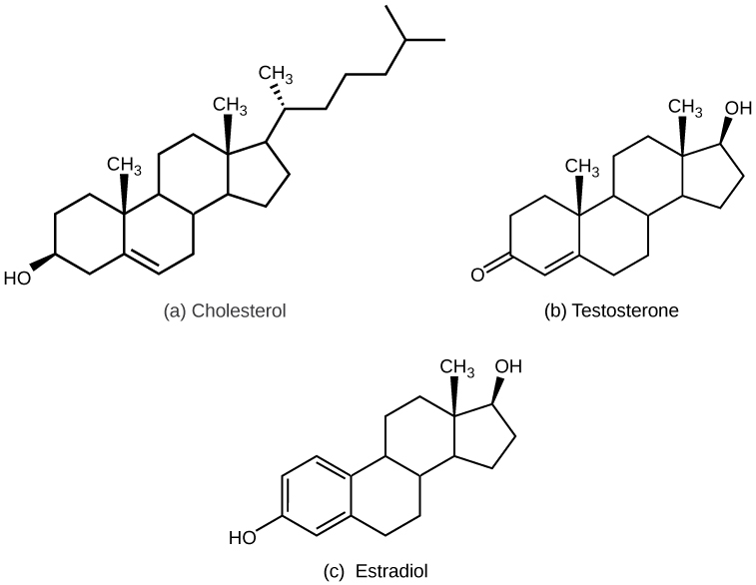
The structures shown here represent (a) cholesterol, plus the steroid hormones (b) testosterone and (c) estradiol.

Slide 4
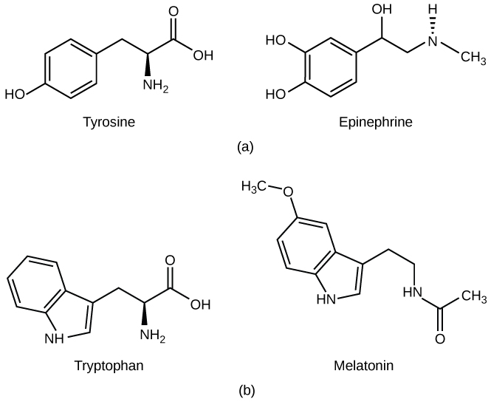
(a) The hormone epinephrine, which triggers the fight-or-flight response, is derived from the amino acid tyrosine. (b) The hormone melatonin, which regulates circadian rhythms, is derived from the amino acid tryptophan.

Slide 5
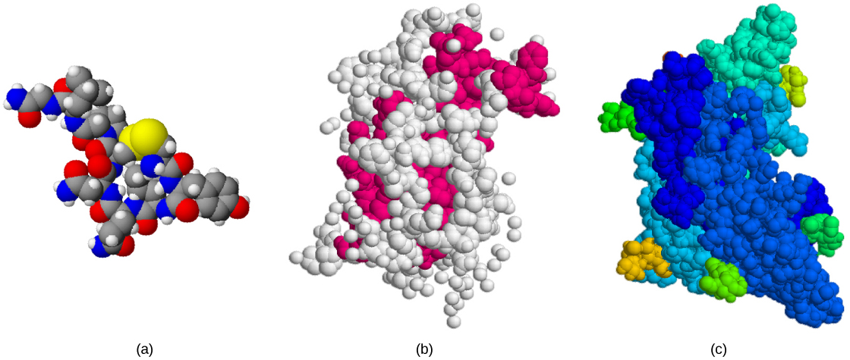
The structures of peptide hormones (a) oxytocin, (b) growth hormone, and (c) folliclestimulating hormone are shown. These peptide hormones are much larger than those derived from cholesterol or amino acids.

Slide 6
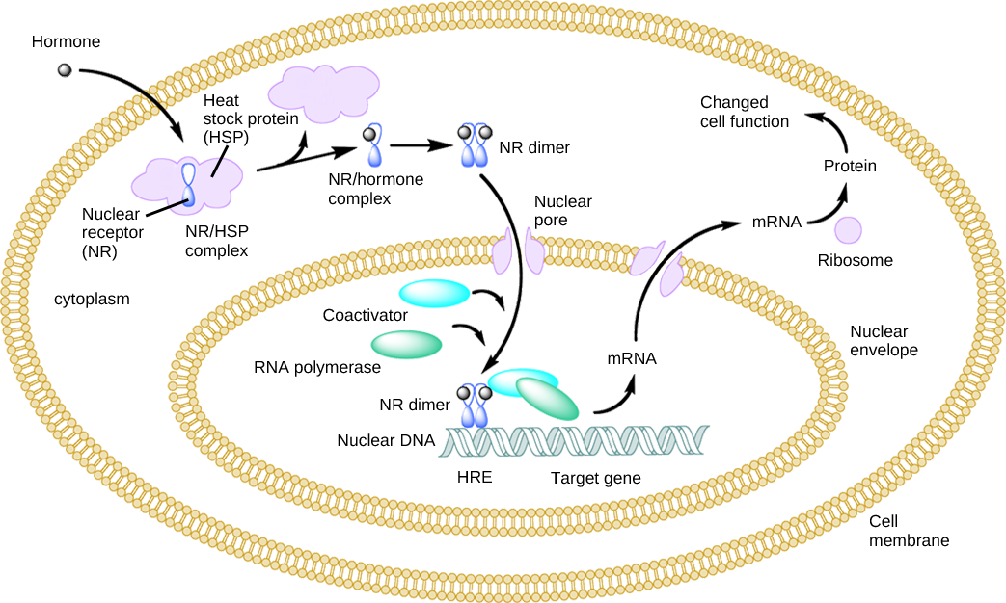
An intracellular nuclear receptor (NR) is located in the cytoplasm bound to a heat shock protein (HSP). Upon hormone binding, the receptor dissociates from the heat shock protein and translocates to the nucleus. In the nucleus, the hormone-receptor complex binds to a DNA sequence called a hormone response element (HRE), which triggers gene transcription and translation. The corresponding protein product can then mediate changes in cell function.

Slide 7
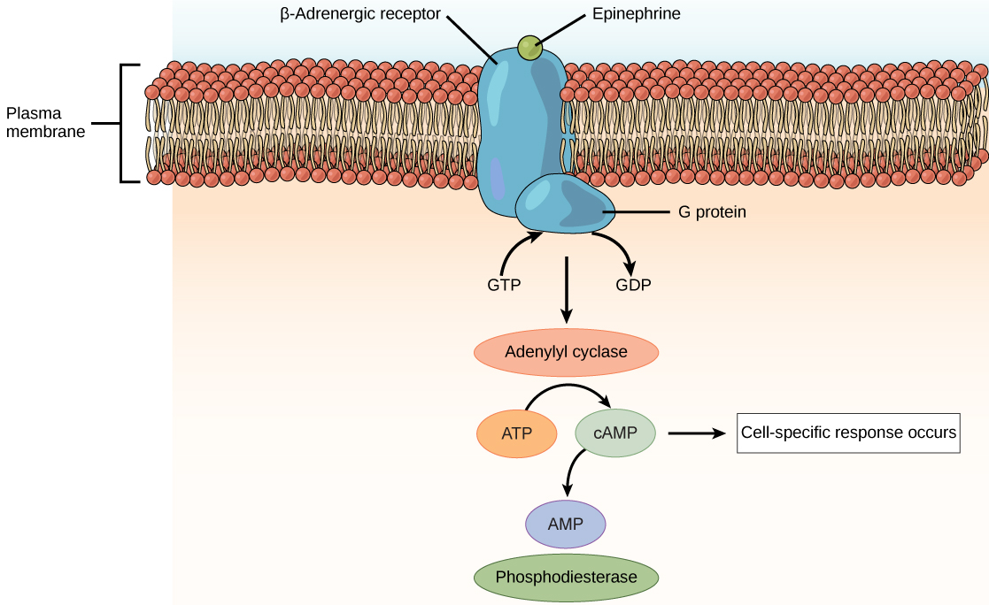
The amino acid-derived hormones epinephrine and norepinephrine bind to betaadrenergic receptors on the plasma membrane of cells. Hormone binding to receptor activates a G-protein, which in turn activates adenylyl cyclase, converting ATP to cAMP. cAMP is a second messenger that mediates a cell-specific response. An enzyme called phosphodiesterase breaks down cAMP, terminating the signal.

Slide 8
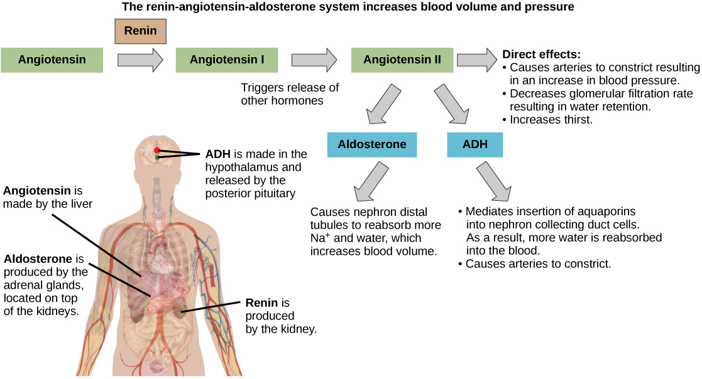
ADH and aldosterone increase blood pressure and volume. Angiotensin II stimulates release of these hormones. Angiotensin II, in turn, is formed when renin cleaves angiotensin. (credit: modification of work by Mikael Häggström)

Slide 9

Professional baseball player Jason Giambi publically admitted to, and apologized for, his use of anabolic steroids supplied by a trainer. (credit: Bryce Edwards)

Slide 10
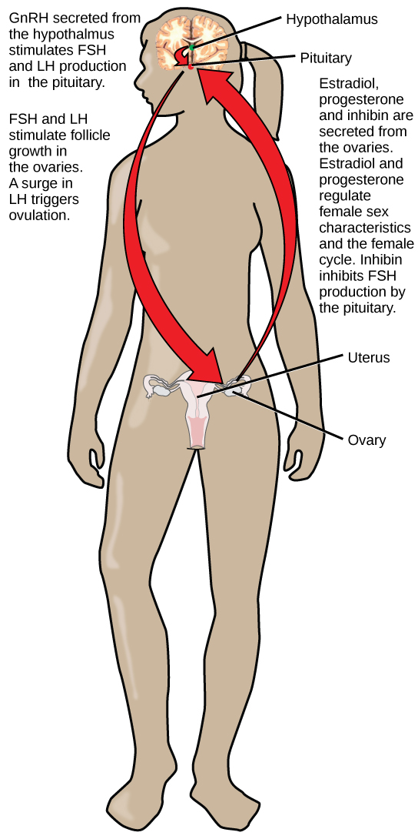
Hormonal regulation of the female reproductive system involves hormones from the hypothalamus, pituitary, and ovaries.

Slide 11
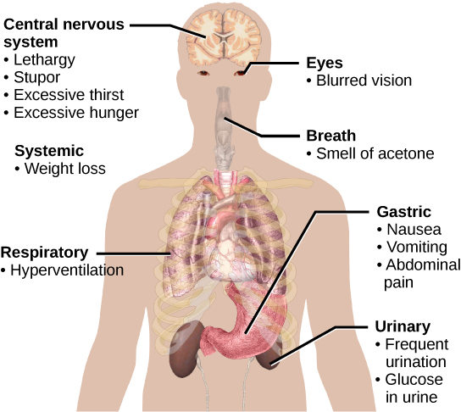
The main symptoms of diabetes are shown. (credit: modification of work by Mikael Häggström)

Slide 12
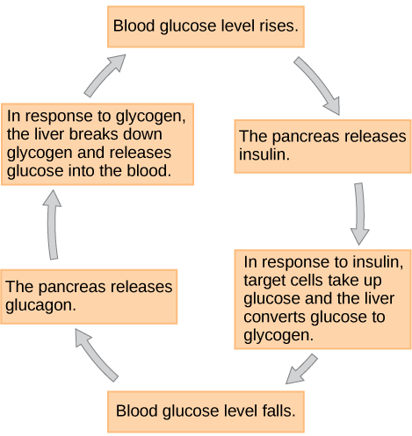
Insulin and glucagon regulate blood glucose levels.

Slide 13
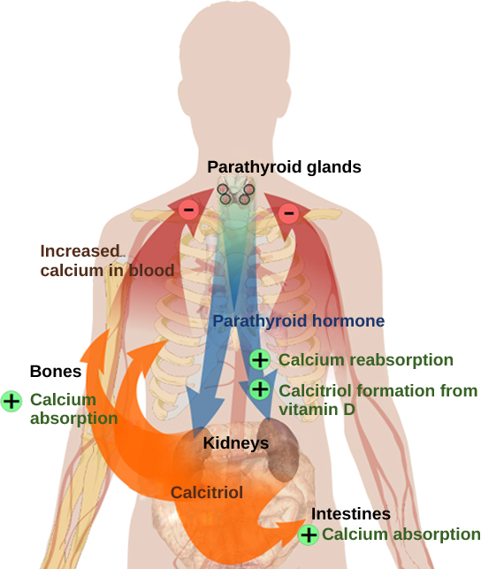
Parathyroid hormone (PTH) is released in response to low blood calcium levels. It increases blood calcium levels by targeting the skeleton, the kidneys, and the intestine. (credit: modification of work by Mikael Häggström)

Slide 14
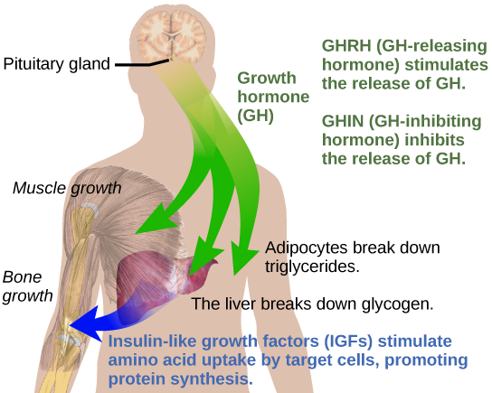
Growth hormone directly accelerates the rate of protein synthesis in skeletal muscle and bones. Insulin-like growth factor 1 (IGF-1) is activated by growth hormone and also allows formation of new proteins in muscle cells and bone. (credit: modification of work by Mikael Häggström)

Slide 15
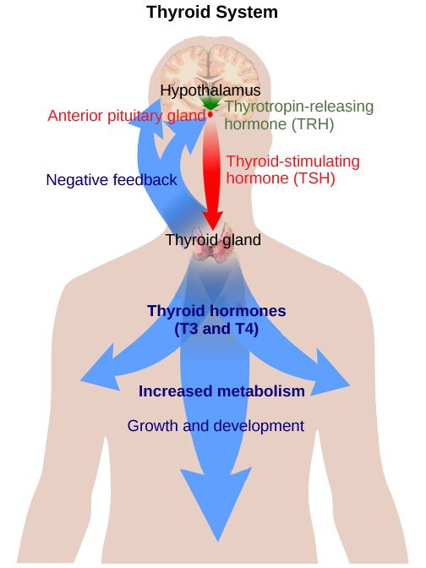
The anterior pituitary stimulates the thyroid gland to release thyroid hormones T₃ and T₄. Increasing levels of these hormones in the blood results in feedback to the hypothalamus and anterior pituitary to inhibit further signaling to the thyroid gland. (credit: modification of work by Mikael Häggström)

Slide 16
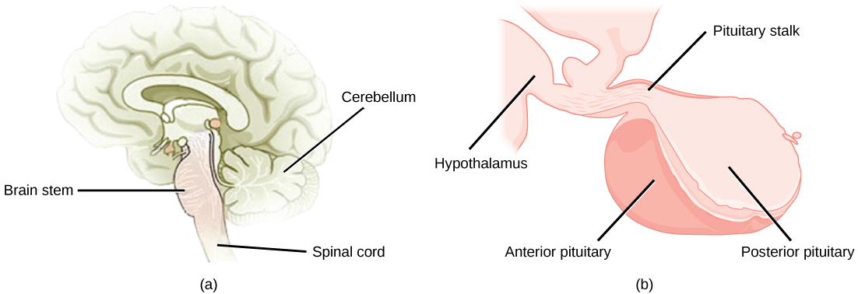
The pituitary gland is located at (a) the base of the brain and (b) connected to the hypothalamus by the pituitary stalk. (credit a: modification of work by NCI; credit b: modification of work by Gray’s Anatomy)

Slide 17
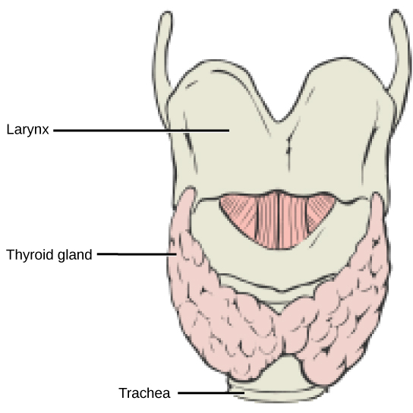
This illustration shows the location of the thyroid gland.

Slide 18
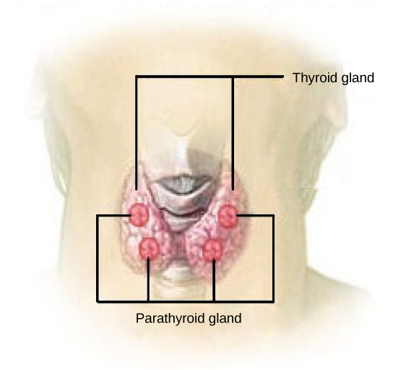
The parathyroid glands are located on the posterior of the thyroid gland. (credit: modification of work by NCI)

Slide 19
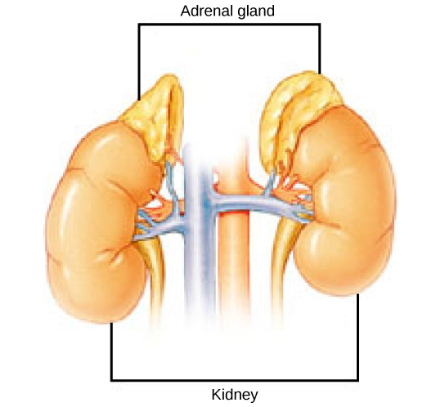
The location of the adrenal glands on top of the kidneys is shown. (credit: modification of work by NCI)

Slide 20
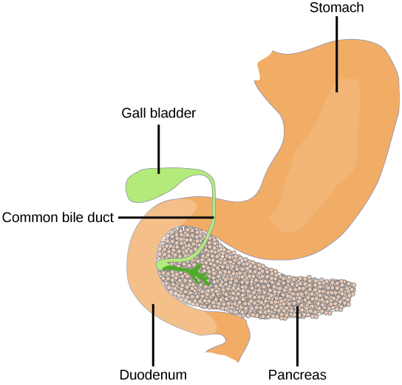
The pancreas is found underneath the stomach and points toward the spleen. (credit: modification of work by NCI)

Slide 21
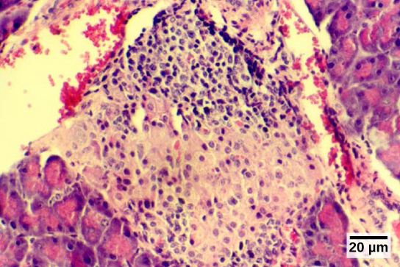
The islets of Langerhans are clusters of endocrine cells found in the pancreas; they stain lighter than surrounding cells. (credit: modification of work by Muhammad T. Tabiin, Christopher P. White, Grant Morahan, and Bernard E. Tuch; scale-bar data from Matt Russell)

