Slide 1
Concepts of Biology:
Animal Reproduction and Development

Slide 2
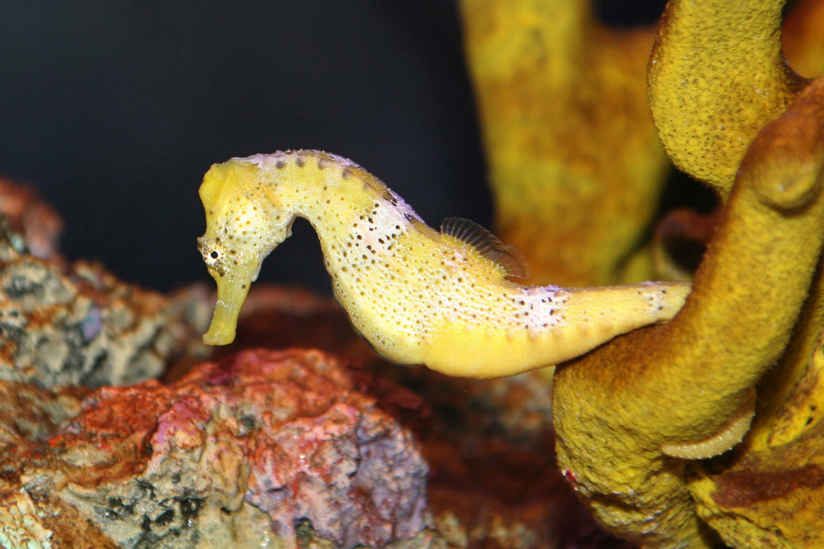
Female seahorses produce eggs for reproduction that are then fertilized by the male. Unlike almost all other animals, the male seahorse then gestates the young until birth. (credit: modification of work by “cliff1066”/Flickr)

Slide 3
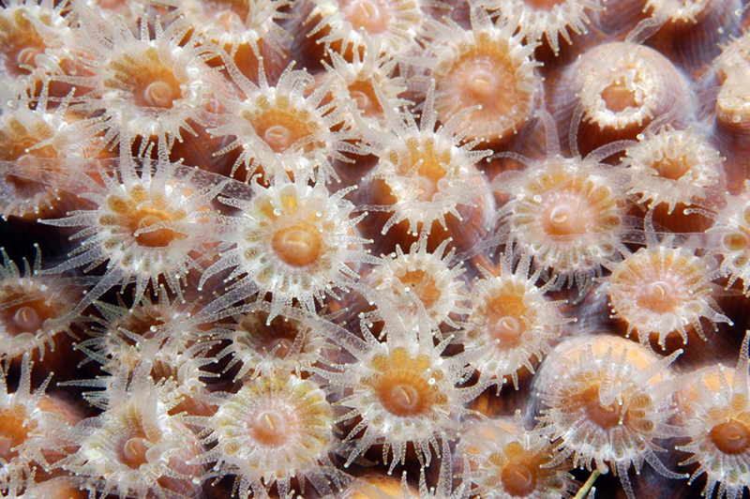
Coral polyps reproduce asexually by fission. (credit: G. P. Schmahl, NOAA FGBNMS Manager)

Slide 4
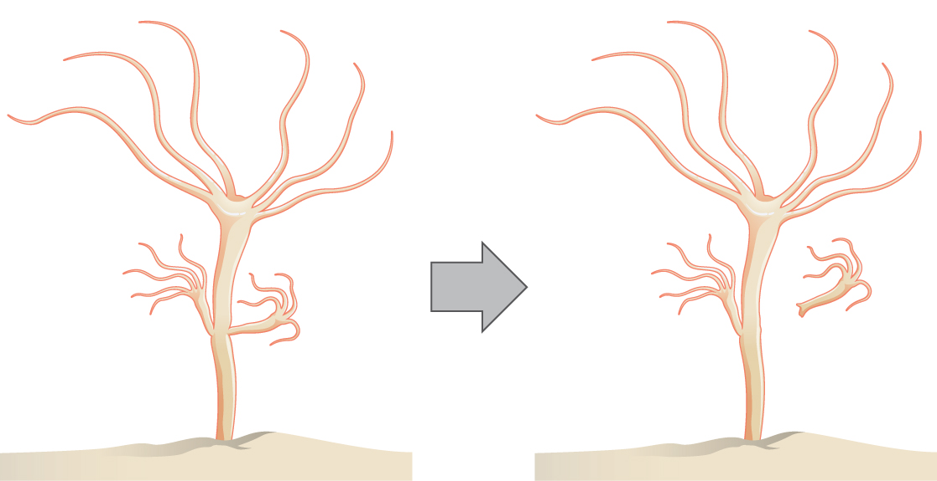
Hydra reproduce asexually through budding.

Slide 5
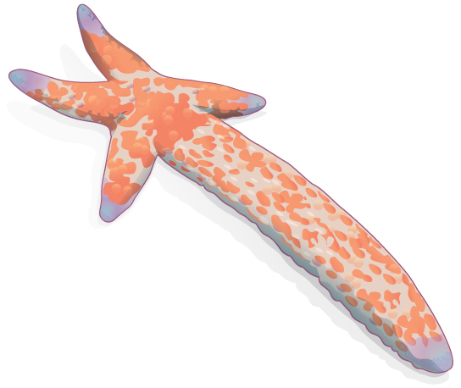
Sea stars can reproduce through fragmentation. The large arm, a fragment from another sea star, is developing into a new individual.

Slide 6
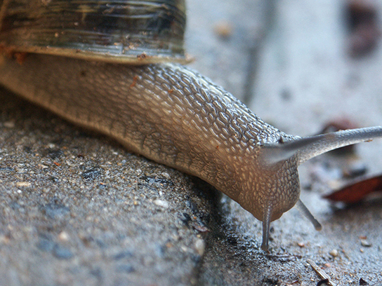
Many snails are hermaphrodites. When two individuals mate, they can produce up to one hundred eggs each. (credit: Assaf Shtilman)

Slide 7
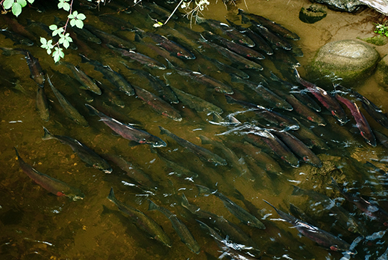
Salmon reproduce through spawning. (credit: Dan Bennett)

Slide 8
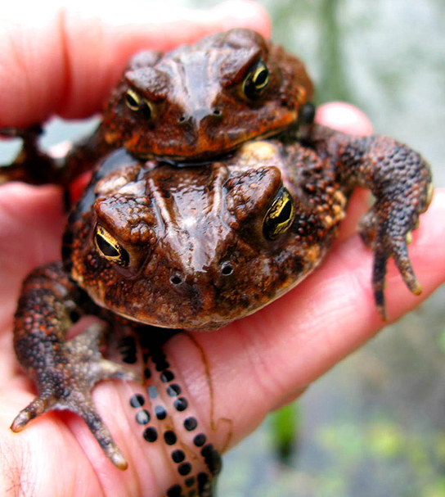
During sexual reproduction in toads, the male grasps the female from behind and externally fertilizes the eggs as they are deposited. (credit: “OakleyOriginals”/Flickr)

Slide 9
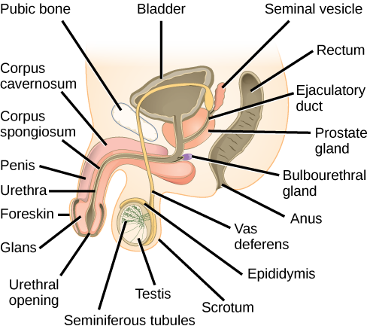
The reproductive structures of the human male are shown.

Slide 10
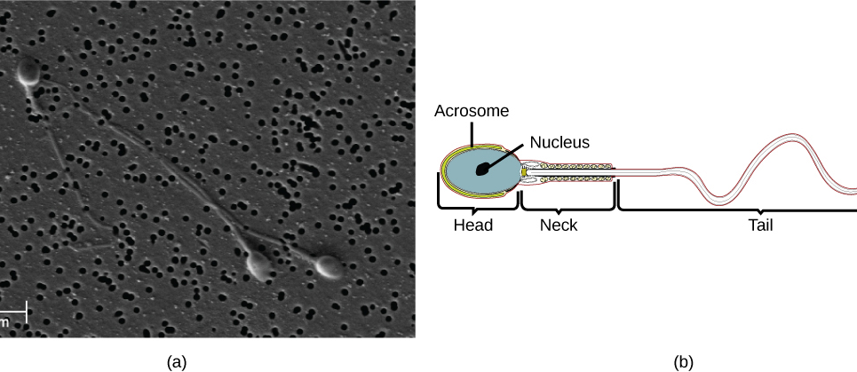
Human sperm, visualized using scanning electron microscopy, have a flagellum, neck, and head. (credit b: modification of work by Mariana Ruiz Villareal; scale-bar data from Matt Russell)

Slide 11
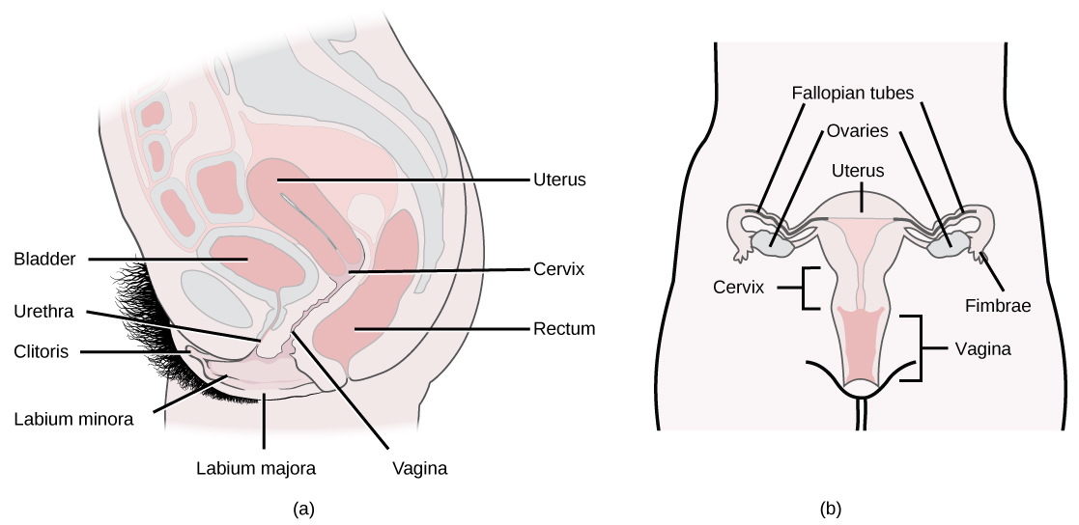
The reproductive structures of the human female are shown. (credit a: modification of work by Gray's Anatomy; credit b: modification of work by CDC)

Slide 12
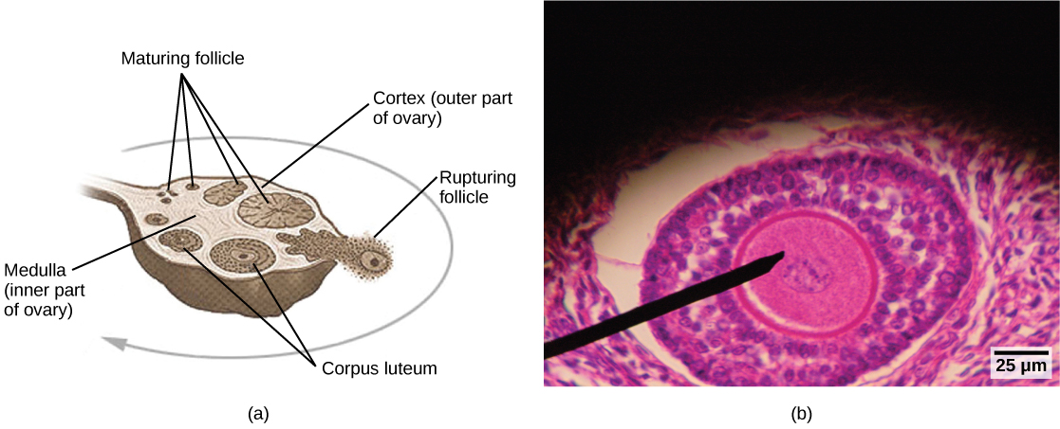
Oocytes develop in (a) follicles, located in the ovary. At the beginning of the menstrual cycle, the follicle matures. At ovulation, the follicle ruptures, releasing the egg. The follicle becomes a corpus luteum, which eventually degenerates. The (b) follicle in this light micrograph has an oocyte at its center. (credit a: modification of work by NIH; scale-bar data from Matt Russell)

Slide 13
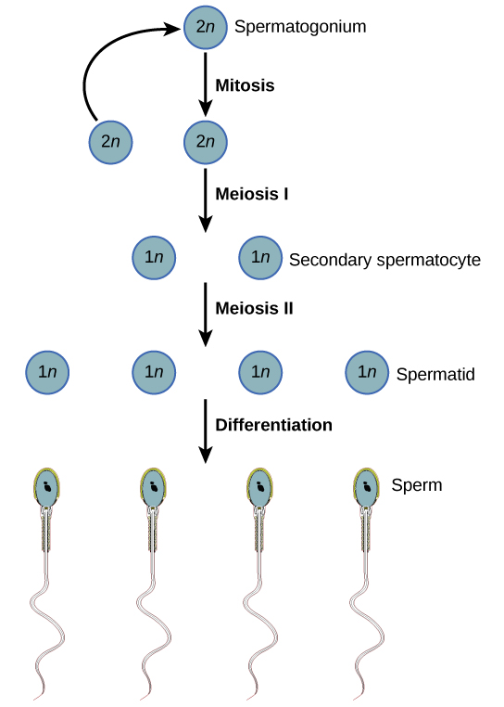
During spermatogenesis, four sperm result from each primary spermatocyte.

Slide 14
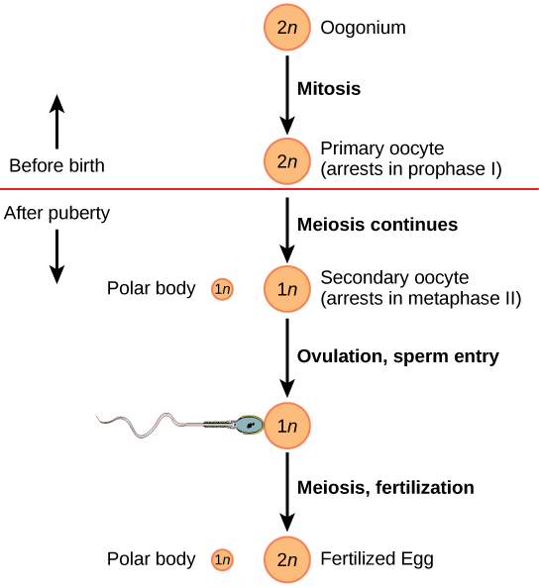
The process of oogenesis occurs in the ovary’s outermost layer.

Slide 15
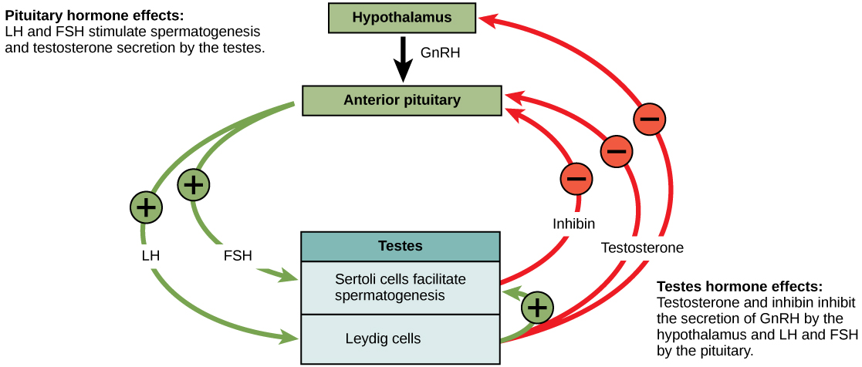
Hormones control sperm production in a negative feedback system.

Slide 16
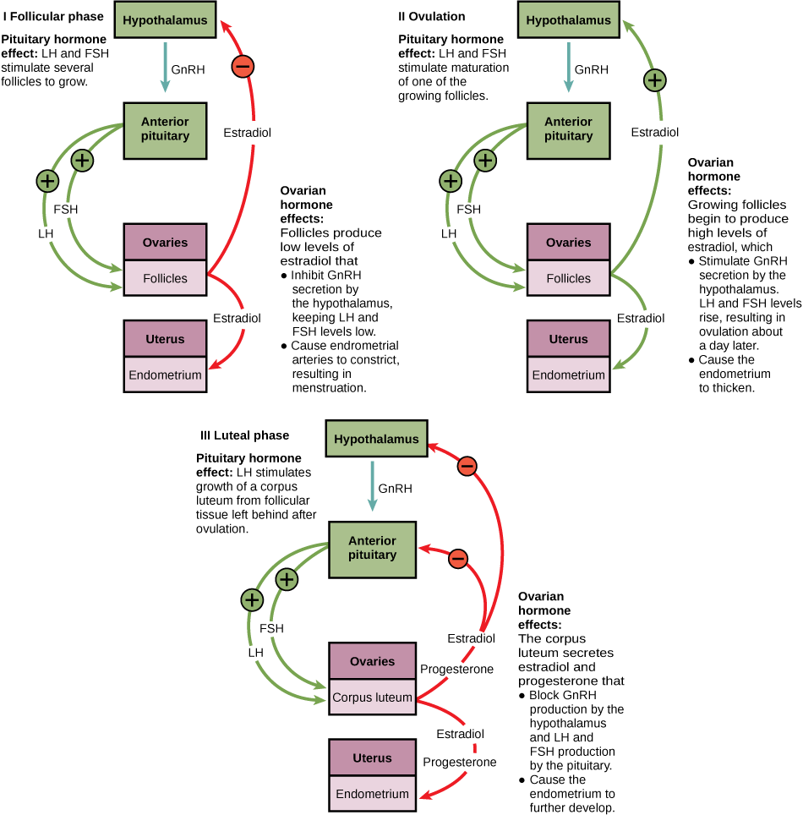
Notes:
The ovarian and menstrual cycles of female reproduction are regulated by hormones produced by the hypothalamus, pituitary, and ovaries.

Slide 17
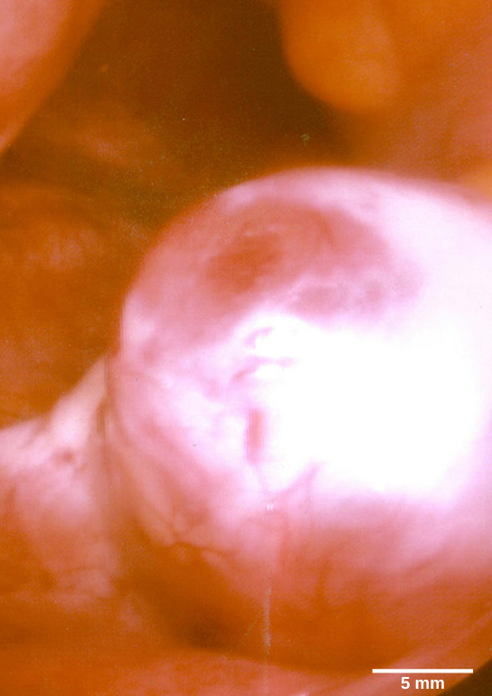
This mature egg follicle may rupture and release an egg. (credit: scale-bar data from Matt Russell)

Slide 18
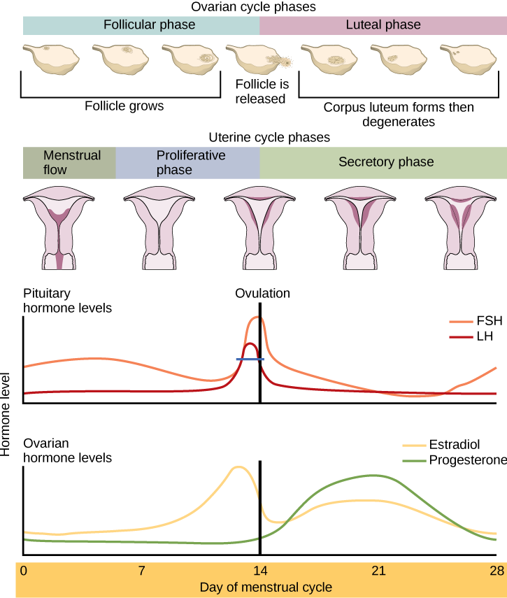
Rising and falling hormone levels result in progression of the ovarian and menstrual cycles. (credit: modification of work by Mikael Häggström)

Slide 19
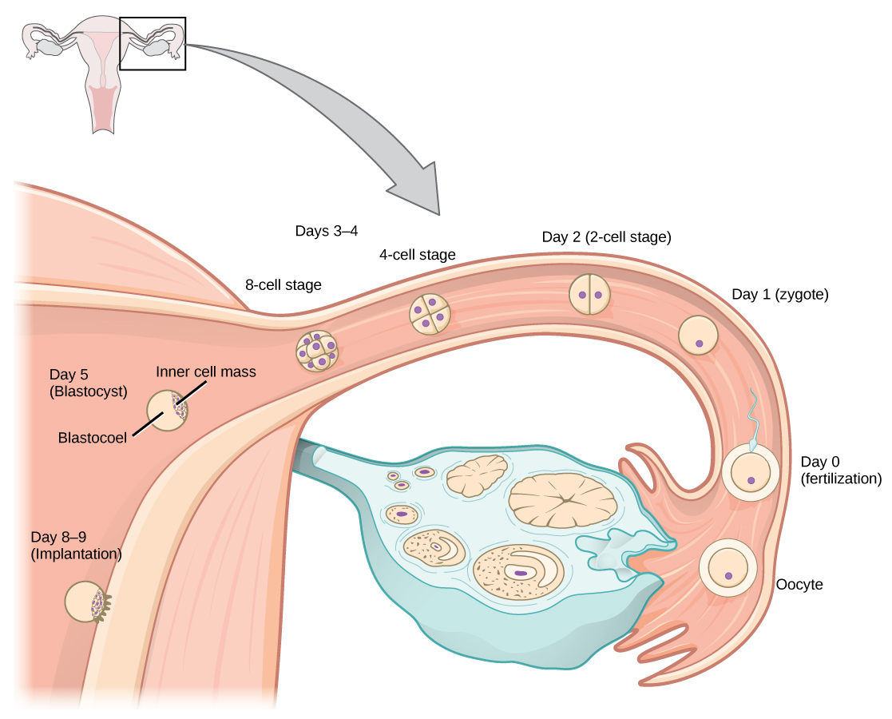
In humans, fertilization occurs soon after the oocyte leaves the ovary. Implantation occurs eight or nine days later.(credit: Ed Uthman)

Slide 20
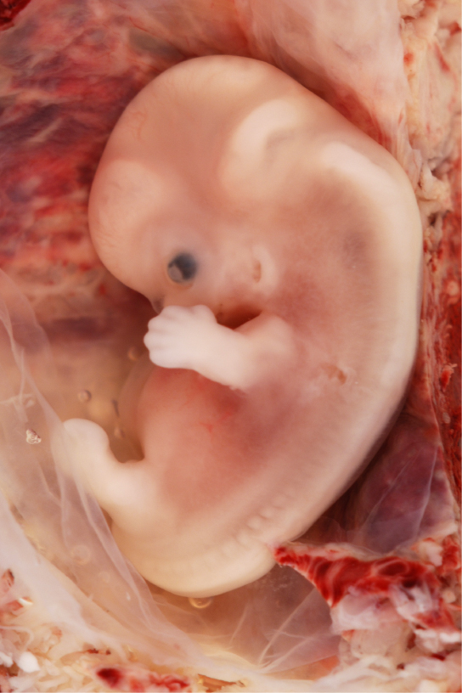
Fetal development is shown at nine weeks gestation. (credit: Ed Uthman)

Slide 21
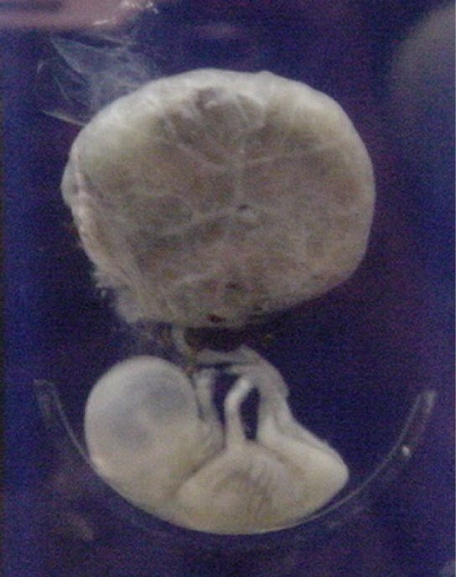
This fetus is just entering the second trimester, when the placenta takes over more of the functions performed as the baby develops. (credit: National Museum of Health and Medicine)

Slide 22
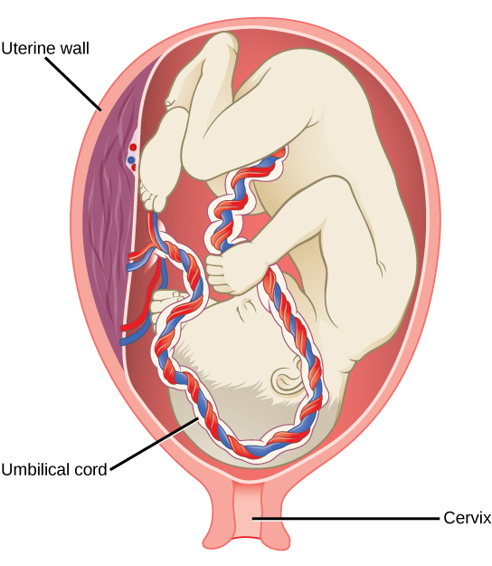
There is rapid fetal growth during the third trimester. (credit: modification of work by Gray’s Anatomy)

Slide 23
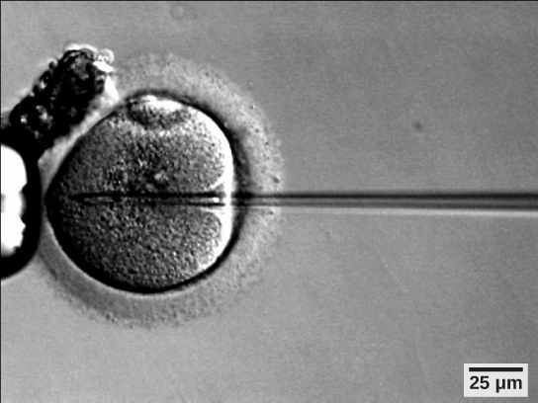
A sperm is inserted into an egg for fertilization during intracytoplasmic sperm injection (ICSI). (credit: scale-bar data from Matt Russell)

Slide 24
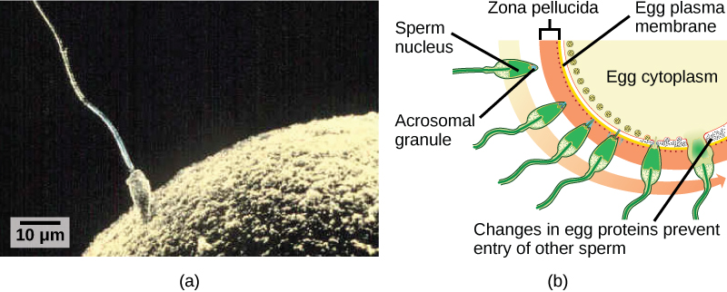
Fertilization is the process in which sperm and egg fuse to form a zygote.
Acrosomal reactions help the sperm degrade the glycoprotein matrix protecting the egg and allow the sperm to transfer its nucleus. (credit: (b) modification of work by Mariana Ruiz Villareal; scale-bar data from Matt Russell)

Slide 25
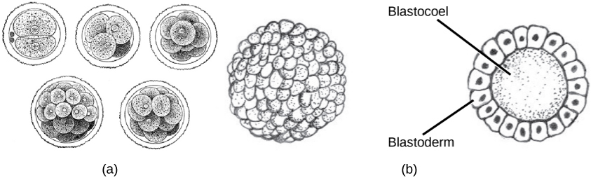
During cleavage, the zygote rapidly divides into multiple cells without increasing in size.
The cells rearrange themselves to form a hollow ball with a fluid-filled or yolk-filled cavity called the blastula. (credit a: modification of work by Gray’s Anatomy; credit b: modification of work by Pearson Scott Foresman, donated to the Wikimedia Foundation)

Slide 26
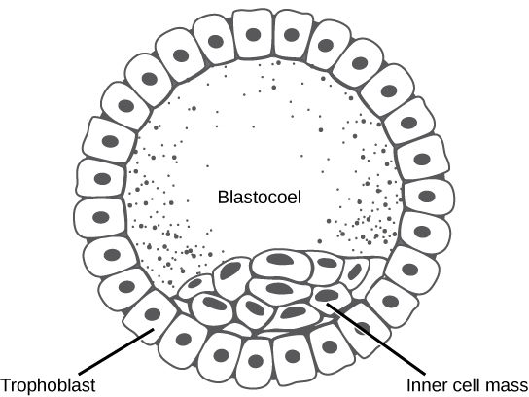
The rearrangement of the cells in the mammalian blastula to two layers—the inner cell mass and the trophoblast—results in the formation of the blastocyst.

Slide 27
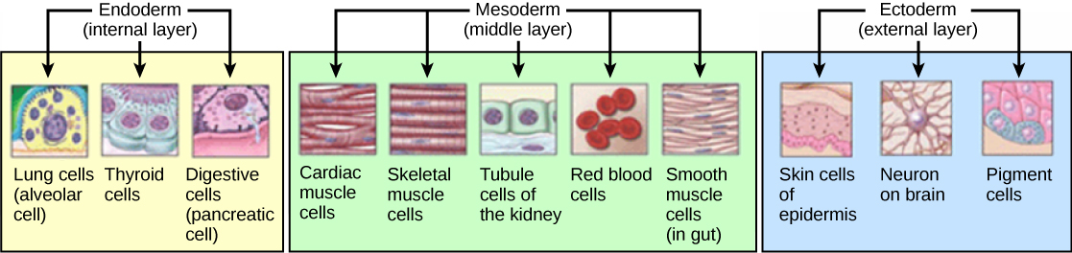
The three germ layers give rise to different cell types in the animal body. (credit: modification of work by NIH, NCBI)

Slide 28
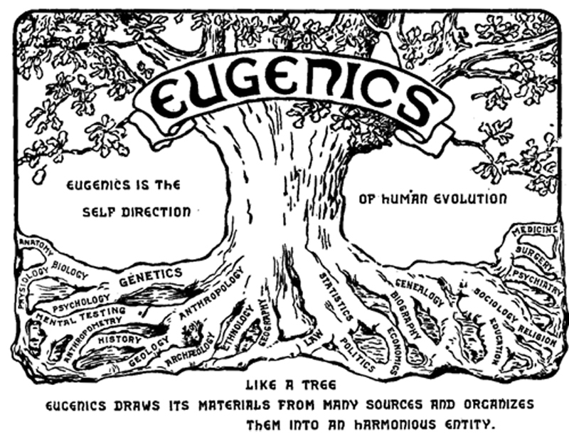
This logo from the Second International Eugenics Conference in New York City in September of 1921 shows how eugenics attempted to merge several fields of study with the goal of producing a genetically superior human race.

Slide 29
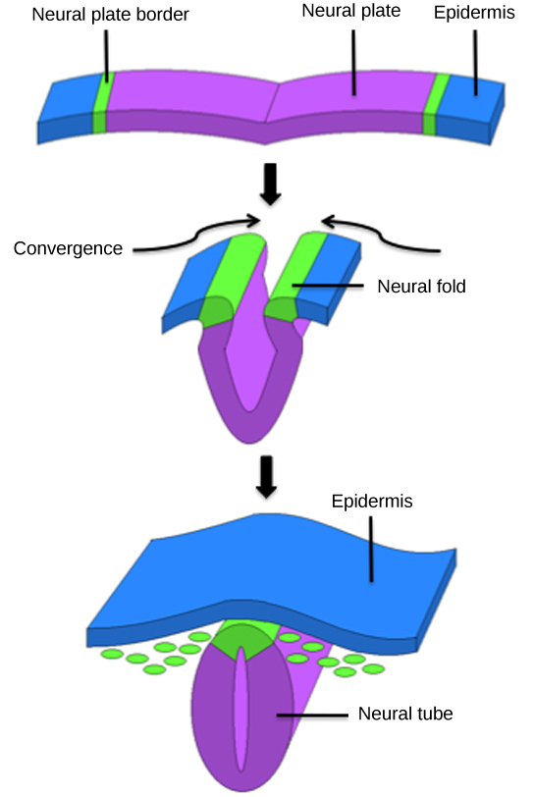
The central region of the ectoderm forms the neural tube, which gives rise to the brain and the spinal cord.

Slide 30
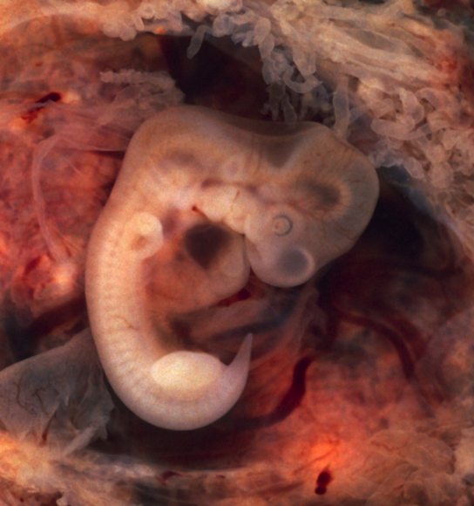
In this five-week old human embryo, somites are segments along the length of the body. (credit: modification of work by Ed Uthman)

Slide 31
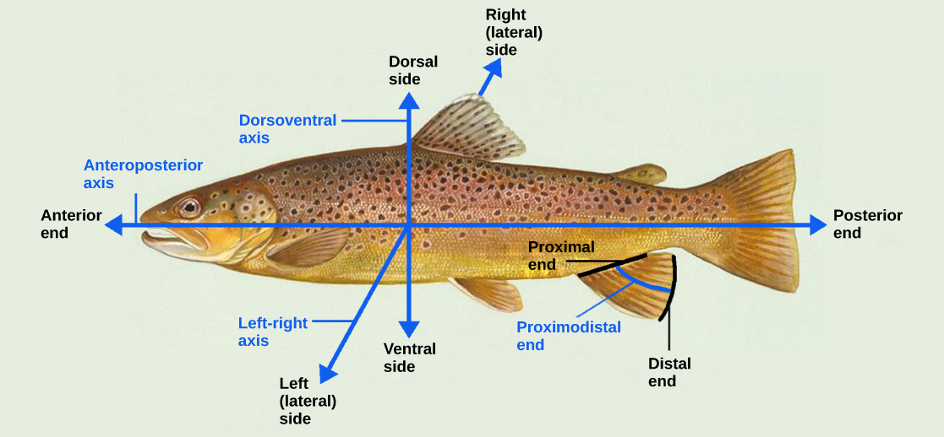
Animal bodies have three axes for symmetry. (credit: modification of work by NOAA)

