Slide 1
Concepts of Biology:
How Cells Obtain Energy

Slide 2
A hummingbird needs energy to maintain prolonged flight. The bird obtains its energy from taking in food and transforming the energy contained in food molecules into forms of energy to power its flight through a series of biochemical reactions. (Credit: modification of work by Cory Zanker)

Slide 3
Life and Energy Transformation
Life is highly ordered.
Life requires energy to maintain order.
ATP is the energy currency.
ATP is the only spendable energy.

Slide 4
Life and Energy Transformation
Photosynthesis reaction, cellular respiration reaction, all life is the interplay of these two organelles: chloroplasts and mitochondria.
Human complexity functions to serve mitochondria — lungs, circulatory system, digestive system.

Slide 5
Life and Energy Transformation
Photosynthesis and cellular respiration are ancient, evolved prokaryotic systems.
Sunlight energizes electrons in sugars — cellular respiration extracts energy from those electrons and puts it in ATP.

Slide 6
Ultimately, most life forms get their energy from the sun. Plants use photosynthesis to capture sunlight, and herbivores eat the plants to obtain energy. Carnivores eat the herbivores, and eventual decomposition of plant and animal material contributes to the nutrient pool.

Slide 7
Catabolic pathways are those that generate energy by breaking down larger molecules. Anabolic pathways are those that require energy to synthesize larger molecules. Both types of pathways are required for maintaining the cell’s energy balance.

Slide 8
Energy
In every reaction, the universe becomes more disordered (entropy).
Life is a temporary battle against entropy.
Living things spend energy to maintain the order necessary for life.

Slide 9
Shown are some examples of energy transferred and transformed from one system to another and from one form to another. The food we consume provides our cells with the energy required to carry out bodily functions, just as light energy provides plants with the means to create the chemical energy they need.
Notes:
(credit “ice cream”: modification of work by D. Sharon Pruitt; credit “kids”: modification of work by Max from Providence; credit “leaf”: modification of work by Cory Zanker)

Slide 10
Still water has potential energy; moving water, such as in a waterfall or a rapidly flowing river, has kinetic energy. (Credit “dam”: modification of work by “Pascal”/Flickr; credit “waterfall”: modification of work by Frank Gualtieri)

Slide 11
Proton gradients in the mitochondrial inner membrane can be compared to water in a hydroelectric dam.
Notes:
(protons are the same things as H⁺)

Slide 12
Shown are some examples of endergonic processes (ones that require energy) and exergonic processes (ones that release energy). (Credit a: modification of work by Natalie Maynor; credit b: modification of work by USDA; credit c: modification of work by Cory Zanker; credit d: modification of work by Harry Malsch)

Slide 13
CONCEPT IN ACTION
Visit the site and select “Pendulum” from the “Work and Energy” menu to see the shifting kinetic and potential energy of a pendulum in motion.
http://webphysics.davidson.edu/physlet_resources/bu_semester1/index.html

Slide 14
Enzymes lower the activation energy of the reaction but do not change the free energy of the reaction.

Slide 15
CONCEPT IN ACTION
View the animation of induced fit.
http://web.chem.ucsb.edu/~molvisual/ABLE/induced_fit/index.html

Slide 16
The induced-fit model is an adjustment to the lock-and-key model and explains how enzymes and substrates undergo dynamic modifications during the transition state to increase the affinity of the substrate for the active site.

Slide 17
Enzymes
Enzymes are proteins.
Tertiary structure allows them to reduce activation energy for their specific substrates.
Notes:
Recall cellulose/starch discrimination by digestive enzymes based on shape (lactose/lactase as examples)

Slide 18
Allosteric inhibition works by indirectly inducing a conformational change to the active site such that the substrate no longer fits. In contrast, in allosteric activation, the activator molecule modifies the shape of the active site to allow a better fit of the substrate.

Slide 19
Have you ever wondered how pharmaceutical drugs are developed? (Credit: Deborah Austin)

Slide 20
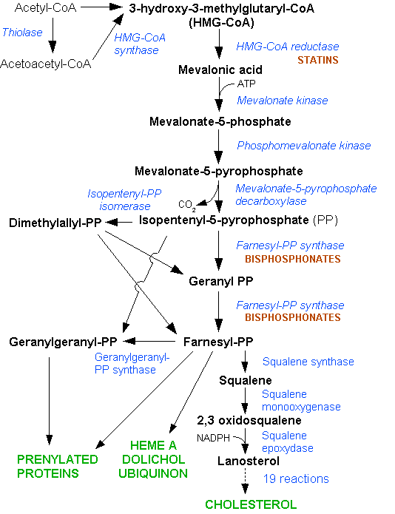
Notes:
Cholesterol biosynthesis pathway – to discuss drugs (like statins) and where cholesterol fits in.

Slide 21
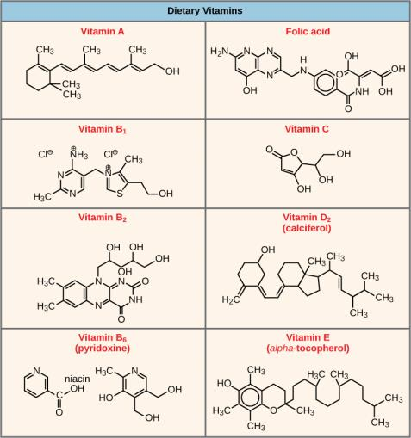
Vitamins and Co-factors
Vitamin B₂ AKA FAD is an electron carrier crucial in ATP synthesis.

Slide 22
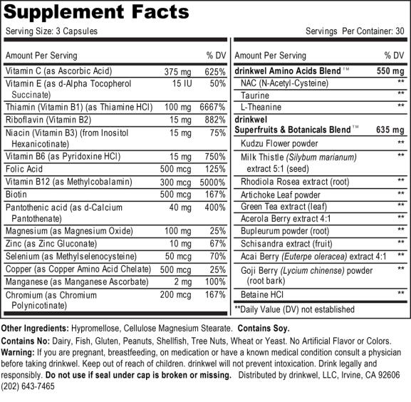
Notes:
Vitamin bottle just to demonstrate some minerals and elements. Vitamins are co-enzymes and some minerals are enzyme co-factors.

Slide 23
Enzyme Inhibition and Activation
We need 20 amino acids.
We can synthesize 9 of them.
A diet rich in those 9 amino acids acts to block their own synthesis by inhibiting enzymes needed in their production.
We have ways to inhibit enzymes in order to prevent wasting energy.

Slide 24
Metabolic pathways are a series of reactions catalyzed by multiple enzymes. Feedback inhibition, where the end product of the pathway inhibits an upstream process, is an important regulatory mechanism in cells.

Slide 25
The structure of ATP shows the basic components of a two-ring adenine, five-carbon ribose, and three phosphate groups.
Notes:
ATP as the spendable energy in cells
Every minute you make and break tens of thousands of ATPs and recycle tens of thousands of NAD⁺s

Slide 26
Electron Carriers
All covalent bonds have shared electrons.
Food has high-energy bonds (made from high-energy electrons) and cellular respiration captures that energy.
Captured electrons are transported by B vitamins NAD⁺ and FAD to the electron transport system.

Slide 27
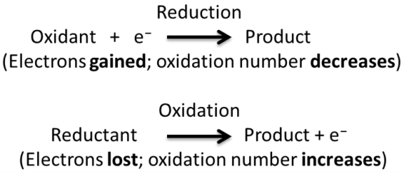
Redox Reactions
Notes:
LEO and GER

Slide 28
Glycolysis — Key Features
Location — cytoplasm.
Input — glucose.
Output — 2 pyruvate.
Anaerobic (does not require oxygen).
2 ATP in.
4 ATP out.
Net 2 ATP.
Net 2 reduced coenzymes (NADH).

Slide 29
In glycolysis, a glucose molecule is converted into two pyruvate molecules.

Slide 30
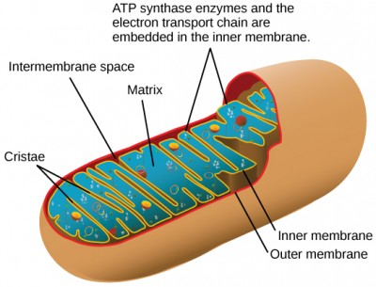
In eukaryotes, oxidative phosphorylation takes place in mitochondria. In prokaryotes, this process takes place in the plasma membrane. (Credit: modification of work by Mariana Ruiz Villareal)

Slide 31
Pyruvate is converted into acetyl-CoA before entering the citric acid cycle.

Slide 32
If oxygen is present, pyruvate is groomed to acetyl CoA .
The first of the eventual 6 CO₂ are released.
Output – acetyl CoA.
2 NADH per glucose (1 per pyruvate).
Acetyl CoA goes to the matrix of the mitochondria.

Slide 33
Citric Acid Cycle
Input — acetyl CoA.
Output — 2 CO₂, reduced coenzymes (3 NADH and 1 FADH₂).
1 ATP.
DOUBLE these numbers for each molecule of glucose.
Requires oxygen.
Location — mitochondrial matrix.
Now the glucose is completely disintegrated.
6 CO₂ are released to our bloodstream and we breathe them out.

Slide 34
Notes:
The electron transport chain is a set of molecules that supports a series of oxidation-reduction reactions.
ATP synthase is a complex, molecular machine that uses an H⁺ gradient to regenerate ATP from ADP.
Chemiosmosis relies on the potential energy provided by the H⁺ gradient across the membrane.

Slide 35
Electron Transport Chain
Here oxygen acts as the magnet for the flow of electrons through the electron transport system.
As electrons flow, protons are dispatched to and trapped in the intermembrane space.
The proton gradient that is created has potential energy like water behind a dam.
A turbine-like ATP synthase captures gradient energy in ATP by chemiosmosis.
Inputs — NADH, FADH_{2.}
Outputs — H₂O, ~ 36 ATP/ glucose total.
34% efficient at capturing energy — 66% leaving as heat.
Location — inner membrane of the mitochondria.
Notes:
Cellular respiration was invented by bacteria and has remained the same for millions of years.
The electron transport chain in yeast is identical in humans.

Slide 36
Mitochondria
It is often helpful to understand how complex things work by seeing how they fail.
For example, cyanide blocks the flow of electrons to oxygen forcing cells to use fermentation.
The lack of ATP could be fatal.
A dangerous diet drug used in the 1920s (dinitrophenol) makes the cristae membrane permeable for protons — with all food energy then lost to heat, users risk fatal overheating.

Slide 37
Anaerobic Respiration (Fermentation)
In the absence of oxygen, pyruvate has a different fate.
The pain you feel on physical overexertion is the buildup of lactic acid caused by a lack of oxygen in your overexerted muscle cells.
Understand that the burning sensation is a signal to stop, rest, and allow your muscles to replenish oxygen.
Some organisms like yeast can survive using anaerobic respiration (the basis of beer and wine-making).

Slide 38
Lactic acid fermentation is common in muscles that have become exhausted by use.

Slide 39
The reaction resulting in alcohol fermentation is shown.

Slide 40
Fermentation of grape juice to make wine produces CO₂ as a byproduct. Fermentation tanks have valves so that pressure inside the tanks can be released.

Slide 41
The green color seen in these coastal waters is from an eruption of hydrogen sulfide. Anaerobic, sulfate-reducing bacteria release hydrogen sulfide gas as they decompose algae in the water. (Credit: NASA image courtesy Jeff Schmaltz, MODIS Land Rapid Response Team at NASA GSFC)

Slide 42
CONCEPT IN ACTION
Visit the site to see anaerobic cellular respiration in action.
https://courses.cit.cornell.edu/biomi290/MOVIES/GLYCOLYSIS.HTML

Slide 43
Glycogen from the liver and muscles, together with fats, can feed into the catabolic pathways for carbohydrates.

Slide 44
Cellular respiration also uses energy from proteins and fats.
Fats have more calories than carbohydrates and proteins, because they have more high-energy chemical bonds, and thus more electrons to feed the electron transport chain.

Slide 45
LTS Activity
http://outreach.letstalkscience.ca/component/zoo/item/diy-activities.html?Itemid=652

