Slide 1
Mastering Strategic Management Chapter 3 Evaluating the External Environment

Slide 2
Learning Objectives
After reading this chapter, you should be able to understand and articulate answers to the following questions:
What is the general environment and why is it important to organizations?
What are the features of Porter’s five forces industry analysis?
Explain how five forces analysis is useful to organizations.
What are strategic groups and how are they useful to evaluating the environment?

Slide 3
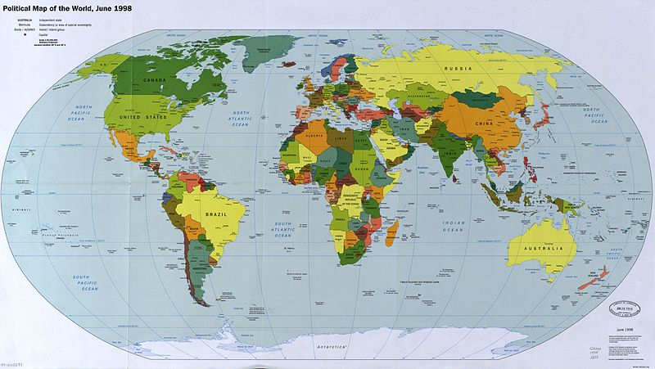
Let’s take a vacation!
Notes:
http://commons.wikimedia.org/wiki/File:Map_of_the_world_1998.jpg

Slide 4
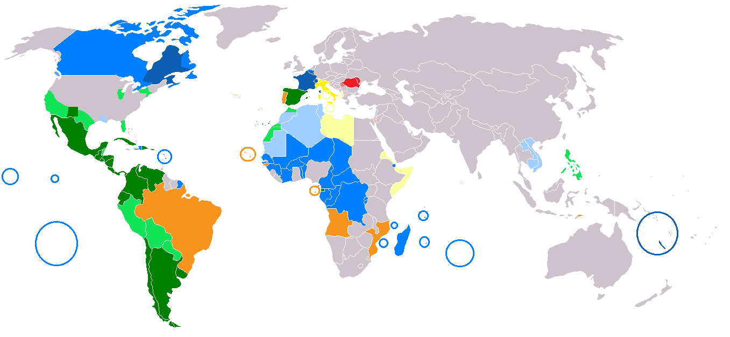
Maybe Somewhere French…
Notes:
http://commons.wikimedia.org/wiki/File:Map-Romance_Language_World.png

Slide 5
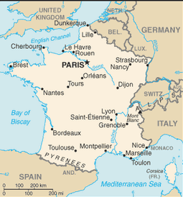
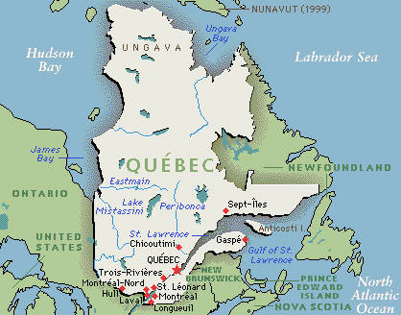
French and maybe some Skiing…
Notes:
http://commons.wikimedia.org/wiki/File:Map_of_the_world_1998.jpg

Slide 6
Discussion
We’re a successful business, why would we possibly care about the external environment (other than keeping our customers happy)?
What factors, in your community, do you think could affect local business? Why?
Next slide for some general ideas…

Slide 7
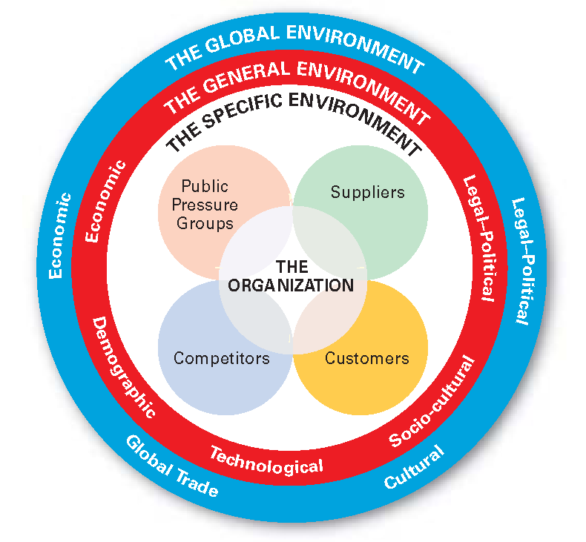
External Environment
Notes:
All three components of the external environment, the specific environment, the general environment and the global environment may have a significant effect on the organization.

Slide 8
Relationship between Org. & Environment
Environment: Set of external conditions and forces that have the potential to influence the organization
General environment (macro-environment): Overall trends & events in a society such as - social trends, technological trends, demographics, and economic conditions
Industry (competitive environment): Consists of multiple orgs that collectively compete with one another by providing similar goods, services, or both

Slide 9
Why Does the Environment Matter?
The environment provides both:
Resources (labour, raw supplies, credit, capital) needed to create goods & services
Demand for products and services
Opportunities: Events and trends that create chances to improve an org’s performance level
Threats: Events and trends that may undermine an organization’s performance
The environment shapes & influences the strategic decisions that executives can choice from as they attempt to lead their organizations to success

Slide 10
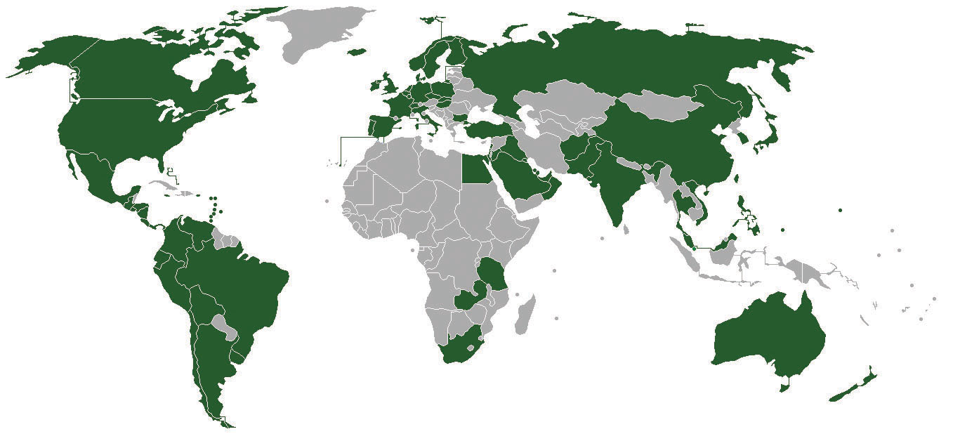
Subway
More stores than MacDonalds. Surprised?
Notes:
Can discuss key difference in Fixed capital or setup costs between Subway sandwich requirements, and all that equipment behind the counter of MacDonalds, and minimum store size (for production, not consumption). Safeway can set up in a shop in a much smaller area.

Slide 11
Discussion
How is external environment contributing to Subway’s success?
Notes:
Jared S. Fogle (born December 1, 1977), also known as the Subway Guy, is a spokesman employed by Subway in its advertising campaigns. He is known for his significant weight loss, now known as the "Subway diet,"[citation needed] attributed to eating Subway sandwiches, which led to his role promoting the company.
http://en.wikipedia.org/wiki/Jared_Fogle

Slide 12
3.1 What Is the Environment?
The set of external conditions and forces that have the potential to influence the organization
Can be divided into general environment (or macro- environment) which includes overall trends and events in society such as social trends, technological trends, demographics, and economic conditions
And, industry (or competitive) environment consisting of multiple organizations that collectively compete with one another by providing similar goods or services

Slide 13
Why does it Matter?
The set of external conditions and forces that have the potential to influence the organization
Can be divided into general environment (or macro- environment) which includes overall trends and events in society such as social trends, technological trends, demographics, and economic conditions
And, industry (or competitive) environment consisting of multiple organizations that collectively compete with one another by providing similar goods or services

Slide 14
Key Takeaways
An organization’s environment is a major consideration. The environment is the source of resources that the organizations needs. It provides opportunities and threats, and it influences the various strategic decisions that executives must make.

Slide 15
3.2 PESTEL Analysis
A analysis technique to organize factors within the general environment & identify how these factors influence industries & firms within them
P – Political
E – Economic
S – Social
T – Technology
E – Environmental
L - Legal

Slide 16
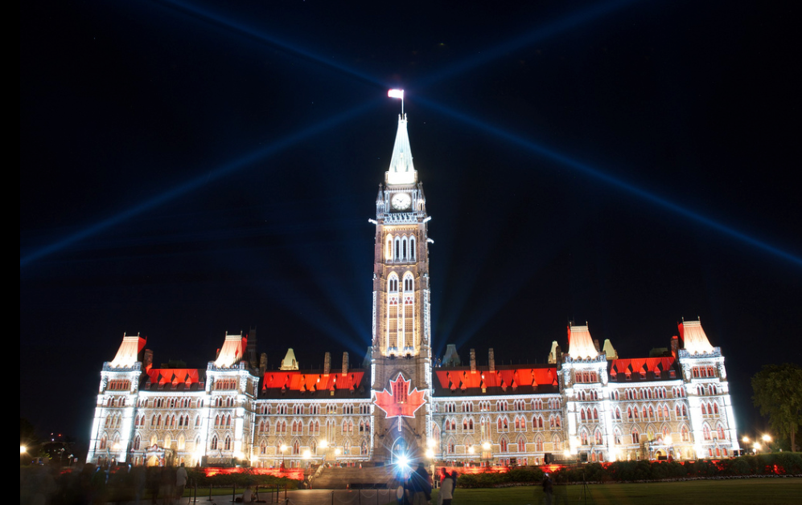
PESTEL Analysis - Political
Centers on role of govts in shaping business.
Includes elements such as tax policies, changes in trade restrictions & tariffs, and the stability of governments
Immigration policy is one aspect that impacts many orgs
Notes:
Source: https://flic.kr/p/aniWCR

Slide 17
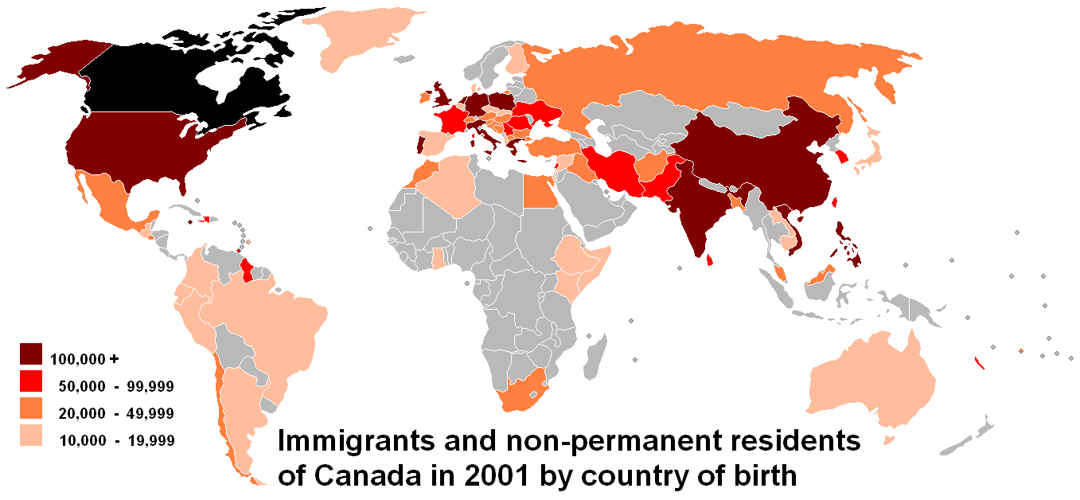
Immigration
Notes:
Canada govt data

Slide 18
PESTEL Analysis - Economic
Includes: interest rates, inflation, GDP, unemployment, disposable income, & overall state of economy
The 2008 economic crash had a tremendous negative global effect, with rising unemployment reduced consumer demand (but Walmart, Dollar Store & PSE boom…)
USA Bank failures led to a dramatic tightening of credit markets around world, including Canada
Similar to Housing Bubble bursting, leads to new Canadian government mortgage restrictions

Slide 19
Social Changes
What social changes have happened since your parents or grandparents were your age?
The important aspect these changes, and any you identified, is that each one creates corporate winners and losers!
Smoking Internet
Declining birth rate McMansions
PSE Marriage
Drinking and Driving Cell phones
Globalization Facebook
Notes:
Trends - demographics such as population size, age, and ethnic mix, as well as cultural trends such as attitudes toward obesity and consumer activism

Slide 20
Women in the Workforce
In WWII (1940), with men away fighting the war, female labour force participation rates suddenly increased, including many traditionally male occupations…
What other things have influenced the number of women working?
Notes:
Image text
Birth control, household labour saving devices, amount of education, social change from “old spinster’ to “single women’, even “Sex in the City”, consumerism – takes two incomes to get the things we want now…
Women’s immense contributions to the war effort during World War II helped create positive social changes in the ensuing decades.

Slide 21
PESTEL Analysis - Technology
Technological segment centers on improvements in products and services that are provided by science.
Relevant factors include, for example, changes in the rate of new product development, increases in automation, and advancements in service industry delivery
From a computer on the desktop to a computer in your pocket (& connected to internet 24/7)
Future technological changes will probably focus on greater integration of computer with human body, and by intellegent computers, decision making under complex situations (i.e. driving, cancer detection)

Slide 22
Non-Computer Technology
While computer / internet technology are probably most obvious to us in our day-to-day lives, technology and technological change is everywhere!
Robotics
Energy (solar, wind, LNG fracking, nuclear)
Dramatically improved car gas mileage (k/100k) & safety
Sensors – tracking, store shelves, active bar codes
Cameras – from Photoshop to security
Even, automatic vacuum cleaners
Notes:
Where did I leave the darn car…. IPhone to the rescue!!

Slide 23
PESTEL – Environment
Notes:
Changing public perspectives, changing rules….
Source NASA

Slide 24
Environment
The environmental segment involves the physical characteristics & conditions within org operates
Includes factors such as natural disasters, pollution levels, and weather patterns (i.e. bottled water example)
Increased social awareness, community activism
Long term verses short term orientation
Environmental reviews, & Social License to Operate
Costs of pollution, garbage disposal (zoo poop)
Reduce, Reuse, Recycle

Slide 25
Business Op?
Notes:
Source: https://flic.kr/p/6uVXmh

Slide 26
PESTEL Analysis - Legal
The legal segment centers on how the laws, regulations & courts influence business activity
Examples include employment laws, health & safety regulations, discrimination & antitrust laws
Intellectual property rights are a particularly daunting aspect of the legal segment for many org
Arguably equally important to the laws themselves, are the potential for change / degree of stability

Slide 27
North Pole Inc.
What are the PESTEL (Political, Economic, Social, Technological, Environment, & Legal) that might affect Santa over the next 3 to 5 years?
Notes:
http://www.premierlife.ca/humour/what's-wrong-with-santa-claus/attachment/santa_-reindeer/

Slide 28
Key Takeaways
PESTEL reflects the general environment factors—political, economic, social, technological, environmental, and legal—that can crush an organization.
In many cases, executives can prevent such outcomes by performing a PESTEL analysis to diagnose where in the general environment important opportunities and threats might arise

Slide 29
For teaching in two 90-minute classes/wk, possible break point

Slide 30
Demographics and You!

Slide 31
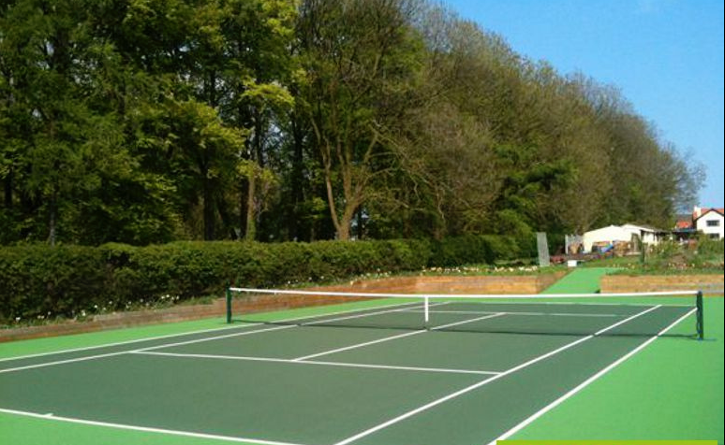
Tennis Clubs & Other Unexpected Changes
In the early 1980s, Tennis clubs were booming!
Now, Tennis clubs are struggling
Why?
Notes:
https://flic.kr/p/bXPwpG

Slide 32
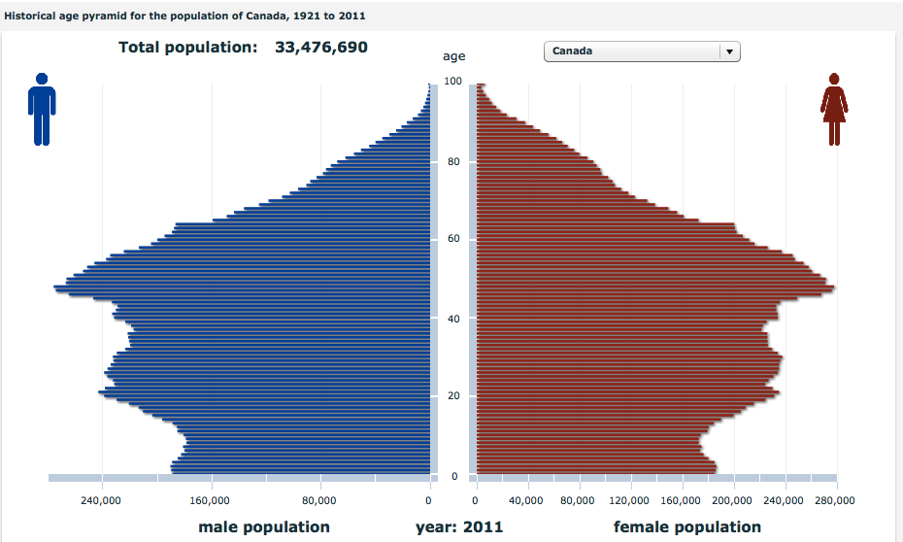
Canada - Those Baby-Boomers… Load - http://www12.statcan.gc.ca/census-recensement/2011/dp-pd/pyramid-pyramide/his/index-eng.cfm
Notes:
Source Stat Can (above)

Slide 33
Demographics, so What?
What would happen if 20% of your local population left (moved away)?
What would the impact be on local jobs, education, services, etc.?
Local labour Force - finding jobs, finding employees
Education
Goods – both buying and selling
Housing prices
Health Care
Culture
New businesses, investment opportunities
Relative importance within province or region

Slide 34
Demographics
It turns out that demographics are an excellent predictors of many things, including:
Income
Marital status
Crime
Health (food)
Fertility
And Canada has 3 significant demographic trends underway right now
Aging baby boomers
Falling birth rates
Urbanization

Slide 35
Your Economic Life in 1 Slide!!
DEBT SAVINGS
INCOME
EXPENSES
Kids ->
House ->
Car ->
Pay-off Loans ->
Payoff Mortgage ->
Kids finish PS ->
Apt ->
Good Pension
Graduate!
Bad Pension
0 10 20 30 40 50 60 70 80
AGE

Slide 36
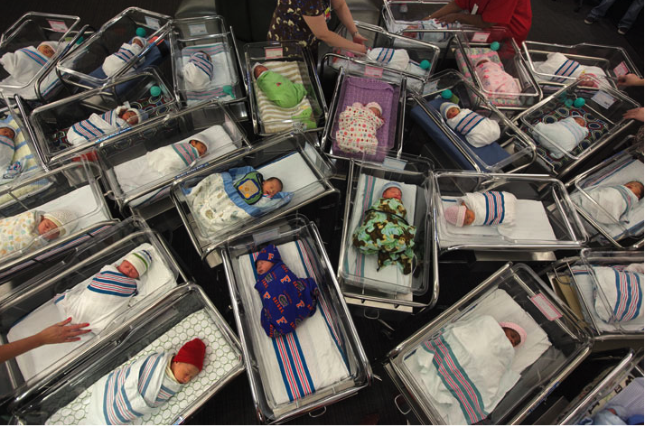
Seeing this Less Often?

Slide 37
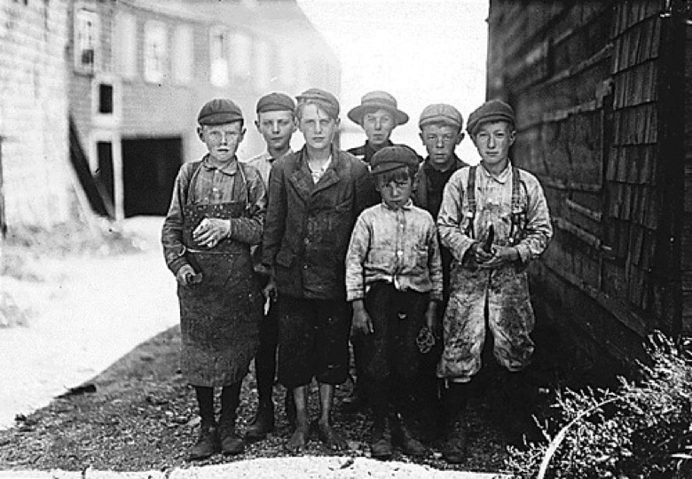
From, Children as Economic Asset (Maine USA Fishing Plant)
Then
Most died (est. 7/10) & birthing was often fatal
Little helping hands ASAP (farming…)
Urbanization & factories at 6 yr.
Retirement plan (if you lived past 40)
Notes:
USA govt Archives

Slide 38
Now, Children as an Economic Liability
Most live 99%
Expensive to raise, now that mom’s not home…
Temporary loss of ‘Moms’ income & career impact on Mom
17-22 years of education before production years start, & limited ROI (unlike history)
High expectations (Toys Unlimited)!!
Notes:
My photo – Xmas at disneyworld

Slide 39
Demographics & Birthrate
If 2.1 children per couple are the sustainable birthrate (for obvious reasons!), what does Canada’s birthrate of 1.67 children per couple mean?
Just for comparison, a birth rate of 1.3 reduces the countries working population by one-third (33%) every generation (35 years)
Spain is 1.4, Italy 1.2, Russia 1.2….
What impact on these cultures?

Slide 40
Why are Birth Rates Falling
Cultural norms
Social change in role of females - home/babies to jobs [100% to 10%]
Birth Control = have children when you want
Female education = greater opportunities, & Op costs
Starting later (marriage & children)
Female self-sufficient
Higher expectations / costs of Kids today

Slide 41
I know, Immigration will solve our Problem…
Notes:
Canada’s long history as a desirable immigration nation will save us from our labour shortages… (far from certain)
Source - https://flic.kr/p/eZ28Uu

Slide 42
Not Just Canada, Global Birthrates
History: 1750-1850-1B, 1950-85-3B, 85-2000-6B
Why? (infant mortality, Life exp.)
How? (Better health care public & primary, new medicines, more food)
International Birth Rates…..
44 most advanced countries 1.6
Middle tier 2.9
Developing 5.0

Slide 43
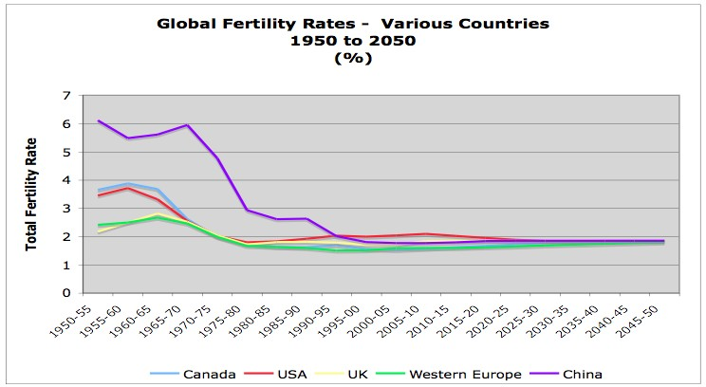
I know, Immigration will Solve our Problem… Source: http://esa.un.org/unpp/
Canadian rate - 1.67 babies per couple…
[2.1 is replacement level]
So for every 100 of us - working adults in Northern BC - there will only be 75 to take our places
Replacement Rate

Slide 44
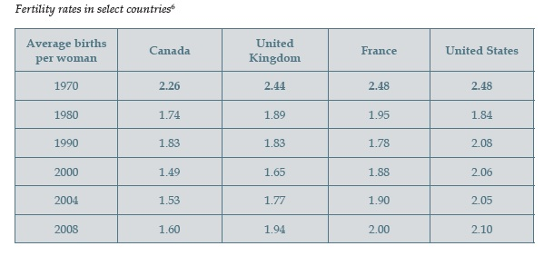
Fertility Rates, Selected Countries

Slide 45
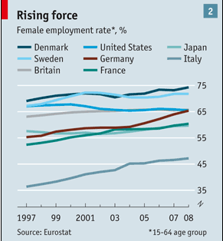
Female Labour Force Participation Rates
Notes:
Source – The Economist jan 2, 10
Female Power

Slide 46
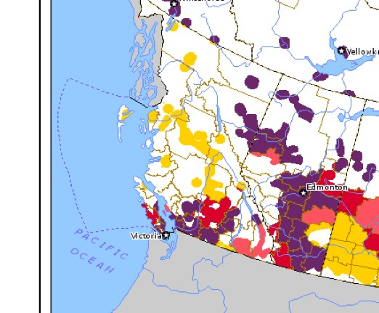
Urbanization - BC Pop. change (2001 to 2006)
More than -3%
-3.0% to -0.1%
0% to +3.0%
Greater than +3%
[WHITE – Sparse pop.]
Notes:
BC prov Govt data

Slide 47
ME!
In 1956, a newborn could expect to live just over 70 years
But a child born today can expect to live for just over 80 years.
What does this mean for business?

Slide 48
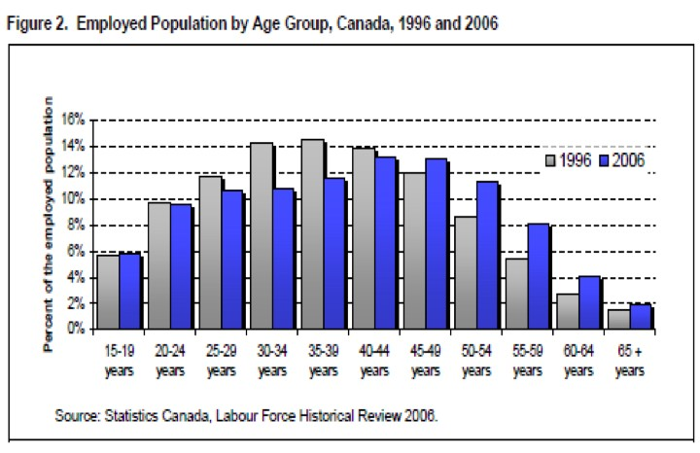
Who Works?
Notes:
The impacts of the aging population

Slide 49
First Nations Demographics
In 2000, the First Nations birth rate was 23.4 births per 1,000 population -- more than twice the Canadian rate
Per couple, FN birthrate was 2.6 per couple verses 1.67 for all Canadians
As a result, by 2017, Aboriginal people aged 20 to 29 could make up 30% of those in their 20s in Saskatchewan; 24% in Manitoba
In three urban areas, more than half of the Aboriginal population was aged 24 and under: Regina (56%), Saskatoon (55%), and Prince Albert (56%) – [Prime childbearing years]
Terrace has ~30% FN/aboriginal population, with a birthrate double the non-aboriginal population…

Slide 50
Demographics & Business
Good Ideas
Health
Luxury items
Anything for the Grandkids!
Old Age Homes
IT and Seniors
Discretionary Spending
Convenience
Passive Sports (golf)
Less Good Ideas
Funeral Home (not yet, but in 20 years….)
Children (parents buying)
Fun, but Dangerous
Physical or difficult to access (sports cars)
Active Sports (hockey)

Slide 51
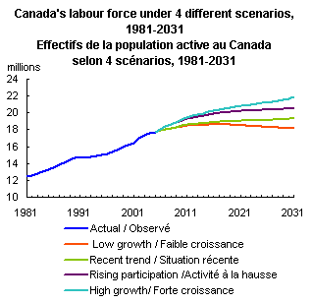
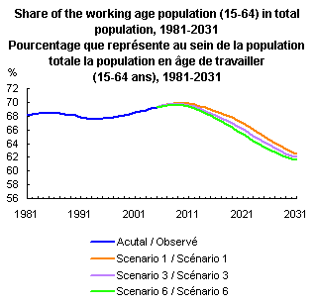
Labour Force predictions - 2031
Notes:
Stat Can data

Slide 52
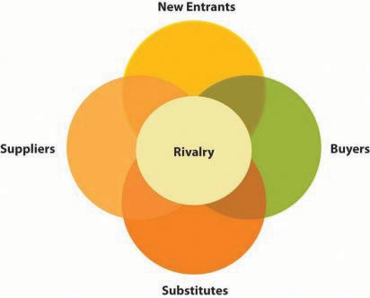
3.3 Porter’s Five Forces Analysis

Slide 53
Five Forces Analysis
Five forces analysis: Technique for understanding an industry, by examining the interactions among:
Competitors in an industry
Potential new entrants to the industry
Substitutes for the industry’s offerings
Suppliers to the industry
Industry’s buyers
Purpose of the analysis is to identify how much profit potential exists in an industry

Slide 54
Porter’s Five Forces Model of Industry Competition
Threat of
new entrants
Bargaining power of suppliers
Bargaining power of buyers
Threat of Substitute products & services

Slide 55
Why is degree of Rivalry Important?
Degree of rivalry helps shape industry’s profit potential
When competition highest, prices wars often occur
In general, rivalry higher when:
growth rate of demand low, lack of new customers forces more comp. for existing customers
fixed costs high (firms fight for enough customers to cover these costs), although high costs tend to reduce (new) competition too…
competitors are not differentiated (forces firms to compete on price rather than product uniqueness)
exit barriers high (because firms do not have the option of leaving the industry gracefully)

Slide 56
Why is degree of Rivalry Important? (con’t)
Rivalry higher (con’t)
Excess capacity exists (global car manufactures)
Capacity must be expanded in large increments to be efficient (hydro)
Product is perishable (food, airplane seats)

Slide 57
Low Rivalry?
Low Rivalry more likely when:
economies of scale (because new entrants struggle to match incumbents’ prices)
capital requirements to enter are high (because new entrants struggle to gather enough cash to get started),
access to distribution channels is limited (because new entrants struggle to get their offerings to customers),
governmental policy discourages new entry, differentiation among existing competitors is high (because each incumbent has loyal customers that enjoy its unique features),
switching costs are high (because this discourages customers from trying new offerings)

Slide 58
Why don’t Hydro companies have more competition?
Notes:
Huge fixed costs!
https://flic.kr/p/9G4bff

Slide 59
New Entrants
How easy can new companies enter the industry?
Deep industry knowledge, including innovation potential
Govt laws & regulation, permits
Intellectual Property / manufacturing process
Relative portion of fixed costs (higher is harder to enter)
Access to suppliers of raw goods/production inputs
Experience, including attracting experienced staff
Quality Control
Brand / Consumer or buyer awareness
And, deep $$ pockets to survive a price war!

Slide 60
Porter’s Five Forces Substitutes
In addition to new competitors, who often engage in prices wars when entering the industry, new substitutes are another potential source of industry disruption
Substitutes are offerings that differ from the goods and services provided by the competitors in an industry but that fill similar consumer needs
Executives need to be constantly aware of other consumer possibilities, and especially changes or trends in these potential / partial competition industries

Slide 61
Technology Change
New technologies are constantly discovered that tend to lower costs, or increase features/quality
Consider what modern smart phones have done to industries such as GPS device manufacturers…
Innovation can
Incremental product improvement, Improved quality or functionality, or better service a sub-section of market
Brand new (pretty rare…)
Internal - Improved production, process, components, reliability, even innovative marketing!
Innovation may temporarily increase profits, attracting new competition. However, more firms increase industry capacity and reduce prices

Slide 62
Porter’s Five Forces Suppliers
Who’s got more (relative) power, Suppliers or Manufacturers?
If suppliers, then prices of supplies may increase over time, & vice-versa
Vertical integration possible response, even for electricity!
Notes:
CC - https://flic.kr/p/6ShWkL
Vertical integration at home

Slide 63
Porter’s Five Forces Suppliers
Supplier are Powerful when
Relatively few suppliers in industry
Goods/Services relatively unique (not easy to substitute)
Supplier has significant cost advantage (transportation costs, high fixed costs, brand, quality, history, etc.)
High Buyer switching costs in changing vendor (sunk costs)
Low threat of backwards or vertical integration by buyers
Central or very important to buyer end goals/product

Slide 64
Porter’s Five Forces Competition & Buyers
Notes:
Ford and Hertz

Slide 65
Porter’s Five Forces Buyers
Buyers (Consumers) are Powerful when
Relatively few buyers (Monopsony – 1 buyer)
Goods/Services homogeneous (hard to distinguish between)
No or low cost changing vendor, including search costs
Purchase represents large volume, expensive, or a high percentage of buyer’s costs, encouraging ongoing searches for lower-price suppliers
Credible threat of backwards integration if motivated
Of limited important to overall quality or price of buyer’s offering

Slide 66
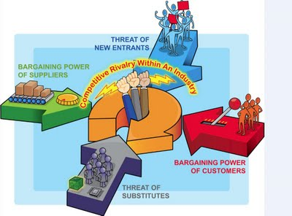
Porter’s 5 Forces & MacDonalds
Notes:
Source http://20110036nd.blogspot.ca/2011/08/week-2-information-systems-in-business.html

Slide 67
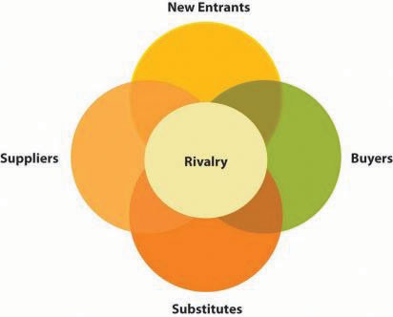
Porter’s Five Forces Limitations
Implicit assumption that competition is a zero sum game - amount of profit potential in an industry is fixed
But economies of scope, partnerships and collaboration have all achieves significant industry-wide improvements, far beyond zero-sum
Innovation also has potential for disruption, both positive and negative

Slide 68
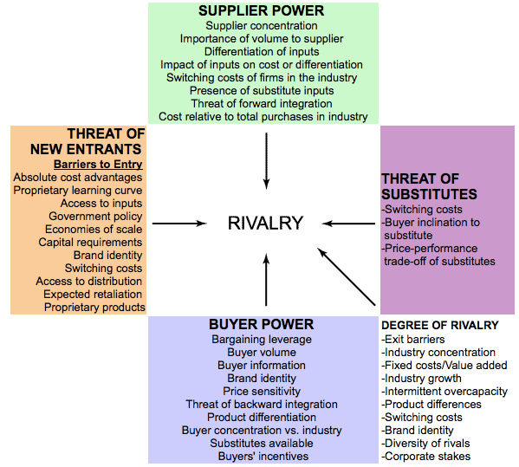

Slide 69
Key Takeaways
“How much profit potential exists in our industry?” is a key question for executives. Five forces analysis provides an answer to this question. It does this by considering the interactions among the competitors in an industry, potential new entrants to the industry, substitutes for the industry’s offerings, suppliers to the industry, and the industry’s buyers.

Slide 70
3.4 Mapping Strategic Groups
Strategic groups: Consist of a set of industry competitors, that have similar characteristics to each other but differ in important ways from the members of other groups
Narrows the focus by centering on subsets of the competitors, whose strategies are similar to each other
The analysis of the strategic groups in an industry can offer important insights to executives
Closest rivals
Alternative paths to success
Untapped opportunities

Slide 71
WHY map Strategic Groups?
First, members of a firm’s group is helpful because these firms are usually its closest rivals.
When assessing their firm’s performance and considering strategic moves, competitors often best referents
Second, strategies pursued by firms within other strategic groups highlight alternative paths to success.
Third, analysis of strategic groups can reveal gaps in the industry that may represent untapped opportunities

Slide 72
Key Takeaways
Examination of the strategic groups in an industry provides a firm’s executives with a better understanding of their closest rivals, reveals alternative paths to success, and highlights untapped opportunities.

Slide 73
Five Forces Analysis
Five forces analysis: Technique for understanding an industry, by examining the interactions among:
Competitors in an industry
Potential new entrants to the industry
Substitutes for the industry’s offerings
Suppliers to the industry
Industry’s buyers
Purpose of the analysis is to identify how much profit potential exists in an industry

