Slide 1
Mastering Strategic Management
Chapter 5
Selecting Business-Level Strategies

Slide 2

SWOT – Your Public Library
Notes:
My photo – Terrace Public Library

Slide 3
Learning Objectives
Understanding the four main generic strategies, and their limitation
Advantages & disadvantages of a cost leadership or best-cost strategy, & economies of scale
Differentiation, focussing on a target market
Describe the nature of focused cost leadership and focused differentiation
Combining – A Best-Cost Strategy
What does it mean to be ‘Stuck in the middle’?

Slide 4
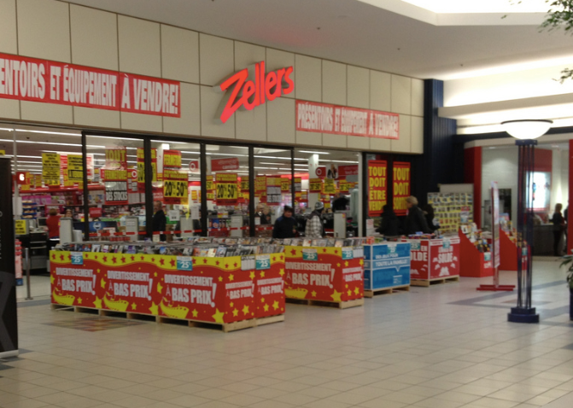
Made-to-Measure
Suit Sale!!
Notes:
Source: https://flic.kr/p/dB2cZ4

Slide 5

Is understanding your Strategy really important?
“Would you tell me, please,
which way I ought to go from
here?” said Alice.
“That depends a good deal on
where you want to get to,” said
the Cheshire cat.
“I don’t much care care where…”
said Alice.
‘Then it doesn’t matter which
way you go,” said the cat.
- Lewis Carroll’s Alice in Wonderland
Notes:
Image - http://openclipart.org/people/frankes/alice_cheshire_cat.svg

Slide 6
5.1 Generic Strategies
A general way of positioning a firm’s business level strategy within an industry
Focusing on generic strategies allows executives to concentrate on the core elements of firms’ business-level strategies
Builds on the strategic resources available to the firm
The most popular set of generic strategies is based on the work of Professor Michael Porter HBR

Slide 7
Strategies
Strategy - a road map of the actions an entrepreneur draws up to achieve a company’s mission, goals, and objectives. It is the company’s game plan for gaining a competitive advantage.
Three basic strategies:
Cost leadership
Strategy?
Differentiation
Focus

Slide 8
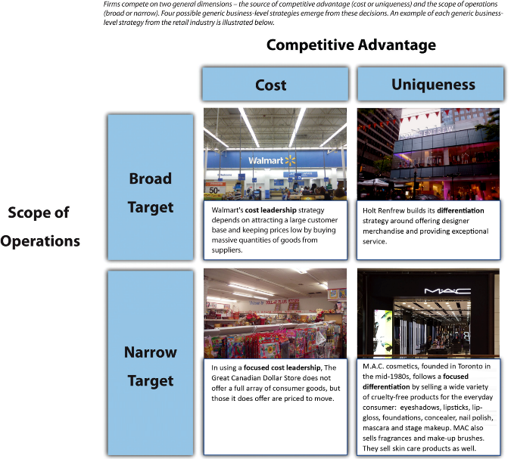

Slide 9

Beer Strategies…
Notes:
Photo http://en.wikipedia.org/wiki/Beverage_can

Slide 10

Generic Bus Strategies
Two competitive dimensions are key:
Source of competitive advantage
  keep costs down or
  offer something unique in market
Scope of operations
  target all possible customers or
  focus on a smaller segment or
  sub-section of market
Notes:
Top photo - http://openclipart.org/detail/150223/a-target-with-a-dart-by-rg1024
Bottom photo - http://pche121.wordpress.com/2011/01/27/porters-generic-strategies/

Slide 11
Economics In Action
What is your favorite restaurant?
What’s their strategy? cost leadership or niche
Effective strategy must offers low prices, provides satisfactory quality, & attract enough customers to be profitable.
Notes:
Ask – Are they successful at their strategy (hopefully yes, if it is their favorite!!)

Slide 12
Key Takeaways
Business-level strategies examine how firms compete in a given industry
Generic strategies based on source of competitive advantage - price or differentiation, &
Scope of operations targets a broad or narrow market

Slide 13
Section 5.2 Cost Leadership

Slide 14
Cost Leadership
Cost leadership: Generic strategy that offers products or services with acceptable quality and features to a broad set of customers at a low price
Economies of scale: Exists when the costs of offering goods and services decreases as the firm is able to sell more items
  Expenses are distributed across a greater number of items

Slide 15
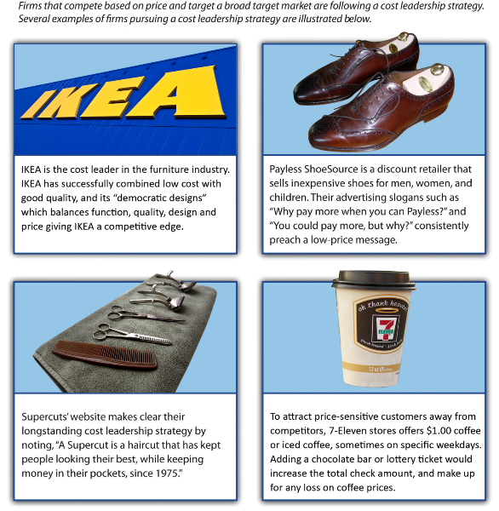

Slide 16
From Theory to Reality (Porter)
Cost Leadership
Become the low cost producer in its industry
Sources of cost advantage are varied and depend on the structure of the industry, may include pursuit of economies of scale, proprietary technology, preferential access to raw materials and other factors
Low cost producer must find and exploit all sources of cost advantage to achieve and sustain overall cost leadership
Leads to above average performance in its industry
Assuming can set prices at or near industry average

Slide 17
Overall Cost Leadership
Integrated tactics
Aggressive construction of efficient-scale facilities
Vigorous pursuit of cost reductions from experience
Tight cost and overhead control
Avoidance of marginal customer accounts
Cost minimization in all activities in the firm’s value chain, such as R&D, service, sales force, and advertising

Slide 18
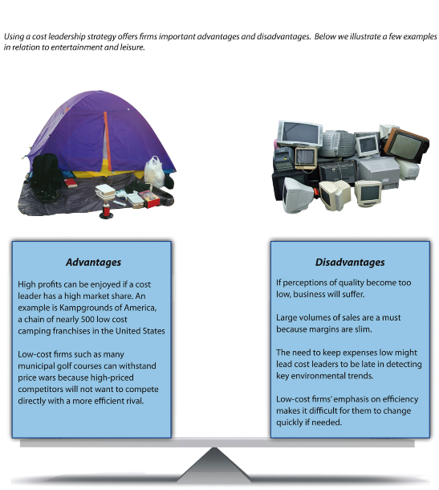

Slide 19
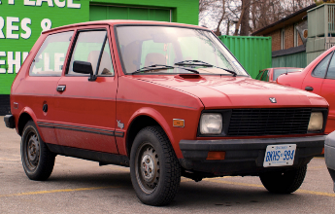
Cost Leadership gone bad - Remembering the Yugo…
How do you make a Yugo go faster? A towtruck
What do you call a Yugo’s shock absorbers? Passengers
How can you get a Yugo to do 60 miles an hour? Push it over a cliff
The new Yugo has an air bag. When you sense an impending accident, start pumping real fast.
A friend went to a dealer the other day
and said, "I'd like a gas cap for my
Yugo." The dealer replied, "Okay.
Sounds like a fair trade.”
Two guys in a Yugo were arrested last
night in Oakland following a push-by
shooting incident
Notes:
https://www.flickr.com/photos/brucewood/369426089/in/photolist-yDmVi-6hJts-yDpvk-4X7JFd-9HPeXx-9HPf5a-cTAWbE-yJQVi-yJTgT-4hzt16-Ujycq-9rnZYt-4X3SeF-yJTLk-dCn1sn-6WU8GX-5BrhPr-t1N9d-bRg1bv-6PmbFK-6rgaD5-b37jjT-fhD5zf/

Slide 20
Cost Leadership & Economics
Economics tells use cost leadership less effective when
Small percentage of consumer’s overall budget (salt)
Low volume of purchases (i.e. PSE)
Few alternatives (gasoline)
Higher search costs

Slide 21

You (generally) get what you pay for!!
Notes:
Photo: Image URI: http://mrg.bz/RvhkDR

Slide 22
Economics In Action
Think of three industries where a cost leadership strategy would be very difficult to develop or implement
agriculture, arms industry, and nuclear industry.
Notes:
Poster - textbook

Slide 23
Key Takeaways
Cost leadership is an effective business-level strategy to the extent that a firm offers low prices, provides satisfactory quality, and attracts enough customers to be profitable.

Slide 24
Section 5.3 Differentiation

Slide 25
Differentiation
Differentiation strategy: A generic strategy that attempts to convince customers to pay a premium price for its good or services by providing unique and desirable features
Using a differentiation strategy firm compete based on uniqueness, rather than price (only)
Success depends on offering unique features that CUSTOMERS value!
and communicating this enhanced value to the potential customers
Notes:
legal decrees that protect inventions from direct imitation for a limited period of time
(Figure 4.6). Obtaining a patent involves navigating a challenging process. To earn a patent from the
US Patent and Trademark Office, an inventor must demonstrate than an invention is new, nonobvious,
and useful. If the owner of a patent believes that a company or person has infringed on the patent, the
owner can sue for damages.

Slide 26
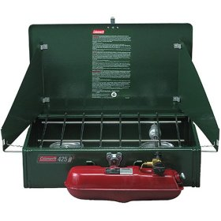
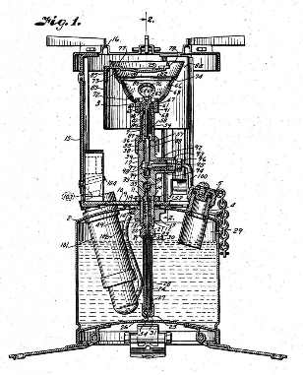
Colman Stove
Differentiation strategy:
7 Decades, same basic design!
Higher quality, & higher price
Value includes reduced risk of
failure… (1 moving part!)
Part branding/marketing
Notes:
Drawing – from Text
Colman store photo – company website http://www.colemancanada.ca/Products/0903/liquid-fuel

Slide 27
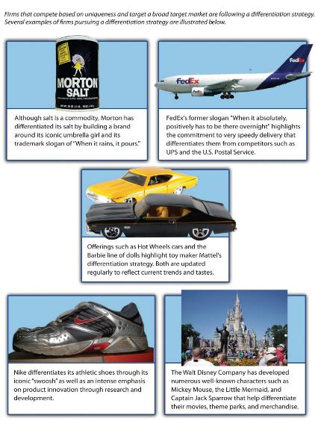
Differentiation
Seeks to be unique in its industry along some dimension(s) that are widely valued by buyers
Typically, firm identify & improves this aspect of product & Markets and sells at a price premium

Slide 28
Differentiation
Differentiation can take many forms
Prestige/brand
Quality
Technology
Innovation
Features
Customer service
Dealer network
BMW, Roots, Holt Renfrew
Toyota, President’s Choice
Martin Guitars, North Face camping
Medtronic (medical) 3M, Cirque Soleil
Honda Mountain Equipment Coop
Nordstrom, Four Season hotel
Lexus Caterpillar, Canadian Tire

Slide 29

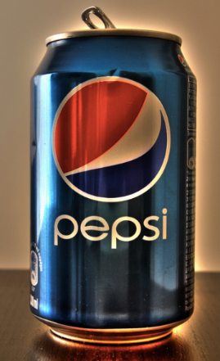
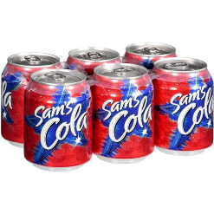
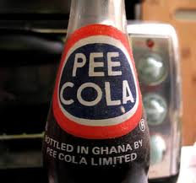
Missed Opportunity!!
Notes:
Photos left to right
https://flic.kr/p/poJmy
https://flic.kr/p/8eXHNg
http://www.walmart.com/ip/Sam-s-Cola-Soda-6-pk/10794687
http://www.k-international.com/blog/international-food-packs-fail/

Slide 30

Tilley – A Canadian Success Story
Adventurer clothing
Hats sold by 2,000+ retailers around the world, & 1,500 USA retailers
Notes:
Photo Tiley company website - http://www.tilley.com/us_en/ltm2-airflor.html

Slide 31
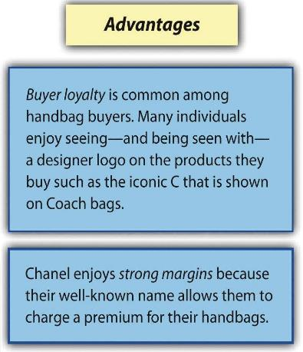
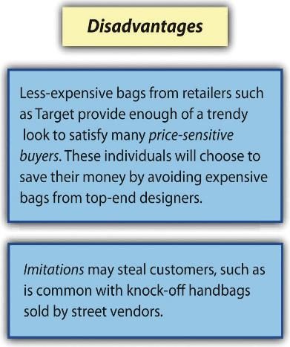
Differentiation

Slide 32
Potential Pitfalls of Differentiation Strategies
Uniqueness/differentiation that add little valuable
Too much differentiation
Too high a price premium
Differentiation that is easily imitated
Dilution of brand identification through product-line extensions, especially reduced price extensions of brands (i.e. levis jeans at Walmart)
Failing to focus on Buyers perceptions of value (not the sellers)
  Feature creep (too complex)

Slide 33
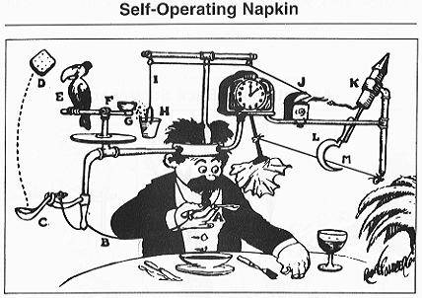
Notes:
Gotta be more than Different!!
Source http://commons.wikimedia.org/wiki/File:Professor_Lucifer_Butts.gif

Slide 34
The Internet
How has the arrival of the Internet created many new low-cost options?
How has it changed the low-cost game?

Slide 35
Key Takeaways
Differentiation can be an effective business-level strategy to the extent that a firm offers unique features that convince customers to pay a premium for their goods and services.

Slide 36
For teaching in two 90-minute classes/wk, possible break point

Slide 37
Section 5.4
Focused Cost Leadership &
Focused Differentiation

Slide 38
Focused Cost Leadership and Focused Differentiation
Focus strategies: The generic focus strategy rests on competing (only) within a sub-section of the potential buyers instead of across all consumers within an industry.
Firms select a target population in the industry and tailors its strategy to serving them to the (possible) exclusion of others
  Focused cost leadership: competing based on price, but only within a narrow market
  Focused differentiation: offering unique features that fulfill the demands of a sub-group of consumers

Slide 39

Focussed Cost Leadership
Not cheapest everywhere, just cheapest here…
Notes:
Source: Google map screen capture

Slide 40
Focused Cost Leadership
Firms that charge relatively low prices for a sub-group of the overall marketplace. Could be based on geography, demographics, channel (internet only) or features
Difficult to execute - Creating unique features and communicating to customers why these features are useful generally raises a firm’s costs of doing business
Similar to overall Cost Leadership lower overhead costs and economies of scale useful
Depending on niche, may be open to duplication by competitors

Slide 41
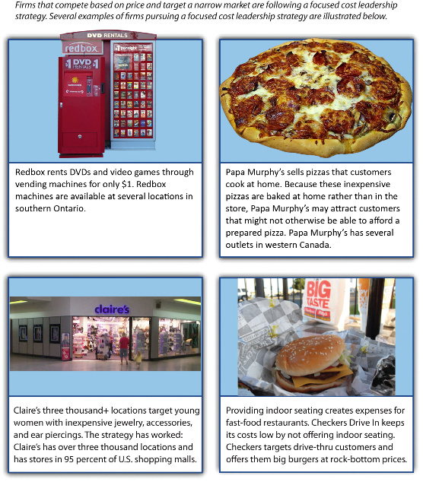

Slide 42
Focused Cost Leadership
Could be based on:
Demographics (young women)
Geographic (small communities)
Service (Drive through, no seating)
Degree of Consumer involvement (Ikea self-assembly)
Sales Channels (Home purchase – Avon, Mary Kay)
Price level marketing (Dollar Stores)

Slide 43
(For clarity), Generic vrs Focused Cost Leadership
Key difference between overall Cost Leadership & Focused Cost Leadership is that while both groups use price as primary source of competitive advantage,
Focused cost leadership strategy requires competing based on price only within a narrow or limited marketplace
  A firm following this strategy does not necessarily charge the lowest prices in industry
  Instead, it charges low prices relative to the other firms that compete within narrow target market
  Nature /size of target market varies across market segment targeted

Slide 44
Focused Differentiation Leadership
Focused differentiation strategy requires offering unique features that fulfill demands of a narrow market
While a differentiation strategy involves offering unique features that appeal to a variety of customers, the need to satisfy the desires of a narrow market means that the pursuit of uniqueness is often take to the proverbial “next level” by firms using a focused differentiation strategy.
The unique features provided by firms following a focused differentiation strategy are often very specialized

Slide 45
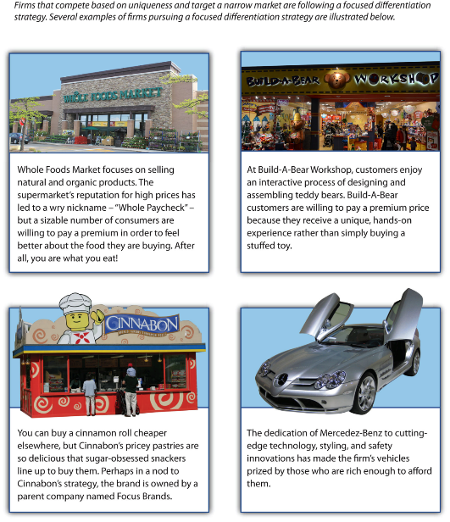

Slide 46
Focused Differentiation Leadership
Could be based on:
Higher quality product/service
Extensive R&D
Demographics (late middle age men)
Geographic (‘warm’ retirement communities)
Buying experience (Financial Services, Cadillac)
Degree of Consumer Sophistication (high end stereo)
After-sales support (Nordstrom's, HOG)

Slide 47
Focused Differentiation Strategies
Advantages:
  Higher prices can be charged
  Firms often develop tremendous expertise about niche products (camping gear), & reputation (MEC)
Disadvantages:
  Limited demand available within niche may limit growth
  Once its target market is being well served, expansion may require developing new skills / products / markets
  Niche could disappear or be taken over by competitors
  Damaging attacks may come not only from larger firms but smaller ones that adopt an even narrower focus

Slide 48


Lights!
You are selling lights. What are 3 different demographics that firms might target to establish a focused strategy?
Now, think of 3 different target or niche markets that your firm could focus on that use lights (i.e. airport landing strips)
Notes:
Top: https://flic.kr/p/fyACEX
Bottom: http://www.deviantart.com/art/Light-Fixture-stock-3-212936444

Slide 49
Worth Noting…
No business level strategy can overcome a product or service which is poorly designed FOR THE MARKET IT WISHES TO SERVE or COMPETE IN…..
Can include over developed for low-cost market…
Poorly thought out niches; too broad, too narrow
Value that consumer do not appreciate (with $$)
Poor value proposition for consumers

Slide 50
Key Takeaways
Focus strategies can be effective business-level strategies to the extent that a firm can match their goods and services to specific niche markets

Slide 51
Section 5.5
Best-Cost Strategy

Slide 52
Best-Cost Strategy
A best-cost strategy can be an effective business level strategy to the extent that a firm offers differentiated goods and services at relatively low prices.
This strategy difficult to execute in part because creating unique features and communicating to customers why these features are useful generally raises a firm’s costs of doing business.
Firms that manage to implement an effective best-cost strategy are often very successful!

Slide 53
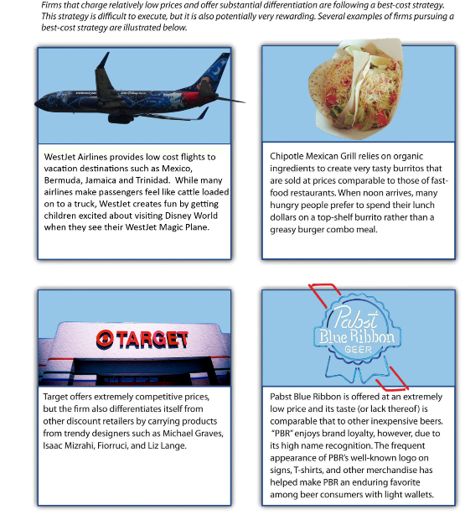

Slide 54

Stuck in the Middle
A situation where business level strategy
  does not offer features that are unique enough to motivate consumers
  And, prices are too high to effectively compete on price
Usually, firms become stuck in the middle not because they lack a well-defined strategy But because firms are simply outmaneuvered by rivals

Slide 55
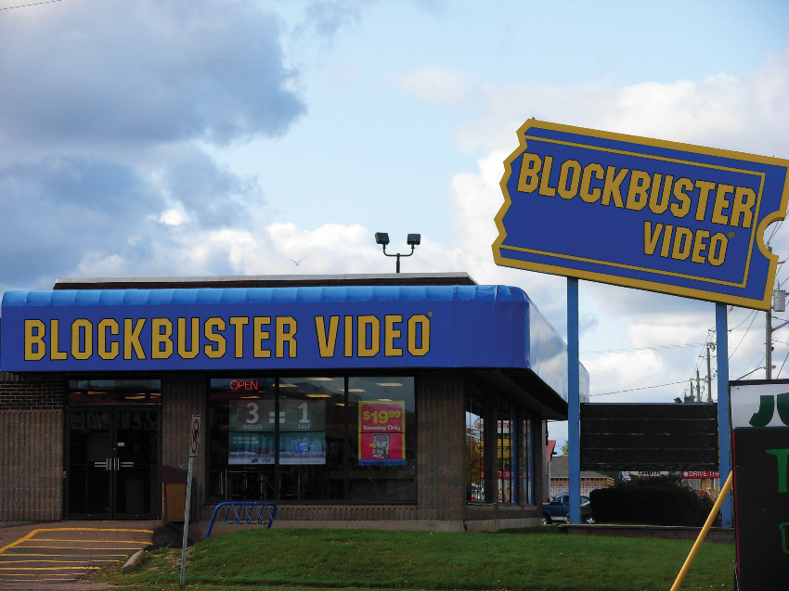
Notes:
Textbook - When Netflix began offering inexpensive DVD rentals through the mail, customers defected in droves from video rental stores such as Blockbuster. Netflix customers were delighted by the firm’s low prices, vast selection, and the convenience of not having to visit a store to select and return videos. Movie Gallery was stuck in the middle—its prices were higher than those of Netflix, and Netflix’s service was superior. Once individuals lacked a compelling reason to be Movie Gallery customers, the firm’s fate was sealed.
Image courtesy of Stu pendousmat, http://en.wikipedia.org/wiki/

Slide 56
Key Takeaways
When executing a business-level strategy, a firm must not become stuck in the middle between viable generic business-level strategies by neither offering unique features nor competitive pricing.

Slide 57
Stages of Industry Life Cycle

Slide 58
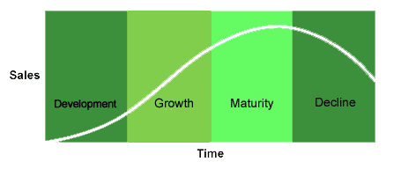
Stages of Industry Life Cycle
Notes:
https://courses.cit.cornell.edu/cuttingedge/lifeCycle/01.htm

Slide 59
Stages of Industry Life Cycle
Stage
Introduction Growth Maturity Decline
Factor
Generic strategies
Differentiation Differentiation Differentiation Overall cost Overall cost leadership
leadership Focus
Market growth rate
Low Very large Low to Negative
moderate
Number of segments
Very few Some Many Few
Intensity of competition
Low Increasing Very intense Changing
Emphasis on product design
Very high High Low to Low
moderate

Slide 60
Stages of Industry Life Cycle
Stage
Introduction Growth Maturity Decline
Factor
Emphasis on process design
Low Low to High Low
moderate
Major functional area(s) of concern
Research and Sales and Production General
Development marketing management
and finance
Overall objective
Increase Create Defend Consolidate,
market share consumer market share maintain,
awareness demand and extend harvest, or product life exit
cycles

Slide 61
Strategies in Introduction Stage
Products are unfamiliar to consumers
Market segments not well defined
Product features not clearly specified
Competition tends to be limited
Strategies
  Develop product and get users to try it
  Generate exposure so product becomes “standard”

Slide 62
Strategies in the Growth Stage
Characterized by strong increases in sales
Attractive to potential competitors
Primary key to success is to build consumer preferences for specific brands
Strategies
  Brand recognition
  Differentiated products
  Financial resources to support value-chain activities

Slide 63
Strategies in the Maturity Stage
Aggregate industry demand slows
Market becomes saturated, few new adopters
Direct competition becomes predominant
Marginal competitors begin to exit
Strategies
  Efficient manufacturing operations and process engineering
  Low costs (customers become price sensitive)

Slide 64
Strategies in the Decline Stage
Industry sales and profits begin to fall
Strategic options become dependent on the actions of rivals
Strategies
  Maintaining
  Exiting the market
  Harvesting
  Consolidation

Slide 65
Generic business strategies in clothing industry?
Cost leadership strategy
  provide clothing at low prices with basic designs
Differentiation strategy
  provide clothes created by well-acclaimed designers, high quality, high price
Focused cost leadership strategy
  Competing on price but narrow market – i.e. safety
Focused differentiating strategy
  unique features fulfill demands of narrow market – biking
Best Cost strategy
  Firms charge relatively low prices & still offer substantial differentiation valued by consumers

Slide 66
The Best Online Firm
(StellaService.com)
They make sure customers can reach a human being easily: How easily? The average time to a live agent for the highest-rated subset of the 100 companies is 23 seconds. Not minutes, seconds.
They respond to inbound messages with lightning speed: Average time to reply to an email for the best companies is 1 hour and 24 minutes. "We'll make every effort to respond to you within 24-48 hours" definitely doesn't cut it.

Slide 67
The Best Online Firm
(StellaService.com)
They ship crazy fast: Average delivery time is is less than 2 days from order to receipt. Before you say "give me a break, we can't do that," the stat is presumably skewed by Amazon Prime & Zappos' legendary free overnight delivery. Clearly many, if not most of us can't afford this, so a few more days isn’t critical, But the best companies stress the critical need for maximum speed.
They give money back as quickly as they take it: Among the peak performers, the average time from return initiation to processed refund is three days. Customers don't want to wait for their money any more than they want to wait for their orders.

Slide 68
In Conclusion,
This chapter explained generic business-level strategies including low-cost, differentiation, or a broad or narrow market focus strategy
Perhaps the best strategy, best cost, occurs when firms can offer relatively low prices while still managing to differentiate goods or services
Between Globalization and Internet, competition continues to increase, which suggests that consistently sticking to their strategy is a good predictor of firm success
Whatever the strategy, avoid being “stuck in the middle” by not offering sufficiently unique features or competitive prices

