Slide 1
Image Descriptions
Download slides: bit.ly/accessbites
Josie Gray (she/her)
BCcampus
jgray@bccampus.ca
October 26, 2023
Notes:
Hello everyone! Thank you so much for joining us for the second topic in the accessibility bites series.
Before I get started, I want to highlight that you can download the slides for this session from bit.ly/accessbites. My colleague Helena will put this link directly into the chat as well. These slides are accessible and include my full speaking notes. You can use them to refer back to at any time and adapt for your own purposes. In this folder, you will also see the slides from the previous Accessibility Bites session.
I am grateful to be joining you all today from Moh’kins’tsis, now known as the city of Calgary. The land I live on is part of Treaty 7, which includes the Blackfoot Confederacy (the Siksika, Piikani, and Kainai Nations), the Tsuut’ina Nation, and the Stoney Nakoda (including the Chiniki, Bearspaw, and Wesley Nations). I also know that you all are coming from all over, so I want to recognize that land acknowledgements in virtual meetings can be complicated. As a remote worker, I appreciate the practice of acknowledging the land as a way to ground myself and keep front of mind my responsibilities as a settler in this place.
My name is Josie Gray, and I use she/her pronouns. For those who can’t see me, I am a white woman in my late-twenties with shoulder-length blond hair, glasses, and a septum piercing. I work for BCcampus, and I have been working in digital accessibility in education for seven years and I have a Master’s of Design in Inclusive Design. The things I will be sharing throughout this series have come from my experience in making educational materials more accessible to disabled students. However, it’s important to recognize I am not a disabled person, and that disability is a huge category and there is a huge amount of diversity even among people with similar disabilities. I say this because I do not know everything of what it is to make something accessible to all people, and what may work for one person may not work for another. So I really want to encourage you to dig into all of the topics we will cover through the series, and then seek out further learning, especially from people with lived experience.
Welcome to the first session of the Accessibility Bites series, a series that looks at different accessibility topics related to teaching and learning in post-secondary.
For today’s topic, we are exploring image descriptions.

Slide 2
What to expect
15-minute presentation
10-minute activity to practice
5-minute discussion/questions
Notes:
Here is what you can expect from the session today.
I will take 15 minutes to explain some key concepts. Then there will be 10-minute activity that will allow you to practice. And we will use any time we have left for additional discussion and questions.

Slide 3
What is accessibility?
When we design and create resources, experiences, tools, and spaces that enable the diversity of our bodies and minds and centres the needs of people with disabilities.
Notes:
So before we can talk about image descriptions, we need to understand accessibility.
For this series, when we talk about accessibility, we are specifically talking about what is needed to ensure people with disabilities can have equitable access to education.
To make education accessible, we must design and create resources, experiences, tools, and spaces that allow for and support the diversity of our bodies and minds. So rather than focusing on what we think is normal or average, we are going to start from a place where we celebrate the presence of diversity and work to build in flexibility and choice so people can access their education in a way that works for them.
Although accessibility can benefit everyone, the needs of disabled people are the priority and focus of accessibility work.

Slide 4
An image description
is a verbal or written description of an image for someone who can’t see it.
Notes:
So today's topic is all about image descriptions. An image description is a verbal or written description of an image for someone who can't see it.

Slide 5
Who are image descriptions for?
Someone who has
A disability affecting vision (i.e., blindness)
A brain injury that causes sensitivity to screens
A cognitive disability where a written explanation may be helpful
Poor internet connection that causes images not to load
Notes:
So, who are image descriptions for? Image descriptions are most commonly used by people who have a disability that affects their vision, for example, someone who is Blind. They may also be used by someone with a brain injury that makes it hard for them to look at computer screens or someone with a cognitive disability who appreciates a written explanation of what is going on in the image. Image descriptions can also be helpful for someone with a poor internet connection that causes images not to load.

Slide 6
Why are image descriptions important?
Images have huge explanatory power. They allow us to give context, represent spatial concepts, show relationships, and provide examples in minimal space.
In education, images are often crucial parts of course materials. Image descriptions ensure that important information is provided for all students from the very beginning.
Notes:
Image descriptions are important because images have huge explanatory power. Images can provide context, represent spatial concepts, show relationships, and provide examples in very small spaces.
In education, images are often crucial parts of course materials. Image descriptions ensure that important information being conveyed visually is accessible for all students from the very beginning.
This is possible when course materials are provided in digital, accessible formats. Students can use assistive technologies called screen readers to access digital materials. Screen readers allow them to navigate digital interfaces like computers and phones, and they will read out the content on the page. If an image has an image description, the screen reader will read out that description. Or if the images on the page aren't loading, the image description will display instead.

Slide 7
Where are image descriptions used?
Image descriptions can be used anywhere digital images are used:
Websites
Social media
Course materials
E-books
Notes:
So where would you use image descriptions?
Image descriptions can be used anywhere digital images are used. This includes websites, social media, course materials, and e-books. They can be added to content created in Pressbooks, Microsoft Word and Google Docs, PowerPoint, WordPress, etc.

Slide 8
Where do image descriptions go?
Alternative text
Surrounding text
Long description section
Notes:
[Josie]
So where do image descriptions go? The most common place is the alternative text of an image. I will explain more about what that means on the next slide.
Image descriptions can also go in the text surrounding the image, like the caption field.
If an image is really complex and needs a long description (multiple sentences), a description can also be added to a long description section where people who need it can navigate to.

Slide 9
What is alternative (alt) text?
A type of written image description that is added to the HTML of a digital image.
It will not appear visually but can be accessed by assistive technology.
Notes:
So what is alternative text, also known as "alt text"? It is a type of written image description that is added to the HTML of a digital image. That means the alt text will not appear visually in the resource, but can be accessed by assistive technology, like a screen reader.
The example on the screen shows a screen shot from a platform called Pressbooks. We are looking at the image details page for an image. There is an alternative text field that reads: "An empty highway surrounded by trees and snow-capped mountains disappears into the distance."
Underneath is the caption field that reads: "Highway 16 – Terrace to Prince Rupert."
So the text added to the alternative text box with not display visually in the Pressbook, but it can be accessed by a screen reader.
This example also is showing us the difference between alternative text and a caption. The alternative text is telling us what is visually shown in the picture. The caption is giving us additional information and context.

Slide 10
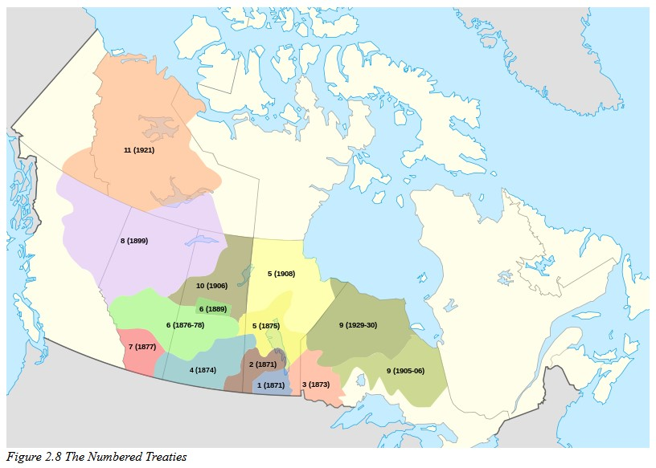
Image description example
A map of Canada showing the land covered by each of the eleven Numbered Treaties and the dates they were signed.
Figure 1 The Numbered Treaties
Map of Numbered Treaties of Canada by Themightyquill is licensed under a CC BY-SA 2.5 licence.
Notes:
So to illustrate this example, I have an image on the screen here that is covered. All we can see is the figure caption, which reads "Figure 2.8 The numbered treaties."
So I am curious: How many of you think you could guess what this image is based on the caption alone. If you want to, you can put your answer in the chat - Don't worry, I won't call on you – I just want to see what people think.
Here is a possible image description for the image: [read out slide] [next]
And here is the actual image. Without that image description, a student who relies on image descriptions would be left to guess the content of the image.

Slide 11
Does the image need a description?
A decorative image is an image that is primarily for design and doesn’t convey information.
It does not need a description.
A functional image is an image that conveys information that is not described elsewhere.
It does need a description.
Notes:
So let's move on to how to go about describing an image. So the first thing to figure out is if the image needs a description in the first place. To do that, we need to make distinction between decorative images and functional images. Decorative images are images that are used primarily for design and do not convey content. Or they convey content that is already described in the surrounding text. As such, they do not need text descriptions. Functional images are images that convey important non-text content. For functional images, you have to consider what information would be lost if those images weren’t available. This information needs to be provided in a text format.

Slide 12
Example of a decorative image
A bag of potato chips weighs 48 grams.
How many milligrams is that?
Notes:
So here is an example for a decorative image that appears beside a question in a math textbook. The text reads “A bag of potato chips weighs 48 grams. How many milligrams is that?” And then beside that, there is an image of an open bag of chips. The image of the bag of chips helps break up the text and make it more engaging, but it is more decorative than functional. No information would be lost if this image was deleted, so it doesn’t need a text description.
“Bag of chips” is licensed under the CC0 licence.​

Slide 13
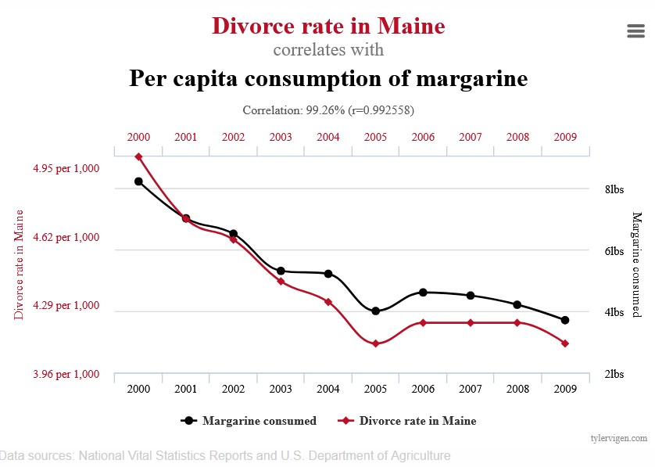
Example of a functional image
Spurious Correlations by Tyler Vigen is licensed under a CC BY 4.0 licence.​
Notes:
In contrast, here is a line graph that shows a close correlation between the divorce rate in Maine and the per capita consumption of margarine between 2000 and 2009. It was taken from a sociology textbook where it was included to demonstrate that correlation does not equal causation. If this image were not included, the example would be lost and the point would be less effective. As such, it does need a description.

Slide 14
Object – Action - Context
Object: A line graph
Action: shows a close correlation between the divorce rate in Maine and the per capita consumption of margarine between 2000 and 2009.
Context: The lines fall at the same rate from 2000 to 2005, then there is a slight rise before it levels off again.
Chen, A. (2020).
Notes:
So you've determined that an image does need a description. So what about it do you describe?
A helpful framework is "Object – Action – Context," which was developed by Alex Chen.
In object – action – context, the object is the main focus; the action describes what’s happening, usually what the object is doing; and the context describes the surrounding environment.
This is to help you structure an image description to ensure the most important information comes first.
So if we go back to the line graph example,
The object is "A line graph"
The action is "shows a close correlation between the divorce rate in Main and the per capita consumption of margarine between 2000 and 2009.
The context is "the lines fall at the same rate from 2000 to 2005, then there is a slight rise before it levels off.

Slide 15
Things to keep in mind
Context: Why is the image there?
Audience: Who is accessing the image?
Concise: Keep it short
Objectivity: Avoid judgements
General to specific
Tone and language
The DIAGRAM Center. “How to Describe Images.” Poet Training Tool. https://poet.diagramcenter.org/how.html
Notes:
When describing an image, here are 6 things to keep in mind. These were developed by the Diagram Center.
Context: Why is the image there? What is it's significance in the context it is appearing in?
Audience: Who is accessing this image? What information are they expected to takeaway from this image? For example, a description for first year students may be less detailed than a description for graduate students.
Concise: Keep it short, only include information that is relevant to the context and information that would be lost if that image wasn't provided.
Objectivity: Objectivity can be tricky, and there are contexts where less objective descriptions are appropriate. But overall, avoid putting your own judgements into the image description. And only describe what's visually showing in the image. If you find yourself adding additional context to the description, that's probably something that should just be added to the caption or surrounding text for everyone to access.
When structuring your image description, especially for a complex image, start with a general overview and then get more specific. This will make your description easier to understand.
And then consider your tone and language. Your tone when describing a personal image for social media will likely be different than when describing an image in a textbook. In addition, use language that will be accessible to your audience.

Slide 16
Activity: What do you see?
Take one minute. Write down 5-10 things that you see.
Notes:
So let's do an activity. I have a picture up on the screen. I'd like you all to take about a minute and write down things that you see. Aim to make note of 5-10 things.
If your comfortable, please share in the chat when you're done so we compare the different things that people noticed.
Example: Math classroom, tiered desks, students with paper and calculators, instructor at the front with a projector
Image attribution: Math class at College of the Rockies from 1.1 Adult Learning in Student Success by Mary Shier. CC BY 4.0

Slide 17
Activity: Try to describe
Write a description for this image.
Remember: Context, Audience, Concise, Objective, General to specific, Tone & language.
Notes:
So now try to write an image description. You're welcome to write them directly into the chat or just for yourself.
Image attribution: Math class at College of the Rockies from 1.1 Adult Learning in Student Success by Mary Shier. CC BY 4.0

Slide 18
Activity: Possible description
A college math classroom. Students sit in 4 rows of tiered desks. An instructor stands in front of a projector.
Notes:
So a possible description for this image would be: A college math classroom. Students sit in 4 rows of tiered desks. An instructor stands in front of a projector.
Also, with this activity, I didn't give you any context about where the image appears. Context would likely affect what you describe in this picture. For example, if the picture appeared in a section talking about the pros and cons of different classroom set ups, you would make sure to describe the formation of the rows and orientation of the room. If it appeared in a section talking about the importance of coming prepared for class, you might mention that students all have notebooks and calculators in front of them.
We got this image from a Student Success textbook in a section that talks about how normal it is to feel anxious about returning to school as an adult. In that context, this image isn't giving us more information. It's more there for decorative purposes and to break up the text. In that case, we may decide to keep the alt text super short ("A college math classroom") or not provide alt text at all.
Image attribution: Math class at College of the Rockies from 1.1 Adult Learning in Student Success by Mary Shier. CC BY 4.0

Slide 19
Questions and Discussion
Notes:
That brings us to the end of this session. Are there any thoughts or questions that anyone would like to bring forward? You're welcome to use the chat or unmute and speak.

Slide 20
Tools and Resources
Alt Text as Poetry
POET Training Tool
Accessibility Toolkit’s chapter on Images
Complex Images for All Learners [PDF]
Extract text from an image
Character counter

Slide 21
Thank you!
Register for upcoming Accessibility Bites sessions: https://bccampus.ca/events/
Download these slides:
bit.ly/accessbites
Notes:
Thank you so much everyone for attending and for your engagement.
We are hosting Accessibility Bites sessions on the last Thursday of the month, except for December. You can register for the upcoming events at bccampus.ca/events.
Upcoming topics include:
PowerPoint Slides
Social media
Word Documents
If you want a copy of these slides, you can download them at: bit.ly/accessbites

Slide 22
References
AccessiblePublishing.ca. (n.d.). Guide to image descriptions. https://www.accessiblepublishing.ca/a-guide-to-image-description/
Chen, A. (2020, July 16). How to write an image description. Medium. https://uxdesign.cc/how-to-write-an-image-description-2f30d3bf5546
Coolidge, A., Doner, S., Robertson, T., & Gray, J. (2018). Accessibility toolkit (2nd ed.). BCcampus. https://opentextbc.ca/accessibilitytoolkit/
The DIAGRAM Center. (n.d.). How to describe images. Poet Training Tool. https://poet.diagramcenter.org/how.html

