Slide 1
Social Media
Download slides: bit.ly/accessbites
Josie Gray (she/her)
BCcampus
jgray@bccampus.ca
January 25, 2024
Notes:
Hello everyone! Thank you so much for joining us for the fourth topic in the accessibility bites series.
Before I get started, I want to highlight that you can download the slides for this session from bit.ly/accessbites. My colleague Helena will put this link directly into the chat as well. These slides are accessible and include my full speaking notes. You can use them to follow along as well go, refer back to at any time, and adapt for your own purposes. In this folder, you will also see the slides from the previous Accessibility Bites sessions.
I am joining you all today Lac La Biche, which is located in the very northern part of Treaty 6. The county of Lac La Biche is part of Treaty 8 and Treaty 10 as well, but I am personally on Treaty 6 today as well as Region 1 of the Métis Nation of Alberta. Treaty 6 signed was signed in 1876, one of the 11 numbered treaties signed between the First Nations and the British Crown. One of the provisions of this treaty was that Indigenous peoples had the right to continue their hunting and fishing practices. For those of you familiar with Alberta, there is a lot of industry in northern Alberta, especially oil and gas. In 2008, the Beaver Lake Cree Nation, who are currently based just south of Lac La Biche, filed a statement of claim against the Alberta provincial and Canadian federal governments arguing that they failed to manage the overall cumulative environmental effects of development of their traditional territory and as such have violated the provision in Treaty 6 that guaranteed those hunting, fishing, and trapping rights. On their website, they say: "Our land used to be home to large herds of moose, caribou and elk. Hundreds of freshwater lakes and rivers provided clean water and an abundance of healthy fish. But now, cumulative impacts from industry and development have poisoned water, eliminated whole forests, and decimated traditional food sources for the Beaver Lake Cree Nation people. We had to act. Beaver Lake Cree Nation is the first ever to challenge and be granted a trial on the cumulative impacts of industrial development. Not one project, not one mine: all of them at once." From what I can find online, this case has still yet to be tried, but I wanted to highlight the work the Beaver Lake Cree Nation is doing to hold governments accountable to treaty promises, and it's something I will be keeping an eye out for.
My name is Josie Gray, and I use she/her pronouns. For those who can’t see me, I am a white woman in my late-twenties with shoulder-length blond hair, glasses, and a septum piercing. I work for BCcampus, and I have been working in digital accessibility in education for seven years and I have a Master’s of Design in Inclusive Design. The things I will be sharing throughout this series have come from my experience in making educational materials more accessible to disabled students. However, it’s important to recognize I am not a disabled person, and that disability is a huge category and there is a huge amount of diversity even among people with similar disabilities. I say this because I do not know everything of what it is to make something accessible to all people, and what may work for one person may not work for another. So I really want to encourage you to dig into all of the topics we will cover through the series, and then seek out further learning, especially from people with lived experience.
Welcome to the fourth session of the Accessibility Bites series, a series that looks at different accessibility topics related to teaching and learning in post-secondary.
For today’s topic, we are exploring social media. Since people use a range of social media sites, I will focus on practices that apply across social media platforms rather than going into detail on specific sites.

Slide 2
What to expect
15-minute presentation
15 minutes for discussion/questions/activities
Notes:
Here is what you can expect from the session today.
For the first 15 minutes, I will present some core practices that are needed to make social media content accessible. And we will use any time we have left for additional discussion and questions as well as some activities.

Slide 3
What is accessibility?
When we design and create resources, experiences, tools, and spaces that enable the diversity of our bodies and minds and centres the needs of people with disabilities.
Notes:
So before we get farther into this topic, we need to understand accessibility.
For this series, when we talk about accessibility, we are specifically talking about what is needed to ensure people with disabilities can have equitable access to education.
To make education accessible, we must design and create resources, experiences, tools, and spaces that allow for and support the diversity of our bodies and minds. So rather than focusing on what we think is normal or average, we are going to start from a place where we expect and plan for the presence of diversity and work to build in flexibility and choice so people can access their education in a way that works for them.
Although accessibility can benefit everyone, the needs of disabled people are the priority and focus of accessibility work.

Slide 4
Multi-Word Hashtags: PascalCase
#accessibilitybites
#goopen
#openeducationweek
#AccessibilityBites
#GoOpen
#OpenEducationWeek
Which is easier to read?
Notes:
Since we are talking about social media, let's start with Hashtags. Especially multi-word hashtags. Hashtags are used across multiple social media platforms.
On the screen I have examples of hashtags written in two different ways. On the left, the hashtags use lower case. On the right, the hashtags use PascalCase.
PascalCase: When there are no spaces between words and the first letter of each word is capitalized.
Why use PascalCase?
Easier to read
Screen readers will pronounce each word individually

Slide 5
Emojis are accessible... in moderation
Notes:
Emojis are accessible – when a screen reader encounters an emoji, it will read out the label an emoji is associated with. However, when people overuse emojis, it can become a problem.
So in this example, there is a screen shot of a social media post that reads: Why are my toes so cold even when I have my slippers on? And in between each word, there is a hands-clapping emoji.
So for people reading this post visually, the effect is clear. It's imitating the effect of clapping between each word to give emphasis. However, if using a screen reader, you would hear something like: Why clapping hands sign are clapping hands sign my clapping hands sign toes clapping hands sign etc. It's much harder to understand the post and it takes a lot longer to get through the emojis.
So if using emojis, use them in moderation.

Slide 6
Creative Formatting
Kopacz, L. (2019, Feb 25). 7 ways to make your tweets more accessible. A11y with lindsey. https://www.a11ywithlindsey.com/blog/7-ways-tweets-more-accessible
Notes:
So here is another example of a trend that was going around on Twitter a few years ago, where people would use backslashes, underscores, and parentheses to create the shape of a tea cup and then write some sort of statement inside the tea cup, which they called: Today's tea. In this screenshot, the tea is: "Grad students should be paid livable wages for their hard work." For anyone who can see the tweet, the point is clear. However, this is what that same Tweet sounded like when read with a screen reader.
This also applies to fancy fonts and characters that people sometimes copy into their posts. Often the screen reader will read out the character name and not the word, which means the meaning is lost and they are left to listen to a bunch of repetitive characters.

Slide 7
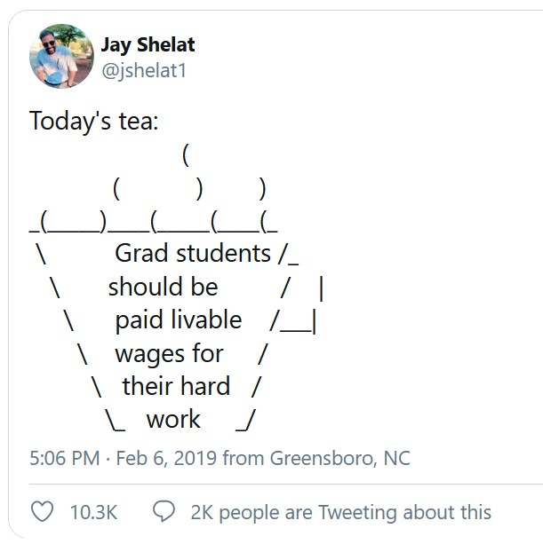
What would be an accessible way to share these posts?
Take screenshots and post them as pictures with alt text.
Notes:
So let's say, there is a social media trend going around that relies on visual layout, lots of emojis, or symbols, and you have a great idea for a post, is there an accessible way to participate? Does anyone have any ideas?
So set up your post on the social media platform however you want. Then take a screenshot and post that screenshot with alt text, which is a text description that is added to the image that is accessible to people using screen readers. That way you still get the visual affect, but the content is more accessible and user friendly.

Slide 8
Images
All social media platforms should have a place where you can add alternative text to images.
Notes:
As we've talked about in past webinars in this series, images need text descriptions to be accessible to people who cannot see them.
All social media platforms should allow you to add alternative text to images. Look for an "alt" or "Describe" button. Or look in the settings for the image. If you don't see a place to add a description, describe the image in the post itself. You can also try googling the name of the social media platform and "how to add alt text" to find specific instructions for a platform.
If you're not sure how to describe an image, we covered that topic in a previous accessibility bites session, and you will be able to find the resources from that session in the folder I shared a link to at the beginning of the presentation. In the screenshot on the slide, I am adding alt text to an image on the BlueSky social media platform. The alt text reads: An empty, snow covered highway with tire tracks running down each lane. The trees on either side are bare and coated with frost. The sky is blue and clear.

Slide 9
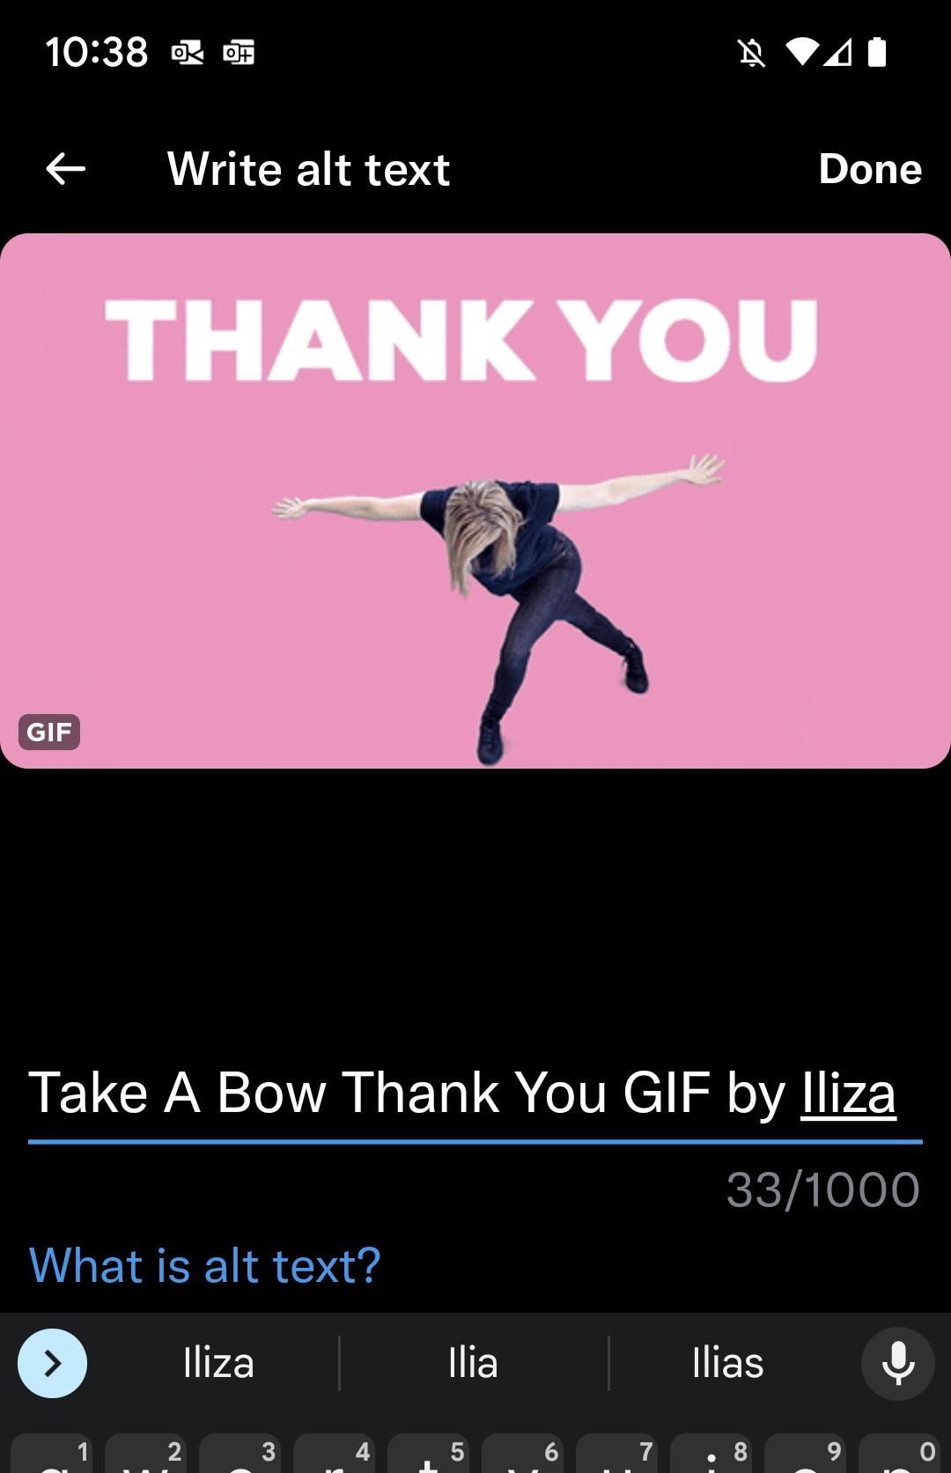
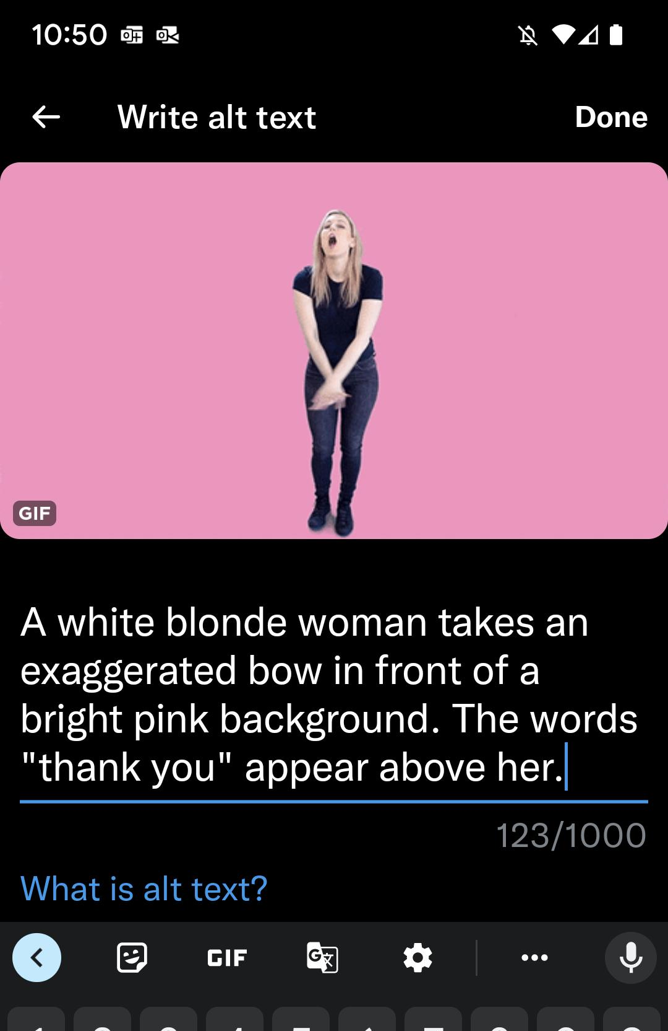
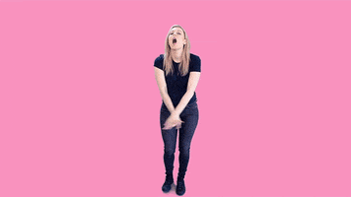
GIFS
Notes:
You can also add alternative text to GIFs. In this example, the alt text reads: "A white blonde woman takes an exaggerated bow in front of a bright pink background. The words "thank you" appear above her."

Slide 10
Videos
Notes:
Over the last few years, video has grown in popularity across multiple social media platforms, but especially Instagram and TikTok.

Slide 11
Videos: Open vs. Closed Captions
Notes:
When making videos accessible, the first thing to do is to create captions for the video. Captions are a written version of what you can hear in the video that is synched with the audio of the video so people can read while they watch. Captions are primarily for people who are deaf or hard of hearing, but captions are widely used by people without hearing-related disabilities as well – especially on social media where people are likely to watch with volume off.
You have two options when adding captions to a video: open captions or closed captions. For social media, one isn't necessarily better than the other, so just use the one that is easier for you.
The first is open captions. With open captions:
The captions are part of the video – they cannot be turned on/off by the viewer
Open captions are usually inserted in a video editing tool like Adobe Premier, however, Instagram and TikTok also have automatic caption options directly in the apps. They will generate captions based on audio and then you can edit for accuracy. These captions become part of the video when you publish.
Open captions allow you to customize the display of captions and ensure they display the same across multiple platforms. As such, make sure you set them up so they are easy to read.
The other option is closed captions. Closed captions are uploaded to a video as a separate file. A popular caption file type is SRT, but there are others as well.
These captions can be turned on and off by the viewer, and some video players allow the viewer to adjust the display of captions.
Closed captions are what you see on movie/TV streaming sites like Netflix and YouTube
Some social media sites allow you to upload SRT files to your videos before you post them, including Twitter (X) and LinkedIn.
As I mentioned, it doesn't really matter which caption method you use, so select the one that makes the most sense for the platform you are posting on and your video creation workflow.

Slide 12
Visual Descriptions in Videos
Include the description in the audio of the video
OR
Provide the description in the post
Notes:
Another thing to consider with videos is how to convey what is visually going on in a video to people who can't see it. There is no alt text for videos. That means you need to include the description some other way. If you are creating the video, the easiest way to do that is to build description into audio of the video.
Another option that can work with shorter videos shared on social media, especially videos that are mainly for sharing text or audio, is to include a visual description in the caption. Here is a Tweet by Witch, Please. a podcast, that includes a video that has audio, captions, and a static image as a background. In the Tweet, they include a description of the image in the video that reads: Photo ID: An illustration by Zoe of a purple snail leaving a trail of goo with the words "Purple Velvet is Gay" written in it.

Slide 13
Readibility!
Use
Large text
Simple, clear fonts
High contrast colours
For open captions, ensure they are on the screen long enough for people to read.
Notes:
When you are posting visuals to social media, whether that be images, GIFS, or videos, make sure any text you are sharing with those visuals is easy to read. That means
Ensure the text size is large enough to read. I can't give you a minimum font size since platforms can be so different, but I would generally recommend as big as you can.
Also make sure the fonts you are using are simple. Avoid italics and decorative fonts that can be hard to read.
Also ensure that the font colour that you are using is a high contrast with the background colour.
With captions, ensure they are on the screen long enough for people to read.

Slide 14
Questions!

Slide 15
Activities to Try Out
If you use a social media platform that allows you to edit past posts, go back and add alt text to images you've posted (i.e., Instagram)
Share a post on any social media platform sharing what you learned in this session. Consider using hashtags and including a picture (with alt text).
Find a post in this list of blog posts to read: https://veroniiiica.com/tag/social-media/

Slide 16
More Resources
A Guide to TikTok Accessibility: Settings, Tips, and Tricks
Image Accessibility by Platform
Veronica with Four Eyes - Blog posts re: social media

Slide 17
Thank you!
Register for upcoming Accessibility Bites sessions:​ https://bccampus.ca/events/​ ​
Download these slides:​
bit.ly/accessbites

