Slide 1

Pressbooks Training Webinar series
Intermediate 1
How to Import & Export Files
Unless otherwise noted, this work is released under a CC BY. 4.0 International Licence. Feel free to use, modify, or distribute any or all of this presentation with attribution.
Notes:
Last updated: April 10, 2018, LA

Slide 2
Curriculum
Lesson 1: How to import a Pressbooks file
Lesson 2: How to clone a textbook
Lesson 3: How to import a Word document
Lesson 4: How to export many file types for one book
Lesson 5: How to add multiple books to a Pressbooks account
Lesson 6: How to delete a book, chapter, or part
Notes:
Here are our topics for today.
A new lesson has been added based on a new feature: Lesson 2 – How to clone a textbook

Slide 3
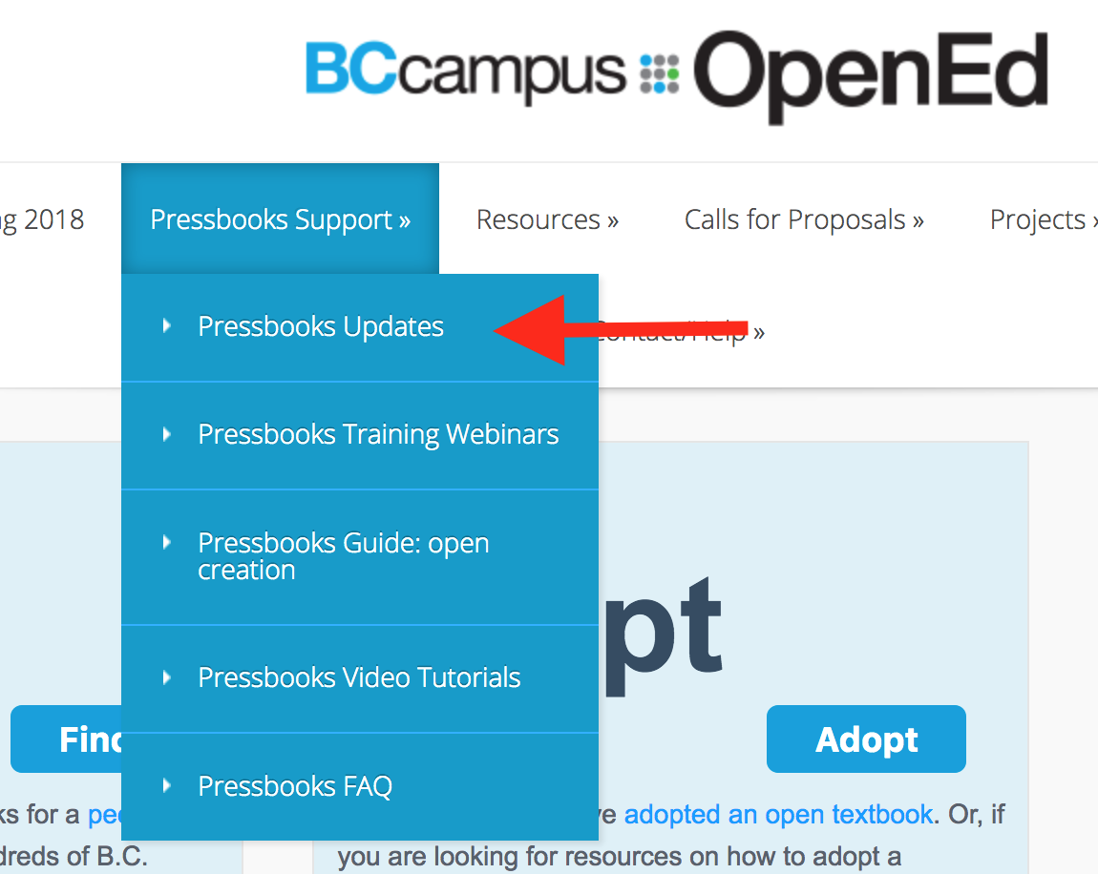
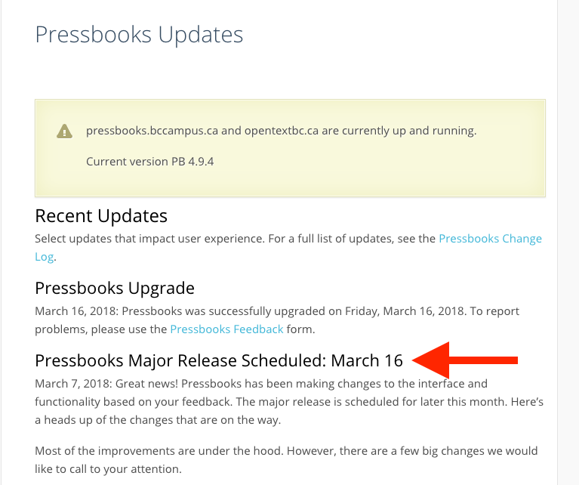
Pressbooks Updates
Notes:
The two BCcampus Pressbooks instances went through a major upgrade on March 16, 2018. For a list of changes made, see our “Pressbooks Updates” page under “Pressbooks Support” on the BCcampus Open Education website (open.bccampus.ca).

Slide 4
Lesson 1
How to import a Pressbooks file
Notes:
Lesson 1: How to import a Pressbooks file.
In this lesson, you will learn two different ways to import a Pressbooks file into your account. This is one way to add a copy of another open textbook to your account.
If you have already created an account, please follow along.

Slide 5
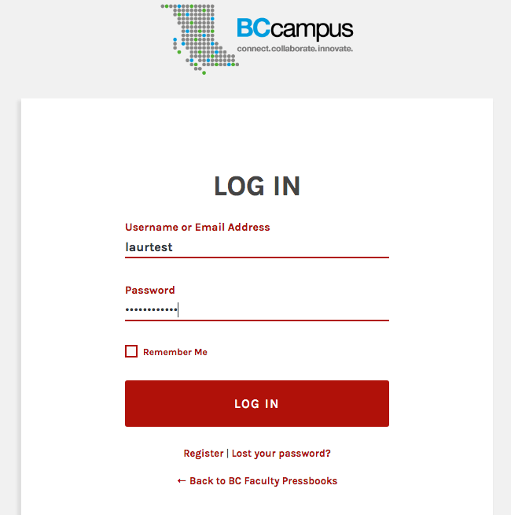
Notes:
To begin, log into your Pressbooks account.

Slide 6
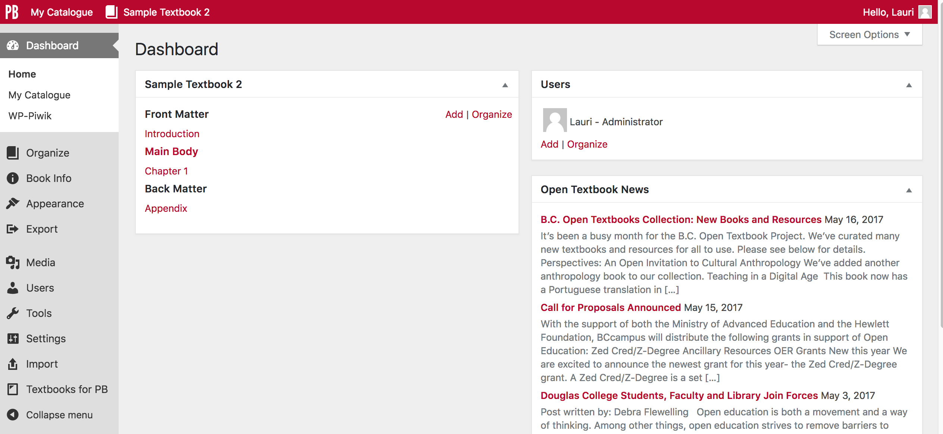
Notes:
You must have a book shell created and ready to receive the imported Pressbooks file.
When you do this, think about the name of the book you will be importing. This name doesn’t need to be the exact title of the existing book, but could be a customized version especially if you’re planning on creating an adaptation of the original.
And remember: all book URLs in Pressbooks are unique so you can’t reuse an existing link name.
For our purposes here, the book shell has been titled “Sample Textbook 2”.
Notice the empty chapters or sections:
“Introduction” in the front matter
“Chapter 1” in the Main Body part
“Appendix” in the back matter
These chapters are mainly empty, but do contain a sentence or two of instructions. These can be deleted before you begin the import, or left in place and deleted later if you don’t need them. The imported file does not insert content into these sample chapters. For this demonstration, these empty chapters will be left alone.

Slide 7
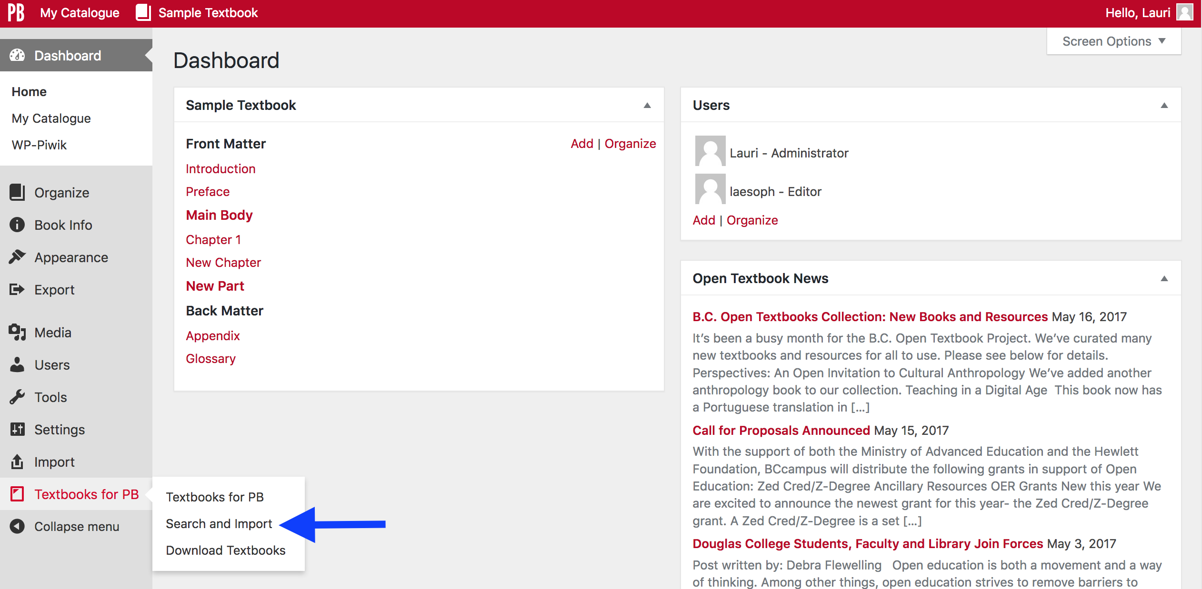
Notes:
If you are looking for a specific topic, or particular book, you can use the “Search and Import” feature found under “Textbooks for PB” on the Dashboard. PB stands for Pressbooks.
This tool is particularly useful if you know that the book you want to import already exists in the B.C. Open Textbook Collection (most of which live in the opentextbc.ca instance of Pressbooks) or within the B.C. Faculty Pressbooks, self-serve instance at pressbooks.bccampus.ca.

Slide 8
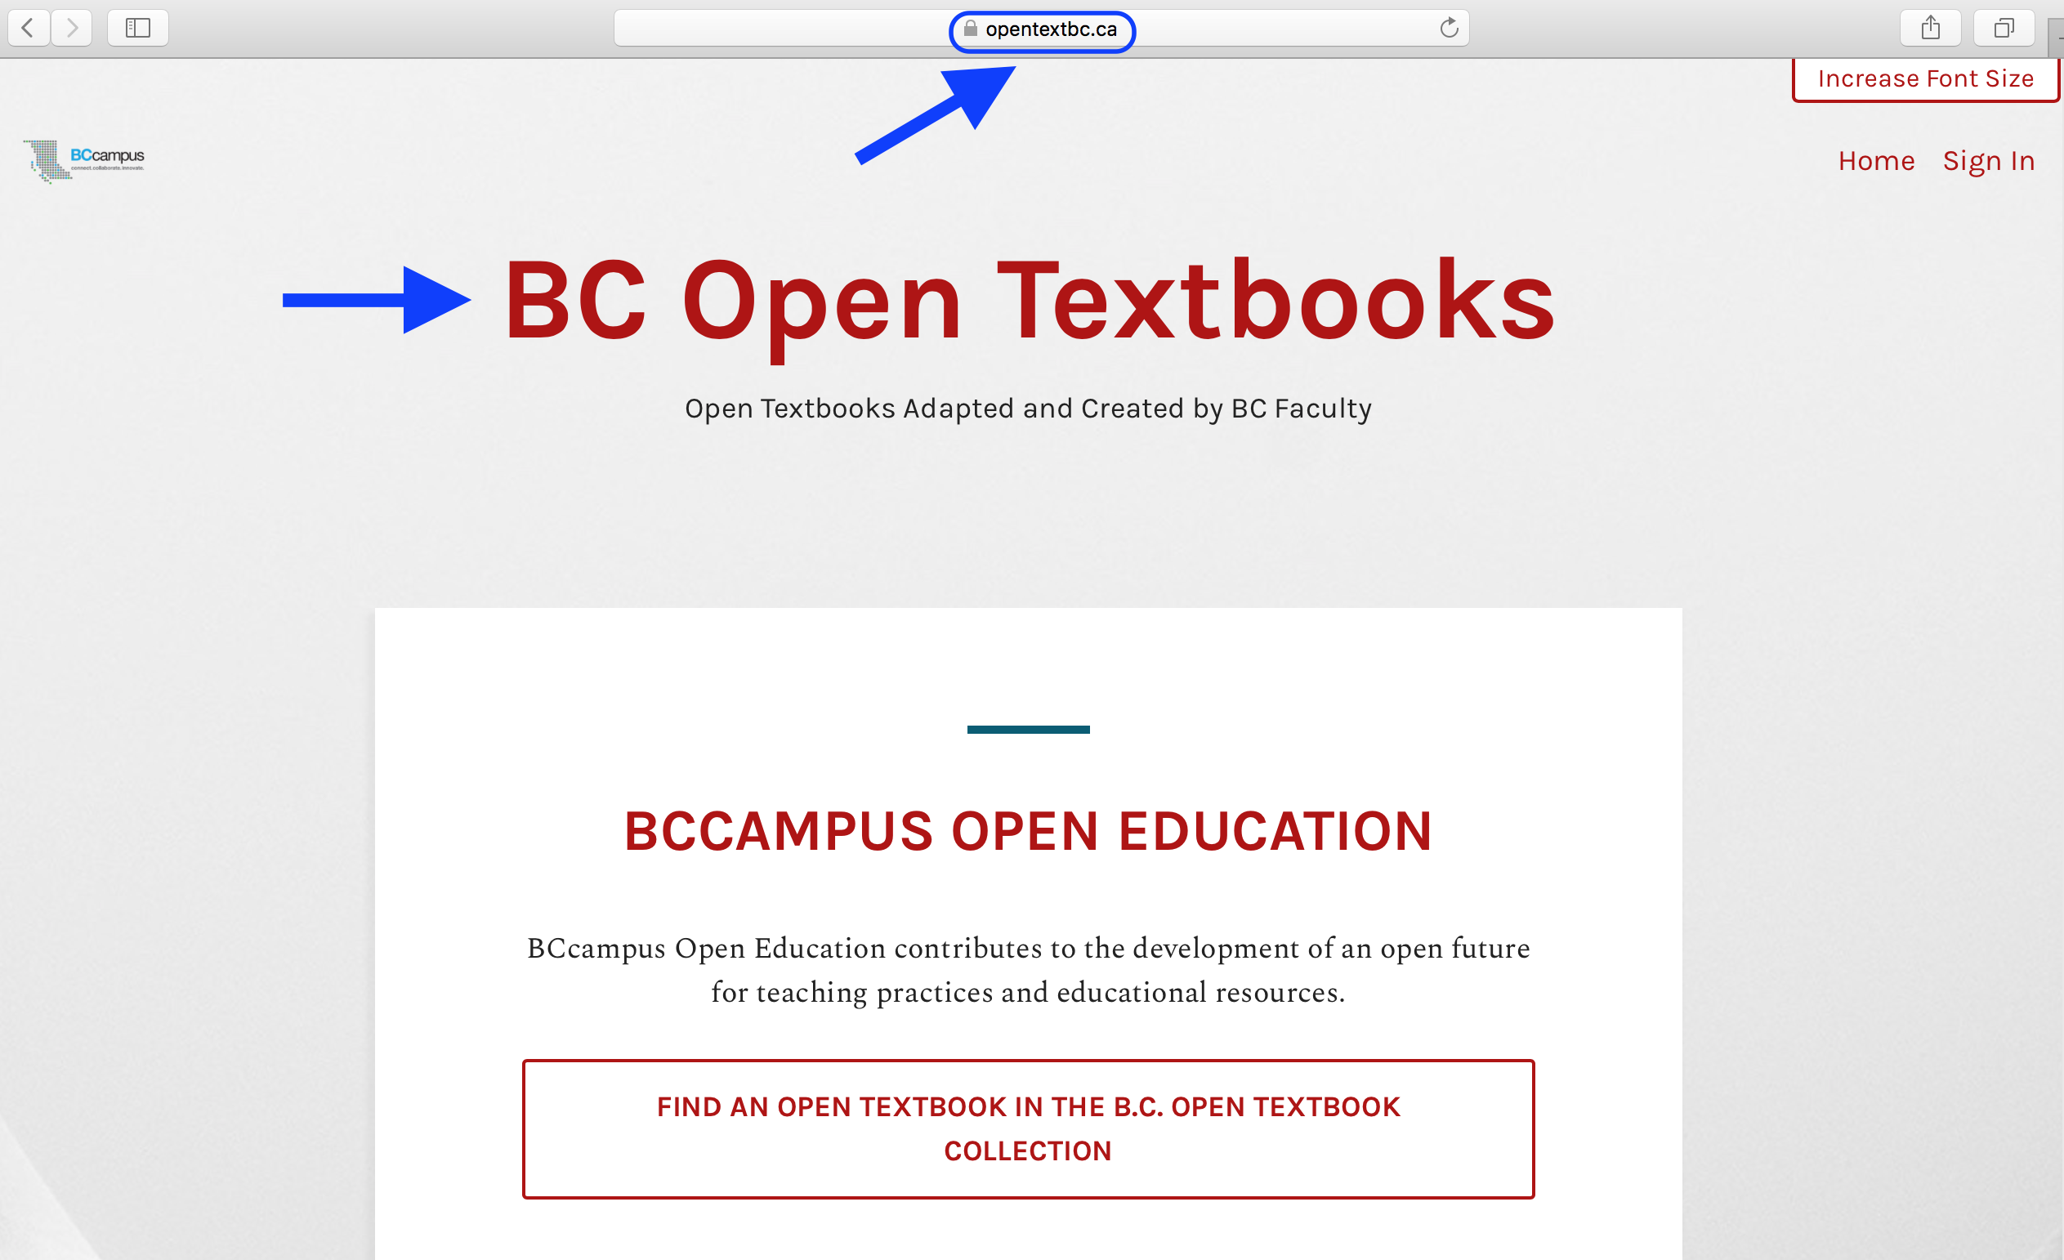
Notes:
In case you’re unaware, BCcampus hosts two instances or Pressbooks websites.
The URL or web address for the internal Pressbooks instance, used to host most of the books written by faculty during the first funding phase of BCcampus Open Education, is opentextbc.ca.
GO TO NEXT SLIDE
EXPLAIN AND SHOW THE TWO INSTANCES OF PRESSBOOKS HOSTED BY BCCAMPUS. HOW EACH IS USED, AND THEIR URLS.

Slide 9
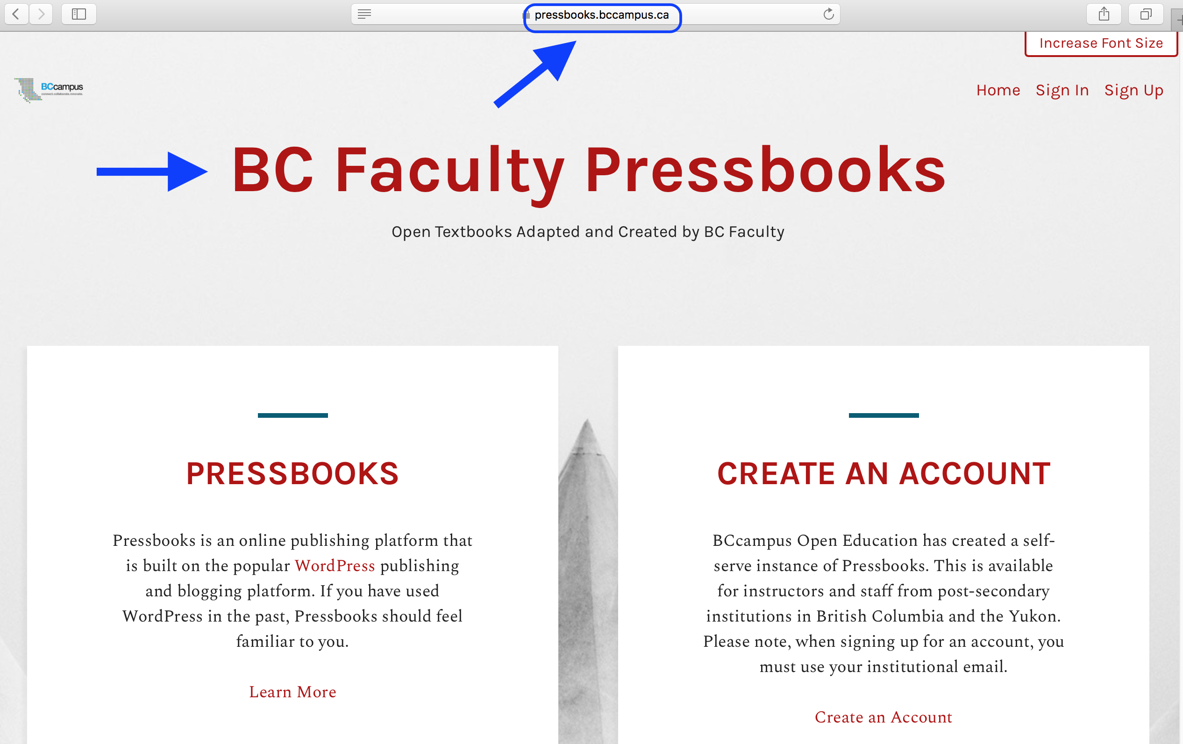
Notes:
The second instance is at https://pressbooks.bccampus.ca and is the free, self-serve Pressbooks instance for B.C./Yukon faculty and staff

Slide 10
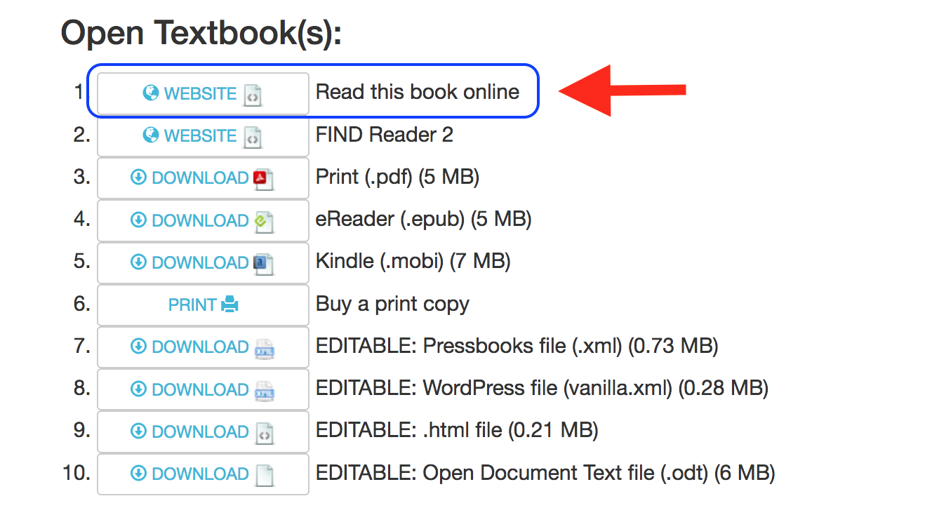
Notes:
To find out which Pressbooks instance a textbook from the B.C. Open Textbook Collection lives, just look at the book’s URL. The easiest way to do this is to locate the book in the collection and click on the “Read this book online” button.

Slide 11
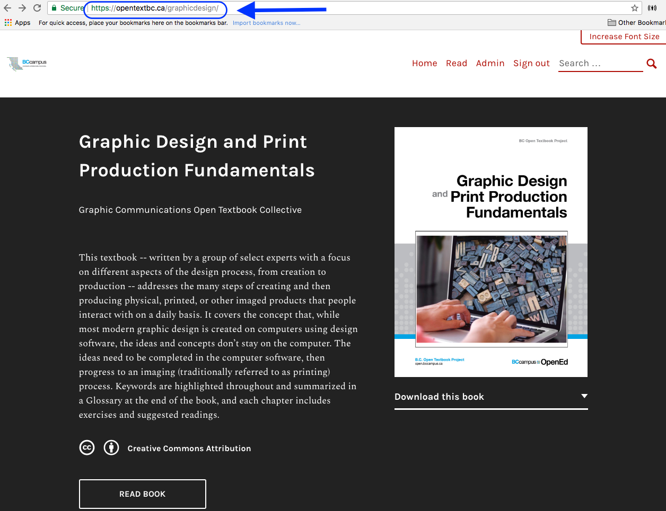
Notes:
In the web address field at the top of the page for this book, “Graphic Design and Print Production Fundamentals”, you can see that the URL includes ”opentextbc.ca” indicating that this book is housed in the BCcampus internal instance of Pressbooks.

Slide 12
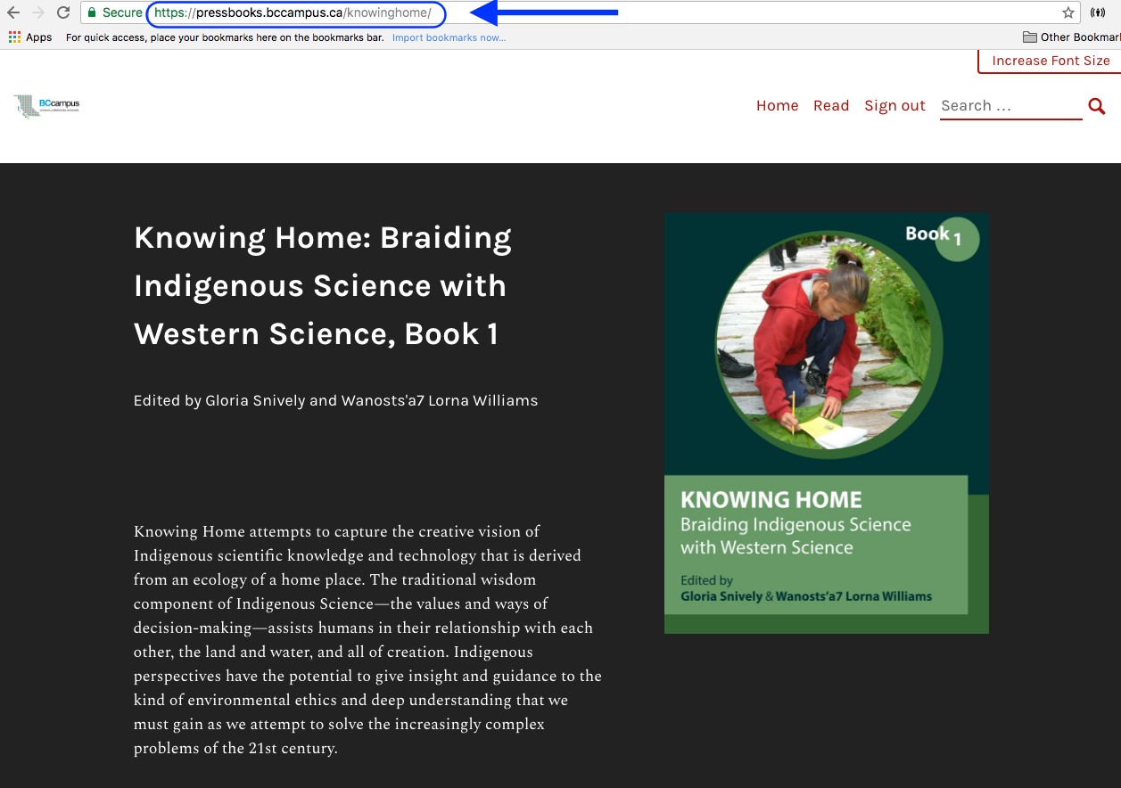
Notes:
For “Knowing Home”, the URL indicates that the self-serve instance of Pressbooks at pressbooks.bccampus.ca is where this book lives.
Now, let’s continue talking about the “Search and Import” feature.

Slide 13
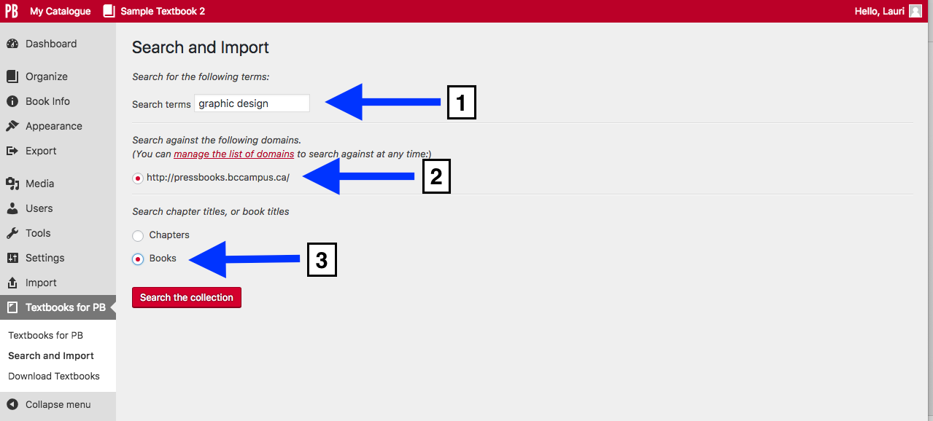
Notes:
To use this feature:
Enter key terms or the book’s title in the “Search terms” field
The search will span the entire pressbooks.bccampus.ca instance
Select the title of individual Chapters within books or Books themselves
And click the red “Search the collection” button
Notice that in this search, you can only look for books in the pressbooks.bccampus.ca (self-serve) instance of Pressbooks.
GO TO NEXT SLIDE

Slide 14
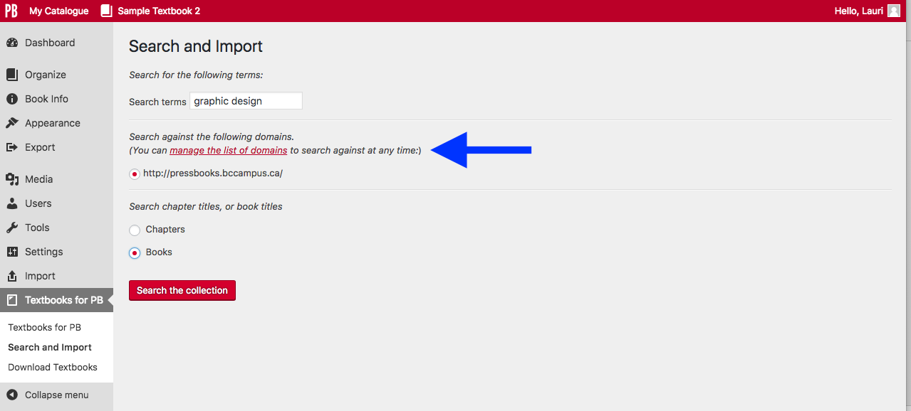
Notes:
However, if you want to also search the internal BCcampus instance of Pressbooks at opentextbc.ca, click on the “manage the list of domains” link indicated by the arrow.
GO TO NEXT SLIDE

Slide 15
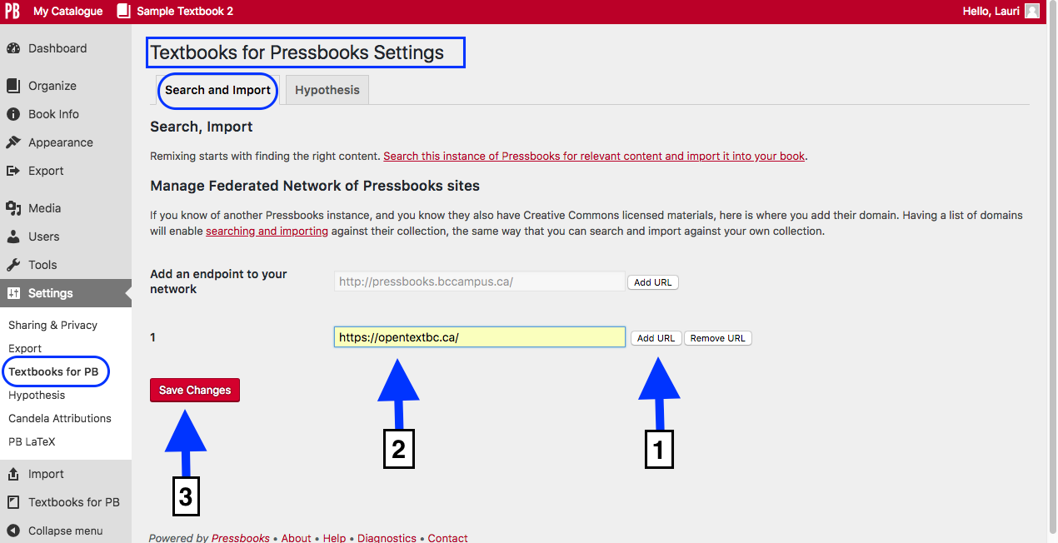
Notes:
…and you will be redirected to the “Search and Import” tab on the “Textbooks for PB” (aka “Textbooks for Pressbooks Settings”) page, under the “Settings” link in the Dashboard.
Here you can add a second domain within which to search for Pressbooks files to import by:
Clicking on the “Add URL” button
Entering the URL of the Pressbooks you want to add. Notice that the two instances hosted by BCcampus are:
https://pressbooks.bccampus.ca
https://opentextbc.ca
Click the red “Save Changes” button

Slide 16
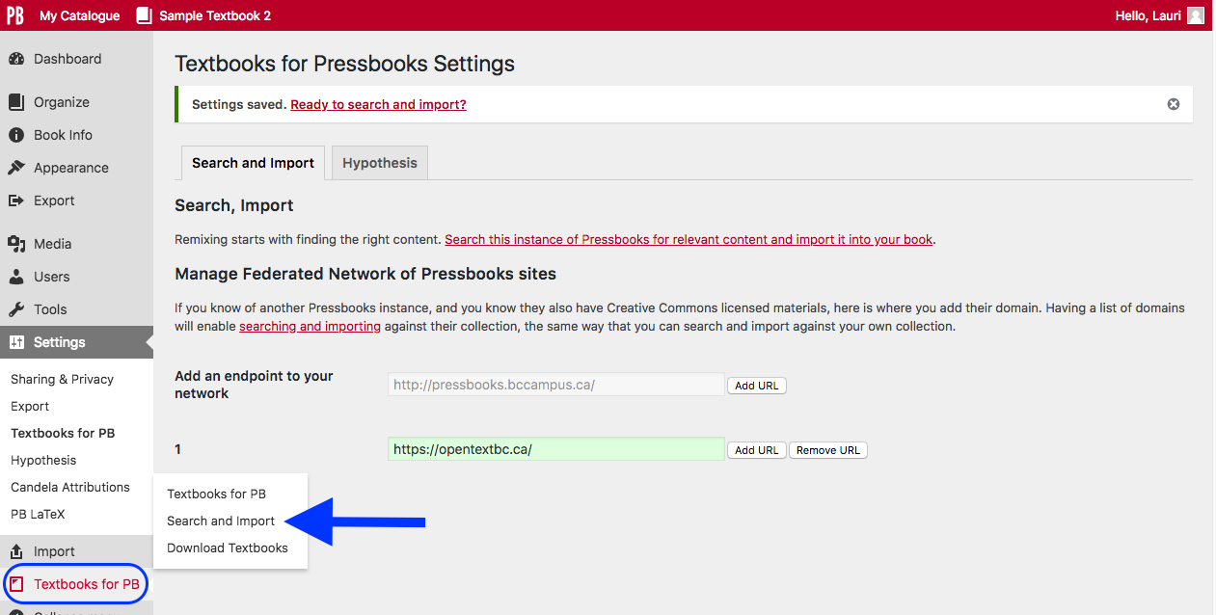
Notes:
To return to the “Search and Import” page, scroll over the “Textbooks for PB” link in the Dashboard and select “Search and Import” from the drop-down list.

Slide 17
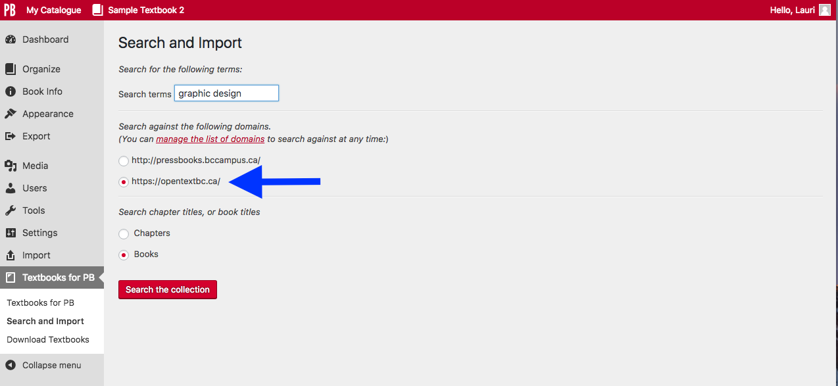
Notes:
Now, by the arrow, you will see that the second Pressbooks instance or domain has been added to the “Search and Import” page so that both instances can be searched.
Notice that radio buttons are used (which are round vs the square checkboxes) for the Pressbooks domains or instances, and under “Search chapter titles, or book titles” for Chapters and Books. This means you can only select one from each group.
1. You can search one domain at a time: pressbooks.bccampus.ca OR opentextbc.ca
2. You can search either Chapter titles OR Book titles, not both at the same time.
For this example, we’ve selected:
opentextbc.ca as the instance
Books
“graphic design” are the keywords added to the “Search terms” field
Begin the search by clicking the red “Search the collection” button
GO TO NEXT SLIDE

Slide 18
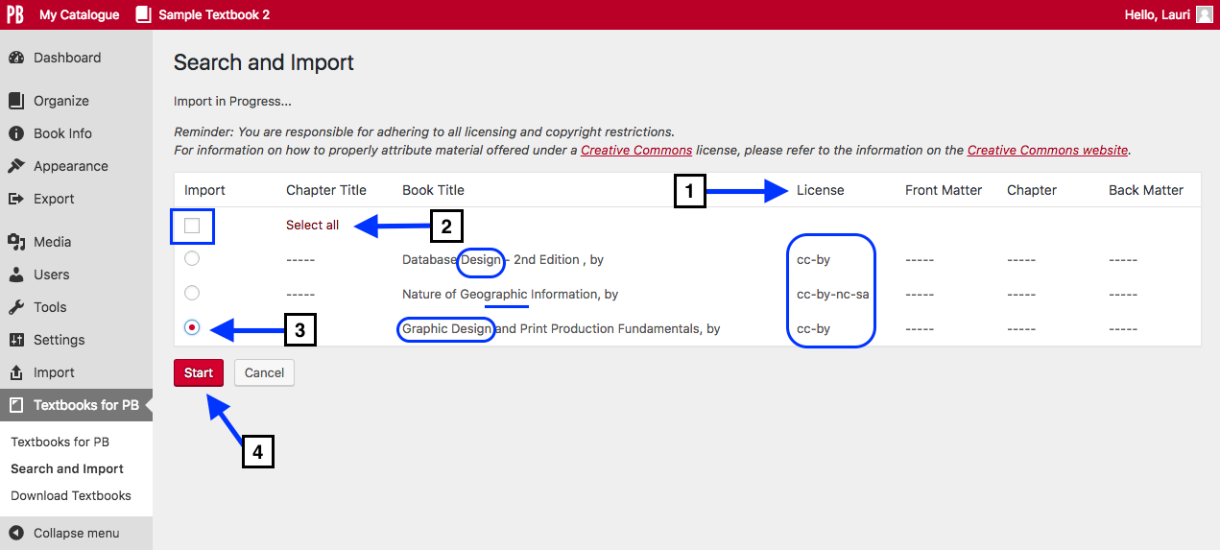
Notes:
This is the result of this search.
Here and some things to notice:
The search looks for the keywords entered – “graphic” OR “design” – in the title of all books in the opentextbc.ca instance of Pressbooks.
See these words circled in blue in this screenshot.
Also notice ”graphic” as part of the word “geographic”, underlined in blue, was selected in the book “Nature of Geographic Information.
Notice:
The type of CC or open-copyright licence for each book
2. You can the “Select all” results checkbox
3. However, the radio button by the “Graphic Design and Print Production Fundamentals” book has been chosen
4. To import, click the red “Start” button. The import can take several minutes, depending on the size of the file.

Slide 19
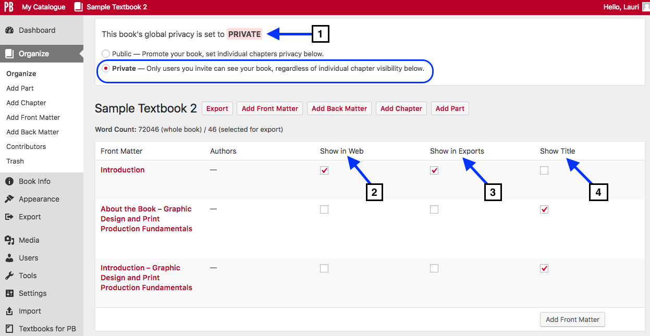
Notes:
When the search is finished, it lands on the “Organize” page shown here.
Notice that:
The book is set to “Private”
Chapters and sections are NOT selected to ”Show in Web”
Chapters and sections are NOT selected to “Show in Exports”
The title for each section and chapter is set to “Show Title”
The disadvantage of using this feature is the inability to delete or move chapters and parts before importing a book. Instead, you must accept all chapters and parts as they appear in the original book and make changes after the import.
And there is one problem….
GO TO NEXT SLIDE

Slide 20
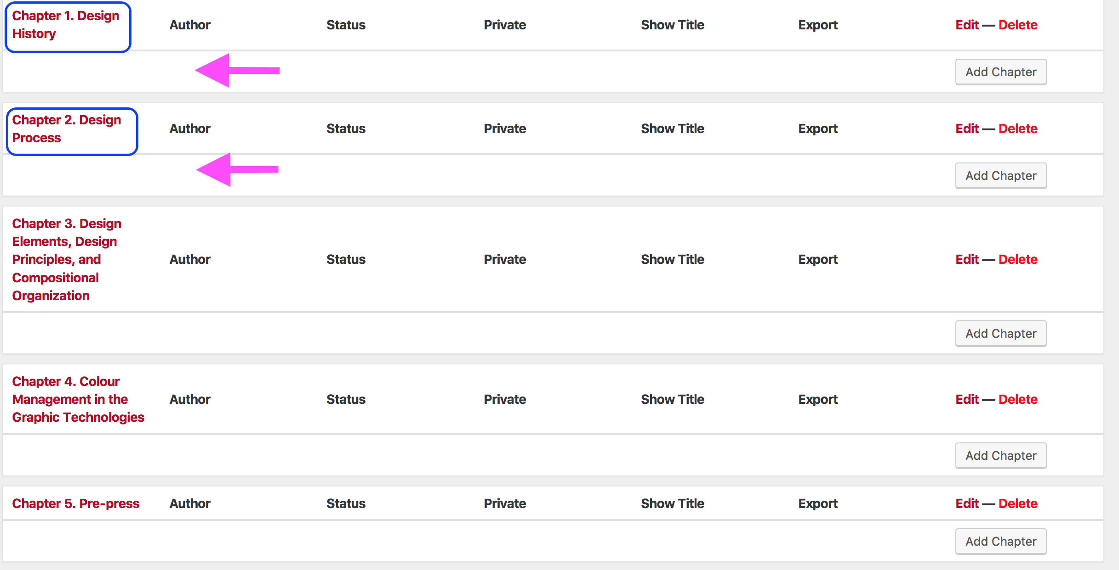
Notes:
… chapters are imported into the Main Body part added when the book shell was created. The parts for the imported book are added separately without their respective chapters.
We are aware of this problem and are currently working to resolve it.

Slide 21
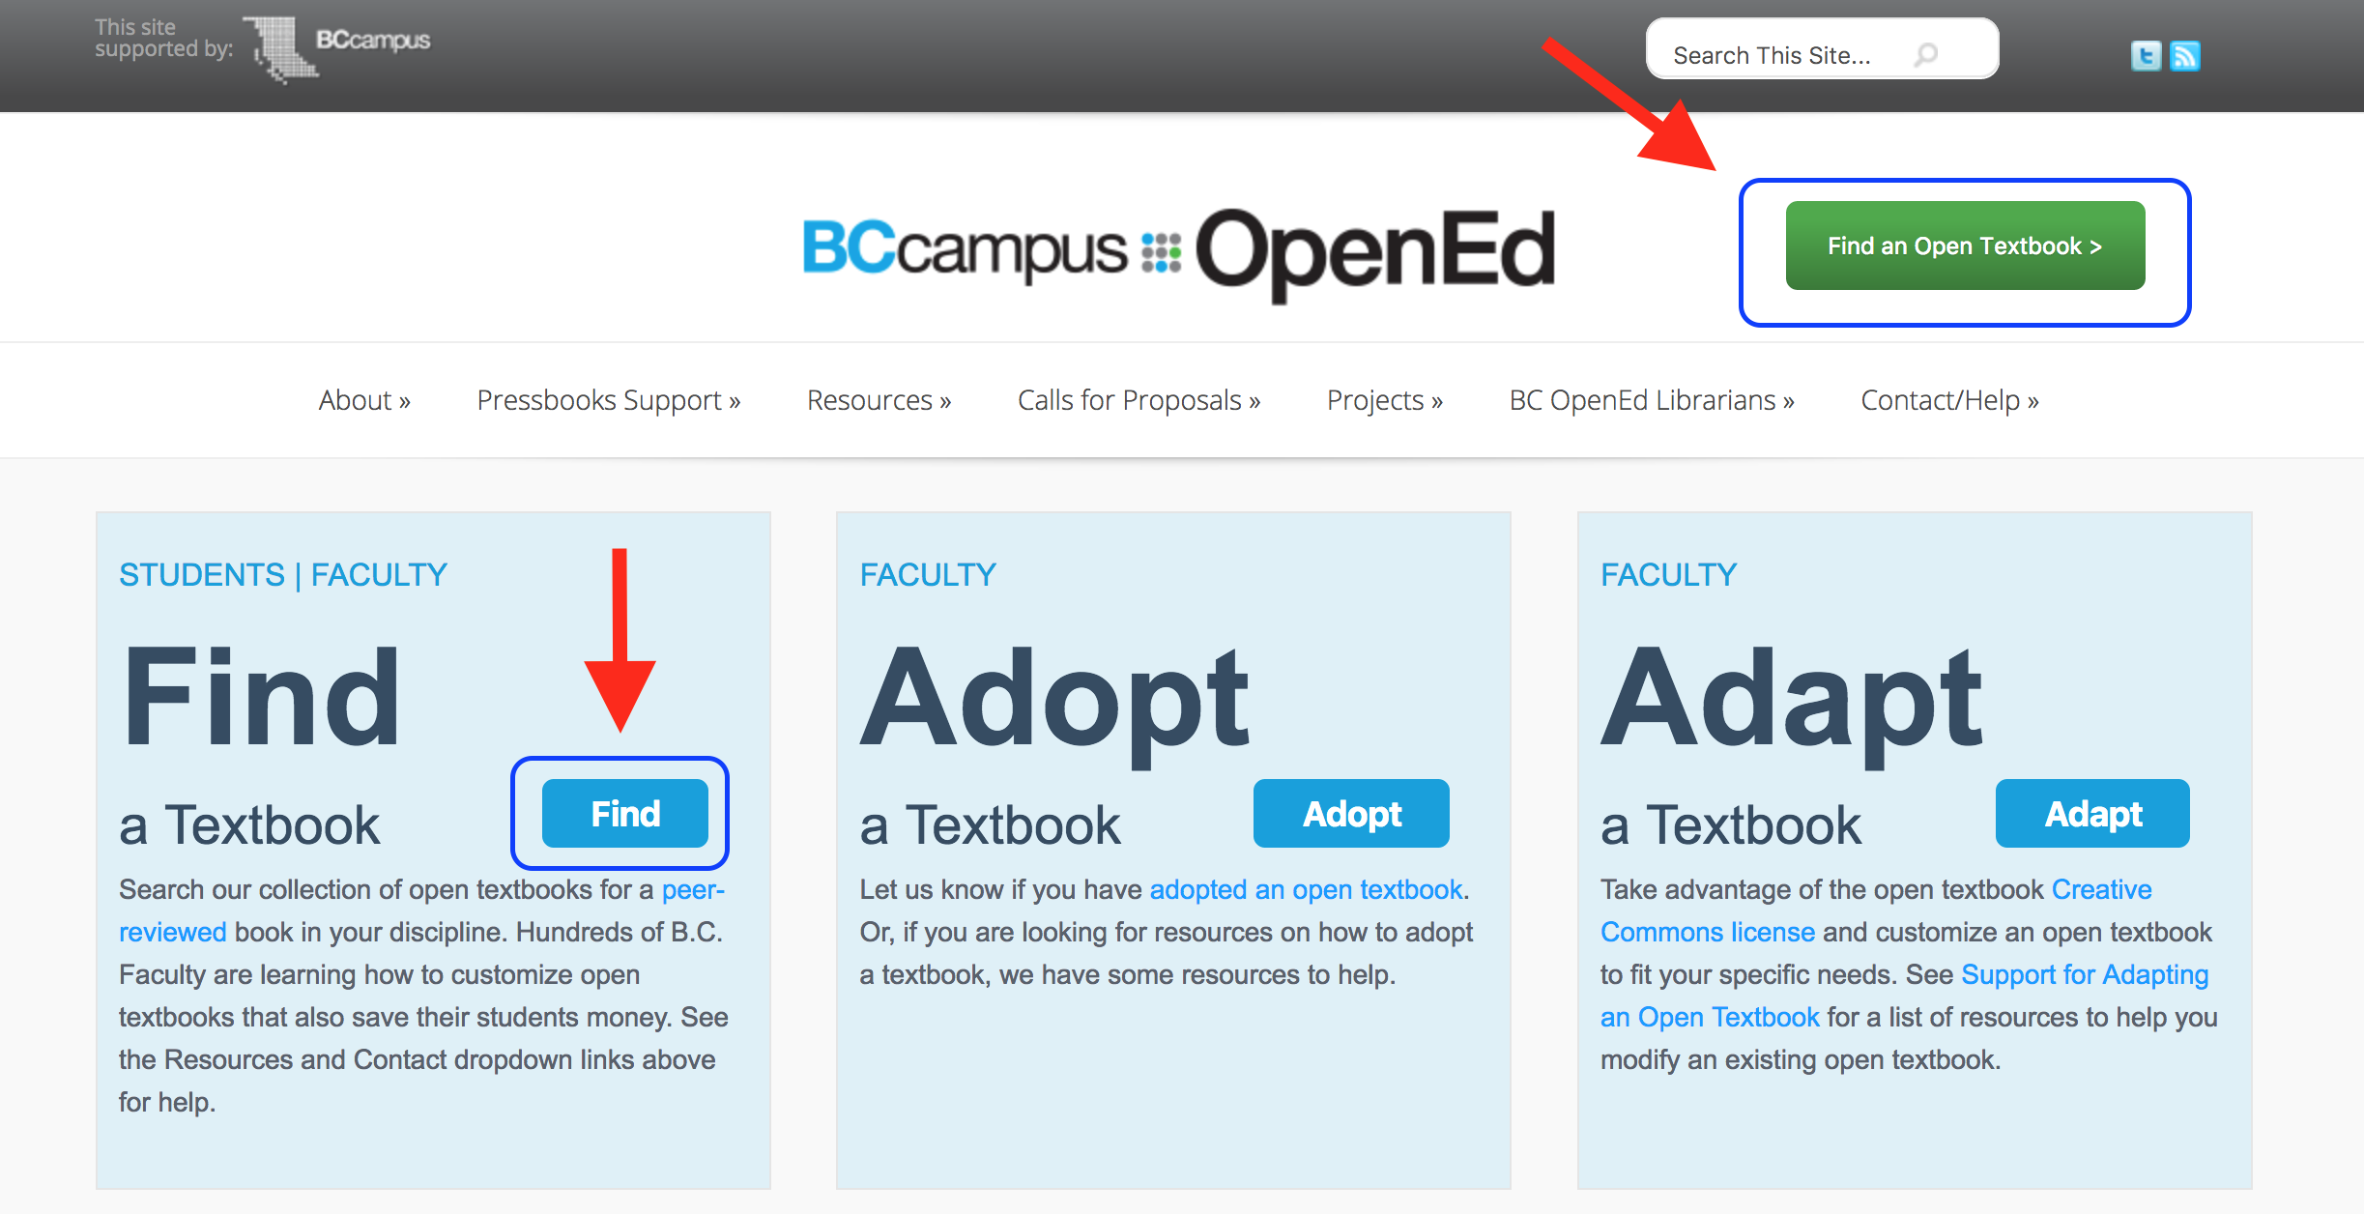
open.bccampus.ca
Notes:
The second – more manual way – to import a Pressbooks file is as follows.
Create a book shell, ready to receive the imported Pressbooks file
Download the Pressbooks file that you will be importing either from a book in another collection or from the B.C. Open Textbook Collection.
To find a book, and its Pressbooks file, from the B.C. Open Textbook Collection, go to the BCcampus OpenEd website and click either of the “Find” buttons shown in this slide.

Slide 22
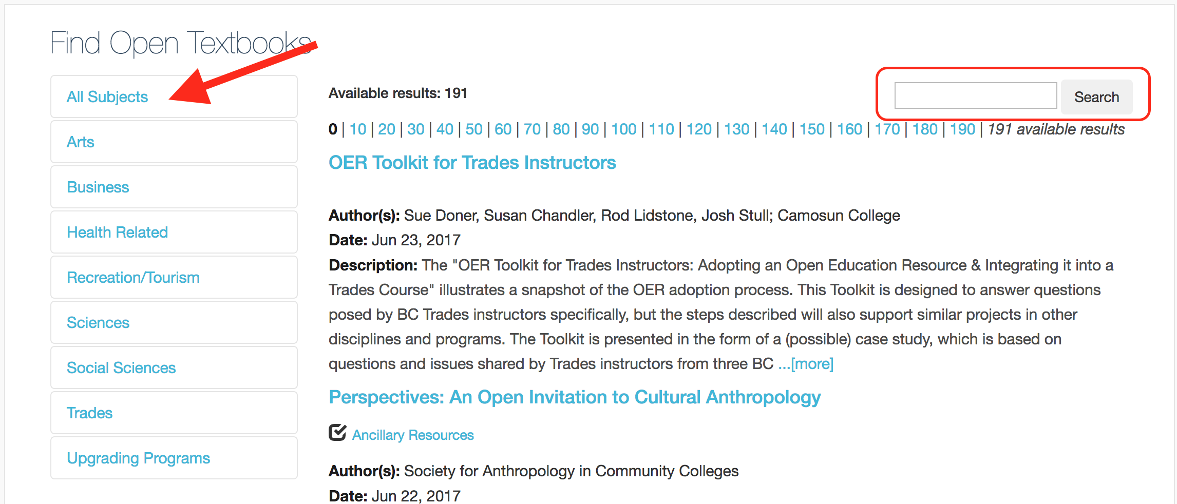
Notes:
Then search for the book you want using the subjects categories on the far left, or the Search field in the top right.

Slide 23
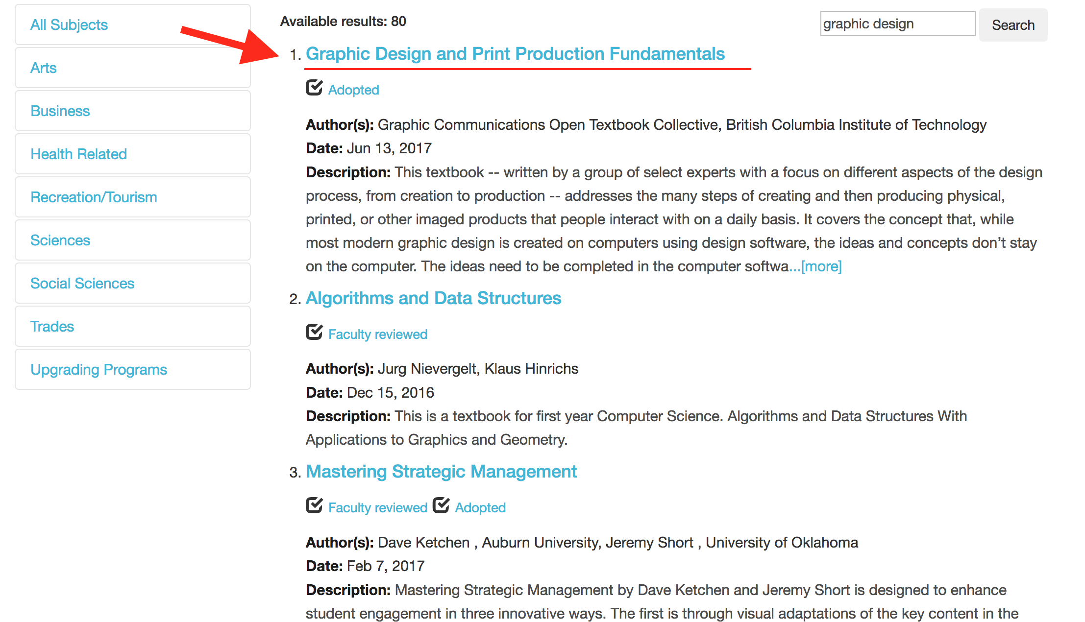
Notes:
Click on the title link of the book you want….
GO TO NEXT SLIDE

Slide 24
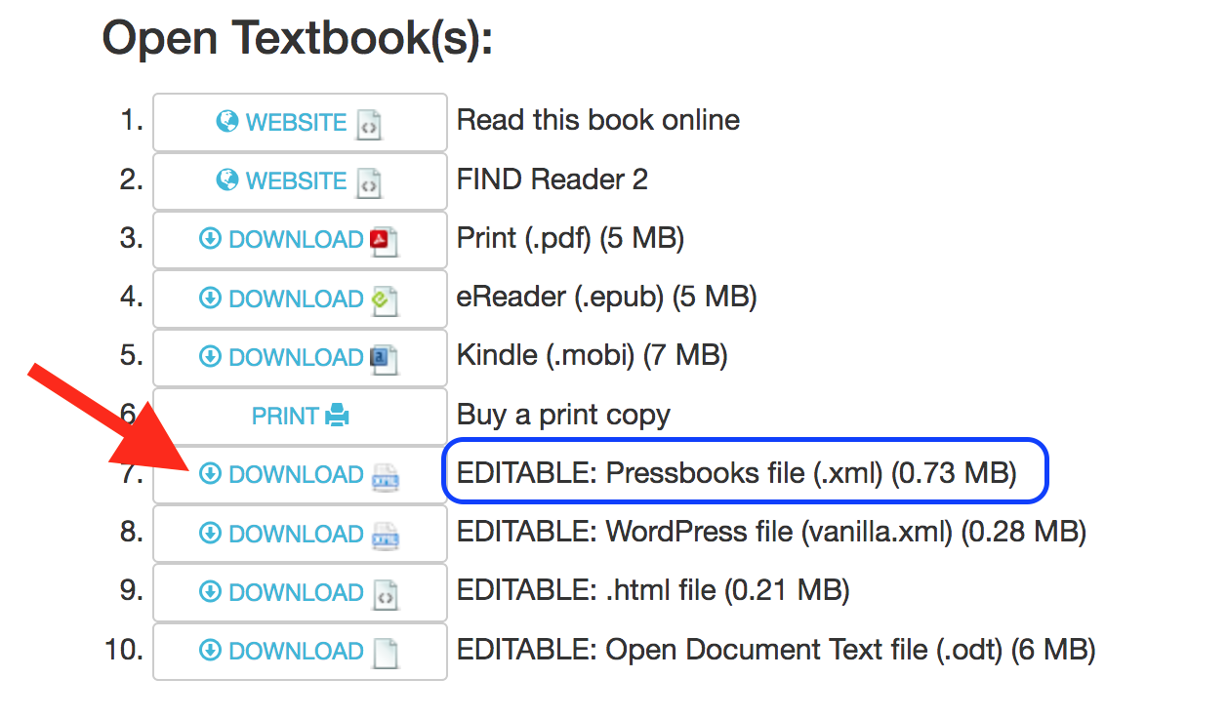
Notes:
… to arrive at the book’s record page.
Below the book’s title, description and cover, are a list of available files. Look for “EDITABLE: Pressbooks file”. Notice that the size of the file is marked at the end of the file’s label. This file is 0.73 MB.

Slide 25
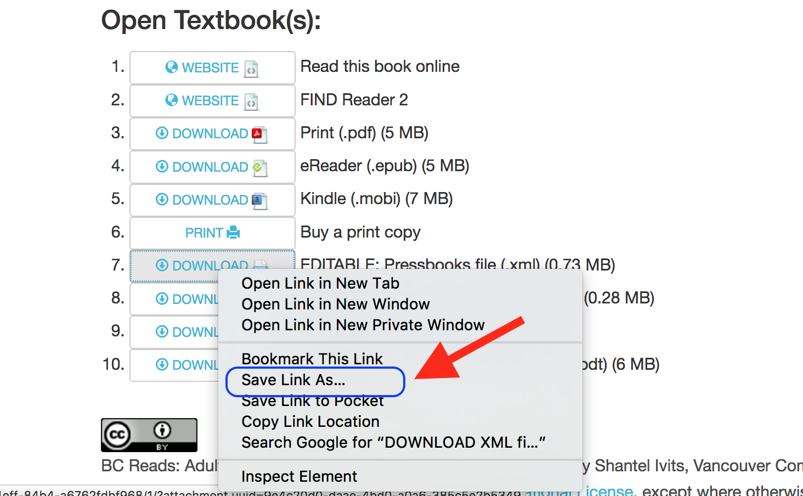
Notes:
For a copy, right-click on the file’s download button and “Save Link As” link. Save the file to a convenient location such as your Desktop, Download folder, or Documents folder.

Slide 26
Notes:
This file can also be found on the book’s Pressbooks homepage accessed by clicking on “Read this book online.”

Slide 27
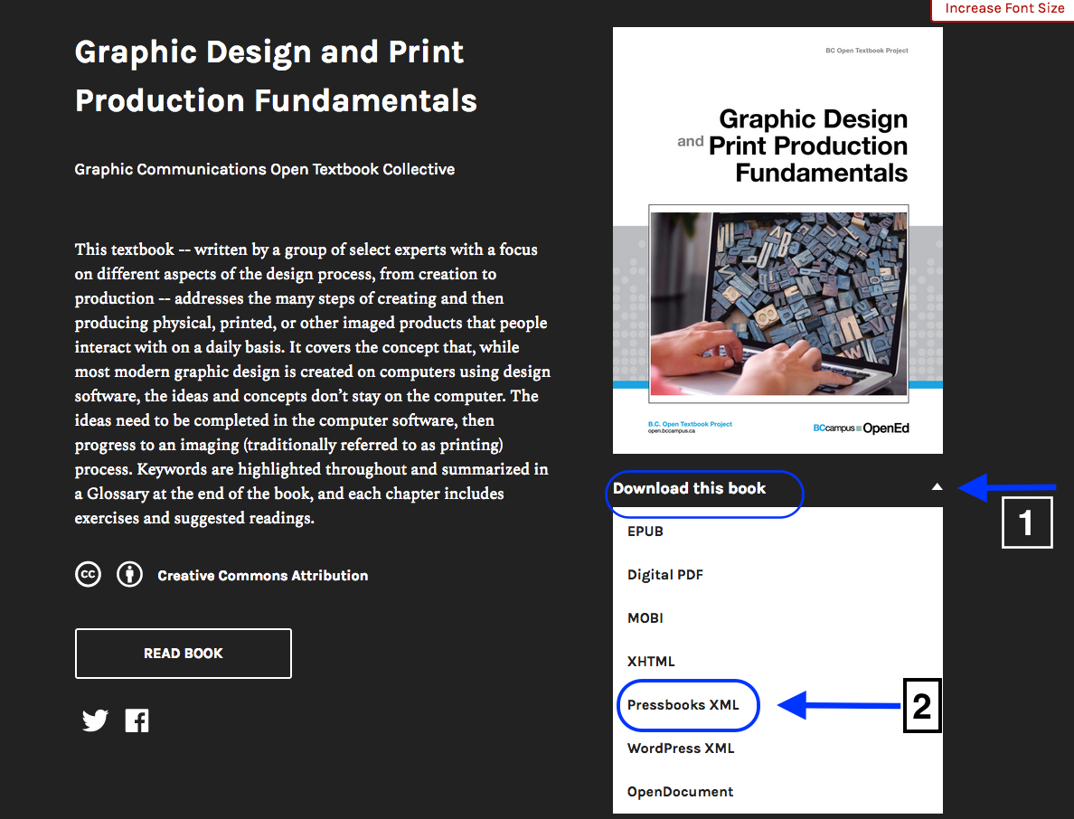
Notes:
The Pressbooks file can then be downloaded.
Click on the the arrow by “Download this book”
Select and download the “Pressbooks XML” file from the drop-down list
Save the file to a convenient location

Slide 28
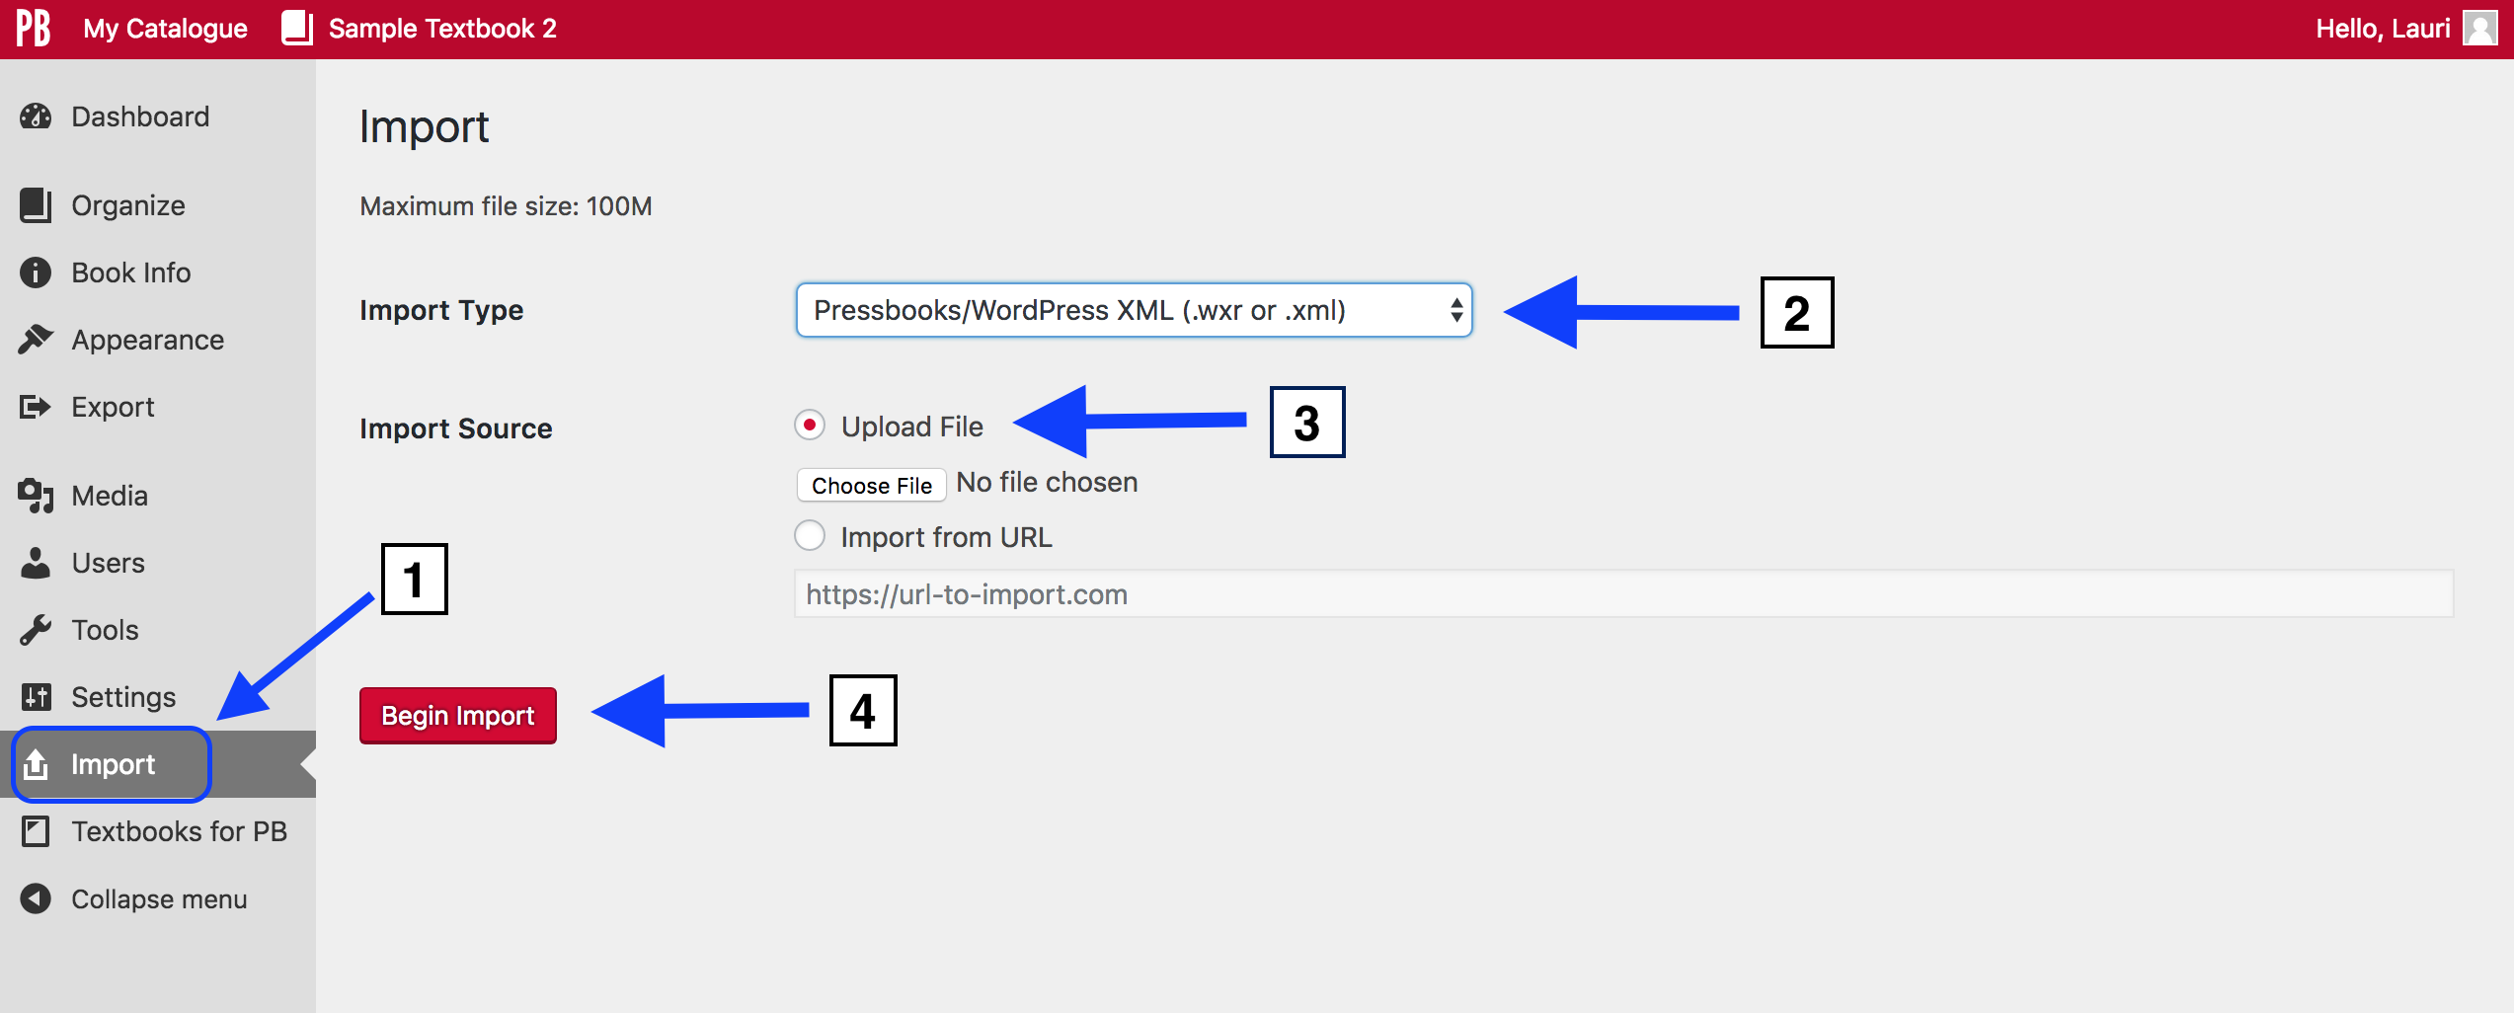
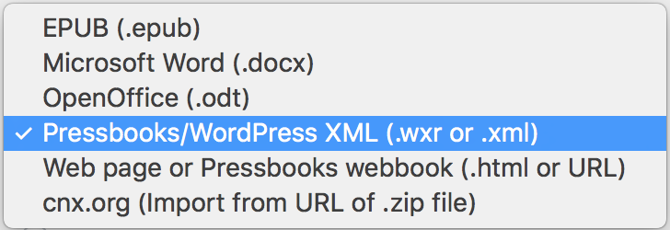
Import Type drop-down list
Notes:
To begin the import process, go to the book shell created to receive this Pressbooks file.
Next:
Go to the Import page found on the Dashboard
From the “Import Type” drop-down list select “Pressbooks/WordPress XML”
By “Import Source”
select “Upload File”
with “Choose File”, locate and upload the desired Pressbooks file
Click the “Begin Import” button

Slide 29
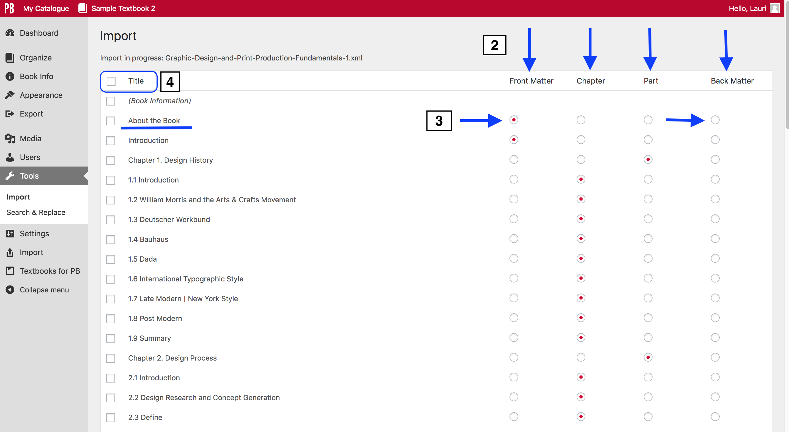
Notes:
When the Pressbooks file has completed the import routine, this is what you’ll see.
Notice that:
Each Chapter (used as chapter sections in this book) are listed separately
To the right of the page, a blue radio button indicates the part of the book that chapters or chapter sections have been placed: front matter, Main Body part, or back matter
items placed in the Main Body are marked by their unit: i.e., Chapter or Part.
Parts are often used as chapter breaks and title pages.
If you want to move a chapter to a different part of the book, use the radio buttons.
For example, if you prefer that “About the Book” appears in the back matter rather than the front matter, then uncheck the radio button under Front Matter and check the radio button under Back Matter.
Lastly, take note of the checkbox by “Title” in the top left corner, and by each chapter. Use these checkboxes to select the chapters you want to import or….
GO TO NEXT SLIDE

Slide 30
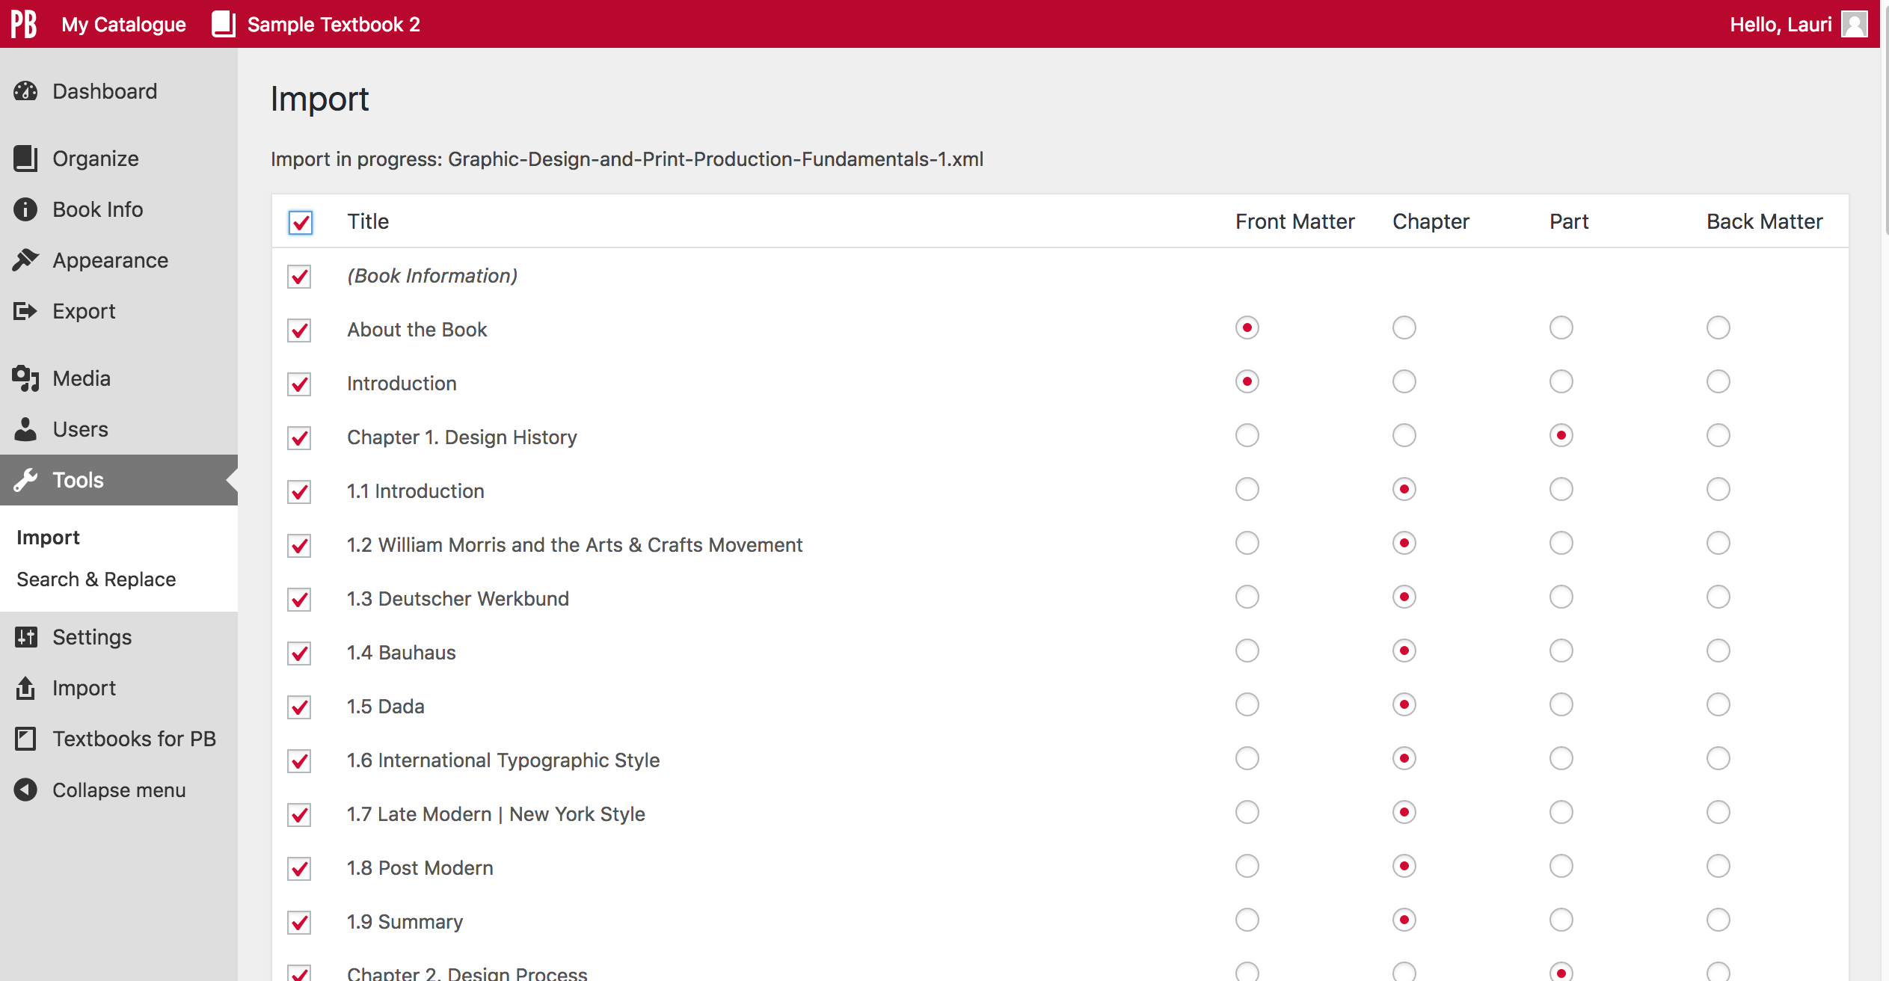
Notes:
…if you want to import the entire book, choose the checkbox by “Title” and all chapters, parts, and sections in the front and back matter will be imported.

Slide 31
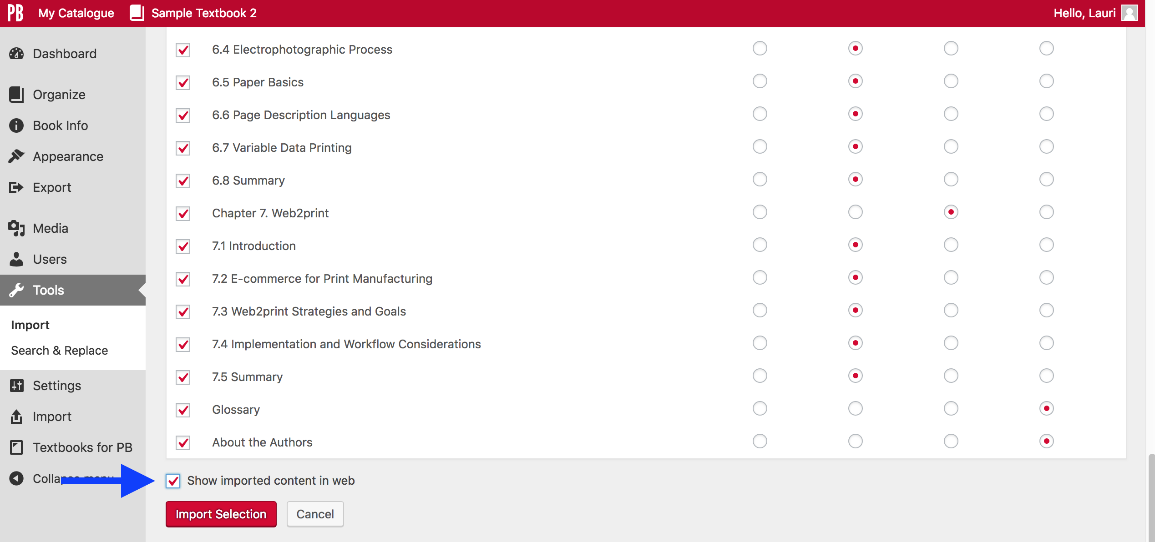
Notes:
Before you hit the red “Import Selection” button, notice the feature called “Show imported content in web.”
If this checkbox is NOT selected, then all chapters, parts, and sections of the book imported will be “drafts”, i.e. they will not be seen in the book view.
This feature also turns on the “Show in Exports” option for every chapter etc. (This makes sure that chapters etc. are included when a book is exported.)
If you do not select this checkbox now, you will need to check the “Show in Web” and “Show in Exports” checkboxes by each chapter, part, and section after it’s been imported.
The “Cancel” button next to “Import Selection” deletes this stage of the Pressbooks file import process.

Slide 32
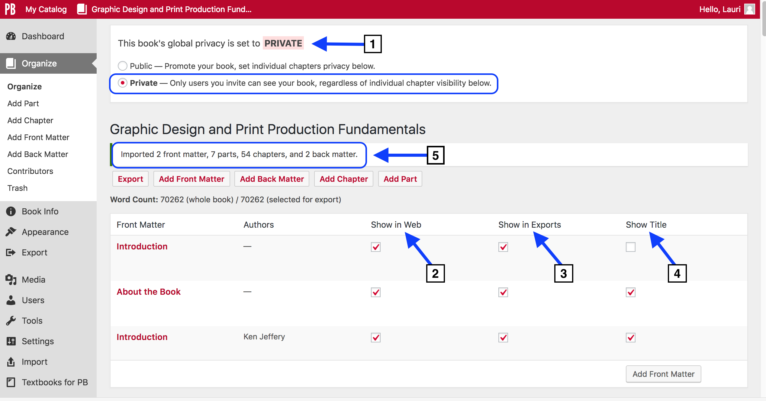
Notes:
Once the import routine has finished, you will be taken to the “Organize” page of the book, shown here.
Notice:
The book’s global privacy is set to “Private”
Chapters and sections ARE selected to ”Show in Web”
Chapters and sections ARE selected to “Show in Exports”
The title for each section and chapter is set to “Show Title”. All three of these are default settings.
Unlike the “Search and Import” function, pulling a book in this way results in this summary statement which indicates how many front matter sections, parts, chapters, back matter sections were imported. The word count for the entire book (70,262) is also listed below that.
All chapters (chapter sections) are placed in their correct parts (marked as chapters in this book).

Slide 33
Lesson 2
How to clone a textbook
Notes:
Lesson 2: How to clone a textbook.
The easiest way to copy an open textbook from within the BCcampus Pressbooks network or from another Pressbooks network is to use the cloning feature.
This feature allows you to copy books from most Pressbooks instances (including those outside of the B.C. system) as long as
The book has been assigned a Creative Commons licence (on its Book Info page) or is in the public domain
Note: All newly created books are not assigned a CC licence so are, by default, restricted with “All rights reserved”. These books cannot be cloned until a CC licence or public domain are assigned.
This feature does not work for books that use the ND (non-derivative) option of a Creative Commons licence
The book is marked as “public”. This feature does not work for marks marked as “private”.
The Pressbooks instance is version 4.1 or higher.

Slide 34
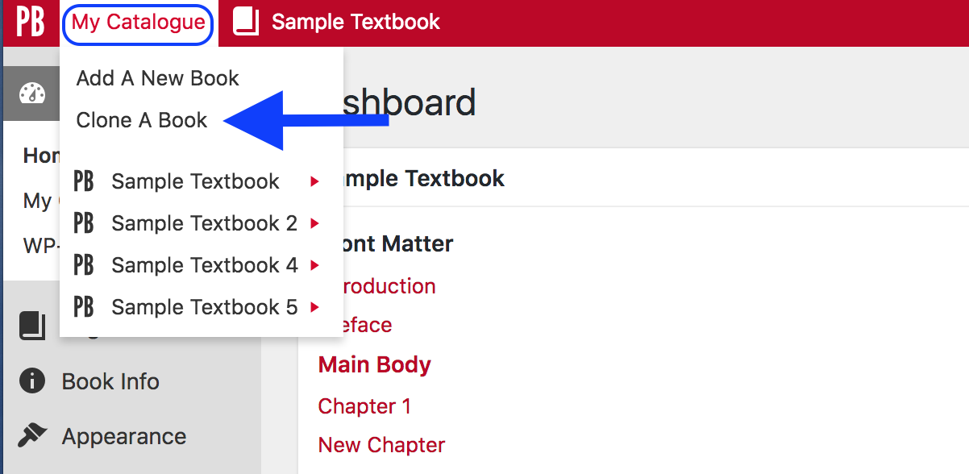
Notes:
To begin:
Scroll over “My Catalogue in the red PB menu bar and
Click on “Clone a Book”

Slide 35
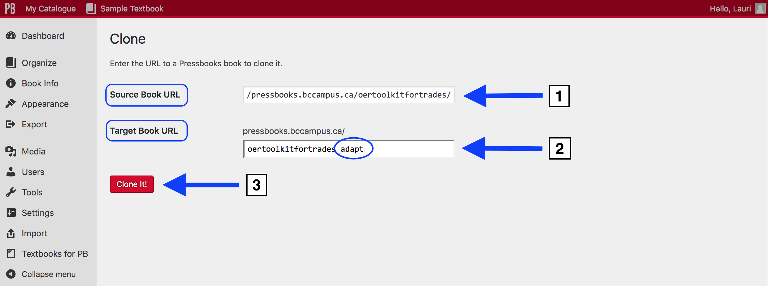
Notes:
This will take you to the “Clone” page.
Here:
Enter the URL or web address of the book you would like to clone – also called the source book – in the “Source Book URL” field. In this example, the “OER Toolkit for Trades” has been chosen.
In the “Target Book URL” add the descriptor you want to use to create the URL or web address for your cloned book, also called the target or destination book.
In this example, “oertoolkitfortrades” has been used plus “adapt” because the plan is to revise the original book.
The other reason for this title is the original book is hosted in the same self-serve instance of Pressbooks as this account.
If the same URL descriptor is used, Pressbooks will reject it because all book URLs must be unique
Note: Your book URL can only contain lowercase letters (a-z) and numbers.
To finish, click the red “Clone It” button.

Slide 36
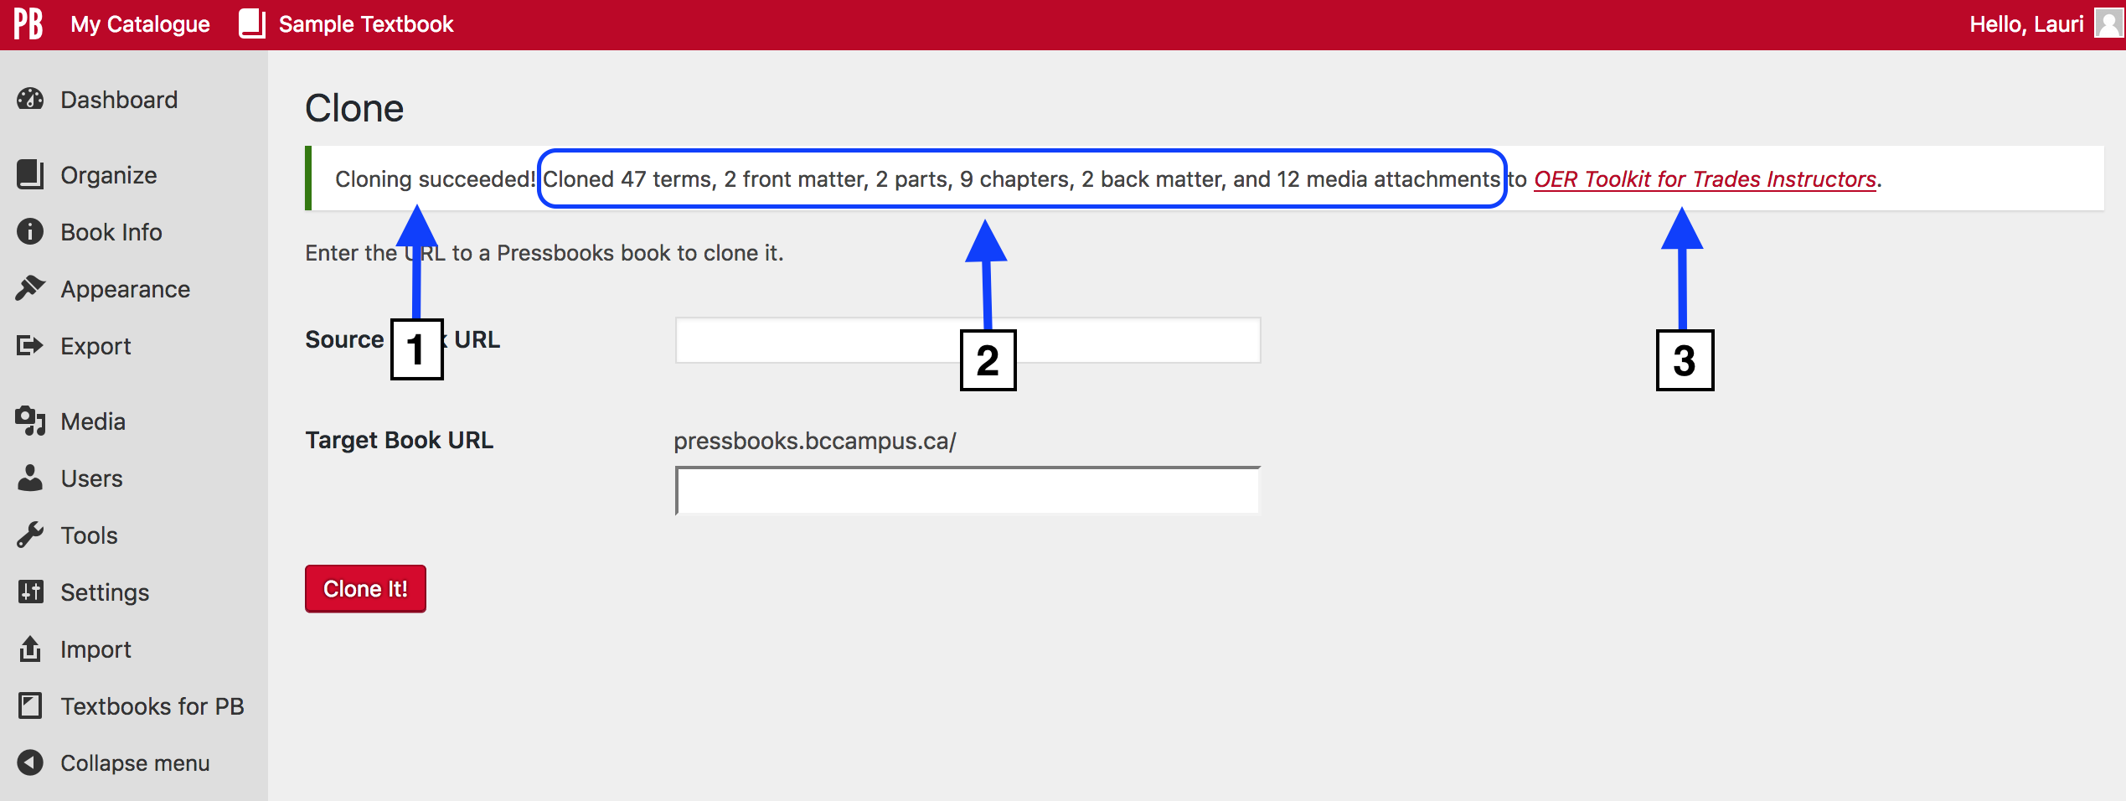
Notes:
Once the cloning process is completed, this is the message your will see.
“Cloning succeeded”
A list of items cloned such as the number of parts, chapters, and the media in the Media Library
A link to the cloned book
The book’s title – in this case “OER Toolkit for Trades Instructors” – is linked to the newly cloned book
The target book URL will also go to the cloned book

Slide 37
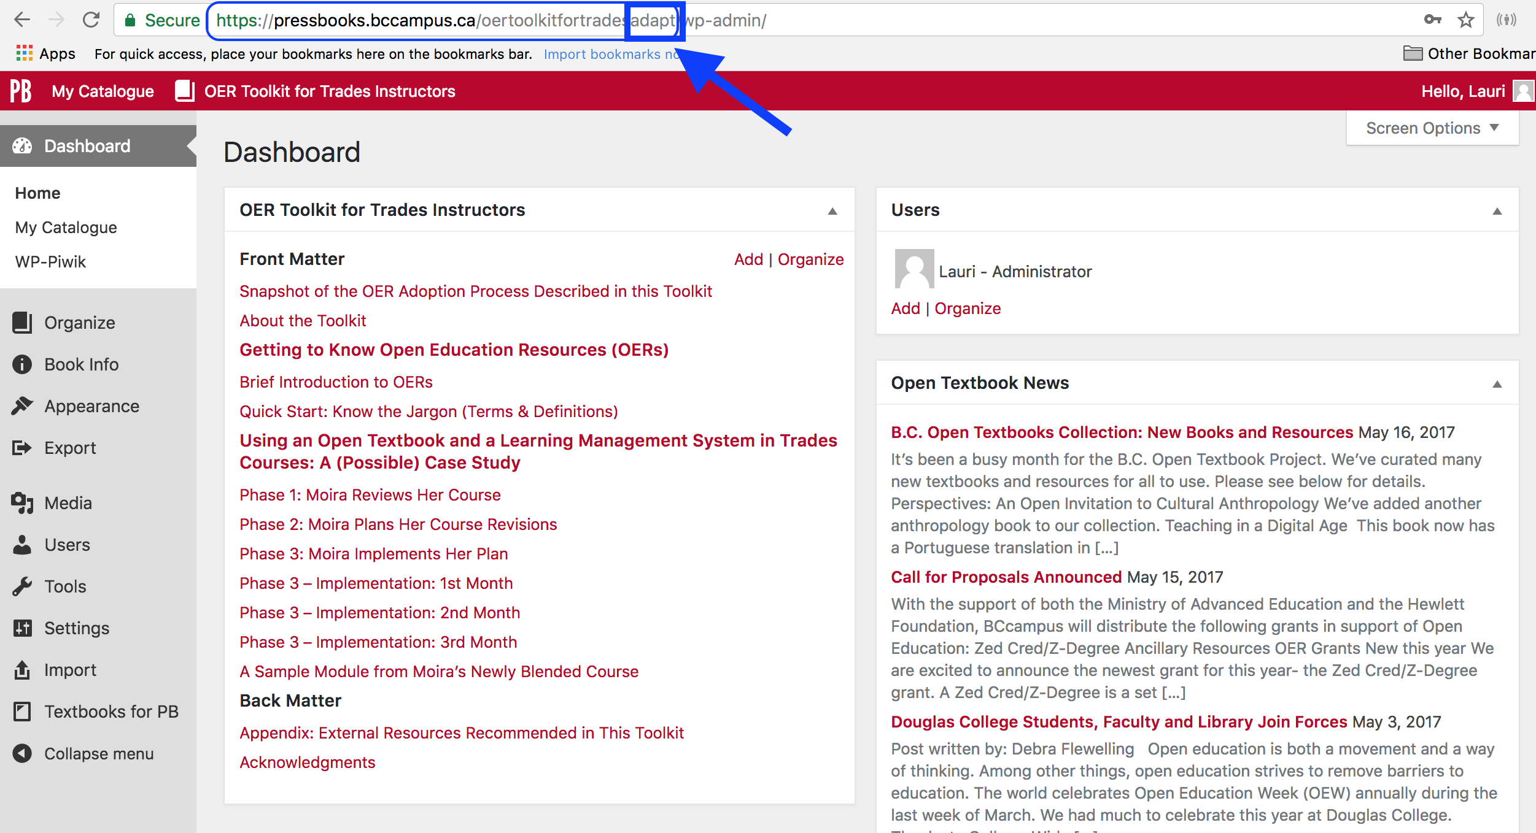
Notes:
Here’s the Dashboard view of the cloned book. It is identical to the original except for the URL which, unlike the web address for the original book, has “adapt” appended to the end.
You can now use this book as is or make changes.

Slide 38
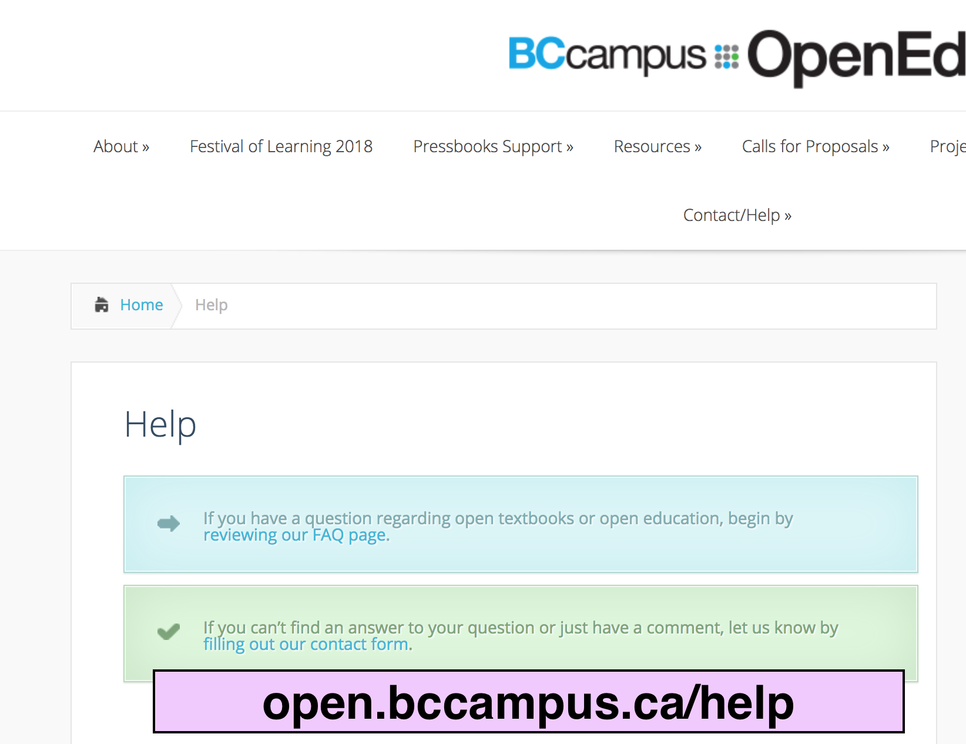
Notes:
Cloning a textbook is a relatively new feature. If you experience problems, see the BCcampus Open Education FAQs for the key open education contact at your institution.
Also, you may run into timing out issues when cloning if:
A book is very large
There is a problem with the Pressbooks network where the original book is hosted

Slide 39
Lesson 3
How to import a Word document
Notes:
Lesson: How to import a Word document into Pressbooks account will be covered next.

Slide 40

Word document
.doc
.docx
Several formatting and styling items will be
lost during this import routine.
Word-document (https://pixabay.com/en/word-document-document-text-150594/ ) released with CC0.
Notes:
Many authors use Word to write or begin to write a book. Often these authors or someone else who wants to adapt their work then look to the import feature to bring the Word document into Pressbooks.
In many ways, importing a Word file is very similar to importing a Pressbooks file. However, there are some items to be aware of before undertaking this step.
See: https://guide.pressbooks.com/chapter/import-from-word-docx/

Slide 41
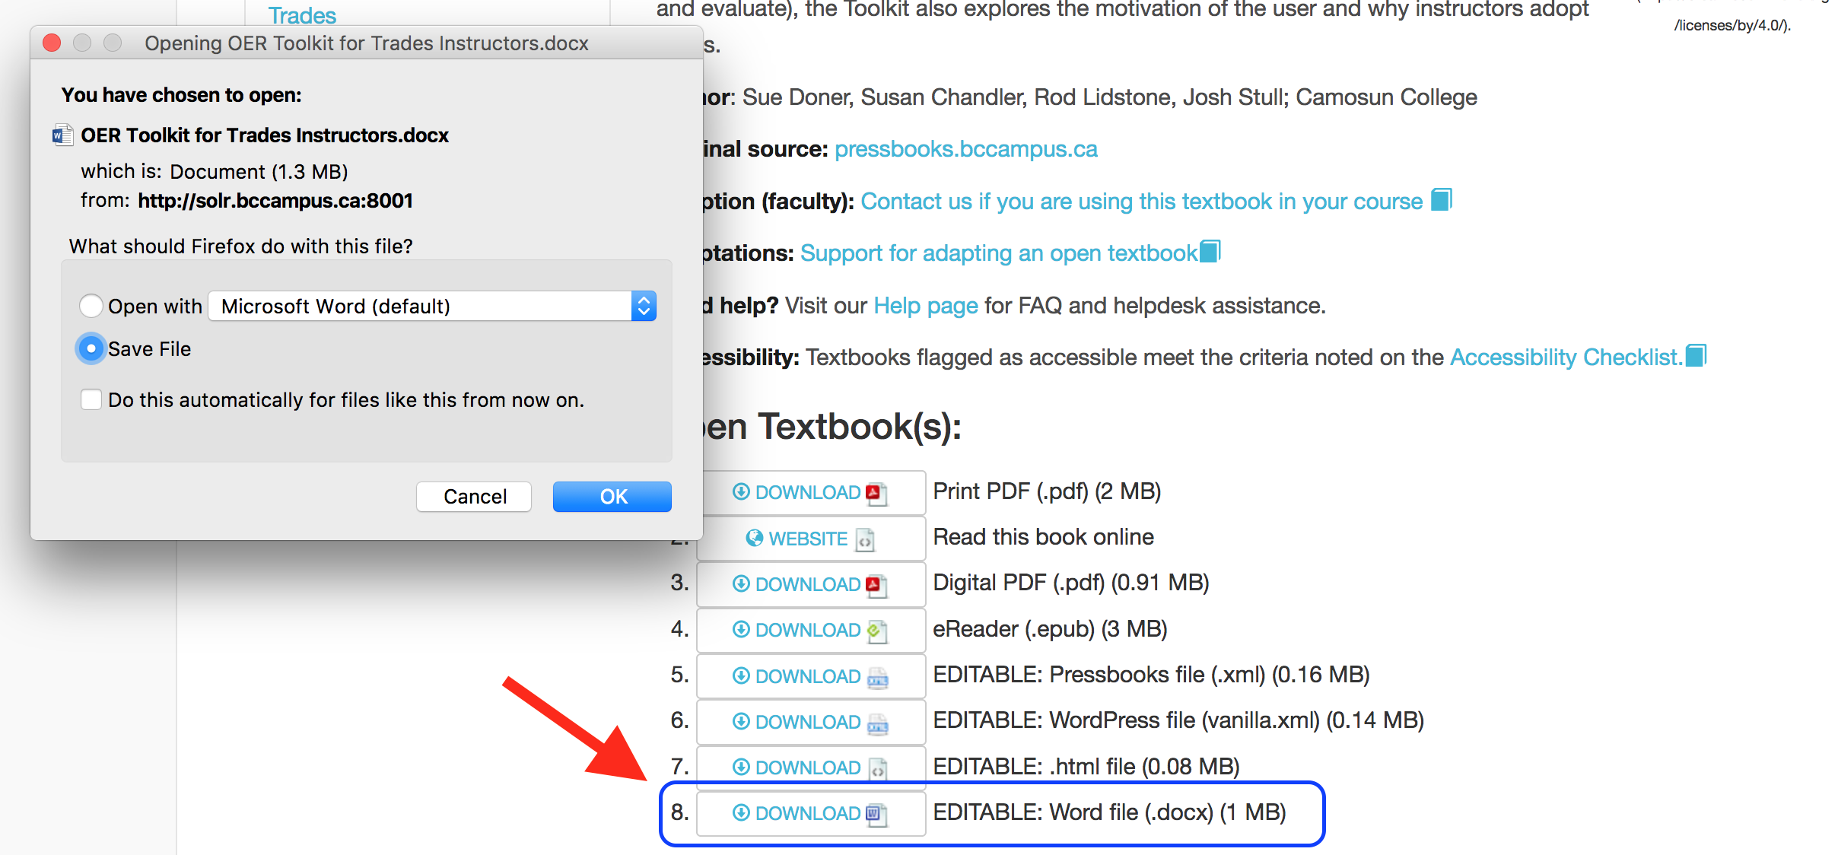
Notes:
Make sure you have downloaded and saved the Word document to your desktop or a folder, such as Downloads or Documents, that you access during the Import routine.
For most authors wanting to import a book into Pressbooks using a Word document do so because:
This is the format with which they have used to write a book or
It is only format available for a book written by another author
Some books in the B.C. Open Textbook Collection include Word document files. However, it is strongly recommended that, if available, a Pressbooks file be used instead of a Word file to import a book into Pressbooks.
Note that Pressbooks is unable to export or generate Word documents so you will not find a Word file on the Pressbooks home page of any textbooks. The closest option is an ODT (Open Document Text) or OpenDocument file.

Slide 42
Proprietary Source Code | Open Source Code
Owned by a company | In the public domain
Guarded by company | Open to the public
Complex | Simpler
Proprietary standards | Open source standards
Notes:
Because the code behind Word documents is proprietary (that is, owned by Microsoft and not open source), it was difficult for Pressbooks developers to create an import routine that recognizes all of the formatting dictated by this code. Not only is proprietary code often guarded by the company that owns it, but it can be very long and complex.
Open source code, upon which Pressbooks is built, is not only free and open to all developers, but tends to follow established open standards and is relatively simple compared to proprietary code.

Slide 43

Digital by geralt (https://pixabay.com/en/digital-zeros-ones-woman-stylish-388075/) released with CC0.
Notes:
Once you understand some of the differences between proprietary code (used for Word) and open source code (used for Pressbooks), then you can begin to appreciate why importing a Word document into Pressbooks might present some problems and why it was difficult for Pressbooks developers to create a system that allows the importing of Word into Pressbooks.
Word documents have thousands of lines of code behind them; by comparison, an Open Document Text (the open source version of Word) has several hundred lines of code.

Slide 44
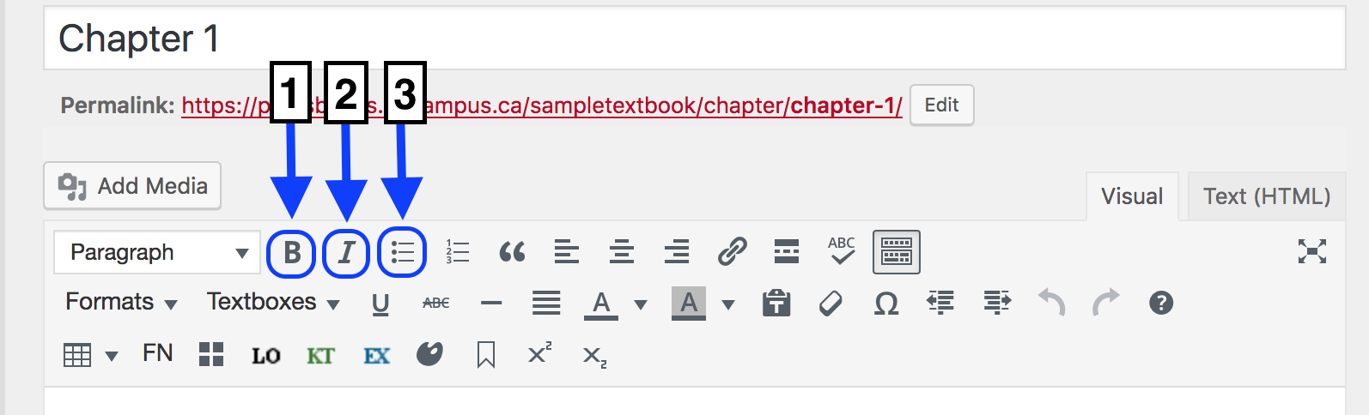
Notes:
Pressbooks developers have done their best to create an import routine that allows Pressbooks to accept a Word document. However, here are some items to be aware of.
Most standard formatting, such as:
Bold
Italics and
Bulleted lists
… should remain intact during the import if standard markup language was used to insert these in the original Word document. (In other words, if the standard Style menu is used – at the top of the Word Home page, as shown in this screenshot.)
The cleaner your Word file is to begin with, with as little formatting as possible except for bold, italics, bulleted lists, and headings, the less clean-up you’ll need to do after it’s been imported into Pressbooks.
Take note of the following:
More exotic styling, such as different font types and coloured text, are lost during import
Underlines are also lost
Numbered lists will appear as bulleted lists
Smart Art images will be lost during import

Slide 45
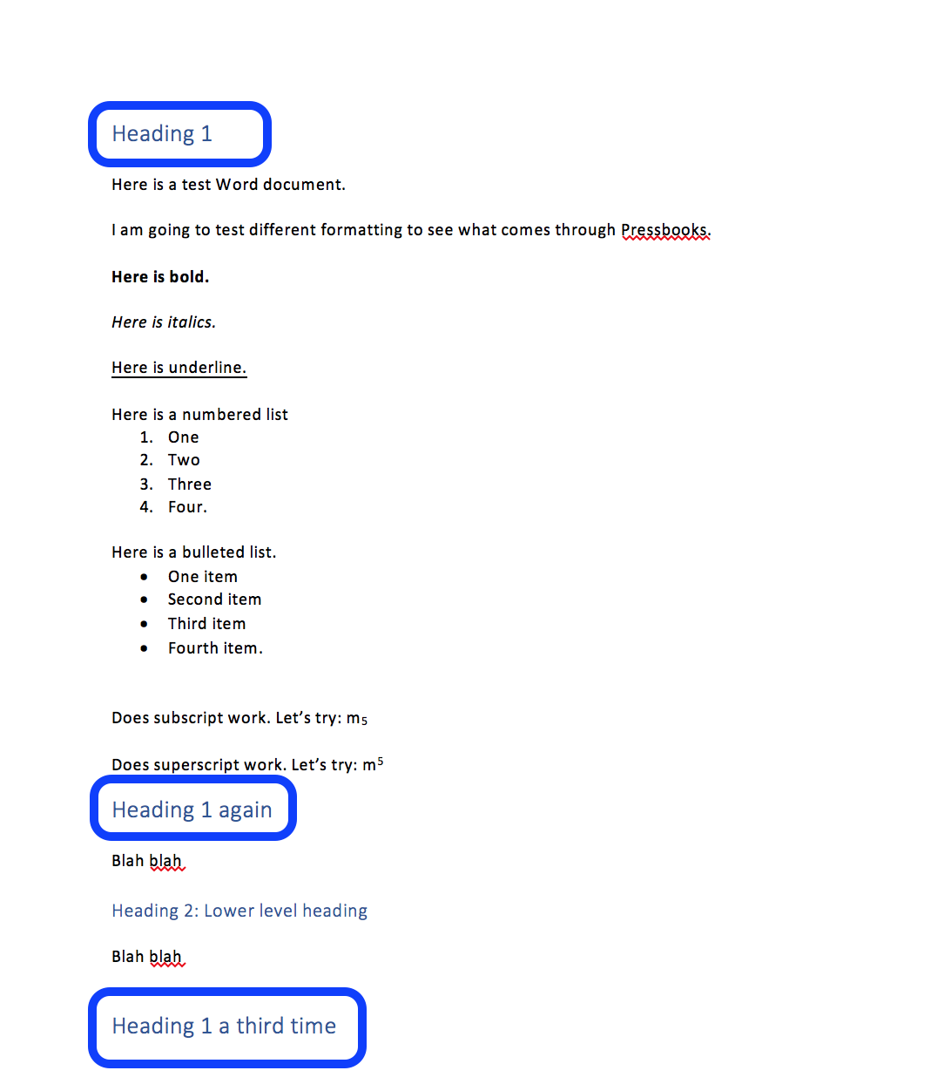
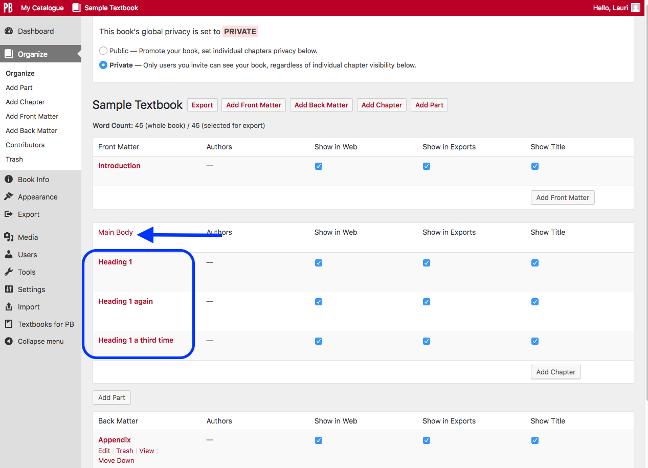
Notes:
If a book is divided into parts or chapters in Word, this layout will be lost during the import to Pressbooks. However, there is a work-around.
Pressbooks will create a new chapter every time Heading 1 is used in Word. So if you want your book to import into separate chapters, make sure that each chapter title is set as Heading 1.
Heading levels lower than “1” should display accurately throughout the chapter.
This slide shows how this works.
On the left side, notice how Heading 1 is used to mark each chapter in a Word document.
The right side of the slide shows the view from the “Organize” page after this Word document has been imported into Pressbooks.

Slide 46
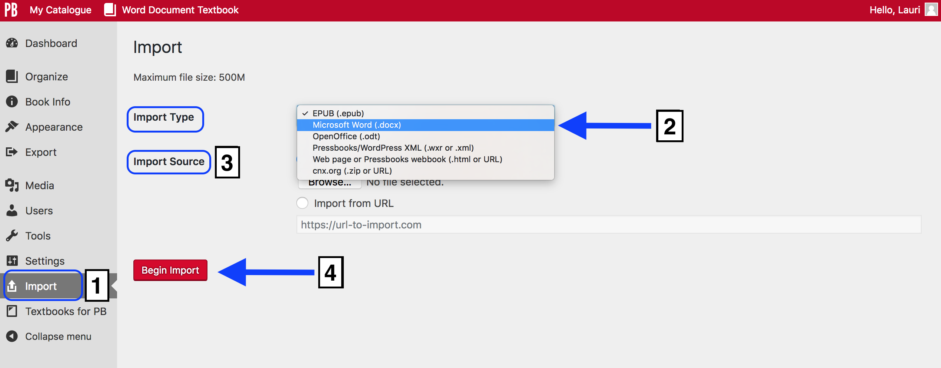
Notes:
To import a Word document, begin by setting up a book shell ahead of time (like is done to import a Pressbooks file).
Go to the “Import” link on the Dashboard of the book shell
From the “Import Type” drop-down list select “Microsoft Word (.docx)”
Make sure that “Upload File” is selected as the “Import Source”
Browse and select Word file
Click the “Begin Import” button

Slide 47
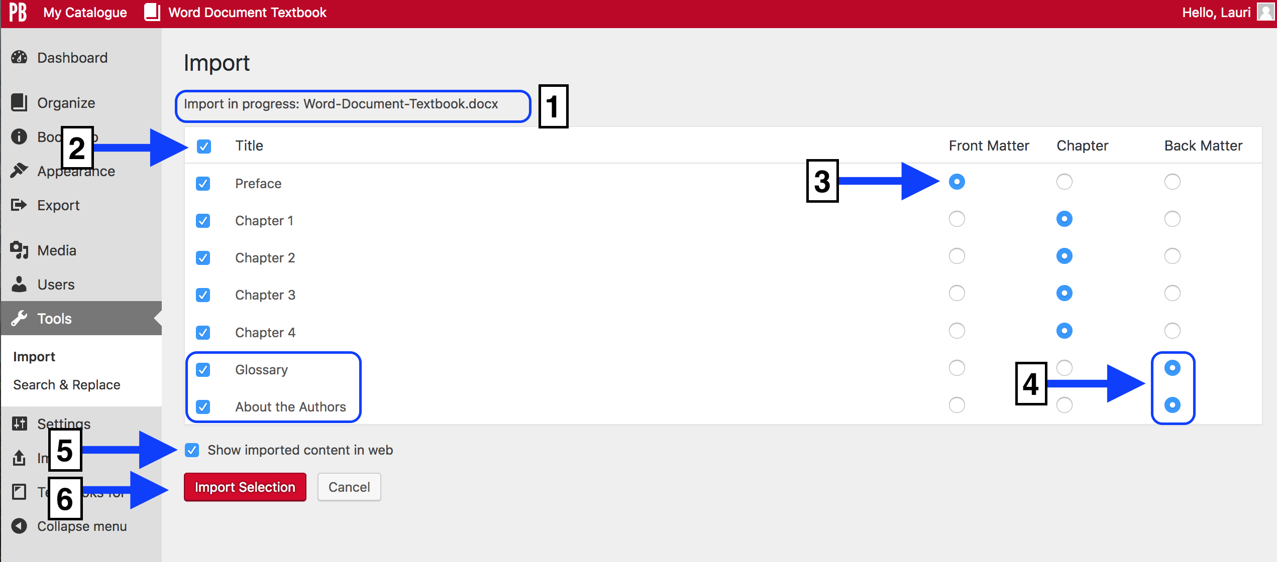
Notes:
The next step of the import process takes you to this page.
The name of your Word document file
Decide which chapters you want to import: some or all of them
Determine if you want to move some chapters to other parts of the book. Here the “Preface” has been moved to the front matter.
The “Glossary” and “About the Authors” section have been moved to the back matter
Select “Show imported content in web” if you want all chapters and sections to display in the online version of your book. If this is not selected, you will need to check each chapter after the import.
Click the “Import Selection” button to complete the import

Slide 48
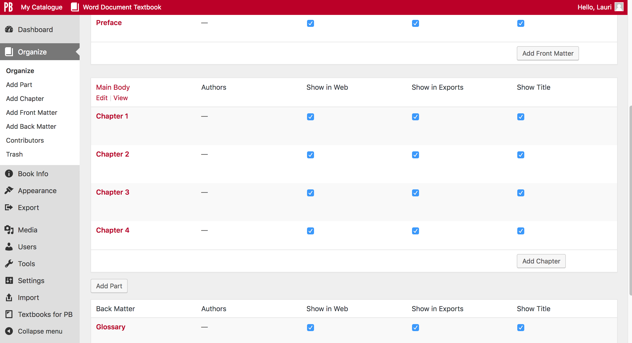
Notes:
Here is the book in the “Organize” view. Each Heading 1 section has imported as a separate chapter, and added to the part (front matter, main body, or back matter) selected.

Slide 49
Lesson 4
How to export
many file types
for one book
Notes:
Now we’ll look at how you can export a variety of file types such as XML files (for use with Pressbooks and WordPress), PDFs, ePUB for eReaders or eBooks, MOBI for Kindles, ODT (Open Document Text files, and HTML files.
This function is covered by video tutorial 12.

Slide 50
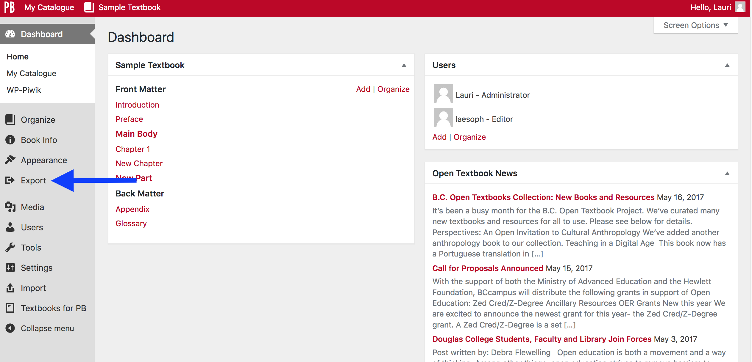
Notes:
One of the advantages of using Pressbooks as an authoring platform is that a variety of file types can be generated for a book.
To export a variety of file types:
Log into your Pressbooks account
Go to the Dashboard
Select “Export”

Slide 51
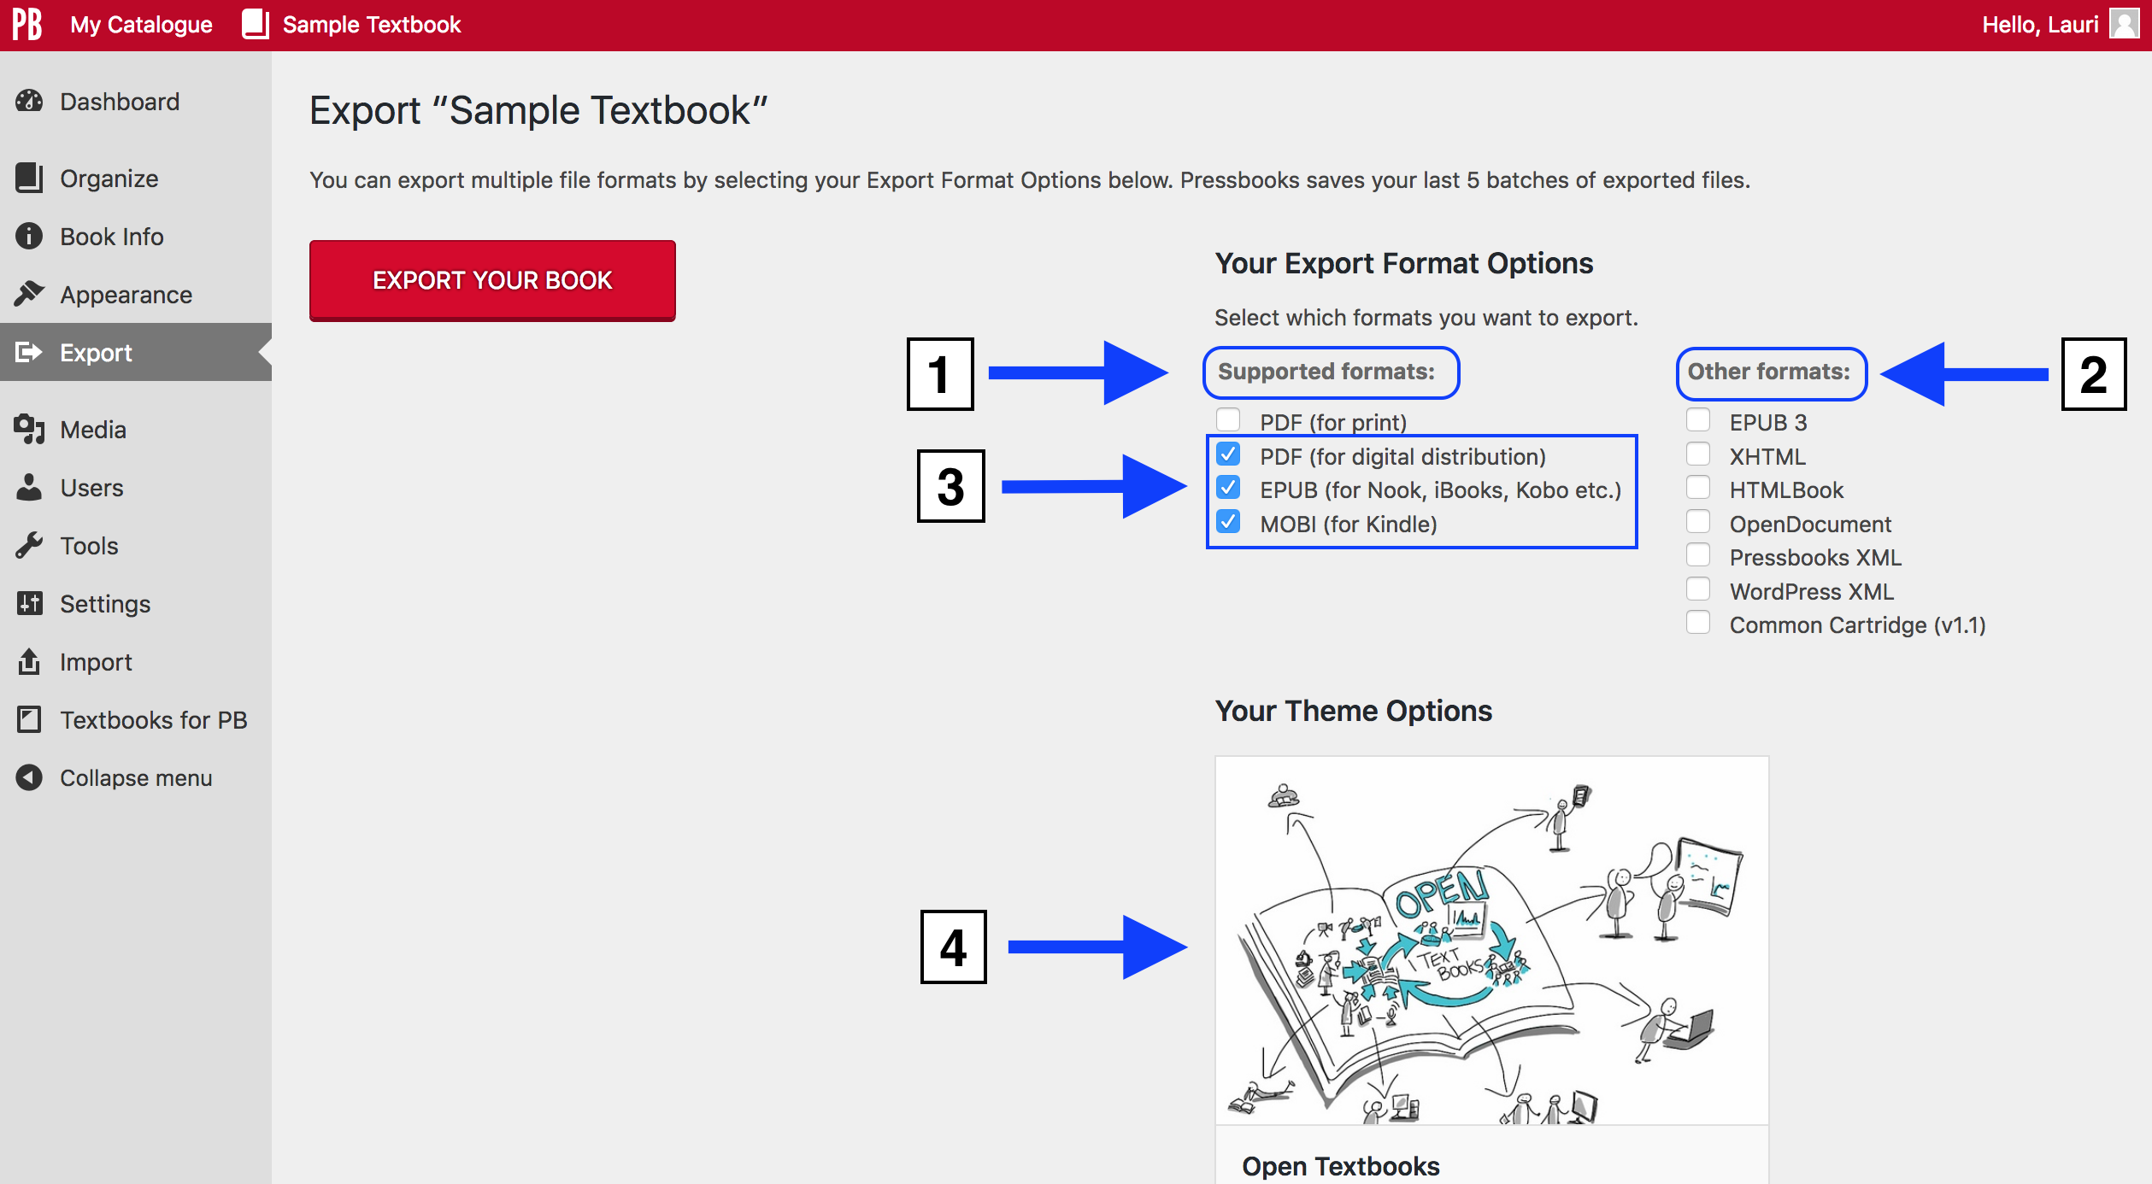
Notes:
Here is the Export page where you can see two categories of available file formats.
1. “Supported formats” include:
PDF (for print)
PDF (for digital distribution)
EPUB (for eReaders or eBooks such as Nook, iBooks, Kobo), and
MOBI (for Kindle)
”Other formats”, i.e. file types that are used less frequently, include:
EPUB 3 (beta version of EPUB)
XHTML
HTML Book
OpenDocument (or ODT, an open source version of Word)
Pressbooks (XML), used to import an existing book
WordPress (XML)
Common Cartridge (in beta), used to import a book into an LMS such as D2L or Moodle
Notice that when you land on the Export page, these three files are already checked (by default); however you can select whichever file types you want to export. The default files are:
PDF (for digital distribution)
EPUB (for eReaders or eBooks such as Nook, iBooks, Kobo), and
MOBI (for Kindle)
The theme for the book is displayed on this page too. This is important to know because the styling used by each theme affects the look of the exported files.
The theme can be changed on this page by hovering over the “Open Textbooks” bottom banner

Slide 52
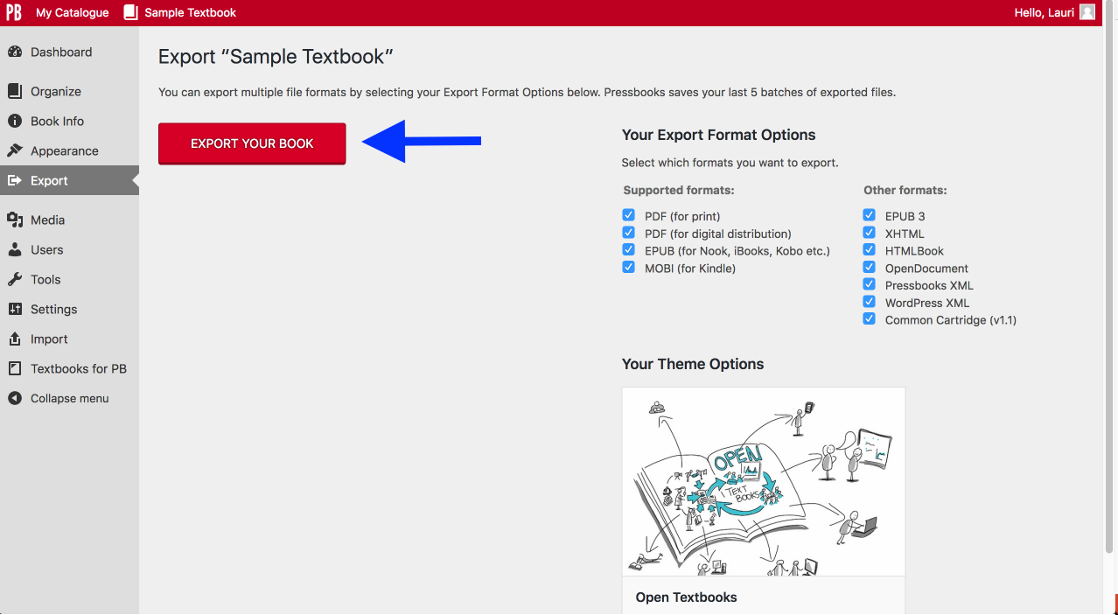
Notes:
You can export one, two, or all of these files at once. Just select the checkbox by the files you want to export, and then click on the red “Export Your Book” button. Depending on the size of book, this process can take seconds to several minutes to complete.
All file types are exported for open textbooks published by BCcampus Open Education. This is done to give instructors, students, and other readers the full range of options afforded by the book’s open-copyright licence.

Slide 53
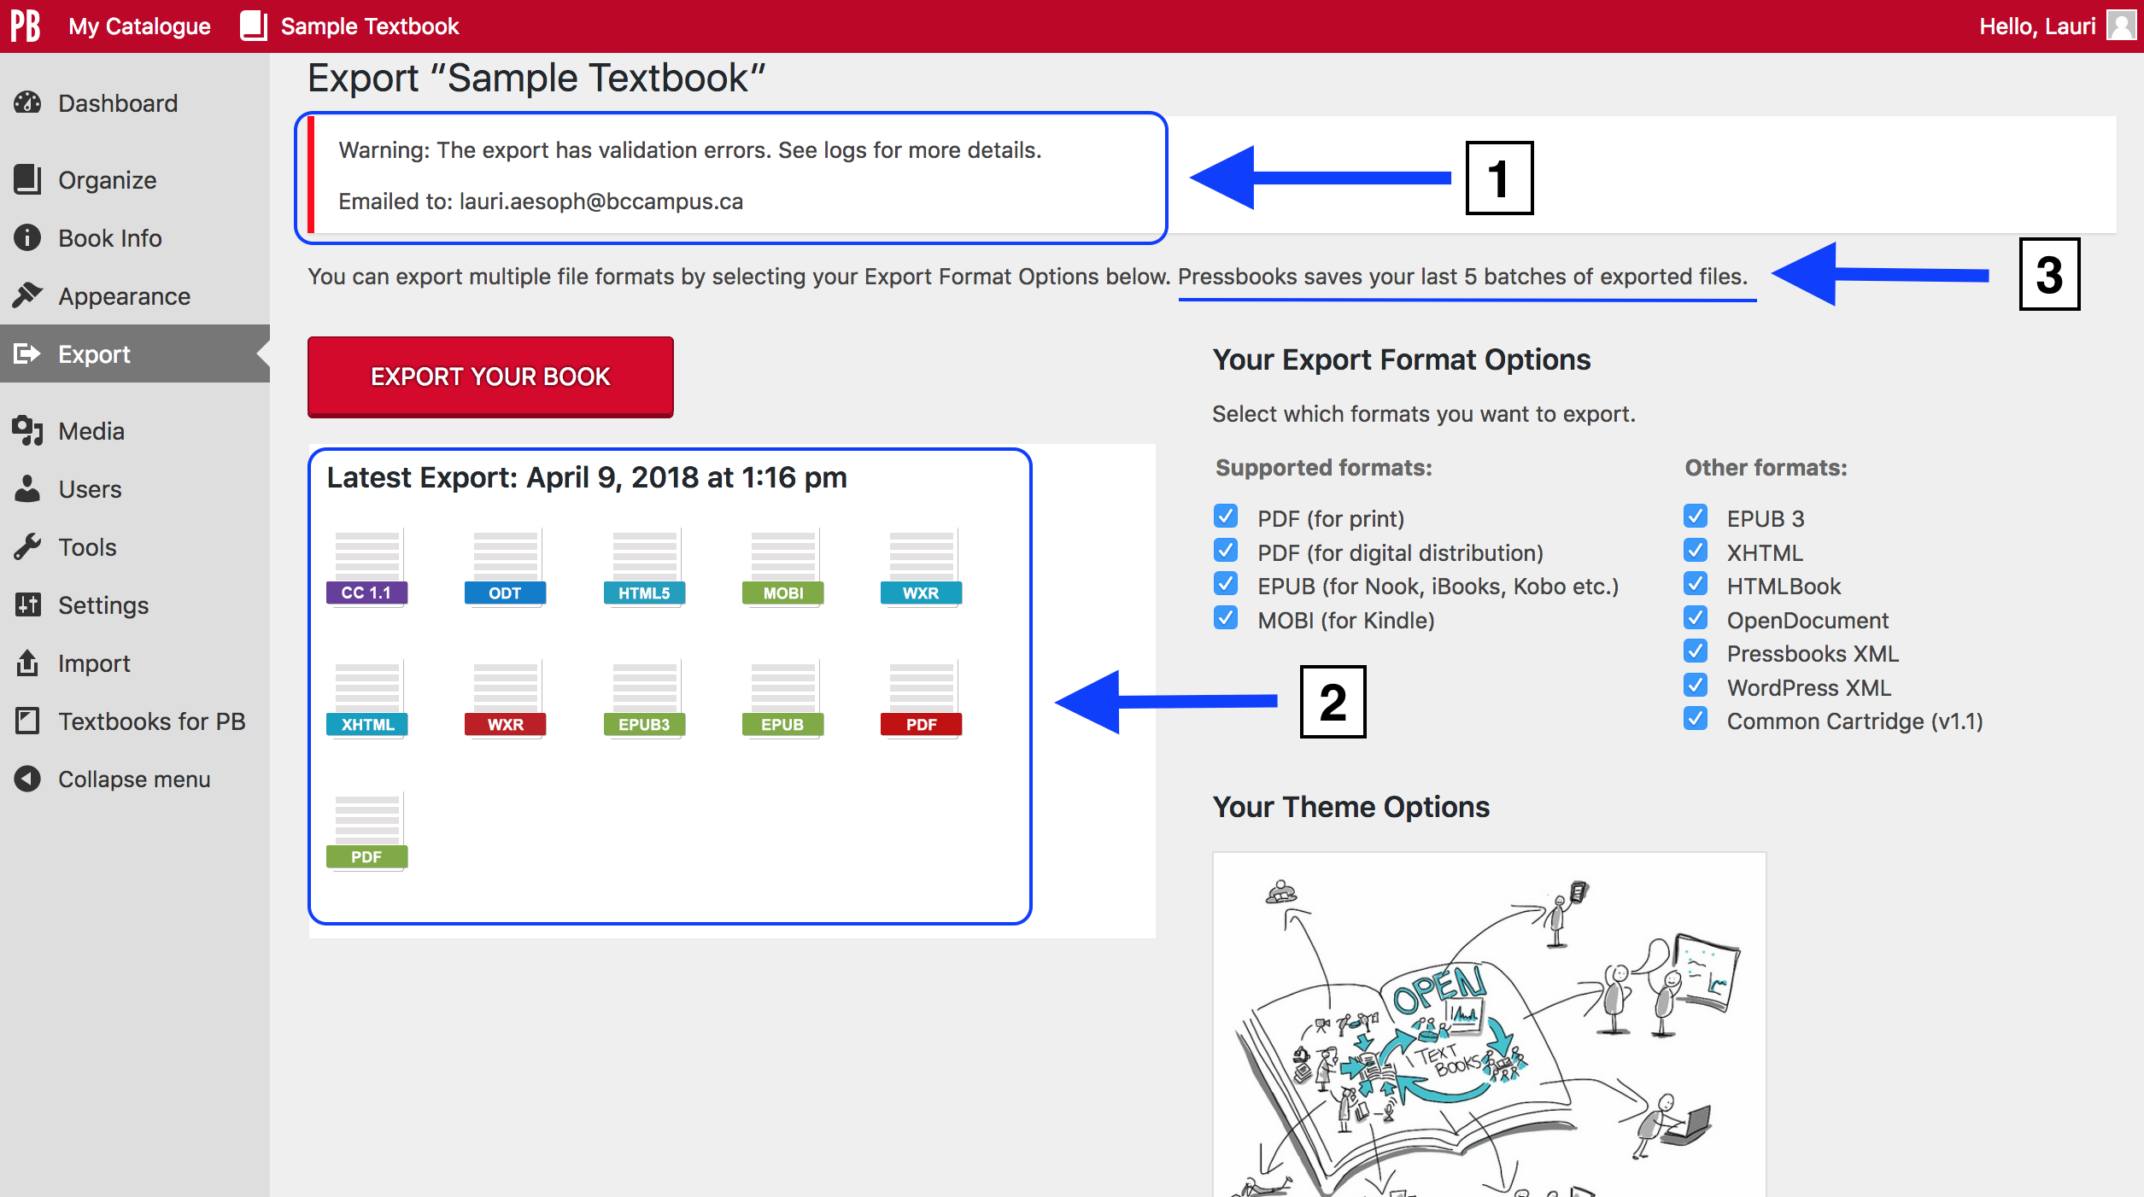
Notes:
This is a completed export.
Take note of:
A warning message at the top that reports “validation errors”
The exported files and, above them, the date and time when the export occurred
“Pressbooks saves your last 5 batches of exported files”. However, unless there is a reason to keep old files, we suggest that once you’re ready to publish your book, keep one complete set of exported files. The Pressbooks homepage of your book will display the last full set of exported files which I’ll show you in a moment.
Here are idiosyncrasies to note:
The blue WXR icon is the WordPress XML file
The red WXR icon is the Pressbooks XML file
The green PDF icon is the digital PDF
The red PDF icon is the print PDF

Slide 54
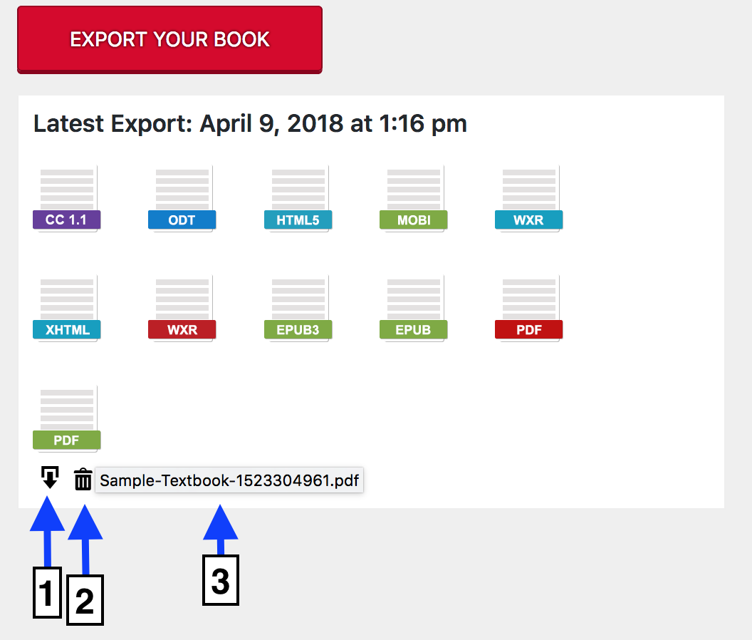
Notes:
If you scroll over one of the file formats (here, the green PDF icon has been chosen), several items will appear.
The download icon
The delete or trash icon
The URL for the downloaded PDF file
Use the download icon/function to save each file, individually, to a desktop, or a folder on your computer. BCcampus Open Education uses the download feature extensively so that files can be uploaded to our open textbook repository for display in the B.C. Open Textbook Collection.

Slide 55
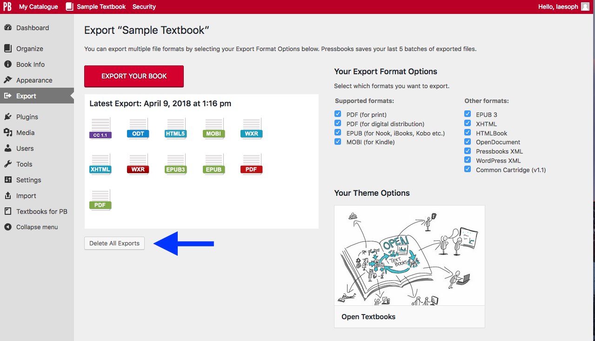
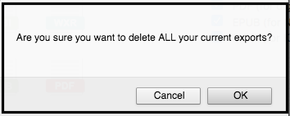
Notes:
If you want to delete all files that have been exported, select the “Delete All Exports” button. A warning message “Are you sure you want to delete ALL your current exports?” pops up when any delete function on this page is initiated to prevent you from accidentally deleting files.

Slide 56
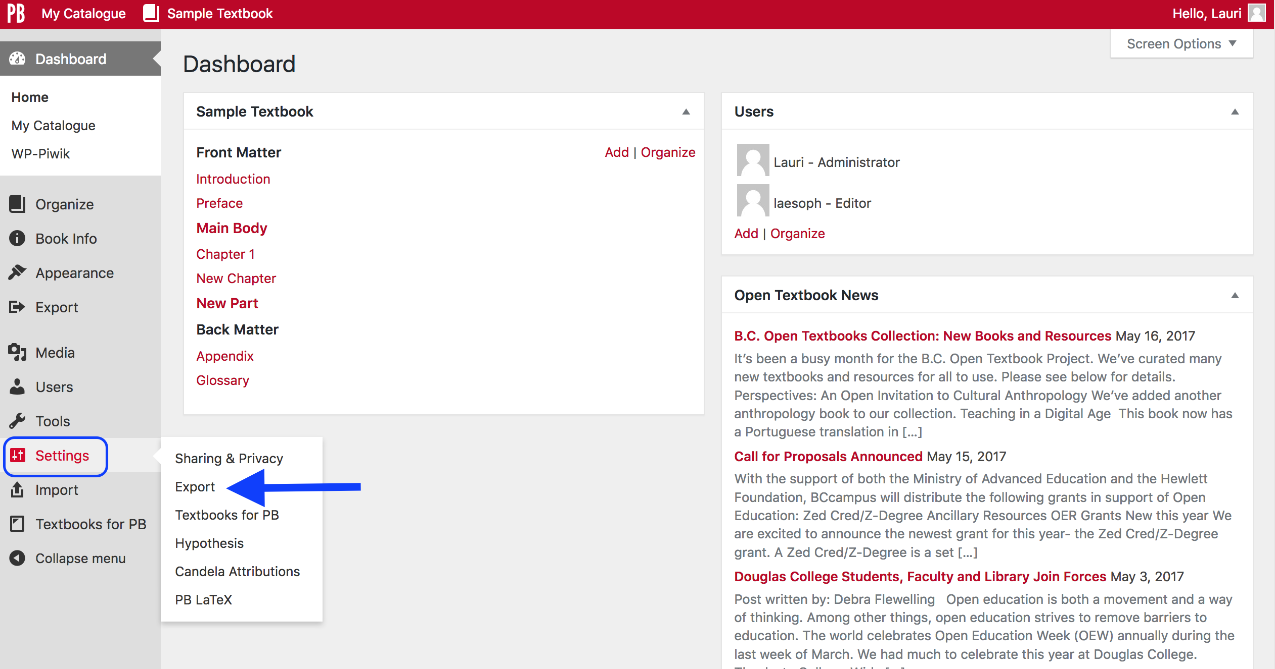
Notes:
In regards to the “validation errors” that appeared at the top of the Export page, you can control whether or not this information is reported to you.
Go to the book’s Dashboard
Select “Settings” and
“Export”
GO TO NEXT SLIDE

Slide 57

Notes:
…then:
Select “No” or “Yes” by the “Email Validation Logs” option
Select the checkbox by “Lock your theme at its current version” if you want to prevent changes to your book’s appearance and page count when themes are updated
Click the red “Save Changes” button
It is suggested that you receive validation error reports if you want information about problems with individual files.

Slide 58


Notes:
At the top of this slide is a screenshot showing the four emails received when exporting a book: one for each of the EPUB files, and one each for the PDF files.
At the bottom of this slide, is the contents of the email for one of the PDF files.
We point this out just for your information, and will not go into details about how to interpret these reports during this webinar.

Slide 59

Notes:
To display the most recent set of exported files on the Pressbooks’ home page of your book, go to “Settings” on the Dashboard, and select “Sharing & Privacy”.
GO TO NEXT SLIDE

Slide 60

Notes:
Then, by the “Share Latest Export Files” item:
Choose “Yes. I would like the latest export files to be available on the homepage for free, to everyone.” (“Yes” is the default setting.)
Click the red “Save Changes” button

Slide 61

Notes:
Here is an example of the result, which displays the last full set of exported files.
To download files:
Click on the the arrow by “Download this book”
Select a file, e.g. “Pressbooks XML”, from the drop-down list
Click on the link and a pop-up box will allow you to open or download it

Slide 62
Lesson 5
How to add
multiple books
to one Pressbooks account
Notes:
Lesson 5: How to add multiple books to one Pressbooks account
Your Pressbooks account can hold several books. This lesson will describe how this is done and how you can locate and access these books.

Slide 63

Notes:
Remember back in the Introductory webinar when you were learning how to create a Pressbooks account, there were two ways to create the first book. Either, by using the “Register my book now” option during the account creation process or….
GO TO NEXT SLIDE

Slide 64

Notes:
…or after creating an account. If you did not create a book during account creation, you were taken to the “Create a new book” page immediately after logging in. Each of these opportunities allows you to create the first book in your Pressbooks account.

Slide 65

Notes:
Fortunately, each Pressbooks account can hold many books.
To add another book:
Hover over the “My Catalogue” link in the top-left corner of the red toolbar
Select “Add a New Book”

Slide 66

Notes:
The “Create a new book” page will appear again, but this time it will list the URLs of all books in your account.
Fill out the form as you did the first time.

Slide 67

Notes:
Once you create a new book, you will land on its Dashboard page.
Now you can use this book shell to:
Import an existing book
Upload the Pressbooks or other file frk an existing book, or
Begin the writing process from scratch

Slide 68

Notes:
Each time a new book is added to your account:
It is added to the list of books that display when you scroll over the “My Catalogue” link in the top left corner.
Click the arrow by the name of a book to reveal …
Other options including the book’s Dashboard and, the “Visit Book” link which redirects to the book or reader’s view

Slide 69
Lesson 6
How to delete a
book, chapter, or part
Notes:
Lesson 6: How to delete a book, chapter, or part

Slide 70

Notes:
Account owners can now delete a book from their account.
To do this:
Go to that book’s Dashboard
Scroll over the book’s title in the top, red menu bar
Select “Delete Book” from the drop-down list

Slide 71

Notes:
On the “Delete Site” page, the following warning message states:
If you do not want to use your BC Faculty Pressbooks Sites site (this refers to the book you want to delete) any more, you can delete it using the form below. When you click Delete My Site Permanently, you will be sent an email with a link in it. Click on this link to delete your site (your book). Remember, once deleted your site (your book) cannot be restored.
If you are sure, then:
Select the checkbox by “I’m sure I want to permanently disable my site (your book), and I am aware I can never get it back or use (the URL of the book is listed) again.”
Click on the “Delete My Site Permanently” button
The Pressbooks developers have done their best to caution that once this is action is taken, the book is gone.

Slide 72

Notes:
After you choose to delete your book, you are given one more chance to back out. The next message reads: “Thank you. Please check your email for a link to confirm your action. Your site (book) will not be deleted until this link is clicked.”

Slide 73

Notes:
Here’s the email with the link.
And just in case you’ve haven’t understood the consequences of deleting your book yet, the email says:
“You will not be asked to confirm again so only click this link if you are absolutely certain…” and
“..remember your current book is gone forever.”

Slide 74

Notes:
Chapters, parts, and sections from the front and back matter can be deleted from the “Organize” page.
To delete a chapter:
Scroll over the chapter’s title, e.g. Chapter 1 from the Main Body, to reveal Edit, Trash, View, Move Down
Click on “Trash” and the chapter will be deleted.
Note: you will not have an opportunity to confirm this action. (We are aware that this message is missing and are working to resolve this issue.)

Slide 75

Notes:
To delete a part, follow the same steps:
Scroll over the part’s title, e.g. “Main Body”, to reveal Edit, Trash, View
Click on “Trash” and the part will be deleted.
Again, no confirmation message appears.

Slide 76

Notes:
If you wish to retrieve a deleted chapter or part, go the “Trash” under “Organize” on the Dashboard…
GO TO NEXT SLIDE

Slide 77

Notes:
… where you can restore a deleted part or chapter.
Note that items in the Trash are permanently deleted after one day.

Slide 78

Notes:
If you decide to delete a part containing chapters (in this example, you are deleting the part called “Chapter 3”) by clicking on “Trash” …
GO TO NEXT SLIDE

Slide 79

Notes:
…the chapters will be reassigned to the part called “Chapter 1” which is the first part of the book’s main body. (The front matter is not considered the first part as it is outside of the main body, and separate.)
This happens even if another part, positioned elsewhere, is empty with no chapters.

Slide 80

Notes:
If you delete the first part in the main body, in this case the part called “Chapter 1”, its chapters are reassigned to the first part after it, in this case the part called “Chapter 2”. In other words, Chapter 2 becomes the first part.

Slide 81

Notes:
Notice too, that once you are down to one part in the main body (called “Chapter 1” in this slide), the “Trash” option for this part is removed. This is because a book must contain at least one main body part.
The front matter and back matter (which are special parts) cannot be deleted, and do not have “Trash” links. However, you can delete the chapters or sections within each of these special parts.

Slide 82


Pressbooks Feedback
Notes:
We welcome your feedback about this webinar and Pressbooks in general and ask that you fill out our Pressbooks Feedback form.
Go to the BCcampus Open Education site at open.bcampus.ca, select ”Pressbooks Support”, and then “Pressbooks Feedback” at the bottom of the drop-down list.

Slide 83
Questions?
open.bccampus.ca

