Slide 1
Supporting Survivors
Notes:
Supporting Survivors Training and Facilitator Guide: Preventing and Responding to Sexual Violence in BC Post-Secondary Institutions, Sexual Violence Training Development Team is licensed under a Creative Commons Attribution 4.0 International License, except where otherwise noted.
Rock Photo by Adam Przeniewski on Unsplash

Slide 2
Territory Acknowledgment
I respectfully acknowledge [insert institution] is on the unceded and traditional territories of the [insert local] Nations
Notes:
Facilitator notes: Recommendation to elaborate on and personalize land acknowledgement. Make connections between colonization (non-consensual theft of land and violence / devaluing of Indigenous People, women, Two-Spirit people and members of the LGBTQ2SIA+ community) and sexual violence (non-consensual sexual touch and/or behavior, devaluing of women's autonomy). Also consider the possible experiences and impacts of colonial violence on diverse cultures present (e.g., international students and non-settler Canadians). Option for learners to briefly share their feelings and experiences with colonization.

Slide 3
Welcome and Introduction
Notes:
Facilitator notes: Welcome learners, introduce self including social location, pronouns, ethnic background, etc.
Take a minute to explain why your positionality is relevant including why someone may wish to state their pronoun (i.e., so they are addressed correctly - we cannot tell someone’s gender by observation and we should not make assumptions).
Include relevant experience and education as well as why you chose to be a facilitator. Note the duration of the workshop (approx. 90 mins).

Slide 4
Workshop Purpose
This is a workshop for understanding how to respond to and support survivors of sexual violence.
Notes:
Facilitator notes: This is a good opportunity to reinstate the importance of this training. The following statistics indicate the prolific nature of sexual violence in our society and the likelihood that at some point in their lives, learners will receive a disclosure. The skills that learners gain in this workshop are also applicable outside of post-secondary contexts.
71% of students at Canadian postsecondary schools either witnessed or experienced unwanted sexual behaviours in a postsecondary setting (Burczycka, Canadian Centre for Justice and Community Safety Statistics, 2020, p. 3).
Up to 75% of women who disclose sexual assault disclose to an informal source such as a friend, family member or co-worker (Ullman, 2010)

Slide 5
Group Agreements
Mutual respect
Confidentiality
Be open minded
Ask questions
Take space, make space
Participation by choice
Take care of yourself
Leave if necessary
Phones on silent
Notes:
Facilitator notes:
Briefly elaborate on each expectation including defining confidentiality (what is said in the workshop stays in the workshop). Participation is by choice but encouraged. Sharing of the space (sharing but not oversharing).
Focus on the possibly emotionally triggering nature of content including possibility of delayed traumatic response (later in the day or subsequent days).
Inform learners that you will be discussing self-care and professional resources within the workshop.
Learners are free to tune out and/or leave the room if they are feeling triggered (learners should be encouraged to signal facilitator that they are ‘ok’ if they leave the room).
Facilitators will be available after training to debrief.
Highlight confidentiality for learners who access support services or debrief with facilitators.

Slide 6
Part 1: What is Sexual Violence and What Does It Look Like?

Slide 7
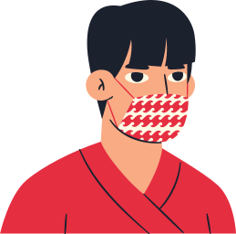
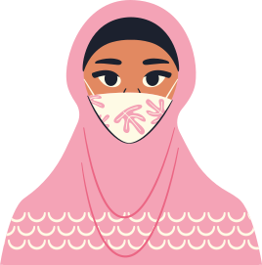
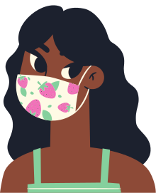
Learning Outcomes
What are we going to be doing?
Discussing sexual violence and trauma
Learning about professional resources
Practising responding skills: Listen, Believe, Support
Acknowledge barriers to disclosing
Notes:
Facilitator notes: Focus on the pragmatic nature of the workshop (i.e., learners will have increased feelings of confidence in their knowledge of what to do to help and not make things worse). Let learners know that the workshop contains a variety of learning resources and activities including: small and large group discussions, videos and case study examples. There is a simple assessment at the end (and a feedback form and handout(s), if applicable to your institution).
This training is not all encompassing of topics related to sexual violence. Learners may have additional thoughts and questions in the days and weeks following this training. This training is complemented by the other trainings on sexual violence. Both facilitators and learners can think of this training as a beginning of a learning journey. Additional reading and learning is recommended

Slide 8
Sexual Violence
An umbrella term used to describe any violence that is sexual in nature.
Notes:
Facilitator notes: Many terms can be used to describe violence that is sexual in nature such as: sexual assault, rape, sexual harassment etc. In this workshop we use the (umbrella) term sexual violence as it includes all forms of violence that are sexual in nature: physical, emotional, psychological, spiritual and financial etc. Is rape sexual violence? Yes. Is unwanted sexual talk (“cat calling”) sexual violence? Also yes.
Recommendation to go deeper by continuing discussion on power, control and privilege in relation to sexual violence i.e., sexual violence is about power, not about sexual desire. For example, understanding sexual violence as an act of force and theft on an individual in the same way that colonization is the forcible theft of land and has supported acts of rape, genital mutilation, forced sterilization, MMIWG.

Slide 9
Consent
An enthusiastic, freely given and ongoing “yes” to any sexual activity. Consent is best practised while sober.
Notes:
Facilitator notes: Now that we have discussed what sexual violence can look like (but is not limited to), it’s important to understand what consent is.
Takeaway messages: Consent requires a freely given, sober “yes” and not just the absence of “no.” See facilitator guide for more information and suggestions for responding to questions about consent and intoxication.
Any sexual act without consent is sexual violence.
Consent is also required in digital contexts - sending and sharing nudes.
Must be ongoing - i.e., saying “yes” once doesn’t mean it’s a “forever yes”
Additional questions: Where else is consent required in society and relationships? (e.g., hugging a friend, making plans, asking personal questions, etc.).

Slide 10
Consent Tea
Notes:
Optional Video: Consent Tea.
Blue Seat Studios. (2015, May 13). Tea Consent [Video]. YouTube. Copyright ©2015 Emmeline May and Blue Seat Studios. https://youtu.be/fGoWLWS4-kU

Slide 11
Building Tools for Supporting Survivors (How Do You Currently Help?)
Notes:
Facilitator notes: This activity provides learners an opportunity to consider what they may already know and do to support people around them who are sharing difficult experiences.
Ask learners to think about what they have done in the past when someone they care about has told them about a recent challenge they encountered. Some examples: Supporting a friend or family member through a significant life change such as a breakup, job loss or the death of a pet.
Instruct learners to individually consider a scenario where they supported another person focusing on what they did and said, as well as other resources they may have suggested for the individual. Next, learners will turn to the person beside them and discuss for 5 minutes.
Online version: Extend time for personal reflection, remove section where learners speak to each other.
Finally, lead the whole group through a brief discussion of what they discussed and considered as possible actions for the scenario. Acknowledge learners’ existing knowledge and ideas of possible actions. Let learners know that the (appropriate) skills they used in their examples are transferable to supporting survivors of sexual violence. Tell learners that towards to the end of the workshop, we will be applying these skills to more intense scenarios involving disclosures of sexual violence.

Slide 12
Framework for Supporting Survivors
Listen Believe Support
Notes:
Facilitator notes: This is the framework we will be using and practising in this workshop.
The likelihood that learners may one day receive is a disclosure is significant:
Less than 10% of incidents of sexual violence are reported to police (Johnson, & Dawson, 2011)
Students are much more likely to disclose to peers or other informal supports (Sable et al., 2006).
Why it matters how we respond: the type of response that a survivor receives when they disclose can greatly impact their emotional and psychological health.
Acknowledge learners’ pre-existing knowledge from previous activity as it relates to this framework.

Slide 13
Part 2: The Impacts of Sexual Violence

Slide 14
Impacts of Trauma
Physical
Emotional
Psychological
Spiritual
Financial
Intergenerational
Interpersonal
Behavioural
Notes:
Facilitator notes: Sexual violence is a traumatic event. There is a growing awareness about the impacts of trauma on the life of survivors. Trauma can produce impacts in various areas of a survivor’s life. Ask learners to consider and provide examples of possible impacts of trauma in the areas of life listed in the slide or other areas.
Physical: injuries, fatigue/exhaustion, disrupted sleep, STIs, intestinal problems, sexual dysfunction, high risk sexual behaviour, unplanned pregnancy.
Psychological and emotional: anxiety, terror, shock, shame, emotional numbness, disconnection, intrusive thoughts, helplessness and powerlessness, nightmares, depression, irritability, and jumpiness, PTSD, self-harm / suicidality, substance abuse.
Financial: Disrupting the ability to earn an income (both short and long term).
Interpersonal: Fear of intimacy Isolation/loneliness, dependence on others for support, discomfort of being touched, difficulty regulating emotions and managing relationships.

Slide 15
Reactions to Trauma
There is not one “normal” reaction to sexual assault.
Trauma impacts everyone in different ways.
Notes:
One way to describe trauma is something someone experiences that is; too much (over stimulation / over exposure), too fast (not comfortable with speed that event occurs in) and too soon (developmentally or experientially)
Also important to note that there are different types of trauma and trauma can be a single event or ongoing abuse. Trauma can occur to children, youth, and adults.
Indigenous learners may have experienced intergeneration trauma as a result of the ongoing impacts of colonization:
Intergenerational trauma describes the psychological or emotional effects from massive group trauma. These collective traumas are inflicted by a subjugating, dominant population (e.g., colonization, war). Intergenerational trauma can be a result of the ongoing impacts of colonization.
Vicarious Trauma: Trauma can also occur from being exposed to other people’s traumatic events. This can be common for those that work with trauma survivors (e.g., first responders, counsellors etc.).
Ask learners: Why is it important to understand that survivors’ responses to sexual violence can be so diverse?

Slide 16
Barriers to Disclosure
Not being believed
Shame, self-blame
Power dynamics
Victim-blaming
Re-traumatizing
Inadequate institutional responses
Known perpetrator / Fear for safety
Fear of reflection on communities
Less than 5% of sexual assaults are reported to police (Dept of Justice, 2019).
Notes:
Facilitator notes: Invite learners to consider who typical professional responders may be i.e., police, school administrators, etc. Let learners know that receiving a disclosure is not the same as making a report and that the decision to report is complex and needs to be made by the survivor with the support of professionals. More information on disclosure vs reporting in section 3 of the facilitator guide.
Take Away: Professional responders are often people in positions of power and their social identity is often one of privilege (e.g., white, cisgender men and women). Responders’ identity can be detrimental to survivors who are disclosing by: reminding survivors of their perpetrator, holding power over survivors and reinforcing rape myths such as disbelief of survivor, retraumatizing the survivor by having them recall the violence, etc.
Barriers Specific to Groups:
International: May lack the confidence in their English language skills to describe what happened and a lack of awareness of Canadian criminal legislation and processes, institutional policies and support services and fear of deportation. Ask them if they would like to have language support or if they feel comfortable with you.
Indigenous Peoples and other marginalized groups may have a reluctance to disclose or report due to previous negative and longstanding experiences with health care, welfare and justice system authorities.
Invite learners to consider who might be a likely informal support to receive a disclosure. Common informal responders will depend on the learner group and content of the training, but common examples may include: residence advisors, classmates, student leaders, community elders, family, siblings etc.

Slide 17
Why People Don’t Report Sexual Assault
Notes:
Facilitator notes: Considering the institutional and personal barriers discussed on the previous slide, there can be lots of reasons why people don’t talk about an experience of sexualized violence for a long time. Encourage learners to take a few minutes to reflect on some of these reasons.

Slide 18
Rape Culture
An environment where sexual violence is prevalent and the norm. Sexual violence is normalized and readily found in the media and popular culture. Rape culture includes rape myths.
Notes:
Facilitator notes: Ask learners for examples of common rape myths. Include the following, if not identified by learners: she was drunk, look at what they were wearing, men can’t be raped. Link rape myths to consent and barriers to disclosure.
Recommendation to go deeper by exploring elements of culture (i.e., media) that support rape culture and sexual objectification: misogynistic lyrics, pornography, attitudes of those in power. When we consume these types of media, we are supporting and complicit in rape culture.
Invite learners to consider how rape culture, power, and control have contributed to the ongoing struggle Indigenous People have with sexual violence.

Slide 19
Sexual Violence on Campus - 1
International students are especially vulnerable to sexual violence both on and off campus, especially at the beginning of the school year.
(Forbes-Mewett, et al., 2015)
41% of all reported incidents of sexual assault were reported by students.
(Statistics Canada, 2017)
Notes:
Up to 25% of women experience sexual assault during college or university (Ontario Women’s Directorate , 2013).
71% of students at Canadian post-secondary schools either witnessed or experienced unwanted sexualized behaviours in a postsecondary setting. (Burczycka, Canadian Centre for Justice and Community Safety Statistics, 2020, p. 3)
6.1% of male students experience sexual assault during college or university (Krebs, C.P., Lindquist, C.H., Warner, T.D., Fisher, B.S., & Martin, S.L., 2007).
41% of all reported incidents of sexual assault were reported by students (Statistics Canada, 2017)
25% of Transgender students on American Universities experience sexual assault (Cantor, D., Fisher, B., et al., 2015).

Slide 20
Sexual Violence on Campus - 2
71% of Post secondary students witnessed or experienced unwanted sexual behaviours in a post-secondary setting in 2019.
(Burczycka, Canadian Centre for Justice and Community Safety Statistics, 2020)
Up to 25% of women experience sexual assault during college or university
(Ontario Women’s Directorate, 2013)
Notes:
Up to 25% of women experience sexual assault during college or university (Ontario Women’s Directorate , 2013).
71% of students at Canadian post-secondary schools either witnessed or experienced unwanted sexualized behaviours in a postsecondary setting. (Burczycka, Canadian Centre for Justice and Community Safety Statistics, 2020, p. 3)
6.1% of male students experience sexual assault during college or university (Krebs, C.P., Lindquist, C.H., Warner, T.D., Fisher, B.S., & Martin, S.L., 2007).
41% of all reported incidents of sexual assault were reported by students (Statistics Canada, 2017)
25% of Transgender students on American Universities experience sexual assault (Cantor, D., Fisher, B., et al., 2015).

Slide 21
Overlapping Marginalizations (Intersectionality)
Those experiencing multiple and intersecting forms of oppression (racism, transphobia, ableism etc.) are especially vulnerable to sexual violence
Notes:
Facilitator notes: Those experiencing multiple and intersecting forms of oppression (racism, transphobia, ableism etc.) are especially vulnerable to sexual violence and face barriers to support services (Johnson & Colpitts, 2013). However it is important that the facilitator makes explicit that groups are at risk for violence as a result of systemic discrimination within institutions and communities, not through actions of their own.
Recommendation to ask learners why they think this is the case and why it is important to know this. Focus on privilege and marginalization of various groups and intersectional social locations of survivors and perpetrators.
Women with disabilities are four times more likely to experience sexual assault than women without disabilities (DisAbled Women’s Network of Canada, n.d.)
Indigenous women are almost three times as likely to experience violence (physical and/or sexual) than non-indigenous women (Brennan, 2011).
In a national survey, almost half of transgender youth (46%) reported they had been sexually abused and more than 1 in 4 (28%) reported being physically forced to have sex when they did want to. (Taylor, A.B., Chan, A., Hall, S.L., Saewyc, E. M., 2020).

Slide 22
Responsibility for Sexual Violence
Revealing clothing
Alcohol and/or drugs
Walking home alone
Flirtatious conversation
Perpetrators
Notes:
Facilitator notes: Sexual violence is always the responsibility of the perpetrator.
Recommendations for extending the discussion: examples of victim blaming found in rape culture (survivor’s choice of clothing, environment, mindstate, etc.).
Systems and structures that support rape culture:
The lack of political will to address murdered and missing Indigenous women
Challenges for survivors in the justice system (low rates of prosecution and conviction of perpetrators, dismissal and lack of acknowledgement by law enforcement). See MMIWG report for more info. Less than half half of sexual assault cases in adult criminal court result in convictions (Stats Can, 2017).
Power over culture. Perpetrators are often known to the survivor and in positions of power or in supposedly caring roles (e.g., parental figures, educator, romantic partner / spouse). High profile examples: Brock Turner, Bill Cosby, Jian Ghomeshi, Harvey Weinstein.
Men and and trans people can face barriers related to cisheterosexism and homophobia

Slide 23
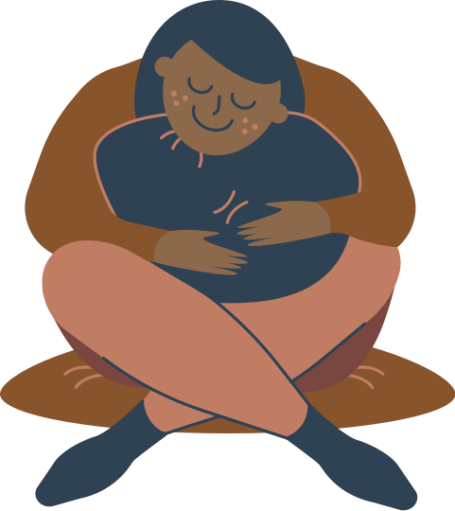
Break Time
Take time to stretch, drink some water, and breathe

Slide 24
Part 3: Responding to Disclosures

Slide 25
Goals of Responding
Listen
Believe
Support
Comfort and support the survivor while determining what services they require.
Notes:
Facilitator notes: Remind learners about the Listen, Believe, Support framework. Let them know that we will be practicing these skills in this final section of the workshop. Acknowledge that it can be difficult to receive a disclosure of sexual violence but when we practice how to respond, we’re more likely to feel confident when it really happens.
Take-Away: The survivor determines who they disclose to, what they disclose, and the pace of the disclosure.
Remind learners to consider their own social location in relation to the person disclosing: how can you increase the comfort of the person disclosing? How can you use your privilege to best support this person (e.g., are you in a position of authority or leadership in the institution)?

Slide 26
Brené Brown On Empathy
Notes:
Facilitator notes: Ask learners what stands out for them in this video. Take away: it’s not necessary to have the solution; simply being present and compassionate is incredibly helpful.
Brené Brown is a research professor at the University of Houston and known for her research on courage, shame, vulnerability, and empathy.
RSA. (2013, December 10). Brené Brown on Empathy [Video]. YouTube. https://youtu.be/1Evwgu369Jw

Slide 27
Disclosing Can Be Difficult
Tell them you are glad they are telling you
Be patient
Ground them if overwhelmed
Don’t press for details
Empathize
Respect their personal space
Notes:
Facilitator notes: Because disclosing sexual violence can be difficult, it is important that we respond with compassion, patience, empathy. Tell them you are glad they are telling you. Don’t press for details and respect their pace and personal space.

Slide 28
Active Listening
Be aware of your body language
Encourage them and show you are listening
Avoid distractions
Mirror their language
Paraphrase
Be aware of the space you are in
Notes:
Facilitator notes: Active listening is a foundational skill of interpersonal communication and used in fields like counselling and coaching. Active listening involves intently listening, trying to understand and remember what is being said by the speaker. Skills include: maintaining a positive body language (eye contact, facing the speaker or sitting parallel, nodding in agreement), encouraging disclosure to “tell you more”, paraphrasing or repeating back what you have heard, using the language that the survivor used to show understanding, avoiding distractions. Note to learners to be aware of the space they are in - is it private and comfortable for the survivor? Note that some cultures are not as likely to engage in direct eye contact or focused body language.

Slide 29
Believe
Assure them it was not their fault
Tell them you will help them get support
Validate their feelings
“Its normal you feel this way.”
Notes:
Facilitator notes: the person who is disclosing has complete control over what next steps and actions, if any, will be taken next. This includes whether or not to report, seek support services, or share this information with anyone else.
The survivor will share their experience of sexual violence because they see you as a safe and trustworthy person. Listen to what they want to share and mirror the language they are using to show that you understand.

Slide 30
Believe and Empathize
It’s not your fault
Thank you for sharing with me
I believe you
Notes:
Facilitator notes: Possible ways to respond to show that you believe and empathize with the survivor. Validation can help to emotionally comfort survivors.

Slide 31
Disclosure and Reporting
Disclosure means simply sharing your experience. It is not a formal process and does not have to lead to a report.
Reporting means sharing your experience with an authority (such as school administrator or police), which may lead to an investigation where additional details (such as where, when and who) are
Notes:
Facilitator notes: Discuss the differences between disclosing and reporting. Reporting does not necessarily mean reporting to RCMP and can refer to (confidentially) reporting to an institution’s counsellor or administrator. Recommendation to explain third party reporting as a possible option.
All adults have a legal duty to report to the Ministry of Children and Family Development if they become aware ongoing abuse committed against a minor - learners need to be aware that they should not make promises that they are not able to keep (e.g., “I won’t tell anyone what you’ve told me”).
Facilitator should be aware of the institution’s sexual violence response policy, specifically any limits to confidentiality and the responsibilities of staff to report incidences of SV. Consult with the appropriate administrator to better understand any staff responsibilities to report.
Take away: There are many options for survivors and decisions on how to proceed do not need to be made immediately. Consulting with community based victim services to better understand survivors’ options is recommended.

Slide 32
Ways to Offer Support
Ensure their safety
Discuss their options
Connect them with Supports
Offer to go with them
Support their decisions!!!
Notes:
Facilitator Notes: If you are in a position of receiving a disclosure, how you react to their disclosure can have a significant impact on whether they proceed to tell you more or not. The survivor will share their experience of sexual violence because they see you as a safe and trustworthy person. Listen to what they want to share and mirror the language they are using to show that you understand.
Beware of specific needs of certain groups (See Facilitator Guide for more information).

Slide 33
Ways to Express Support
“I’m here to listen and support and we can do whatever you feel you need, including reaching out to professionals.”
“What would make it feel safe for you to talk to someone?”
“I’d be happy to go with you to see someone.”
Notes:
Facilitator Notes: Believe what they are telling you and validate their feelings. Students may blame themselves based on their cultural expectations and stigma associated with sex and sexual violence. Acknowledge what they share and tell them you can help. Empower them by asking what their needs are and be honest about your role, capacity and knowledge about resources. Facilitate referrals and advocate for them to ensure they are safe, and have resources in place. Information about free services and supports which include police and third party reporting, access to medical options and community resources increase safety and empower them to make informed decisions which are right for them.
Beware of specific needs of certain groups (See Facilitator Guide for more information).

Slide 34
Support Services
On Campus
In the Community
Notes:
Facilitator notes: Inform learners that it is helpful to have a basic understanding of the services for survivors in the area. Activity: We are going to do a brief group brainstorm of services on campus and in the community. Use white board feature to record learner examples on Zoom. Facilitator to fill in any gaps in services provided by learners.
Facilitators should ensure they are familiar with their institution’s various support services, especially any positions designated to receive disclosures and reports. Facilitators should also be familiar with local community-based services, as well as VictimLinkBC, and any access/inclusion considerations. Facilitators should make a clear distinction between the services offered by community based victim-services and RCMP based victim-services.

Slide 35
Institution and Community Resources
Institution’s Resources
Community Resources
Notes:
Facilitator should have this list completed with institution and community based resources, prior to delivering the training. Consider creating one-page handout for participants. See Appendix 3 in Facilitator Guide for example.
VictimLinkBC is a toll-free, confidential, multilingual service available across B.C. and the Yukon 24 hours a day, 7 days a week and can be accessed by calling or texting 1-800-563-0808 or sending an email to VictimLinkBC@bc211.ca. It provides information and referral services to all victims of crime and immediate crisis support to victims of family and sexual violence, including victims of human trafficking exploited for labour or sexual services.
VictimLinkBC staff can connect you to a network of community, social, health, justice and government resources, including victim services, transition houses and counselling resources. They also provide information on the justice system, relevant federal and provincial legislation and programs, crime prevention, safety planning, protection order registry and other resources as needed.
If you require assistance, please call or text VictimLinkBC at 1-800-563-0808 or email VictimLinkBC@bc211.ca.

Slide 36
Longer-Term Support
Assess what amount and kind of support you are able and willing to give
Ask what kind of support they would like from you
Don’t focus only on their traumatic event/history
Notes:
Facilitator notes: You may want to check in with the survivor in the near future, for example after their first meeting with a professional or authority. Consider what kind of support you are able and willing to provide. Remember that responses to sexual violence, including your own, can be delayed. When supporting someone over the long term, try not to focus on the traumatic event.
Facilitators should be aware of accommodations that are available to survivors, such as academic or residential accommodations and whether these accommodations are accessible without filing a formal report. Be aware of accommodations for employee disclosures as well. Adapt to the audience demographic.

Slide 37
Self Care / Community Care
What can you do to “fill your cup”?
Self-reflection
Establish boundaries
Seek support
Maintain confidentiality
Coping and self-care behaviours
The type of self-care that work best for you is up to you!
Notes:
Self care: What can you do to “fill your cup”?
Facilitator notes: Experiencing sexual violence, even vicariously through supporting a survivor, can be very difficult. It’s important we are aware of ways to take care of ourselves and recover.
Recommendation to go deeper: Explore various types of self care including:
Self-soothing or self indulgence: Usually distraction type activities (binging on TV shows, bubble baths, comfort food.) This type of self care can be very enjoyable but sometimes lacks the healing aspect of self-care.
Self-care: Can involve challenging work to process difficult experiences: seeking counselling, sharing with others who have similar experiences, lifestyle changes, etc.
Community Care: Taking care of others and community spaces, co-operative childcare, local investing and finance management, free / trade / barter groups.

Slide 38
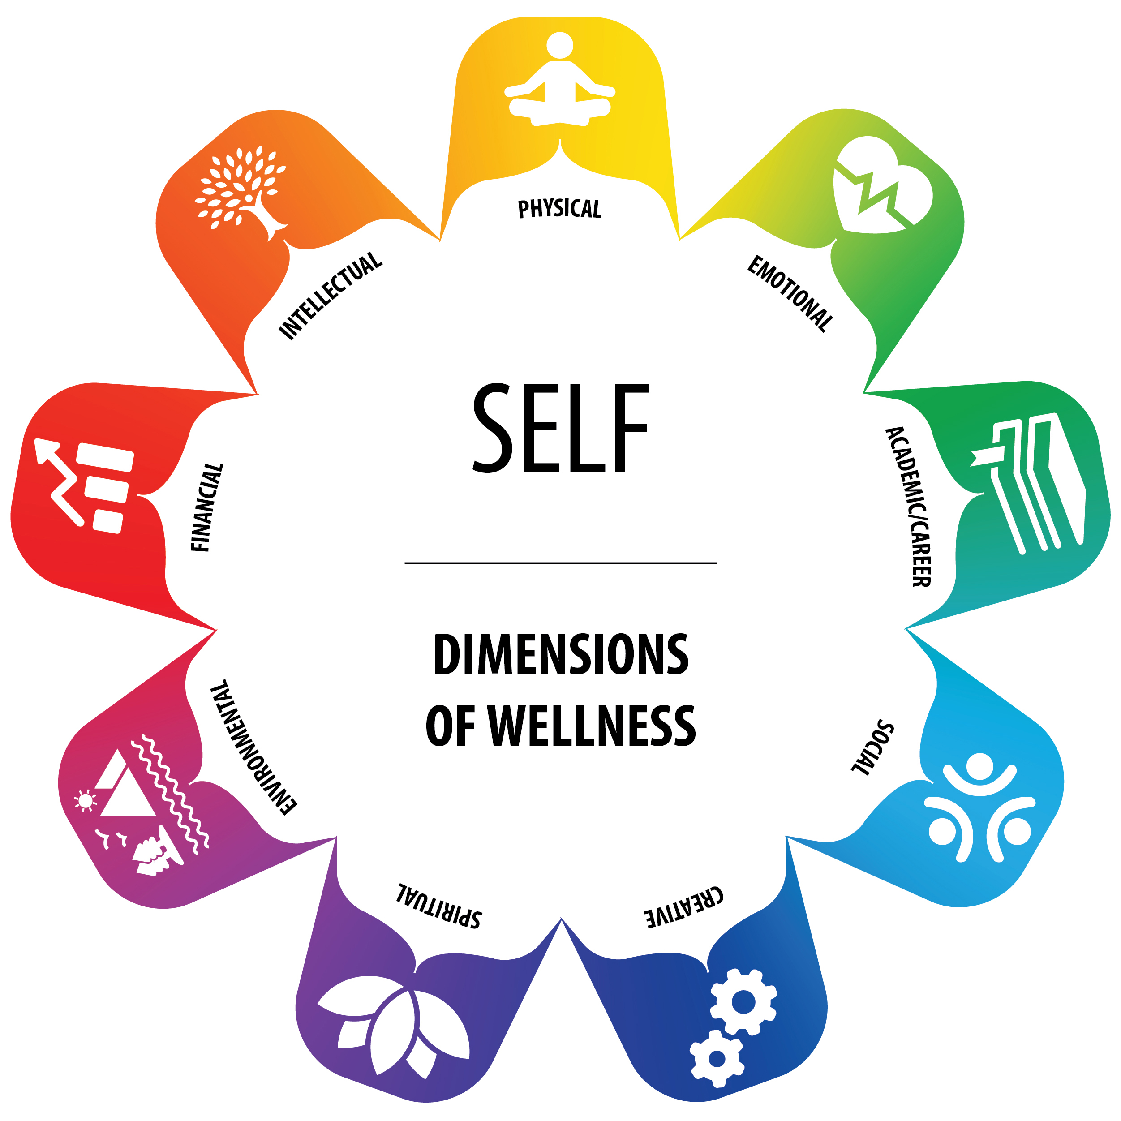
The Wellness Wheel
Notes:
Discussion: Learners share various ways they practice self-care in their personal lives. Facilitator transcribes self-care practices on a whiteboard. Ask learners if they feel these practices would be beneficial to both survivors and those receiving a disclosure.
This Wellness Wheel helps you consider wellness as a sense of balance between the various domains of the self: physical, emotional, academic/career, social, creative, spiritual, environmental, financial, and intellectual. This Wellness Wheel aligns with Indigenous traditional practices that view individuals holistically.

Slide 39
Practice Activity: Listen, Believe, Support
Notes:
Facilitator notes: We are now going to practice the Listen, Believe, Support framework in partners.
One partner will be the survivor and the other will be the responder. Spend about five minutes in the role and then switch.
Important: To avoid potentially triggering learners, should disclose a challenging, non-sexual event (i.e., a disagreement with a friend, being fired from a job, failing an exam). The framework and response remains the same but the disclosure can be something benign like what you did last weekend.
Refer learners to the next slide with examples of what to say at each stage but they can challenge themselves by responding without looking.
Remote delivery: Pair learners and assign each dyad a breakout room to perform the activity in. Facilitator can visit learners in their breakout rooms to check-in and answer any questions.

Slide 40
Activity Debrief: What Do I Say?
LISTEN: Listen, nod, body language, check for
understanding.
BELIEVE: I believe you, I am glad you told me, it’s normal to feel this way
SUPPORT: What do you think would help? Are you aware of the services available? I can go with you if you want.
Notes:
Facilitator Notes: After learners have completed the activity, spend a few minutes debriefing what it was like for them.
Survivors: What was it like to have someone respond to you in that way? Did you feel heard? Any suggestions for responders?
Responders: What was that like for you? What was challenging?

Slide 41
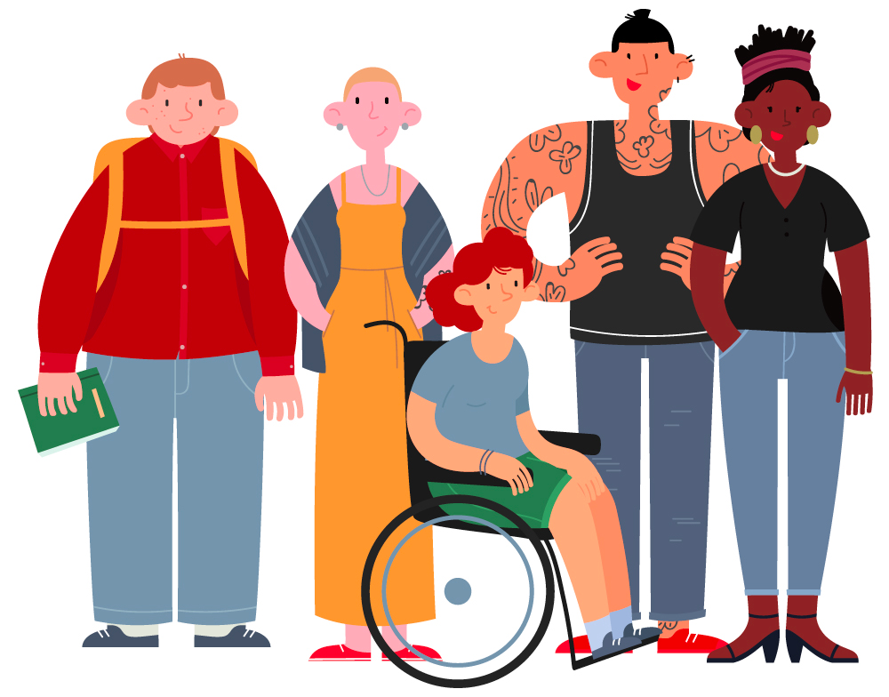
What Can You Do?
How do we resist rape culture and promote consent culture?
Be an active bystander
Speak up in the face of objectification, sexism and victim blaming
Believe survivors
Consider the media you consume
Notes:
Facilitator notes: We all contribute to the society and culture we live in. When we consume misogynistic, homophobic and transphobic media or use sexist language, we reinforce rape culture. When we speak up in the face of objectification, sexism and victim-blaming, we challenge rape culture. When we believe survivors and recognize the influence of power and privilege in sexualized violence, we challenge the societal norms that support rape culture.
Link to bystander training - we can educate our friends and family about the harmful effects of our language.

Slide 42
Scenarios Activity (What Would You Do Now?)
Notes:
Practice Activity
Facilitator notes: Determine which of the four scenarios is best suited to your group of learners. Suggestion to create additional scenario(s) as needed.
Tell learners: We are not going to apply the skills and knowledge we have been discussing to some possible scenarios that involve disclosures of sexual violence. Content warning for sexual violence content. Facilitate group discussion on what knowledge and skills learners now possess. Focus on: awareness of the impacts of sexual violence, practised responding skills and knowledge of local resources.

Slide 43
Scenario 1
You live with a female roommate off-campus and one day you notice her lying on the couch for most of the day, not saying much. When you ask her if everything is ok, at first, she doesn’t respond. When you ask again, without looking over at you, she quietly says that she doesn’t remember much from last night, but she thinks she may have been raped.
Notes:
Scenario 1: Students
The responses and questions generated for each scenario may be dependent on the demographics of the participants.
Key discussion points:
Traumatic responses can take many forms, including minimal reactions or disassociation.
Substances, including alcohol are often used to facilitate sexualized violence.
An existing and close relationship (i.e., roommates) can be an asset to support a survivor with empathy, validation and compassion.
Regardless of the location that the sexual violence took place in, community and campus survivor services are available.

Slide 44
Scenario 2
One night after work, your co-worker shares with you that she was ‘casually dating’ a manager from another department for a few months. Your friend says she ended the relationship two weeks ago, but the manager continues to regularly message her (including sending nudes) and makes jokes about your co-worker needing to take her back because she’s her boss.

Slide 45
Scenario 3
An international student you are acquainted with, Robin, sits besides you as you are waiting for class to begin. You have spoken with them a few times in the past but don’t know them that well. In passing conversation, Robin mentions that they have been groped on several occasions in the hallways when it’s crowded and busy.
Notes:
Scenario 3: International students
The responses and questions generated for each scenario may be dependent on the demographics of the participants.
Key discussion points:
Some survivors may not be fully aware of culturally and legally inappropriate sexual behavior.
Consider other barriers for international students to disclose experiences of sexual violence (specific support services)
Consider how the responder may accommodate the survivor in terms of the environment they are in and the casual nature of their relationship (changing locations, responder providing culturally sensitive support and referrals).

Slide 46
Scenario 4
You are in an English class and the instructor presents information on Residential Schools and the physical, psychological, and sexual abuse survivors of Residential Schools experienced. There is a student in the class with you who has previously openly self-identified as Indigenous. Someone in the class turns to the Indigenous student and asks them “Did all that stuff really happen? I just can’t believe that priests or nuns would assault children like that.” The Indigenous student looks visibly upset, does not respond, and immediately leaves the classroom.

Slide 47
Thank You for Participating

Slide 48
Resources for Further Reading
Ending Violence Association of BC’s ‘Responding to a Sexual Assault Disclosure: Practice Tips for Universities & Colleges’ resource
https://endingviolence.org/wp-content/uploads/2016/05/EVA_PracticeTips_UniversitiesColleges_vF.pdf
Courage to Act: Addressing & Preventing Gender-Based Violence at Post-Secondary Institutions in Canada:
https://www.couragetoact.ca/
Notes:
Resources for further reading:
Ending Violence Association of BC’s ‘Responding to a Sexual Assault Disclosure: Practice Tips for Universities & Colleges’ resource
https://endingviolence.org/wp-content/uploads/2016/05/EVA_PracticeTips_UniversitiesColleges_vF.pdf
Courage to Act: Addressing & Preventing Gender-Based Violence at Post-Secondary Institutions in Canada:
https://www.couragetoact.ca/

Slide 49
References 1
Blue Seat Studios. (2015). Tea Consent [Video]. YouTube. © Emmeline May and Blue Seat Studios. https://youtu.be/fGoWLWS4-kU
Brennan, S.(2011). Violent victimization of Aboriginal women in the Canadian provinces, 2009. Retrieved from: www.statcan.gc.ca/pub/85-002-x/2011001/article/11439-eng.pdf
Burczycka, M. (2020). “Students’ experiences of unwanted unwanted sexualized behaviours and sexual assault at postsecondary schools in the Canadian provinces, 2019.” Juristat. Statistics Canada Catalogue no. 85-002-X.
Cantor, D., Fisher, B., et al. (2015). Report on the AAU Campus Climate Survey on Sexual Assault and Sexual Misconduct. Rockville, Maryland: The Association of American Universities
Notes:
Note – These Reference slides have been created with 24 point font, which is the minimum necessary to meet accessibility guidelines for visual presentation. If the slides will not be displayed to the audience, but shared after the presentation, facilitators may want to consolidate the references onto fewer slides with smaller font size.

Slide 50
References 2
DisAbled Women’s Network Canada. (n.d.) Factsheet: Women with disabilities. Retrieved from: www.dawncanada.net/main/wp-
content/uploads/2014/03/English-Violence-January-2014.pdf
Forbes-Mewett, H., McCulloch, J., & Nyland, C. (2015). International students and crime. Sydney, Australia: Palgrave Macmillan.
RSA (2013, December 10). Brene Brown on Empathy [Video]. Retrieved Feb 10, 2021 from https://www.youtube.com/watch?v=1Evwgu369Jw&vl=zh.
Sable, M. R., Danis, F., Mauzy, D. L., & Gallagher, S. K. (2006). Barriers to reporting sexual assault for women and mem: Perspectives of college students. Journal of American College Health, 55(3), 157-162.

Slide 51
References 3
Statistics Canada (2015). Criminal victimization in Canada, 2014. Retrieved from https://www150.statcan.gc.ca/n1/pub/85-002-x/2015001/article/14241-eng.htm
Statistics Canada (2017). Self-reported sexual assault in Canada, 2014. Retrieved from https://www150.statcan.gc.ca/n1/pub/85-002-x/2017001/article/14842-eng.htm
Taylor, A.B., Chan, A., Hall, S.L., Saewyc, E. M., & the Canadian Trans & Non-binary Youth Health Survey Research Group (2020). Being Safe, Being Me 2019: Results of the Canadian Trans and Non-binary Youth Health Survey. Vancouver, Canada: Stigma and Resilience Among Vulnerable Youth Centre, University of British Columbia
Ullman, E. S. (2010).Talking about sexual assault: Society’s response to survivors. Washington, DC: American Psychological Association

Slide 52
Acknowledgments 1
Supporting Survivors Training and Facilitator Guide: Preventing and Responding to Sexual Violence in BC Post-Secondary Institutions was collaboratively created as part of the BCcampus Sexual Violence and Misconduct (SVM) Training and Resources Project. It is licensed under a Creative Commons Attribution 4.0 International license, except where otherwise noted.
This training is an adaptation of Responding to Disclosures of Sexual Assault by AMS Student Society of UBC Vancouver, Sexual Assault Support Centre (AMS SASC). It was shared under a Memorandum of Understanding with BCcampus to be adapted as an open education resource (OER) for the B.C. post-secondary education sector. It is the result of the BCcampus (SVM) Training and Resources Project funded by the B.C. Ministry of Advanced Education and Skills Training (AEST). This adaptation includes the following changes and additions which are © 2021 by the SVM Training Development Team and are licensed under a CC BY 4.0 Licence.

Slide 53
Acknowledgments 2
We would also like to acknowledge the original Responding to Disclosures of Sexual Assault training was a co-creation between the Ending Violence Association of BC (EVA BC) with the University of British Columbia and AMS SASC. The Listen, Believe, Empower framework was initially developed as part of EVA BC’s Sexual Assault Disclosure Response Practice Tips resource series, developed with funding from Women and Gender Equality Canada.
The enhancements made to this resource were informed by the Evaluating Sexualized Violence Training and Resources: A Toolkit for B.C. Post-Secondary Institutions developed by the SVM Training and Resources Working Group.
Please see the Facilitator Guide that accompanies this slide deck for more information about the development of this resource.

