Slide 1
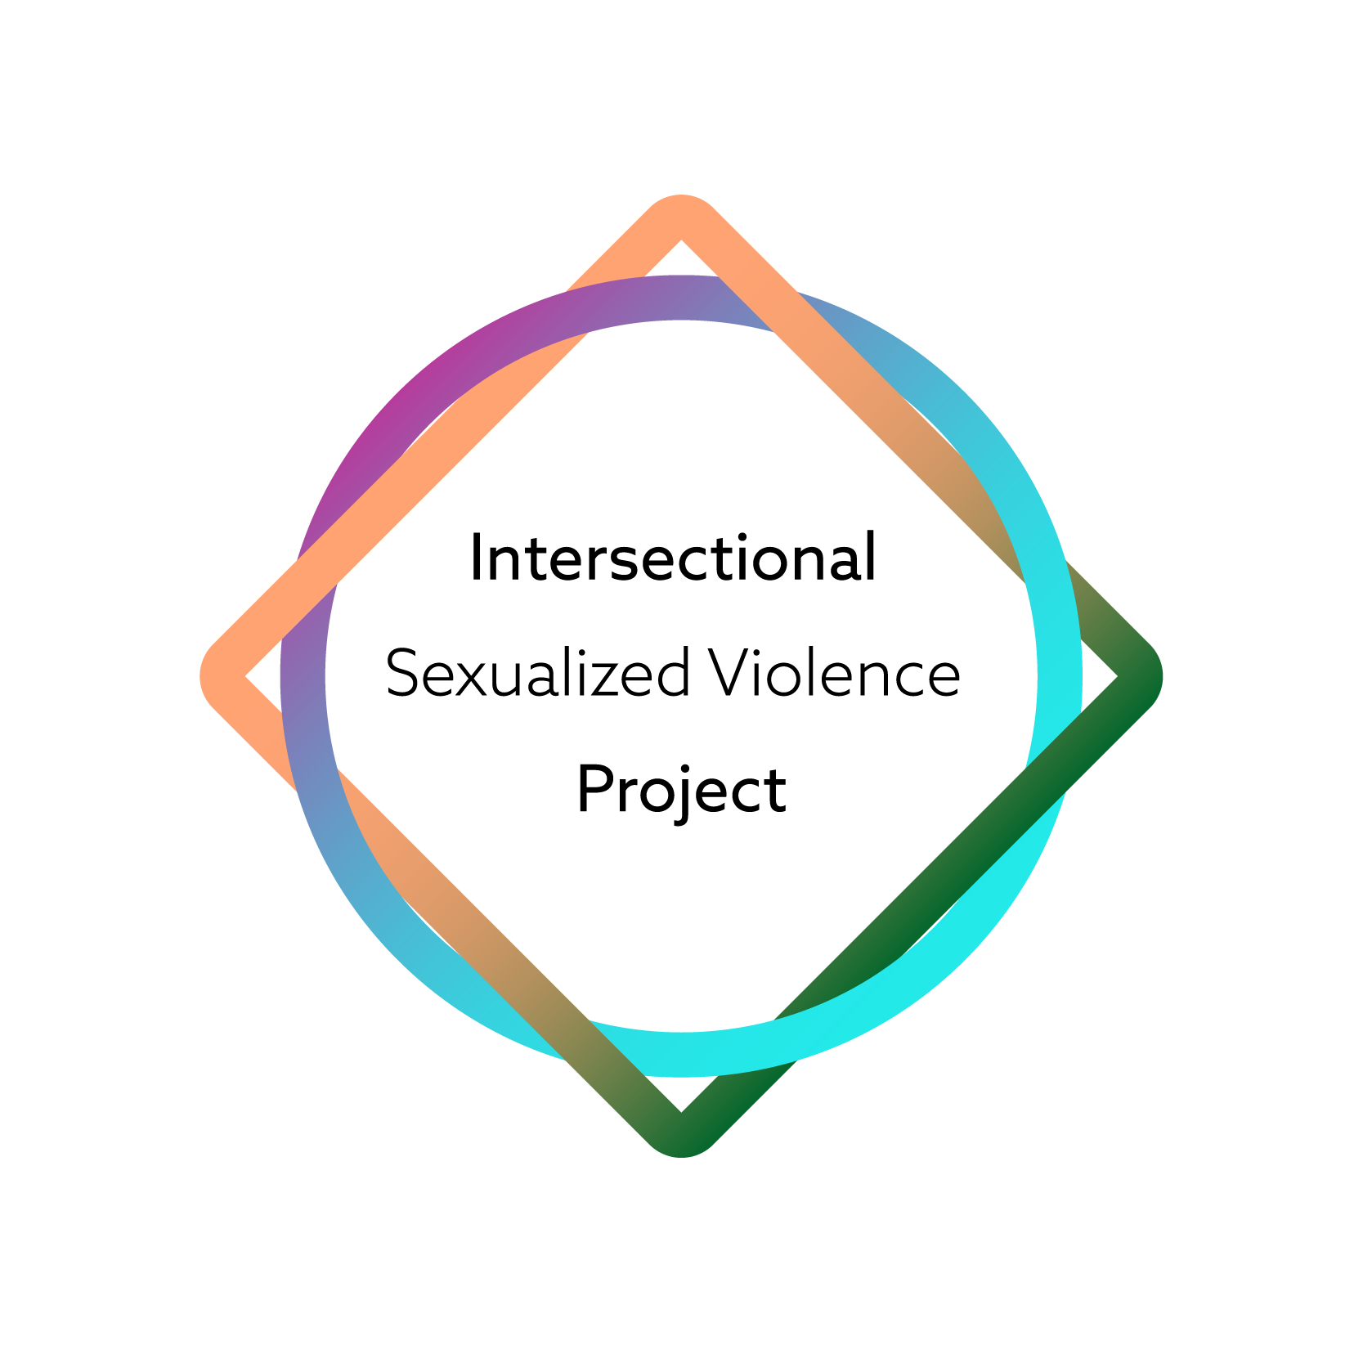
Navigating Power Dynamics and Boundaries:
A Sexualized Violence Prevention Workshop for Graduate Students
© 2024 Government of British Columbia. Power Dynamics and Boundaries: A Sexualized Violence Workshop for Graduate Students was adapted from Professional Boundaries for TAs by Simon Fraser University and Navigating Power Dynamics and Boundaries as a Graduate Student by Possibility Seeds. It is licensed under a Creative Commons Attribution-NonCommercial-Share Alike 4.0 International License.

Slide 2
Territory Acknowledgement

Slide 3
Welcome and Introduction

Slide 4
Session Objectives
Define sexualized violence
Discuss sexualized violence and power dynamics in graduate student culture
Describe different kinds of boundaries
Identify strategies for responding to boundary violations and sexualized violence
Practise setting boundaries and responding to sexualized violence using scenarios
Identify relevant institutional and community resources

Slide 5
Group Guidelines
Mutual respect
Confidentiality
Take space, make space
Participation by choice
Respect lived experiences
Take care of yourself
Leave if necessary

Slide 6
How Do We Define Sexualized Violence?

Slide 7
Sexualized Violence
Individual Level
Sexual assault
Sexual harassment
Stalking
Other forms of sexualized violence
Social Level
Victim blaming
“It was just a joke.”
“What was she wearing?”
Rape culture

Slide 8
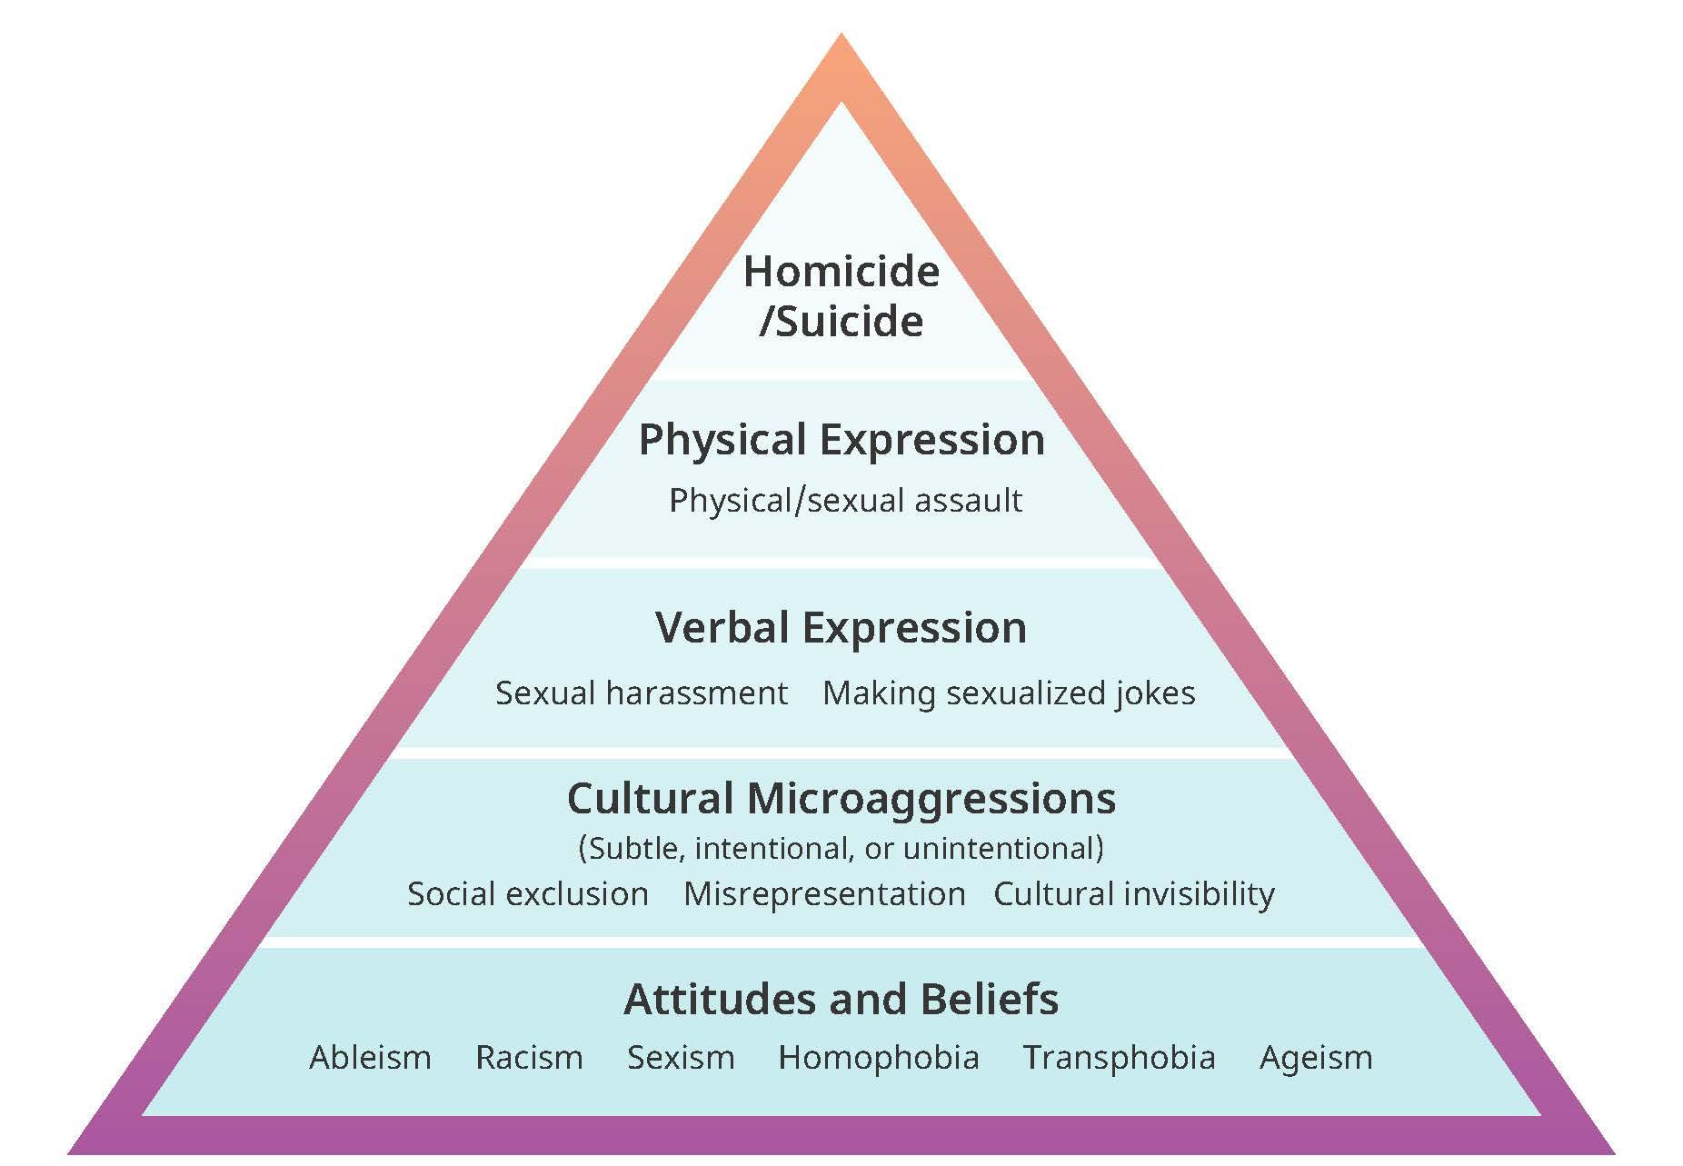
Sexualized Violence Pyramid

Slide 9
Power and Sexualized Violence

Slide 10
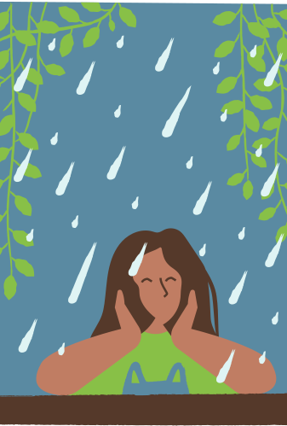
Impacts of Sexualized Violence
Emotional
Psychological
Physical
Professional
Financial

Slide 11
Discussion: Impacts
What could be some of the potential impacts of sexualized violence on graduate students?

Slide 12
Sexualized Violence and Graduate Students
71% of post-secondary students witnessed or experienced unwanted sexual behaviours in a post-secondary setting in 2019 (Burczycka, 2020).
Up to 25% of women experience sexual assault during college or university (Ontario Women’s Directorate, 2013).
A study showed that while graduate students were slightly less likely to report experiencing sexual harassment than undergraduate students (52.9% vs. 55.9%), they were significantly more likely to be harassed by faculty or staff (23.2% vs. 5.8%) (Peter & Stewart, 2019. The University of Manitoba Campus Climate Survey on Sexualized Violence).

Slide 13
Consent and Coercion
Legal definition of consent
Importance of context
Forms of coercion

Slide 14
Discussion: Power Hierarchies
Let’s consider:
What are some examples of power hierarchies or power dynamics within academia?
How might the power hierarchies, attitudes, and behaviors common in academic environments facilitate sexualized violence?
What would it take to change these norms and create a culture where boundaries are respected?

Slide 15
What Are Boundaries?
A guideline or limit that a person creates about reasonable, acceptable, and safer ways to engage with and act towards them.
Boundaries create physical and emotional space.
They demonstrate how a person wants to be treated; in other words, what is okay and what is not.
Setting boundaries can feel very hard!

Slide 16
Boundaries Can Be . . .
Physical
Mental
Emotional
Sexual
Professional

Slide 17
Boundaries Can Be Hard or Soft
Hard boundary: What we never accept or do
Soft boundary: What we may accept in certain circumstances
Setting hard or soft boundaries is individual and deeply personal.

Slide 18
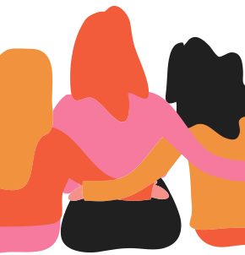
Healthy Boundaries
Healthy boundaries are:
Important – and your right
Learned
Something that changes over time and different contexts

Slide 19
Responding to Boundary Violations
Verbal responses
“I feel ___ when__because___.”
“What I need right now is ___.”
“I’d rather not talk about/do that.”
“I’m not ready for that yet.”
“I appreciated your offer, but that’s not going to work for me.”
“When you did ___, it really hurt me.”
“No.”
Non-verbal responses
Walking away
Moving away to create more distance between you and the person

Slide 20
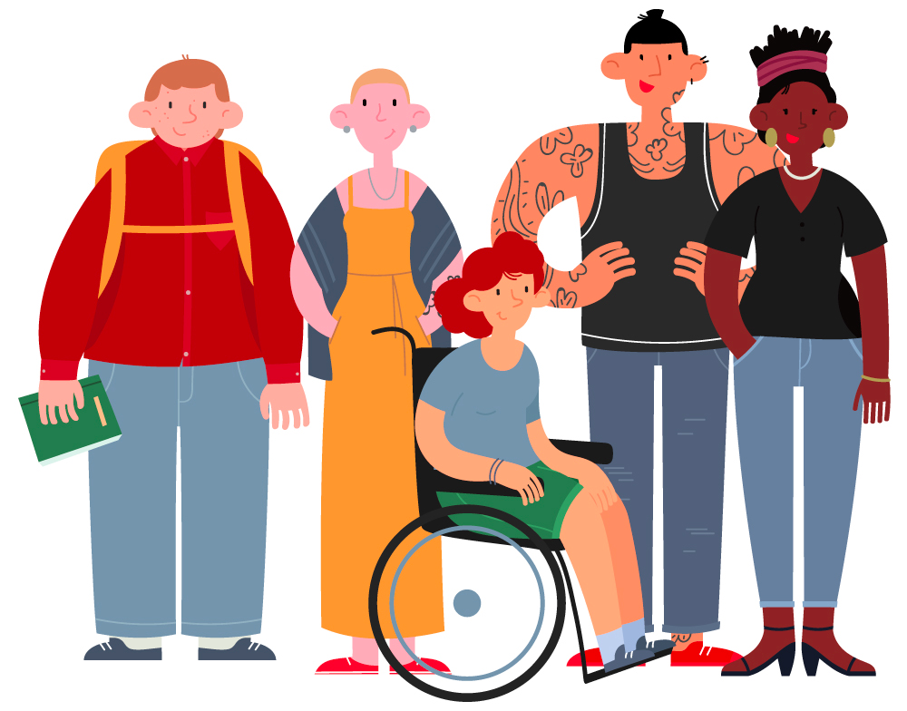
Tips for Setting Boundaries
Practise
Trust your body
Make simple, direct statements
Back up your words with actions

Slide 21
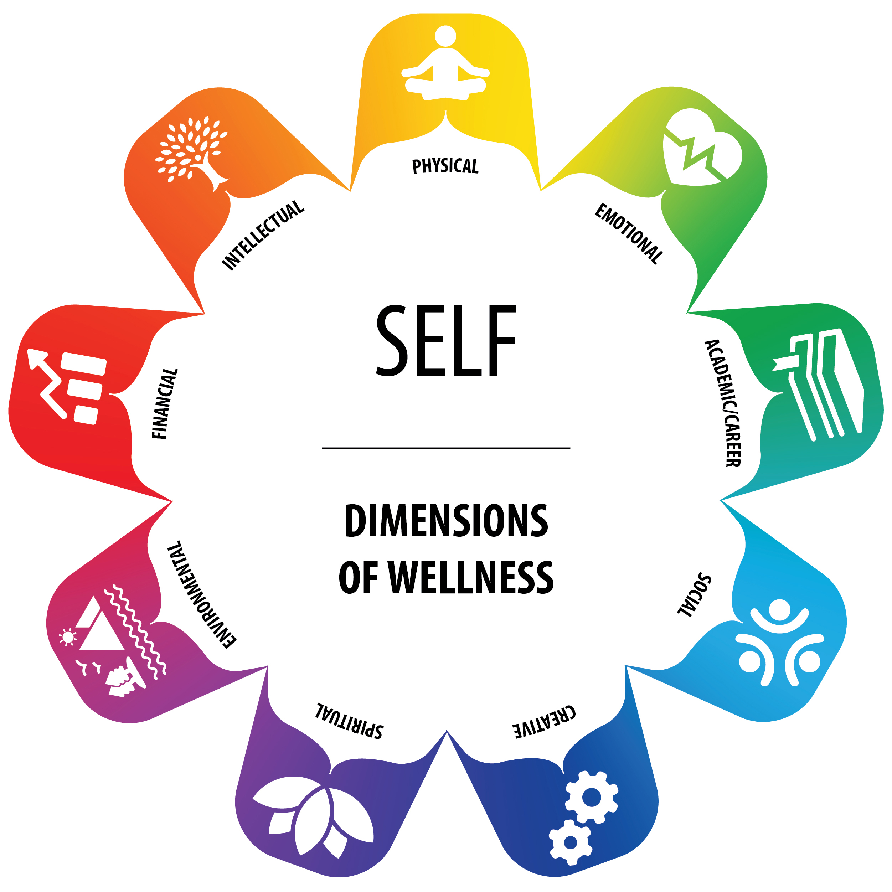
Self-Care
Setting and maintaining boundaries can be difficult and tiring
Practise self-care
Seek support if necessary

Slide 22
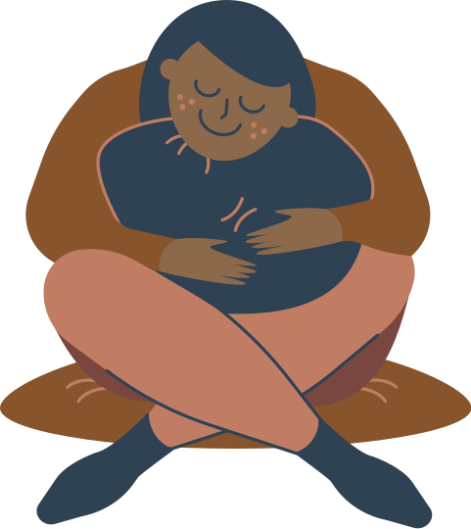
Wellness Strategies
Seek support from appropriate resources
Take care of the basics (food, water, sleep, exercise)
Make time to unwind
Get connected with others
Practise breathing and grounding exercises

Slide 23
Addressing a Boundary Violation

Slide 24
Activity: Practice Scenario
UPDATE THIS SLIDE WITH SCENARIO TEXT

Slide 25
Activity: Practice Scenario Discussion
Let’s consider:
Type of boundary violation and the possible feelings it could bring up for the impacted person
Identities of the people (their positionalities, roles in the institution, and their power dynamics)
Possible responses the impacted person may have
Role the environment plays in the interaction and response (private or public, on or off campus, in person or online)
Culture within the institution, graduate program, and field of study

Slide 26
Break Time
Take time to breathe, stretch, drink some water, or do whatever you need.

Slide 27
Let’s Review Key Concepts
Sexualized Violence
Impacts of Sexualized Violence
Power
Consent
Coercion
Boundaries

Slide 28
Institutional and Community Supports
What resources are available for students:
Who have experienced sexualized violence?
Are supporting someone who has experienced sexualized violence?

Slide 29
List of Supports
At the post-secondary institution | In the community

Slide 30
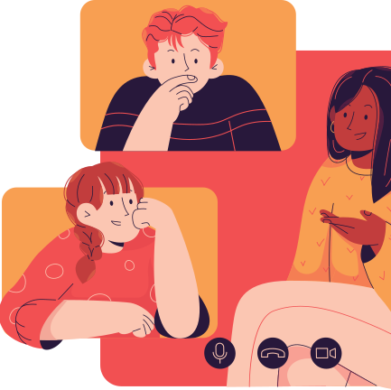
Activity: Scenarios
Working in small groups, discuss the practice scenario provided.
Consider the following:
Type of boundary violation
Individual factors (including roles, power dynamics) and possible responses
The context of the situation (the environment and culture in the institution and program)

Slide 31
Small Group Activity: Scenario
UPDATE THIS SLIDE WITH SCENARIO TEXT

Slide 32
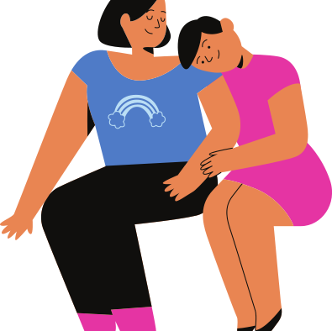
Small Group Activity Debrief
Each group: please share your process, thoughts, and suggestions about your scenario.

Slide 33
Wrapping Up
Any thoughts you’d like to share before we finish today?

Slide 34
Thank You for Participating

Slide 35
References
Burczycka, S. (2020). Students’ experiences of unwanted sexual behaviours and sexual assault at post-secondary schools in the Canadian provinces, 2019. Juristat. Statistics Canada Catalog n. 85-002-X
Cantor, D., Fisher, B., Chibnall, S., & Townsend, R. (2017). Report on the AAUclimate survey on sexual assault and sexual misconduct. Westat. https://www.aau.edu/sites/default/files/AAU-Files/Key-Issues/Campus-Safety/AAU-Campus-Climate-Survey-FINAL-10-20-17.pd
Cotter, A., & Savage, L. (2019). Gender-based violence and unwanted sexual behaviour in Canada, 2018: Initial findings from the survey of safety in public and private spaces. Statistics Canada. https://www150.statcan.gc.ca/n1/en/pub/85-002-x/2019001/article/00017-eng.pdf?st=k5gHNge4
James, S. E., Herman, J. L., Rankin, S., Keisling, M., Mottet, L., & Anafi, M. (2016). The report of the 2015 U.S. transgender survey. National Center for Transgender Equality. http://www.transequality.org/sites/default/ files/docs/usts/USTS%20Full%20Report%20-%20FINAL%201.6.17. Pdf
Livingston, E., Karsen, B., Wilson, R., Harvey, B., Colpitts, E., Runyon, R., Dooley, D., & Black, J. (2020). Navigating power dynamics and boundaries as a graduate student. Possibility Seeds’ Courage to Act: Addressing and Preventing Gender-Based Violence at Post-Secondary Institutions in Canada.
Menon, A. V. (2018). Communities of color and the impacts of sexual Violence. University of Michigan Sexual Assault Prevention and Awareness Center. https://sapac.umich.edu/article/57
National Intimate Partner and Sexual Violence Survey. (2010). NISVS: An overview of 2010 findings on victimization by sexual orientation. Centers for Disease Control and Prevention. https://www.cdc.gov/violenceprevention/pdf/cdc_nisvs_victimization_final-a.pd
Ontario Women’s Directorate & Government of Ontario, Ministry of Training, College, and Universities. (2103). Colleges and Universities Developing a Response to Sexual Violence: A Resource Guide for Ontario’s Colleges and Universities.
Peter, T., & Stewart, D. (2019). The University of Manitoba campus climatesurvey on sexual violence: A final report. University of Manitoba. https:// umanitoba.ca/sites/default/files/2019-09/UM%20Campus%20Climate%20Survey%20on%20Sexual%20Violence%202019.pdf
Pescitelli, A. (2018). Understanding sexual violence: A graduate student’s perspective. Simon Fraser University. https://www.sfu.ca/sexual-violence/education-prevention/new-blog-/support-and-care/Understanding-Sexual-Violence-A-Graduate-Students-Perspective.htm

Slide 36
References (cont.)
Simon Fraser University, Sexual Violence Support and Prevention Office (2020). Sexual Violence Pyramid.
Wells, L., Claussen, C., Aubry, D., & Ofrim, J. (2012). Primary prevention of sexual violence: Preliminary research to support a provincial action plan. Prevent Domestic Violence. https://preventdomesticviolence. ca/primary-prevention-of-sexual-violence-preliminary-research/

